Slide 1
Final Year Project * 2025-26
A ONE MONTH INTERNSHIP AT
TATA GROUP – VOLTAS LIMITED
JAYARAMAN K - 3122225002305
IT - B

Slide 2
Table Of Contents
1 | Internship Overview
2 | Roles and Responsibilities
3 | Gap Analysis
4 | Technology Stack
5 | Challenges and Solutions
6 | Best Practices
7 | Outcomes
8 | Conclusion

Slide 3
Internship Overview
🔹 Internship conducted under Voltas Limited, a TATA Group Company.
🔹 Duration: One Month (July 9 – August 9, 2025).
🔹 Domain: Building Management Systems (BMS) and Industrial Automation.
🔹 Objective: To understand data communication and automation systems in real-world environments.
🔹 Worked under IT and BMS teams focusing on system monitoring and control.
Developed a prototype automation website to improve operational efficiency.

Slide 4
Roles and Responsibility
🔹 Analyzed communication protocols such as Modbus RTU/TCP and BACnet.
🔹 Studied RS-485 physical layer and IP communication setups in automation panels.
🔹 Observed peer-to-peer communication among control devices.
🔹 Assisted in mapping data flow between hardware and software systems.
🔹 Designed and developed an internal automation web interface for monitoring devices.
🔹 Participated in system testing and performance evaluation of control units.
🔹 Collaborated with senior engineers for troubleshooting and optimization tasks.

Slide 5
Gap Analysis
🔹 Academic focus is mainly on theoretical networking concepts.
🔹 Industry applications demand hands-on exposure to industrial communication protocols.
🔹 Limited college exposure to real-time data acquisition and BMS systems.
🔹 Need for integration knowledge between hardware, IoT, and web automation.
🔹 Enhanced understanding of protocol conversion and network diagnostics required.
🔹 Internship bridged the gap by offering practical system-level experience.
🔹 Gained clarity on how automation supports energy efficiency in real-world systems.

Slide 6
Technology Stack
🔹 Communication Protocols: Modbus RTU/TCP, BACnet.
🔹 Networking Layers: RS-485, Ethernet, IP Configuration.
🔹 Web Development: HTML, CSS, JavaScript, Flask/Python (for automation prototype).
🔹 Monitoring Tools: SCADA interface and BMS dashboard.
🔹 Hardware Familiarization: Sensors, Controllers, Automation Panels.
🔹 Database: SQLite / JSON-based data logging .
🔹 Version Control: GitHub for storing project code.
🔹 Documentation: MS Word, PowerPoint, and Excel for reporting.

Slide 7
Challenges And Solutions
🔹 Challenge: Understanding complex communication protocols.
Solution: Studied Modbus and BACnet data flow with mentor guidance.
🔹 Challenge: Integration between hardware signals and web modules.
Solution: Built a simulation-based automation website for testing.
🔹 Challenge: Network latency and data synchronization issues.
Solution: Implemented basic caching and local data handling.
🔹 Challenge: Limited access to proprietary equipment.
Solution: Used open simulation tools to replicate BMS environments.
.

Slide 8
Best Practices
🔹 Adopted systematic documentation and daily progress tracking.
🔹 Followed industrial safety and protocol handling guidelines.
🔹 Practiced clean and modular coding for web automation project.
🔹 Learned the importance of cross-functional collaboration.
🔹 Focused on data accuracy, reliability, and system uptime.
🔹 Maintained timely reporting and clear communication with mentors.
🔹 Adapted to Voltas’s sustainability-driven and innovation-oriented work culture.

Slide 9
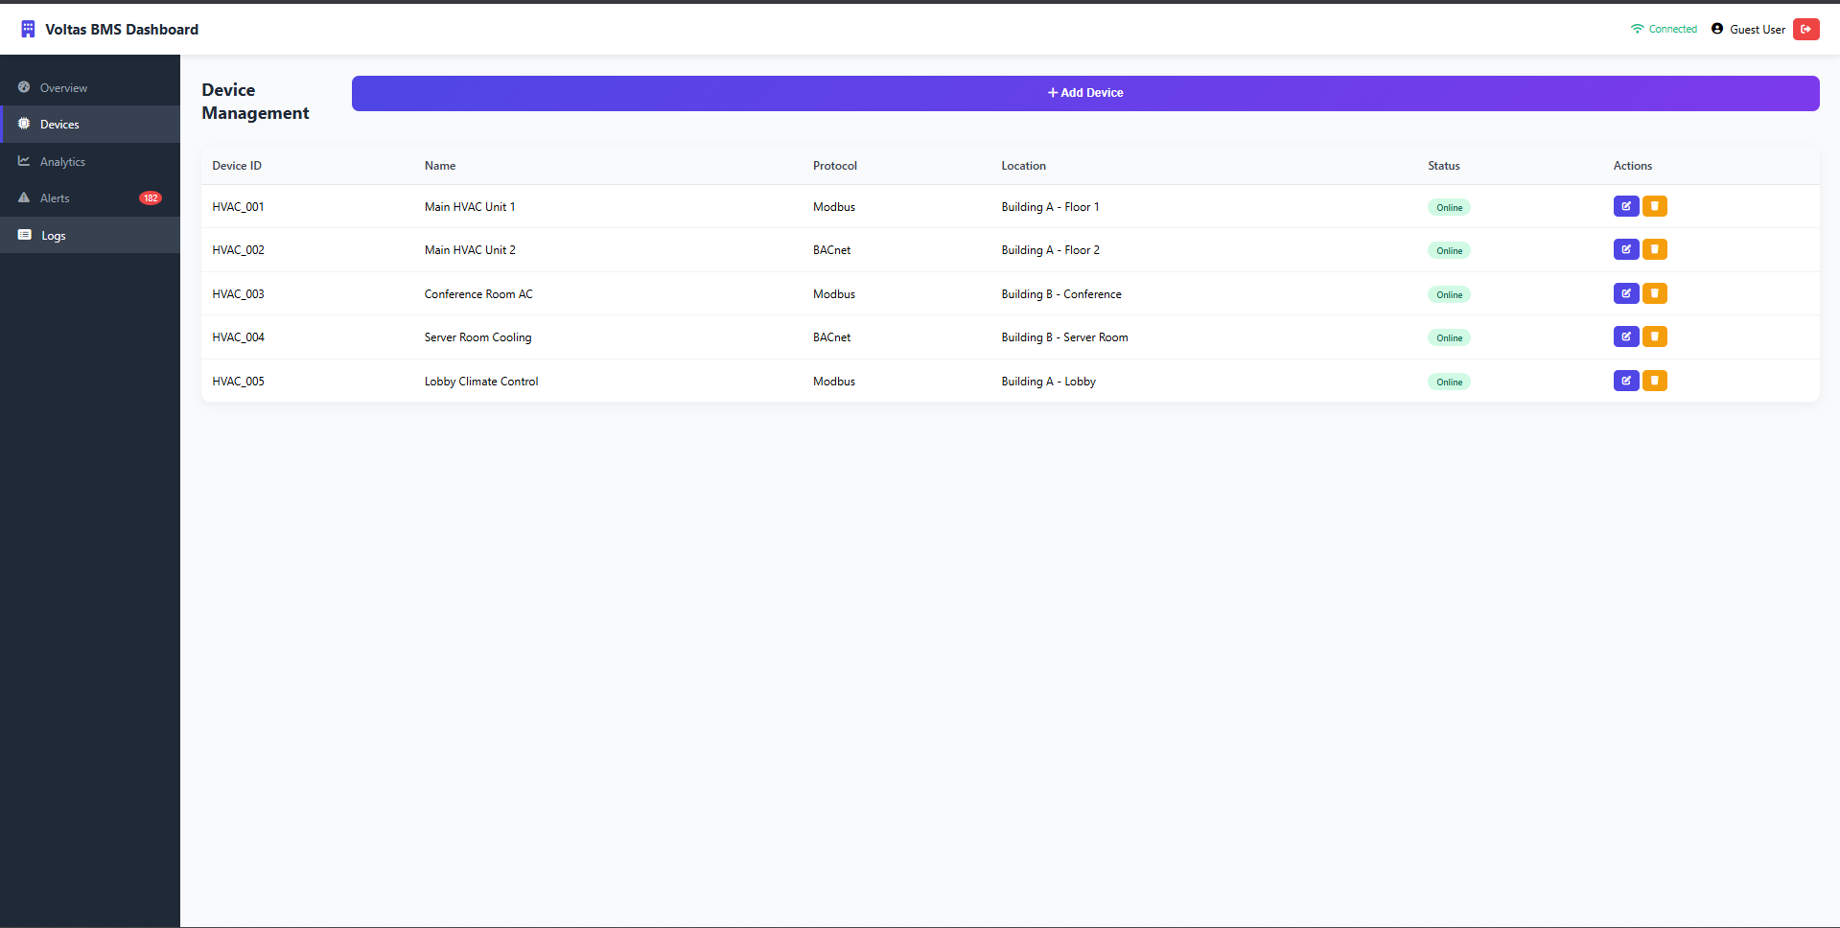
Outcomes

Slide 10
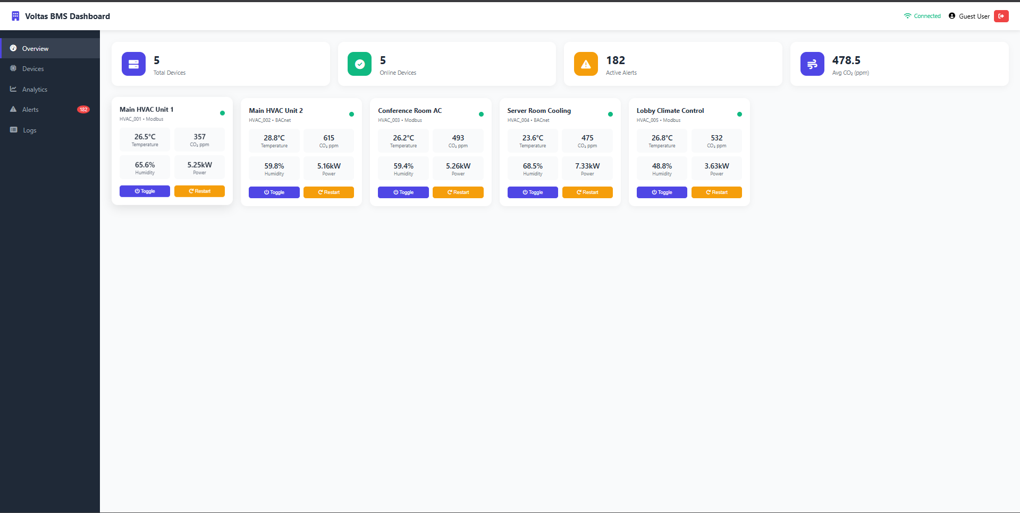

Slide 11
Conclusion
🔹 The internship at Voltas Limited provided valuable industry exposure.
🔹 Bridged the gap between academic theory and industrial practice.
🔹 Strengthened technical foundation in BMS, Modbus, and automation systems.
🔹 Helped understand corporate structure, ethics, and innovation workflow.
🔹 Gave clarity on future goals in IoT, AI-based automation, and embedded systems.
🔹 Overall, it was a transformative learning experience blending technology and professionalism.

