Slide 1

Introduction to MVSNet
By: Srimanth Agastyaraju
Masters in Data Science, Indiana University Bloomington

Slide 2

Agenda
Applications
Prerequisites
Problem Statement
Homography
Datasets
DTU
DataLoader
Training
Code Walkthrough
Point Clouds

Slide 3
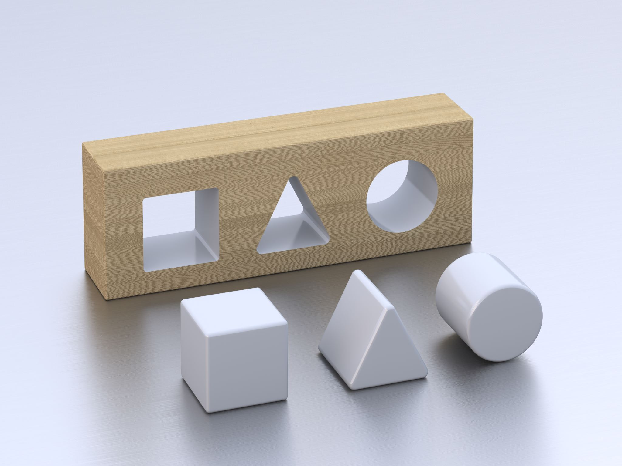
Applications
3D Models in AR/VR
Text to 3D
Diffusion 2D to 3D

Slide 4

Prerequisites
Python Programming Language
PyTorch
NumPy
OpenCV (the basics)
Some background in Traditional CV (Not required but helpful!)

Slide 5
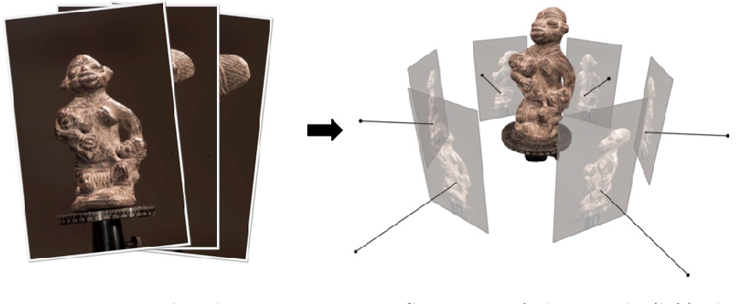
Problem Statement
Given multiple images of the same subject from different perspectives, create a 3D point cloud.
Required steps:
1 Reference view + n source views -> Model -> Depth Map -> Point Cloud
Image Source: SemanticScholar

Slide 6
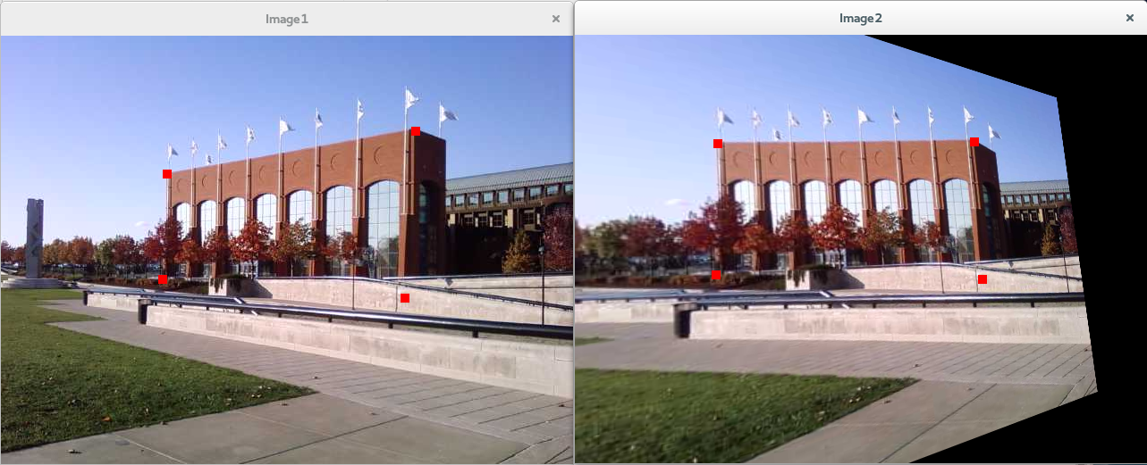
Homography
p̂ = Hp
Image source: Szakrewsky Wordpress
Homography is a method to warp the perspective of an image using linear algebra.
To warp an image from perspective p to p̂, We use a homography matrix H.
In our case, we construct the matrix H from the given Camera Parameters.

Slide 7
Datasets
DTU – The Standard for MVS Datasets, Mostly Indoor Scenes
Blended MVS – Some Outdoor Scenes
Tanks and Temples - Many outdoor scenes
ETH 3D – Many challenging scenes

Slide 8
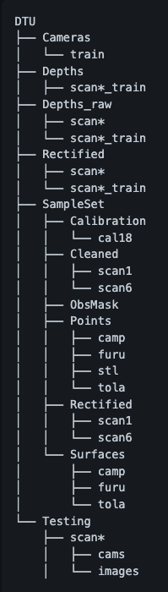
DTU Dataset
The folders Cameras, Depths, Depths_raw and Rectified are typically used during training. The files train.txt, valid.txt and test.txt contain the indexed scan folders for training, validation, and testing. The dataset itself has 80 scans, and each scan has 49-64 views of the same object in different angles and 7 lighting conditions. The 80 scenes contain different number of camera positions. 59 scenes contain 49 camera positions and 21 scenes contain 64 camera positions.
Cameras: The cameras folder contains intrinsic and extrinsic parameters of the camera for every view. Hence, there are 49 .txt files (one for each view) in the training set. It also stores the pair.txt file.
Depths: Depth map encodes the relative distance between two objects in an image. The closer an object is, the higher it's value in the depth matrix.
Rectified: Contains the Original Reference and Source Images

Slide 9
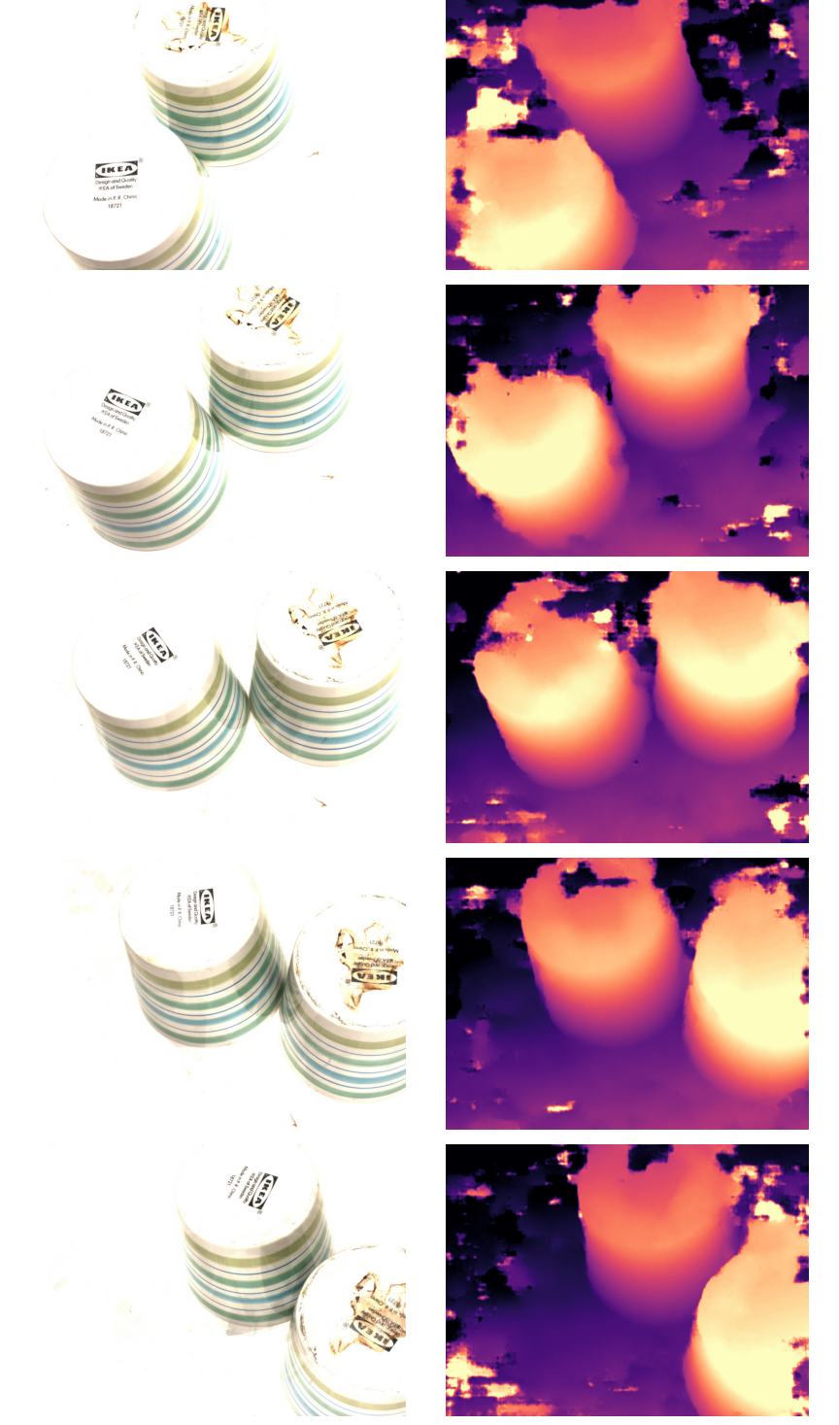
DTU Dataset & Dataloader
Loads 1 reference view and n-1 source views as the input.
The depth map of the reference view is the output / ground truth.
The depth map encodes the distance from the camera to the object.
The farther the object, the lower is its depth value.

Slide 10
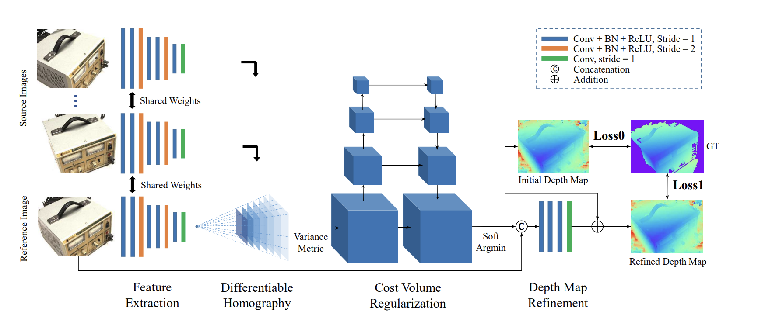
Training & Testing
MVSNet Model

Slide 11
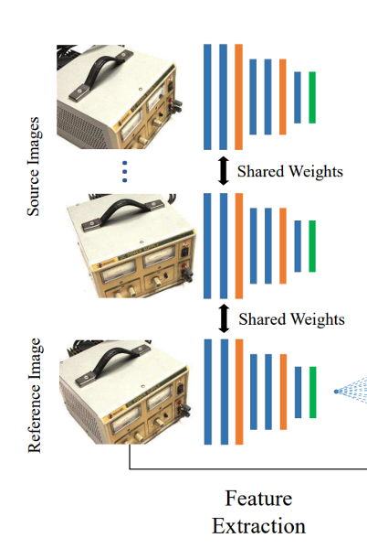
Feature Extractor & Differential Homography
Input: N images – Each of resolution 512 x 640
For 1 reference image, N-1 source images, B as the batch size, C being the number of channels (32), H & W being the height and width.
Input shape: B x N x 3 x H x W
Output shape: B x N x C x H x W
Differential homography: Homography applied on feature maps at a given depth. The parameter Ndepths is initialized with the dataloader.

Slide 12
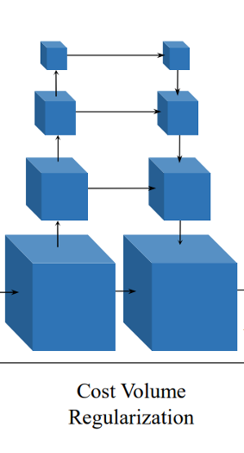
Cost Volume
Input: B x N x C x Ndepths x H x W (After differential homography)
We perform a sum across all the views -> B x C x Ndepths x H x W
Send this into a 3D CNN and perform cost volume regularization. In our case, it is variance-based cost volume regularization.
This probability map is then sent to depth regression to get the depth map – B x 1 x H/4 x W/4.

Slide 13
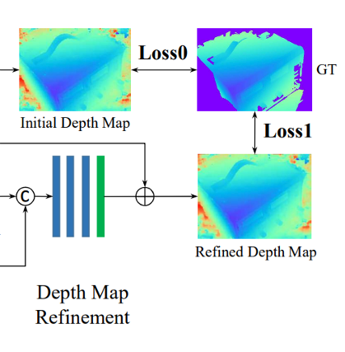
Depth Refinement
Input: The depth map of B x 1 x H/4 x W/4, The reference image B x C x H x W
The reference image is downsampled to the same resolution as the depth map input (B x 3 x H x W -> B x 3 x H/4 x W/4)
The depth map is concatenated as the 4th channel and sent to the network.
Input: B x 4 x H x W -> B x 1 x H x W

Slide 14
Code walkthrough

Slide 15
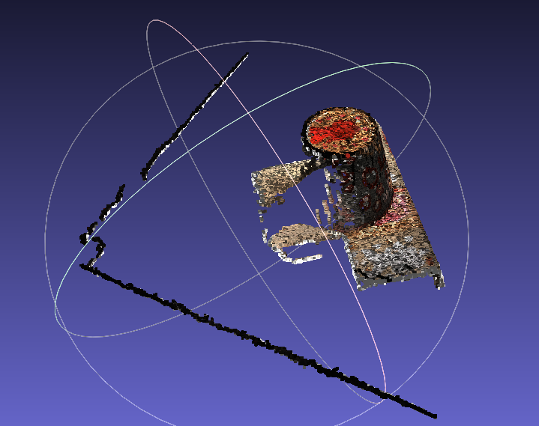
Point Clouds

Slide 16

THANK YOU!
References:
https://github.com/xy-guo/MVSNet_pytorch
https://arxiv.org/pdf/1804.02505.pdf
https://github.com/walsvid/Awesome-MVS
https://roboimagedata.compute.dtu.dk/?page_id=36
My Profile:
https://www.linkedin.com/in/asrimanth/
https://github.com/asrimanth
https://mlzealot.github.io/

