Slide 1





PHARMASAGE : REDUCING HALLUCINATIONS IN LLM FOR DRUG DISCOVERY
Presented by Team 7
K Sampreeth Reddy (AM.EN.U4CSE22328)
G. Arun Chowdary (AM.EN.U4CSE22225)
R Gautham Reddy (AM.EN.U4CSE22348)

Slide 2
MOTIVATION
Challenges:
Hallucinations in biomedical LLMs
Lack of contextual grounding in drug discovery bots
Poor visualization of molecular relationships
Incomplete or redundant data in raw ChEMBL datasets
Need for an AI Solution:
Integrate LLMs with biomedical KGs to reduce hallucinations
Provide drug insights with structural, biological, and clinical context
Deliver intelligent comparisons, predictions, and explainable graphs

Slide 3
PROBLEM STATEMENT
Issues with Existing Systems:
Black-box models with high hallucination rate
Limited KG integration
Poor real-time interactivity
No explainable feedback loop
Project Goal:
Develop a humanized, explainable AI system for drug discovery using fine-tuned LLMs, RAG, knowledge graphs, and RLHF, deployed as an interactive scientific assistant.

Slide 4
EXISTING SYSTEMS
Current AI Drug Discovery Systems:
IBM Watson for Drug Discovery: Strong NLP but lacks explainable KG and customization
PubMed GPT/BioMedLM: Trained on biomedical text, but lacks curated molecular structuring
DrugXplorer: Offers comparisons but no RAG or feedback-based KG growth
MolChatBot: Can answer molecule-related queries but lacks fine-tuned accuracy
BioGPT original: No real-time context integration, humanization, or RLHF loop

Slide 5
EXISTING SYSTEMS
Research Papers:
Lee et al., BioBERT: Biomedical Language Representation Model for Biomedical Text Mining, 2019
Gu et al., Domain-Specific Language Model Pretraining for Biomedical NLP, 2021
Shen et al., ChatGPT in Drug Discovery: A Review, 2023
Jin et al., BioGPT: Generative Pre-trained Transformer for Biomedical Text Generation and Mining, 2022
Micallef et al., ChEMBL: A Large-Scale Bioactivity Database for Drug Discovery, 2022
Wang et al., PubMedQA: A Dataset for Biomedical Research Question Answering, 2020
Peng et al., An Empirical Study of BioBERT-based Question Answering Systems in Biomedical Domain, 2022
Ma et al., DrugKG: Constructing a Knowledge Graph for Drug Discovery, 2021

Slide 6
UNIQUENESS OF OUR SYSTEM
What Makes PharmaSage Novel?
Finetuned DistilGPT2 using ChEMBL v35-derived structured dataset
Integrated FAISS RAG + Knowledge Graphs to reduce hallucinations
Humanization Layer using Gemini API prompts
RLHF loop for knowledge graph expansion based on user feedback
Combines molecular similarity, context-aware explanations

Slide 7
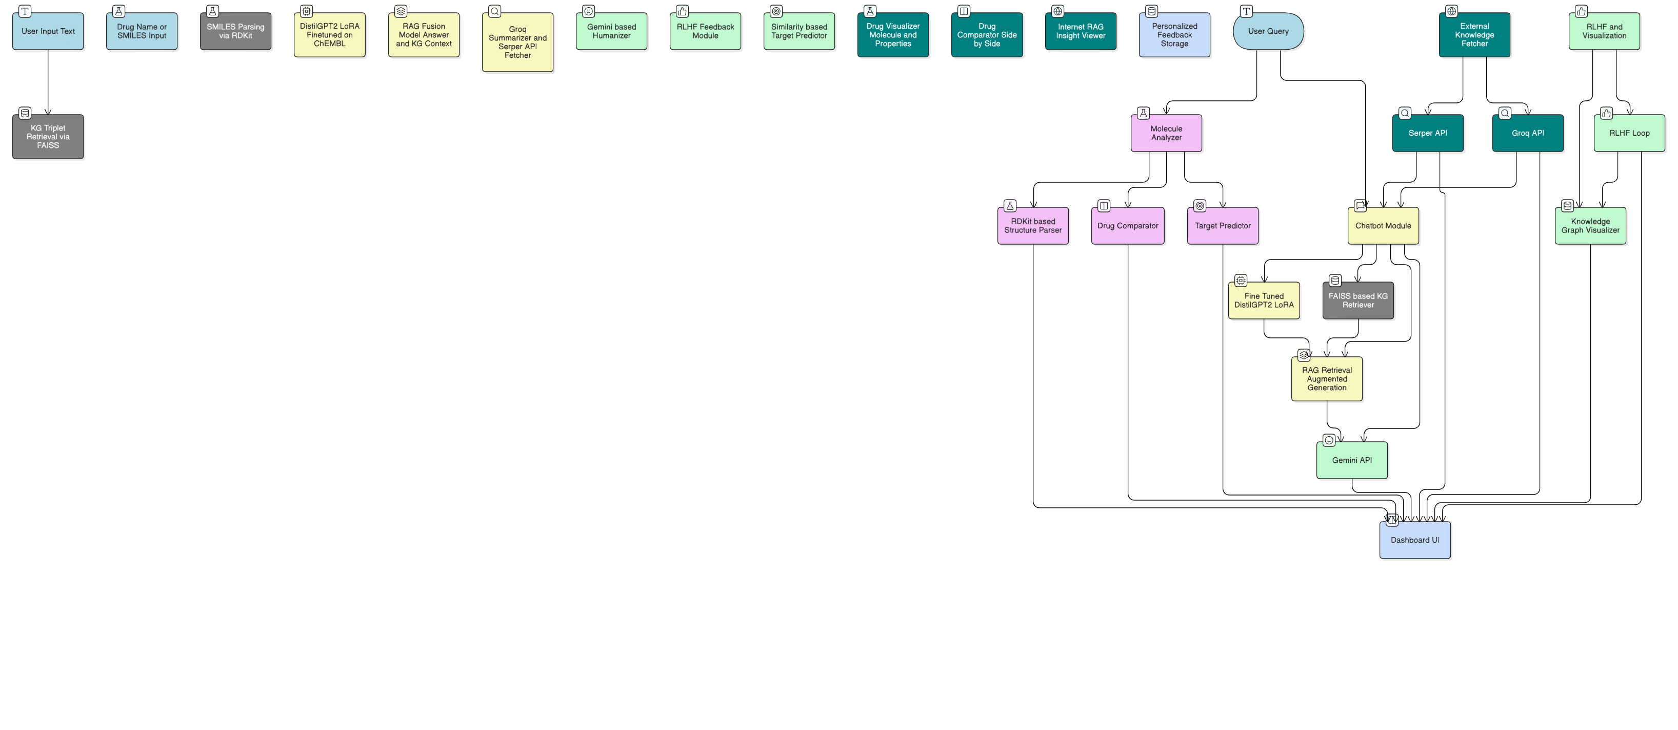
FUNCTIONALITY DIAGRAM

Slide 8
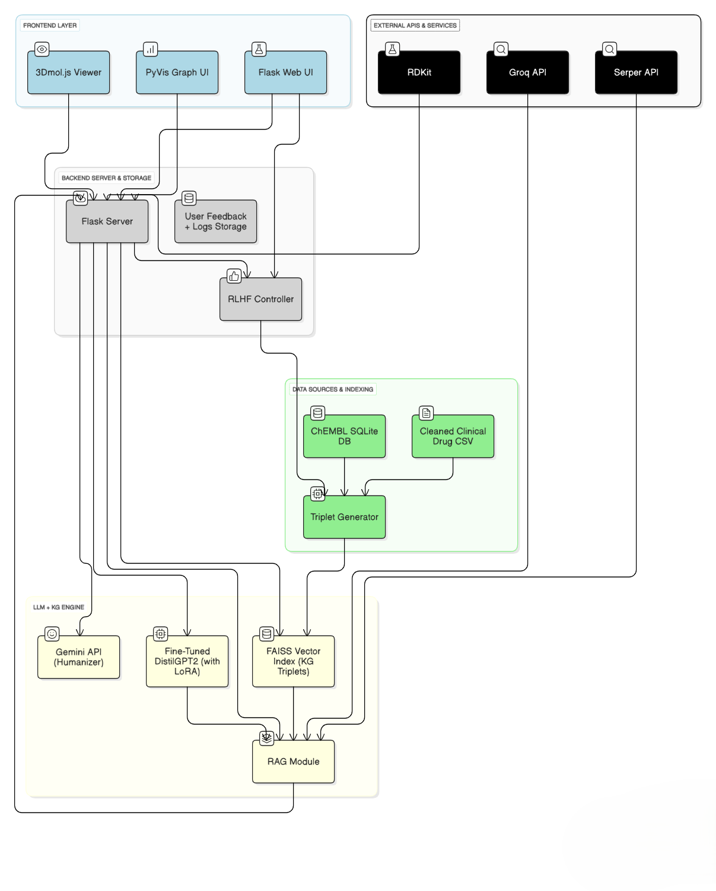
ARCHITECTURE DIAGRAM

Slide 9
SOLUTION APPROACH
COMPONENTS:
Fine-tuned LLM (DistilGPT2 + LoRA)
KG triplets (head-relation-tail from cleaned ChEMBL)
FAISS RAG + Internet RAG (Serper + Groq)
Gemini-based humanization
RDKit-based molecular viewer + comparator
RLHF expansion in KG visualizer

Slide 10
LLM TECHNOLOGIES USED
DistilGPT2 + PEFT LoRA (local model)
FAISS: KG vector indexing
RDKit: SMILES parsing, fingerprinting
RAG + Internet RAG
Groq API: Summarization of externl papers
Serper API: Real-time paper fetching
Gemini API: Human-like response generation
Flask + 3Dmol.js + PyVis: UI and KG viz

Slide 11
RAG Accuracy: 91.00% — Top-3 retrieved KG triples matched ground-truth
PERFORMANCE EVALUATION
Hallucination rate reduced from ~40% to under 8% using RAG + Knowledge Graph
Target prediction accuracy on structurally similar molecules: 82%+
BLEU Score: 65.52 — Strong lexical similarity (0.6552 normalized)
ROUGE-1: 0.8514 — High unigram overlap
ROUGE-2: 0.6451 — Strong bigram fluency
ROUGE-L: 0.8514 — Longest common subsequence match
BERTScore (F1): 0.9818 — Excellent semantic alignment
RAG Accuracy: 91.00% — Top-3 retrieved KG triples matched ground-truth

Slide 12
COMPARISON WITH EXISTING SYSTEMS
Feature | PharmaSage | BioGPT | Watson | DrugXplorer
Finetuned on ChEMBL | ✅ | ❌ | ❌ | ✅
Hallucination Control | ✅ (RAG + KG) | ❌ | ❌ | ❌
RLHF Feedback Loop | ✅ | ❌ | ❌ | ❌
Explainable KG | ✅ | ❌ | ❌ | ✅ (basic)
Internet RAG | ✅ | ❌ | ✅ | ❌

Slide 13
CONCLUSION
Achievements:
Complete fine-tuning pipeline
Drug visualizer, comparator, predictor
RAG with KG + Groq summaries
Interactive RLHF-based KG expansion
Future Work:
Multilingual biomedical responses
Multimodal inputs (chemical drawings, voice)
Integrate with external databases (DrugBank, NCBI)
Impact:
PharmaSage paves the way for hallucination-free, personalized drug discovery using explainable, interactive LLM systems.

Slide 14
THANK YOU

