Slide 1
PowerPoint template
Use and layout examples
2025

Slide 2
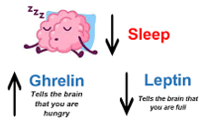
The Science Behind Sleep and Appetite
Sleep regulates key appetite hormones: ghrelin (hunger) and leptin (fullness)
Poor sleep increases cravings for high-calorie, sugary foods
Sleep deprivation disrupts metabolism and blood sugar control
Hormonal imbalance leads to overeating and weight gain

Slide 3

How Sleep and Diet Affect Productivity
Sleep-deprived brains struggle with focus, memory, and decision-making
Fatigue leads to emotional eating and poor food choices
Unhealthy eating reduces energy and motivation
Productivity drops when sleep and nutrition are compromised

Slide 4
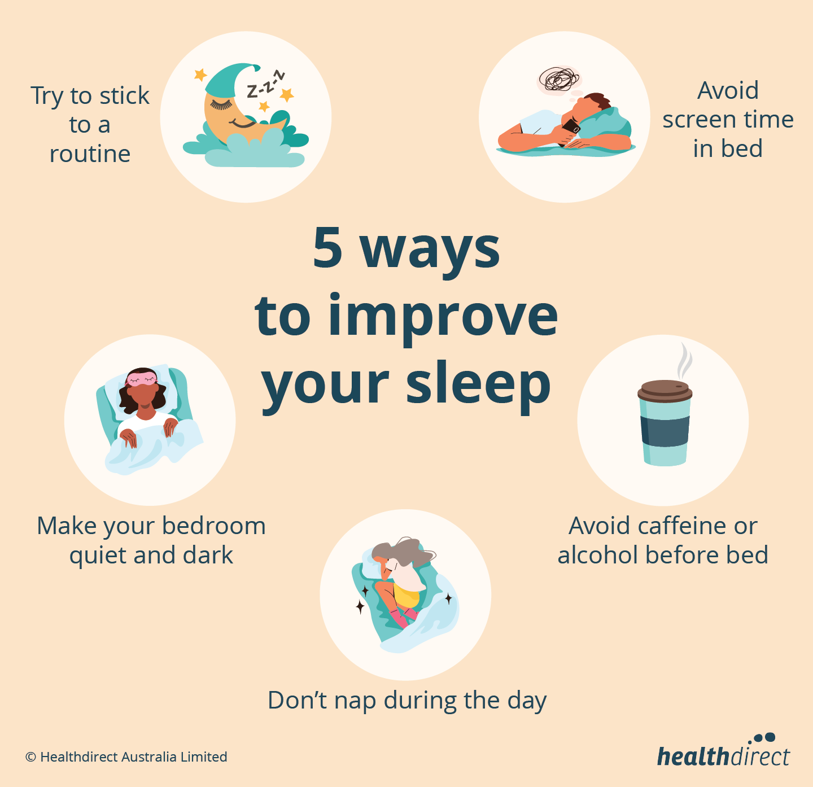
Habits for Better Sleep, Appetite, and Performance
Aim for 7–9 hours of sleep with a consistent schedule
Avoid caffeine, alcohol, and screens before bed
Eat balanced meals with protein, fiber, and healthy fats
Practice stress management: exercise, mindfulness, and relaxation

Slide 5
Thank you
Presenter’s name will go here
Contact information will go here

