Slide 1
Content Monetization Modeler
Jayaseeli s
DS-C-WD-E-B96

Slide 2
Project Overview
Dataset
Data Cleaning
Feature Engineering
Encoding + Scaling
Train/Test Split
Regression Models
Model Evaluation
Best Model Selection
Save Model
Streamlit Web App
Content Monetization Modeler – Predicts YouTube ad revenue using regression models.
Technologies used: Python, Pandas, Scikit‑learn, TensorFlow, Streamlit, Plotly.

Slide 3
Importing Libraries
pandas, numpy – data processing
matplotlib, seaborn – visualization
sklearn – machine learning models
tensorflow – deep learning model
streamlit – web dashboard
plotly – interactive charts
joblib / pickle – model saving & loading

Slide 4
Dataset Loading
Dataset loaded using pandas:
data = pd.read_csv('youtube_ad_revenue_dataset.csv')
The dataset contains:
views, likes, comments, watch_time_minutes,
video_length_minutes, subscribers,
category, device, country, ad_revenue_usd.

Slide 5
Data Cleaning
Removed duplicate rows
Handled missing values using mean
Converted date column to datetime
Extracted year, month, day, day_of_week
Dropped original date column.

Slide 6
Feature Engineering
Created a new feature:
engagement_rate = (likes + comments) / views
This measures how actively viewers interact with the video.
Feature engineering helps the model learn better patterns.

Slide 7
Data Visualization
Distribution plots created using seaborn:
Views
Likes
Comments
Subscribers
Watch Time
Ad Revenue
Purpose: understand data distribution and detect outliers.

Slide 8
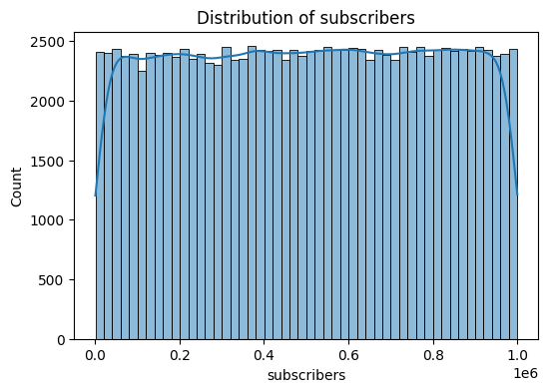
Distribution of Subscriber
subscribers range from very small channels to creators with 1M+ subscribers. The uniform distribution helps the model learn revenue behavior across channel sizes.
uniform, represents small + large creators

Slide 9
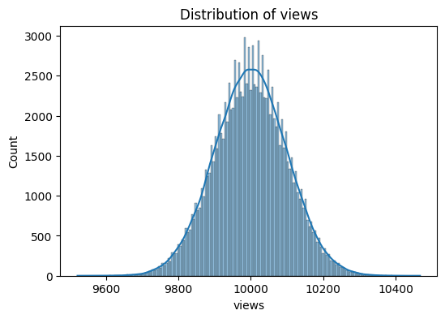
Distribution of Views
Views distribution is normally shaped, centered around 10,000.
This indicates clean, consistent data without outliers — suitable for regression modeling.
normal, clean, no skew

Slide 10
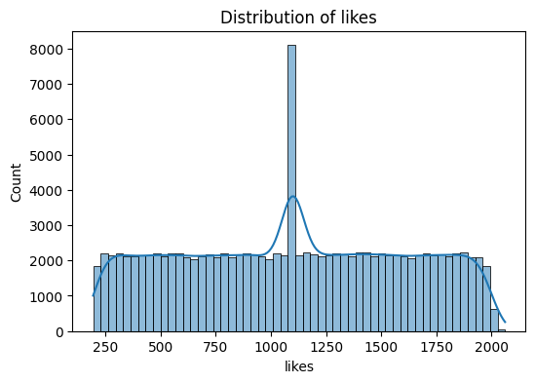
Distribution of Likes
Likes show a uniform distribution, indicating varied engagement across videos.
No major skew or outliers detected.
uniform, varied engagement

Slide 11
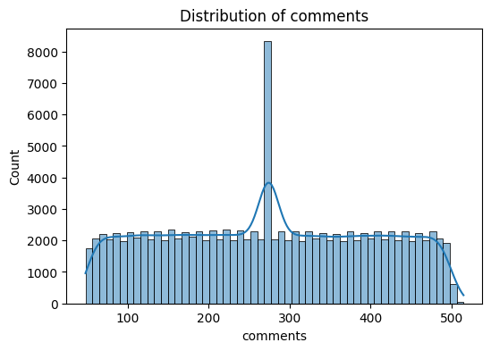
Distribution of Comments
Comments are uniformly distributed with no major skew, indicating consistent audience interaction patterns.
uniform, spread naturally

Slide 12
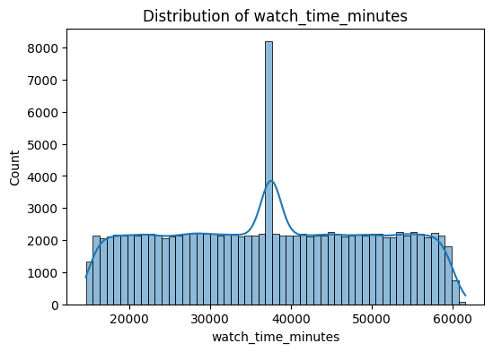
Distribution of Watch Time
atch time is uniformly distributed across videos,
with values ranging from ~15,000 to 60,000 minutes.
There is no significant skew or outliers, indicating that watch time varies naturally across content types.
Uniform distribution

Slide 13
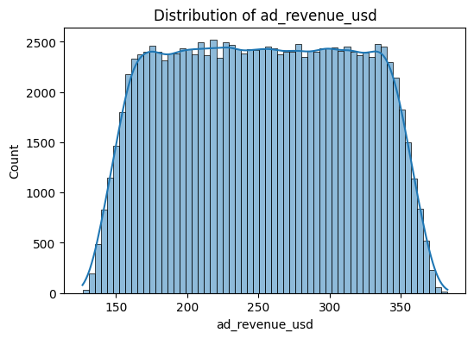
Distribution of Ad Revenue
Ad revenue values are uniformly distributed between ~140 and ~380 USD.
There is no skew or extreme outliers, suggesting stable revenue behavior across videos.

Slide 14
Encoding Categorical Variables
Used One‑Hot Encoding:
pd.get_dummies(data, columns=['category','device','country'])
This converts text categories into numeric columns so ML models can process them.

Slide 15
Feature Scaling
Used StandardScaler:
scaler = StandardScaler()
Purpose:
Normalize numerical values
Improve model performance
Prevent features with large values dominating the model.

Slide 16
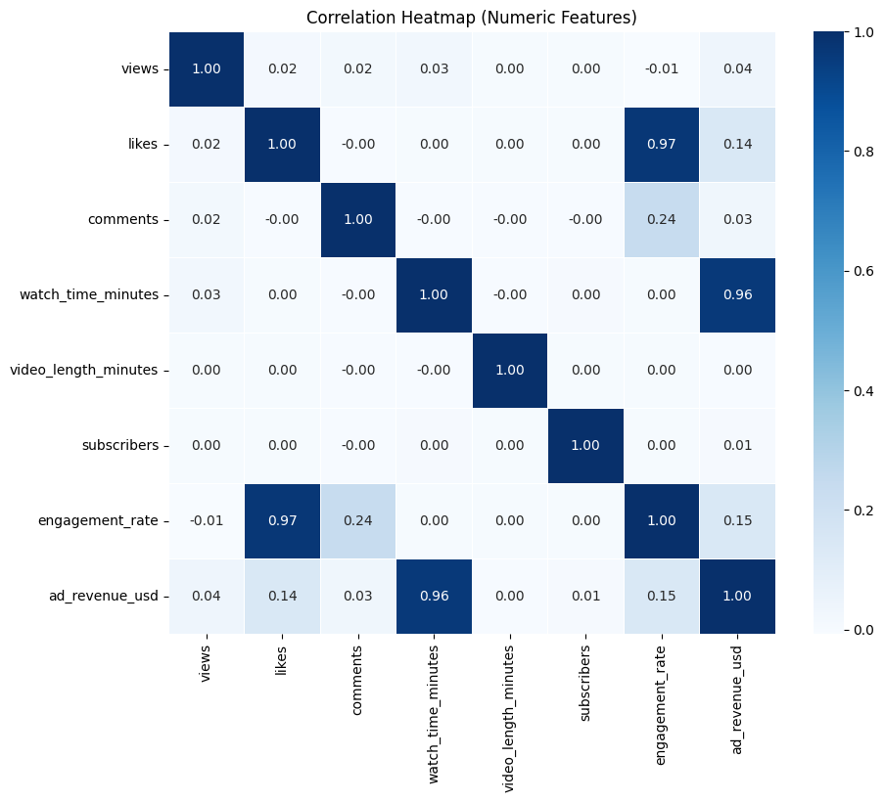
Correlation Analysis
A heatmap was generated to analyze relationships.
Key Insight:
watch_time_minutes has very strong correlation (0.96)
with ad_revenue_usd.
This means watch time is the most important predictor of ad revenue.

Slide 17
Model Training
Train‑test split:
X_train, X_test, y_train, y_test
Models trained:
Linear Regression
Ridge Regression
Lasso Regression
ElasticNet Regression
Huber Regression

Slide 18
Linear Regression
Explanation
Linear Regression predicts the target variable using a linear relationship between features and output.
Example in your project:
Ad Revenue = β0 + β1(views) + β2(likes) + β3(comments) + β4(watch_time) + ...
Key Idea
It finds coefficients that minimize the error between predicted and actual values.
Advantages
✔ Simple and fast ✔ Easy to interpret ✔ Works well when data is linear
Disadvantages
❌ Sensitive to outliers ❌ Can overfit when many features exist

Slide 19
Ridge Regression
Ridge Regression is Linear Regression with L2 regularization.
It adds a penalty term to reduce very large coefficients.
Key Idea
It prevents overfitting by shrinking coefficient values.
Example
If your model gives large weights like:
views coefficient = 120
likes coefficient = 80
Advantages
✔ Handles multicollinearity ✔ Reduces overfitting ✔ Keeps all features
Disadvantages
❌ Does not remove irrelevant features

Slide 20
Lasso Regression
Lasso Regression uses L1 regularization.
The penalty forces some coefficients to become exactly zero.
Key Idea
Lasso performs automatic feature selection.
Example:
views coefficient = 1.2
likes coefficient = 0
comments coefficient = 0
watch_time coefficient = 3.5
✔ Feature selection ✔ Reduces model complexity ✔ Prevents overfitting
Disadvantages
❌ Can remove useful features if λ is too large

Slide 21
ElasticNet
ElasticNet combines Lasso + Ridge regularization.
It uses both:
L1 penalty (feature selection)
L2 penalty (coefficient shrinking)
Key Idea
Useful when there are many correlated features.
Example:
views watch_time likes comments
These variables are highly correlated, so ElasticNet handles them better.
Advantages
✔ Combines strengths of Ridge and Lasso ✔ Works well for large datasets ✔ Handles correlated features
Disadvantages
❌ More parameters to tune
In your project
Tested to see if combined regularization improves performance.

Slide 22
Huber Regression
Huber Regression is a robust regression algorithm that handles outliers.
Instead of using only squared error, it uses Huber Loss:
Small errors → squared loss
Large errors → linear loss
Key Idea
Reduces the impact of extreme values.
Example outlier:
views = 10000 revenue = $20 views = 10000 revenue = $5000 ← outlier
Linear regression gets distorted.
Huber Regression reduces the effect of this outlier.
Advantages
✔ Robust to outliers ✔ Stable predictions ✔ Good for real-world data
Disadvantages
❌ Slightly slower than Linear Regression
project
Huber performed best because:
YouTube data contains outliers viral videos extreme watch times

Slide 23
project
Huber performed best because: YouTube data contains outliers viral videos extreme watch times
Model | Regularization | Feature Selection | Handles Outliers
Linear Regression | ❌ | ❌ | ❌
Ridge | L2 | ❌ | ❌
Lasso | L1 | ✔ | ❌
ElasticNet | L1 + L2 | ✔ | ❌
Huber | Robust Loss | ❌ | ✔

Slide 24
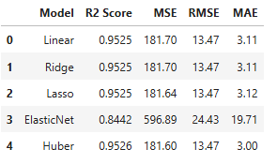
Explanation of Evaluation Metrics
R² Score (Coefficient of Determination)
R² measures how well the model explains the variation in the target variable.
MSE (Mean Squared Error)
Measures the average squared difference between predicted and actual values.
RMSE (Root Mean Squared Error)
It shows the average prediction error in the same units as the target variable (USD).
MAE (Mean Absolute Error)
Average absolute difference between predicted and actual values.

Slide 25
Model Saving
Best model saved using joblib:
joblib.dump(best_model, 'Regression.pkl')
This allows the trained model to be reused in a Streamlit application.

Slide 26
Streamlit Dashboard
This Streamlit application predicts YouTube ad revenue using a trained regression model.
The user inputs video metrics such as views, likes, watch time, and subscriber count.
The input data is processed and converted into the same feature format used during model training.
One-hot encoding is applied to categorical features like category, device, and country.
The trained regression model then predicts the estimated ad revenue and displays it in the dashboard.

Slide 27
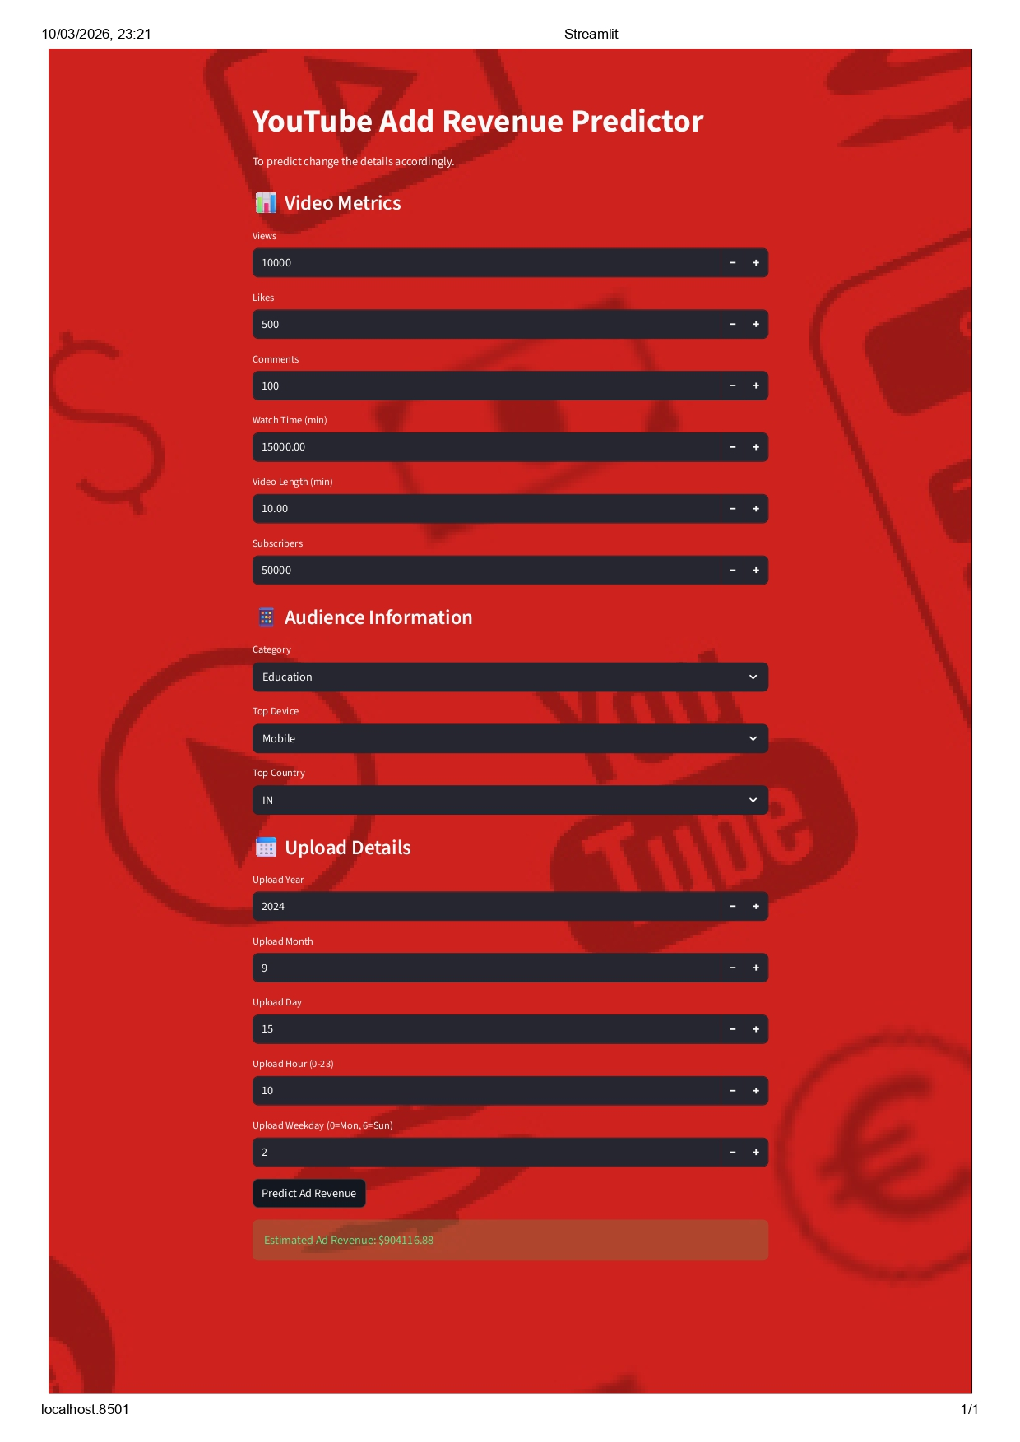

Slide 28
THANK YOU
JAYAEELI S

