Slide 1
AWS Retail Brokerage
Demo storyline
Data Engineering Pipeline
1
Understand the brokerage domain
Project walkthrough deck for students before implementation
2
Inspect source datasets and grains
S3
Glue
Step Functions
Redshift Serverless
3
Read the AWS architecture
4
Trace the daily pipeline execution
5
Map Redshift warehouse outcomes
Instructor cue: “By the end, students should know why every AWS service exists before touching the code.”
AWS Retail Brokerage Data Engineering Pipeline
01
Notes:
Start with the project story: this is not just Glue code. It is an end-to-end AWS-native data engineering implementation with CI/CD, IaC, orchestration, DQ, and warehouse loading.

Slide 2
PROJECT STORY
Business context: a brokerage platform produces many daily events
The project simulates a stock-broking company like a retail trading app. Every day, the platform emits master snapshots plus transactional activity that must become analytics-ready warehouse data.
Customers
Accounts
Orders
Trades
Settlements
Funds
Holdings
Analytics
Key business questions
Why this is a good student project
• Daily gross trading volume and brokerage revenue
• Top traded instruments and sectors
• Current customers by risk band and KYC status
• Account segment changes over time
• Customer holdings value by day
It combines domain modeling, batch ETL, data quality, workflow orchestration, infrastructure-as-code, CI/CD, and analytical warehouse design in one compact project.
AWS Retail Brokerage Data Engineering Pipeline
02
Notes:
Use this slide to make students care about the domain. A brokerage platform has both slow-changing master data and fast-moving transaction data. That contrast is what makes the pipeline meaningful.

Slide 3
REQUIREMENT VIEW
Project requirements: what the solution must achieve
Ingest
Validate
Read daily CSV files from raw S3 partitions by business date.
Run completeness, uniqueness, allowed-value, and numeric DQ checks.
Transform
Orchestrate
Clean master and transaction datasets, calculate trade measures.
Run jobs in the correct order with wait, catch, and notification paths.
Warehouse
Automate
Load Redshift Serverless tables including SCD Type 2 dimensions.
Deploy AWS resources and code through CodeBuild + CloudFormation.
Teaching target: students should know the why before the how, then implement each layer step by step.
AWS Retail Brokerage Data Engineering Pipeline
03
Notes:
Frame this as the project contract. Every AWS service and script should map back to one of these requirements.

Slide 4
CODE TOUR
Project folder anatomy: where the implementation lives
1 retail_brokerage_project/ 2 ├─ generated_data/ 3 │ ├─ raw/business_date=YYYY-MM-DD/*.csv 4 │ └─ reference/advisors.csv, instruments.csv 5 ├─ infra/cloudformation/template.yaml 6 ├─ src/glue/jobs/ 7 │ ├─ job_master_data.py 8 │ ├─ job_transaction_data.py 9 │ ├─ job_publish_dq.py 10 │ └─ job_redshift_load.py 11 ├─ src/redshift/ddl + dml/ 12 ├─ src/stepfunctions/state_machine.asl.json 13 ├─ tests/unit/ 14 └─ buildspec.yml
How students should read it
1. Start with README and diagrams
2. Inspect generated source files
3. Understand CloudFormation resources
4. Walk through Step Functions orchestration
5. Open each Glue job in execution order
6. Finally read Redshift DDL/DML and unit tests
Local checks included
The repo contains unit tests for generator logic, Glue scripts, SQL builder pieces, and infrastructure template sanity checks. This gives students a production-style habit: test before deploy.
AWS Retail Brokerage Data Engineering Pipeline
04
Notes:
This slide prepares students for the hands-on portion. Point out that this is not a notebook-only project. It has generator code, infra code, Glue jobs, orchestration JSON, SQL files, and tests.

Slide 5
DATASETS
Input datasets: the raw material for the pipeline
Dataset
Grain
Use in pipeline
customers_snapshot.csv
Customer per day
Customer dimension + SCD2 history
accounts_snapshot.csv
Account per day
Account dimension + SCD2 history
advisors.csv
Advisor reference
Advisor SCD2 dimension
instruments.csv
Instrument reference
Instrument, company, sector, exchange dims
orders.csv
Order event
fact_orders
trades.csv
Trade execution
fact_trades + amount calculations
fund_movements.csv
Money movement
fact_fund_movements
settlements.csv
Settlement event
fact_settlements
market_prices.csv
Instrument/day price
Holdings valuation support
holdings_snapshot.csv
Account/instrument/day
fact_daily_holdings
AWS Retail Brokerage Data Engineering Pipeline
05
Notes:
Explain grain carefully. Students often confuse orders and trades. Orders are intent. Trades are executed portions. Holdings are snapshots. Settlements and fund movements are money-flow facts.

Slide 6
DATA LAKE LAYER
Sample data volume and raw S3 layout
Business date
Customers
Accounts
Orders
Trades
Funds
Holdings
2026-04-19
500
800
3,501
2,102
2,413
1,034
1 s3://raw-bucket/ 2 ├─ raw/ 3 │ ├─ business_date=2026-04-19/ 4 │ ├─ business_date=2026-04-20/ 5 │ └─ business_date=2026-04-21/ 6 └─ reference/ 7 ├─ advisors.csv 8 └─ instruments.csv
2026-04-20
500
800
3,501
2,079
2,395
990
2026-04-21
500
800
3,501
2,080
2,391
1,036
Why partition by business_date?
Glue can process one day at a time. Step Functions passes the date as a runtime argument, and the jobs read only that date’s folder instead of scanning everything.
Reference data is separate
Advisors and instruments behave more like lookup/master files, so they are stored under reference rather than daily raw partitions.
AWS Retail Brokerage Data Engineering Pipeline
06
Notes:
Show students the raw folder structure before running AWS. The S3 layout mirrors what the generated_data folder contains locally.

Slide 7
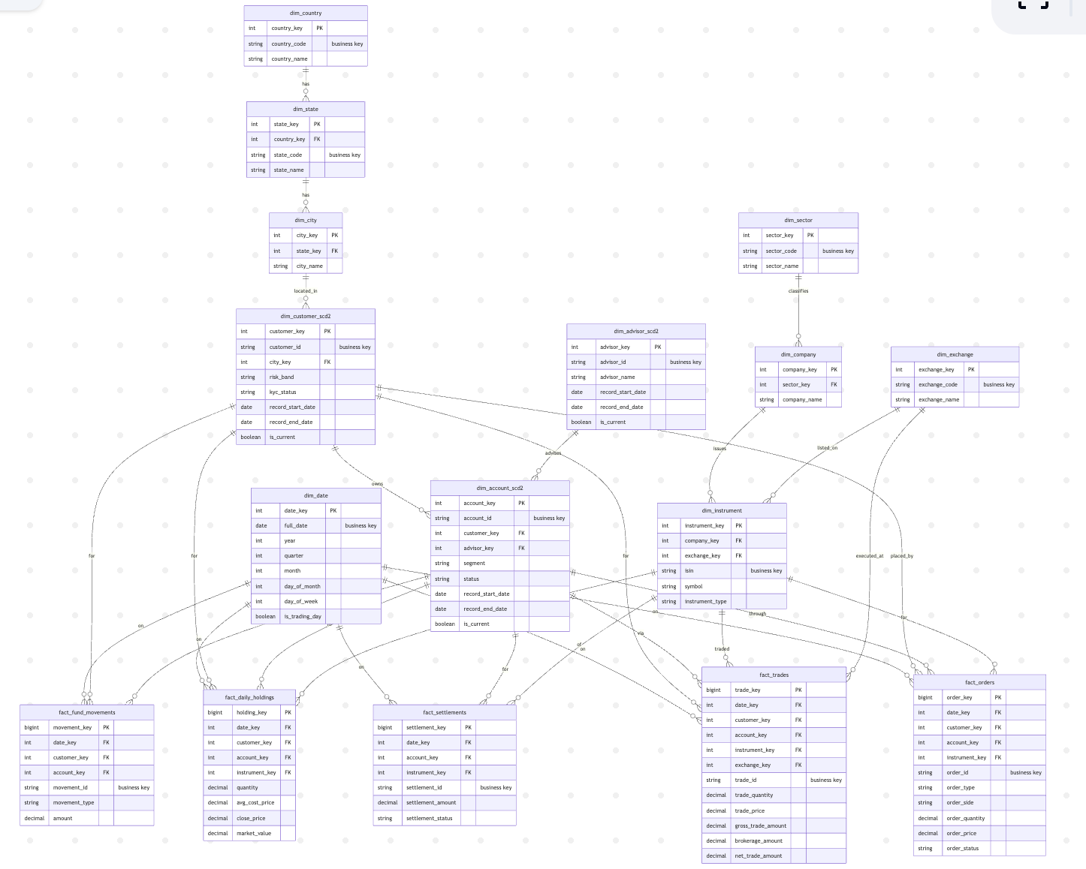
REDSHIFT LAYER
Target warehouse: snowflake-style brokerage data model
Dimensions
Country → State → City
Sector → Company
Exchange → Instrument
Date
Advisor SCD2
Customer SCD2
Account SCD2
Fact tables
Orders
Trades
Fund movements
Settlements
Daily holdings
Interview-friendly feature
SCD Type 2 stores historical changes using start date, end date, and current flag.
AWS Retail Brokerage Data Engineering Pipeline
07
Notes:
Explain snowflake schema: dimensions can branch into other dimensions. Then explain SCD2 with a simple customer address or risk-band change example.

Slide 8
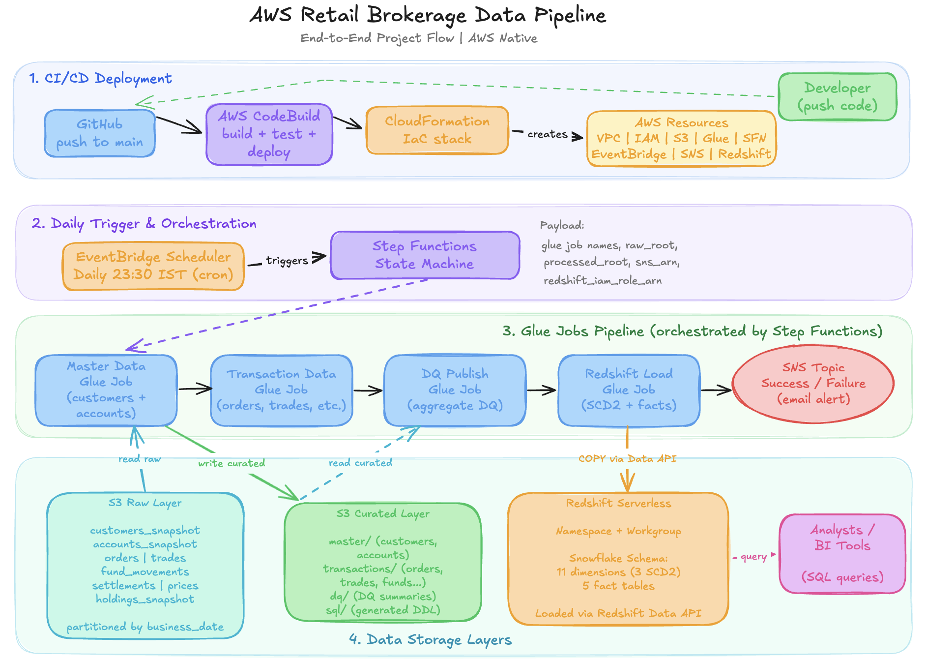
ARCHITECTURE
Full architecture: deployment + daily execution in one view
Four architecture zones
1. CI/CD deployment
2. Daily trigger and orchestration
3. Glue ETL job pipeline
4. S3 + Redshift storage layers
The important idea
CloudFormation creates the AWS skeleton. Step Functions drives the daily heartbeat. Glue does the heavy lifting. Redshift serves analytics.
No Lambda here
This project is intentionally Glue + Step Functions based. Lambda is not part of the implementation.
AWS Retail Brokerage Data Engineering Pipeline
08
Notes:
Use the actual project architecture image. Make students identify each layer verbally before going deeper.

Slide 9
CI/CD LAYER
Deployment flow: from code push to AWS resources
GitHub
main branch
CodeBuild
install + deploy + test
CloudFormation
IaC stack
AWS resources
created/updated
S3 assets
uploaded
CodeBuild tasks from buildspec.yml
CloudFormation creates
• Install Python 3.11 dependencies
• Deploy CloudFormation stack
• Sync Glue scripts, SQL, raw data, and Step Functions assets to S3
• Run pytest unit tests
• Generate coverage reports
VPC, subnets, route table, security group, S3 buckets, IAM roles, Glue jobs, SNS, Step Functions, Scheduler, Redshift Serverless, Secrets Manager.
AWS Retail Brokerage Data Engineering Pipeline
09
Notes:
Make it clear that students create CodeBuild manually, then CodeBuild handles deployment and testing. This is the gateway into real project-style deployment.

Slide 10
ORCHESTRATION LAYER
Runtime flow: how one business date is processed
EventBridge
Scheduler
23:30 IST
Step Functions
State Machine
Master Data
Glue Job
Transaction
Glue Job
DQ + Load
Glue Jobs
State machine logic
Final notification path
• If business_date is passed, use it
• Else derive date from execution start time
• Run Glue jobs synchronously
• Wait 45 seconds before transaction job
• Catch any failure and route to SNS failure alert
After the Redshift load completes, Step Functions publishes success to SNS. If any job fails, the failure branch publishes the error context.
AWS Retail Brokerage Data Engineering Pipeline
10
Notes:
Emphasize synchronous Glue integration in Step Functions. This means the workflow waits for each Glue job to finish before moving ahead.

Slide 11
PROCESSING LAYER
Glue jobs: the ETL engine room
1
job_master_data.py
Reads customer/account snapshots, runs DQ, writes curated master output.
2
job_transaction_data.py
Reads orders, trades, funds, settlements, prices, holdings; calculates trade amounts; writes curated transaction output.
3
job_publish_dq.py
Revalidates curated customer, account, order, trade outputs and publishes DQ summaries.
4
job_redshift_load.py
Creates/loads Redshift schema, stages data, applies SCD2, inserts facts via Redshift Data API.
Teaching hook: each Glue job has a single responsibility, so students can implement and test one job at a time.
AWS Retail Brokerage Data Engineering Pipeline
11
Notes:
Walk through jobs in order. Do not jump into Redshift first. Make students understand S3 raw to S3 curated before warehouse loading.

Slide 12
DQ LAYER
Data Quality checks: catch bad records before trusting analytics
Dataset
Representative checks
Where DQ is used
Customers
customer_id complete + unique, risk_band in LOW/MEDIUM/HIGH, KYC status valid
• Inside master-data job
• Inside transaction-data job
• Again in publish-DQ job on curated outputs
• Results are published for visibility through Glue/CloudWatch-style monitoring
Accounts
account_id complete + unique, account_status ACTIVE/DORMANT, segment valid
Orders
order_id complete + unique, status valid, quantity > 0, limit_price > 0
Trades
trade_id complete + unique, executed quantity/price > 0, trade amounts > 0
Teaching note
The generator injects controlled dirty records, so DQ has a real job to do. This makes the demo more believable than a perfectly clean toy dataset.
Production upgrade idea
Add a hard threshold gate: fail the workflow if critical DQ failures exceed an agreed limit.
AWS Retail Brokerage Data Engineering Pipeline
12
Notes:
Explain that DQ is not decoration. It tells business users whether warehouse outputs can be trusted. Also mention the current project publishes results but can be upgraded with strict gates.

Slide 13
WAREHOUSE LOAD
Redshift Serverless load: staging, dimensions, facts, SCD2
Curated S3
CSV files
Redshift
COPY staging
Load base
dimensions
Apply SCD2
dimensions
Insert fact
tables
SCD2 dimensions in this project
SCD2 columns
Execution mechanism
• dim_advisor_scd2
• dim_customer_scd2
• dim_account_scd2
record_start_date
record_end_date
is_current
Glue builds SQL and executes it through the Redshift Data API against Redshift Serverless.
SCD2 mental model: close old row → insert new row → keep only one current row for reporting.
AWS Retail Brokerage Data Engineering Pipeline
13
Notes:
Give a small example: customer C001 changes risk band from LOW to MEDIUM. The old row gets an end date and is_current=N. A new row is inserted with current flag Y.

Slide 14
SERVICE MAP 1/2
AWS services used: where each one fits
Service
Where used
Why it exists
Amazon S3
Raw, curated, reference, scripts, SQL artifacts, DQ summaries
Durable data lake and deployment storage
AWS Glue
Four PySpark jobs
ETL processing and data quality evaluation
Glue Data Quality
Master, transaction, and publish-DQ jobs
Completeness, uniqueness, allowed values, numeric validation
Step Functions
Daily state machine
Controls dependency order, waits, catches errors, sends final path
EventBridge Scheduler
Daily 23:30 IST cron trigger
Starts the state machine automatically
SNS
Success/failure email topic
Sends outcome alerts to subscribed users
AWS Retail Brokerage Data Engineering Pipeline
14
Notes:
Spend time on the “why it exists” column. Students should not memorize services. They should map every service to a requirement.

Slide 15
SERVICE MAP 2/2
AWS services used: deployment, security, warehouse
Service
Where used
Why it exists
Redshift Serverless
Final brokerage_dw warehouse
Queryable analytics store without managing a provisioned cluster
Redshift Data API
job_redshift_load.py
Runs SQL statements from Glue without a persistent JDBC connection
CloudFormation
infra/cloudformation/template.yaml
Creates repeatable AWS infrastructure as code
CodeBuild
buildspec.yml
Deploys stack, syncs assets, runs tests and coverage
IAM
Glue, Step Functions, Scheduler, Redshift COPY roles
Least-privilege service execution and S3/Redshift access
Secrets Manager
Redshift admin secret
Stores credentials outside source code
VPC / Subnets / SG
Redshift Serverless network
Network placement and access control
CloudWatch
Glue logs + DQ visibility
Operational troubleshooting and metrics
AWS Retail Brokerage Data Engineering Pipeline
15
Notes:
This slide covers the infrastructure and operational services. Mention that IAM is the invisible glue for all AWS service-to-service permissions.

Slide 16
IMPLEMENTATION ROADMAP
Suggested classroom demo sequence
01
Project orientation
02
Local data inspection
Open README, architecture, and data model.
Check generated_data/raw and row counts by business_date.
03
CodeBuild setup
04
CloudFormation deploy
Create project, connect GitHub, configure env variables.
Run stack creation through CodeBuild.
05
Validate AWS resources
06
Manual state machine run
Inspect S3, Glue jobs, IAM roles, Step Functions, Redshift.
Pass business_date and watch Glue jobs execute.
07
Check outputs
08
Query Redshift
Open curated S3 paths and DQ summaries.
Run analytics SQL and verify dimensions/facts.
Best teaching rhythm
First explain the layer, then show the file, then execute, then verify the AWS output. Repeat until students can predict the next service before it appears.
AWS Retail Brokerage Data Engineering Pipeline
16
Notes:
Use this as your demo itinerary. It prevents the class from getting lost inside AWS screens.

Slide 17
REALITY CHECK
Useful observations before implementation
Serverless Redshift
CSV curated layer
Transcript may say cluster, but code uses Redshift Serverless namespace + workgroup.
Good for learning; production would usually prefer Parquet.
DQ gate
Fact keys
DQ results are published. Add strict thresholds if you want fail-fast governance.
Model image shows surrogate keys; implemented facts mostly keep business IDs.
Network posture
Reconciliation
Demo setup is simplified. Production should avoid broad public ingress.
Add raw vs curated vs Redshift row-count checks after load.
Position these as improvement ideas, not blockers. The project is strong for teaching end-to-end AWS data engineering.
AWS Retail Brokerage Data Engineering Pipeline
17
Notes:
This builds credibility. Students should see the difference between a learning project and production hardening.

Slide 18
What students will learn by building this project
Architecture thinking
Data modeling
ETL engineering
Map business requirements to AWS services.
Design dimensions, facts, and SCD2 history.
Build Glue PySpark jobs with clear responsibilities.
Orchestration
Quality & testing
Warehouse analytics
Use Step Functions for dependable job sequencing.
Run DQ rules, unit tests, and coverage checks.
Load Redshift and answer brokerage business questions.
From raw trading data to governed analytics, the pipeline becomes a small AWS data-platform universe students can actually touch.
AWS Retail Brokerage Data Engineering Pipeline
18
Notes:
Close by reminding students that this project teaches the system, not just syntax.

