Slide 1
Movie Rental Analytics
From raw data to insights: cleaning, data model, SQL EDA and Power BI report
Sakila DVD rental database | 16 tables | 15 EDA questions | 15 Power BI questions
Notes:
This deck walks through the Movie Rental analysis: how I prepared the data, the SQL-based EDA, the data model and the Power BI report.

Slide 2
How I worked with the data
1. Understand the data
Sakila DVD rental database: 16 tables on customers, films, inventory, staff, stores and payments
2. Clean the data
Check nulls, unreturned rentals, films with no copy and one-day batches
3. Transform the data
Add calculated columns, hide key columns and write DAX measures
4. Build the data model
Rental as the centre table, linked to customers, staff, inventory and payments
5. EDA with SQL
Answer 15 EDA questions with PostgreSQL queries on one rental fact view
6. Power BI report
5 pages answering the 15 Power BI questions with slicers, cards and charts
Notes:
This is the order I worked in. Clean data gives a reliable model, and the model feeds both the SQL queries and the Power BI measures.

Slide 3
The dataset at a glance
16,044
Rentals
599
Customers
Analysis area | Source tables
Customers | customer, address, city, country
Sales | payment
Films | film, category, film_category, language
Inventory | inventory, film, rental
Staff | staff, rental, payment
Stores | store, inventory, rental, customer
1,000
Films
4,581
Copies
2
Stores
$67.4K
Revenue
Data runs from May 2005 to Feb 2006; July and August carry most of the activity.
Notes:
Six analysis areas keep the breakdown MECE. Each area uses its own set of source tables.

Slide 4
Data preparation
Cleaning, transformation and the data model

Slide 5
How I cleaned the data
183 rentals have no return date
Labelled 'Not Returned' in Return Status; late-return rate uses returned rentals only
1
42 films have no inventory copy
Kept in the Film table, flagged as films that cannot be rented
2
Customers have no rating or age data
Used average rentals per customer as the engagement proxy and noted the limit
3
All films are English; all create_date values equal
Kept as is; language and tenure comparisons marked not possible
4
One-day batch of 182 rentals on 14 Feb 2006
Excluded from the hourly analysis so it does not fake a 3 PM peak
5
Key and ID columns clutter the report
Hidden customer_id, rental_id, inventory_id and similar columns from report view
6
Notes:
These are the data quality points I handled before the analysis. Each one would have distorted a count or an average if left alone.

Slide 6
How I transformed the data
Customer columns
Customer Name, Customer Type (new or existing), Lifetime Spend and Spend Tier (High, Mid, Low).
Payment bands
Payment Band with Band Order (Under $2, $2-4.99, $5-7.99, $8+) and Year-Month for trends.
Rental columns
Rental Days, Return Status (On Time, Late, Not Returned) from rental and return dates.
Film and store labels
Rental Rate Label, Rental Duration (days) and Store Location (city, country).
Staff columns
Days Active, First and Last Rental Handled and Staff Status.
DAX measures
Avg Rental Days, Avg Payment, Payments and Inventory Copies feed the cards and charts.
Notes:
These calculated columns and measures are what make the charts possible, for example the spend tiers and payment bands.

Slide 7
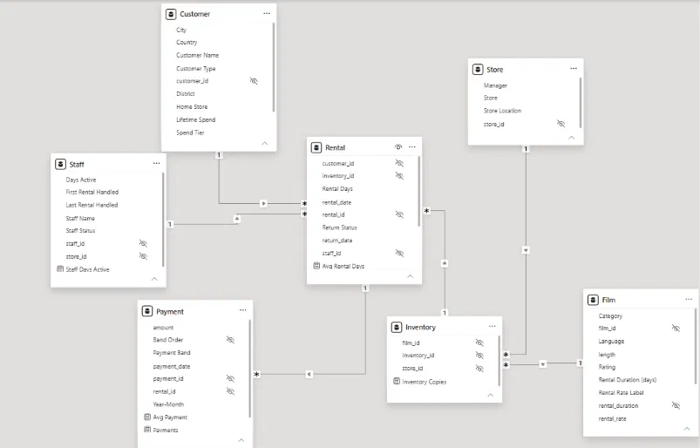
Data model
Rental sits at the centre; Customer, Staff, Inventory and Payment connect to it, and Store and Film connect through Inventory.
Notes:
Walk through the tables: Rental is the central fact table, Inventory links the film and store dimensions.

Slide 8
Relationships in the model
Relationship | Type | Key | What it does
Customer to Rental | 1 : many | customer_id | One customer has many rentals; Country and City slicers filter rentals
Staff to Rental | 1 : many | staff_id | One staff member handles many rentals; gives rentals and days per staff
Inventory to Rental | 1 : many | inventory_id | One copy is rented many times; connects rentals to films and stores
Rental to Payment | 1 : many | rental_id | A rental has its payments; gives revenue by month, band and customer
Store to Inventory | 1 : many | store_id | Each store owns many copies; drives revenue and rentals by store
Film to Inventory | 1 : many | film_id | One film has several copies; gives category, rating and language views
Single-direction filters flow from the dimension tables to Rental, so there are no ambiguous paths.
Notes:
Every relationship is one-to-many. Filters flow from the one side to the many side, so slicers on customer, film or store filter all rentals and payments.

Slide 9
EDA with SQL
15 questions: the query, the finding and what it means

Slide 10
Q1. New vs repeat customers
What are the purchasing patterns of new customers versus repeat customers?
SQL QUERY
96.3%
of revenue comes from repeat rentals
SELECT CASE WHEN rental_no = 1 THEN 'New (first rental)'
ELSE 'Repeat' END AS customer_type,
COUNT(*) AS rentals,
COUNT(DISTINCT customer_id) AS customers,
ROUND(SUM(amount), 2) AS revenue,
ROUND(AVG(amount), 2) AS avg_payment,
ROUND(AVG(rental_rate), 2) AS avg_rental_rate,
ROUND(AVG(length), 1) AS avg_film_length
FROM v_rental_fact
GROUP BY 1
ORDER BY 1;
Key finding
First rentals are only 599 of 16,044 rentals ($2,508). Repeat rentals bring $64,899, with the same $4.20 average payment.
What it means
Revenue depends on customers coming back. Retention matters far more than the first rental.
Notes:
What are the purchasing patterns of new customers versus repeat customers? Insight: First rentals are only 599 of 16,044 rentals ($2,508). Repeat rentals bring $64,899, with the same $4.20 average payment. Revenue depends on customers coming back. Retention matters far more than the first rental.

Slide 11
Q2. Highest rental rates and demand
Which films have the highest rental rates and are most in demand?
SQL QUERY
$4.99
top rental rate (336 films)
SELECT film_id, title, category, rental_rate,
COUNT(DISTINCT rental_id)
AS rentals,
ROUND(SUM(amount), 2)
AS revenue
FROM v_rental_fact
GROUP BY film_id, title, category, rental_rate
ORDER BY rentals DESC, rental_rate DESC
LIMIT 25;
Key finding
Bucket Brotherhood is the most rented film (34 times). Films at $0.99, $2.99 and $4.99 get about 16 rentals each.
What it means
Price is the revenue lever, not the demand driver: $4.99 films give 48.9% of revenue.
Notes:
Which films have the highest rental rates and are most in demand? Insight: Bucket Brotherhood is the most rented film (34 times). Films at $0.99, $2.99 and $4.99 get about 16 rentals each. Price is the revenue lever, not the demand driver: $4.99 films give 48.9% of revenue.

Slide 12
Q3. Staff performance
Are there correlations between staff performance and customer satisfaction?
SQL QUERY
8,040 vs 8,004
rentals, staff 1 vs staff 2
SELECT staff_id,
COUNT(*) AS
rentals,
COUNT(DISTINCT customer_id) AS
customers,
ROUND(SUM(amount), 2) AS
revenue,
ROUND(AVG(amount), 2) AS
avg_payment,
ROUND(100.0 * AVG(is_late), 1) AS
late_return_pct,
ROUND(100.0 * AVG((rental_no > 1)::int), 1) AS
repeat_rental_pct
FROM v_rental_fact
GROUP BY staff_id
ORDER BY staff_id;
Key finding
Revenue is $33,525 vs $33,882 and late-return rate 45.3% vs 46.3%. Both staff perform almost equally.
What it means
No evidence either staff member changes satisfaction. There is no rating data, so late returns are only a proxy.
Notes:
Are there correlations between staff performance and customer satisfaction? Insight: Revenue is $33,525 vs $33,882 and late-return rate 45.3% vs 46.3%. Both staff perform almost equally. No evidence either staff member changes satisfaction. There is no rating data, so late returns are only a proxy.

Slide 13
Q4. Seasonal trends by location
Are there seasonal trends in customer behavior across different locations?
SQL QUERY
72 to 289
rentals per active day, May to Aug
SELECT store_id,
EXTRACT(YEAR FROM rental_date)::int AS yr,
EXTRACT(MONTH FROM rental_date)::int AS month_no,
COUNT(*) AS rentals,
COUNT(DISTINCT customer_id) AS
active_customers,
ROUND(SUM(amount), 2) AS revenue
FROM v_rental_fact
GROUP BY 1, 2, 3
ORDER BY store_id, yr, month_no;
Key finding
Rentals per day grow every month in both stores, and the two stores stay within 3% of each other.
What it means
This is a ramp-up inside 41 days of data, not a true yearly season. No store behaves differently.
Notes:
Are there seasonal trends in customer behavior across different locations? Insight: Rentals per day grow every month in both stores, and the two stores stay within 3% of each other. This is a ramp-up inside 41 days of data, not a true yearly season. No store behaves differently.

Slide 14
Q5. Language and customer segments
Are certain language films more popular among specific customer segments?
SQL QUERY
100%
of rentals are English films
WITH tier AS (
SELECT customer_id, NTILE(3) OVER (ORDER BY
SUM(amount) DESC) AS t
FROM v_rental_fact GROUP BY customer_id
)
SELECT CASE tier.t WHEN 1 THEN '1 High spenders' WHEN 2
THEN '2 Mid spenders' ELSE '3 Low spenders' END AS
segment,
v.language_name,
COUNT(*) AS rentals,
ROUND(100.0 * COUNT(*) / SUM(COUNT(*)) OVER
(PARTITION BY tier.t), 1) AS share_in_segment_pct
FROM v_rental_fact v JOIN tier USING (customer_id)
GROUP BY tier.t, v.language_name
ORDER BY tier.t, rentals DESC;
Key finding
All 1,000 films are English; the other five languages have 0 films. High, mid and low spenders differ only in volume.
What it means
Language cannot explain differences between customer segments here.
Notes:
Are certain language films more popular among specific customer segments? Insight: All 1,000 films are English; the other five languages have 0 films. High, mid and low spenders differ only in volume. Language cannot explain differences between customer segments here.

Slide 15
Q6. Loyalty and revenue over time
How does customer loyalty impact sales revenue over time?
SQL QUERY
31% vs 19%
revenue: most vs least loyal quartile
WITH loyalty AS (
SELECT customer_id, NTILE(4) OVER (ORDER BY COUNT(*)
DESC) AS loyalty_quartile
FROM v_rental_fact GROUP BY customer_id
)
SELECT DATE_TRUNC('month', v.rental_date)::date AS month,
l.loyalty_quartile,
COUNT(DISTINCT v.customer_id) AS customers,
COUNT(*) AS rentals,
ROUND(SUM(v.amount), 2) AS revenue
FROM v_rental_fact v JOIN loyalty l USING (customer_id)
GROUP BY 1, 2
ORDER BY 1, 2;
Key finding
The most loyal 150 customers (about 33 rentals each) made $21,129 against $13,007 for the least loyal quartile.
What it means
Loyalty works through frequency, not basket size. A loyal customer is worth about $141 vs $87.
Notes:
How does customer loyalty impact sales revenue over time? Insight: The most loyal 150 customers (about 33 rentals each) made $21,129 against $13,007 for the least loyal quartile. Loyalty works through frequency, not basket size. A loyal customer is worth about $141 vs $87.

Slide 16
Q7. Categories by location
Are certain film categories more popular in specific locations?
SQL QUERY
596 vs 624
Action (Store 1) vs Sports (Store 2)
SELECT store_id, category,
COUNT(*) AS rentals,
ROUND(100.0 * COUNT(*) / SUM(COUNT(*)) OVER
(PARTITION BY store_id), 1) AS share_in_store_pct,
RANK() OVER (PARTITION BY store_id ORDER BY COUNT(*)
DESC) AS rank_in_store
FROM v_rental_fact
GROUP BY store_id, category
ORDER BY store_id, rank_in_store;
Key finding
Store 1 leads with Action, Drama and Animation. Store 2 leads with Sports, Documentary and Animation.
What it means
The differences are real but small (each category is 5-8% of rentals), so no big stocking changes.
Notes:
Are certain film categories more popular in specific locations? Insight: Store 1 leads with Action, Drama and Animation. Store 2 leads with Sports, Documentary and Animation. The differences are real but small (each category is 5-8% of rentals), so no big stocking changes.

Slide 17
Q8. Staff availability and ratings
How does the availability and knowledge of staff affect customer ratings?
SQL QUERY
2 staff
active in every store-month
WITH sm AS (
SELECT store_id, DATE_TRUNC('month',
rental_date)::date AS month,
COUNT(DISTINCT staff_id) AS
staff_on_duty,
COUNT(DISTINCT rental_date::date) AS
active_days,
COUNT(*) AS
rentals,
ROUND(100.0 * AVG(is_late), 1) AS
late_pct,
ROUND(100.0 * AVG((rental_no > 1)::int), 1) AS
repeat_pct
FROM v_rental_fact GROUP BY 1, 2
)
SELECT sm.*,
-- ... full query in EDA workbook
Key finding
Availability is constant and there are no ratings. Workload rose from 36 to 144 rentals per day, but late returns stayed flat at 43-47%.
What it means
Busy periods did not hurt customer behaviour, but the effect cannot be fully measured.
Notes:
How does the availability and knowledge of staff affect customer ratings? Insight: Availability is constant and there are no ratings. Workload rose from 36 to 144 rentals per day, but late returns stayed flat at 43-47%. Busy periods did not hurt customer behaviour, but the effect cannot be fully measured.

Slide 18
Q9. Store proximity and rentals
How does the proximity of stores to customers impact rental frequency?
SQL QUERY
0.05
correlation: distance vs rentals
WITH c AS (
SELECT cu.customer_id,
a.city_id AS c_city, ci.country_id AS c_country,
sa.city_id AS s_city, sci.country_id AS s_country
FROM customer cu
JOIN address a ON a.address_id = cu.address_id
JOIN city ci ON ci.city_id = a.city_id
JOIN store s ON s.store_id = cu.store_id
JOIN address sa ON sa.address_id = s.address_id
JOIN city sci ON sci.city_id = sa.city_id
)
SELECT CASE WHEN c_city = s_city THEN '1 Same city
as store'
WHEN c_country = s_country THEN '2 Same country,
other city'
ELSE '3 Different country' END AS
-- ... full query in EDA workbook
Key finding
Customers live 745 to 18,112 km from their store, yet each band averages 25 to 27 rentals per customer.
What it means
Proximity has no measurable influence on how often customers rent.
Notes:
How does the proximity of stores to customers impact rental frequency? Insight: Customers live 745 to 18,112 km from their store, yet each band averages 25 to 27 rentals per customer. Proximity has no measurable influence on how often customers rent.

Slide 19
Q10. Categories by age group
Do specific film categories attract different age groups of customers?
SQL QUERY
No age
column in the customer table
-- The customer table has no age / birth date.
-- Only date field is create_date, so check it:
SELECT MIN(create_date) AS first_created,
MAX(create_date) AS last_created,
COUNT(*) AS customers
FROM customer;
Key finding
The customer table has no age or birth date, and create_date is the same for all 599 customers.
What it means
Cannot be answered with this data. Adding an age column would make it possible.
Notes:
Do specific film categories attract different age groups of customers? Insight: The customer table has no age or birth date, and create_date is the same for all 599 customers. Cannot be answered with this data. Adding an age column would make it possible.

Slide 20
Q11. Highest-spending customers
What are the demographics and preferences of the highest-spending customers?
SQL QUERY
14.3%
revenue from the top 10% (60 customers)
WITH spend AS (
SELECT customer_id, ROUND(SUM(amount), 2) AS
total_spent, COUNT(*) AS rentals,
NTILE(10) OVER (ORDER BY SUM(amount) DESC) AS decile
FROM v_rental_fact GROUP BY customer_id
),
fav AS (
SELECT customer_id, category,
ROW_NUMBER() OVER (PARTITION BY customer_id ORDER BY
COUNT(*) DESC, category) AS rn
FROM v_rental_fact GROUP BY customer_id, category
)
SELECT s.customer_id,
cu.first_name || ' ' || cu.last_name AS customer,
co.country, ci.city, cu.store_id,
s.total_spent, s.rentals,
-- ... full query in EDA workbook
Key finding
Top spenders spend at least $144.67 each. Karl Seal leads with $221.55. They rent 35.0 times vs 25.9.
What it means
They are not a special demographic. Frequency sets them apart.
Notes:
What are the demographics and preferences of the highest-spending customers? Insight: Top spenders spend at least $144.67 each. Karl Seal leads with $221.55. They rent 35.0 times vs 25.9. They are not a special demographic. Frequency sets them apart.

Slide 21
Q12. Inventory and repeat business
How does the availability of inventory impact customer satisfaction and repeat business?
SQL QUERY
3.5
rentals per copy at 2, 3 or 4 copies
WITH copies AS (
SELECT store_id, film_id, COUNT(*) AS copies FROM
inventory GROUP BY 1, 2
),
nxt AS (
SELECT v.*, LEAD(rental_date) OVER (PARTITION BY
customer_id ORDER BY rental_date, rental_id) AS
next_rental
FROM v_rental_fact v
)
SELECT CASE WHEN c.copies <= 2 THEN '1-2 copies' WHEN
c.copies <= 4 THEN '3-4 copies' ELSE '5+ copies' END AS
availability,
COUNT(*)
AS rentals,
COUNT(DISTINCT n.store_id::text || '-' ||
-- ... full query in EDA workbook
Key finding
Every store holds 2 to 4 copies per film. Late returns are 44% vs 46% and repeat rentals are almost universal.
What it means
No evidence that 2 vs 4 copies changes behaviour. Stock-outs are not recorded.
Notes:
How does the availability of inventory impact customer satisfaction and repeat business? Insight: Every store holds 2 to 4 copies per film. Late returns are 44% vs 46% and repeat rentals are almost universal. No evidence that 2 vs 4 copies changes behaviour. Stock-outs are not recorded.

Slide 22
Q13. Busiest hours and days
What are the busiest hours or days for each store, and how does it impact staffing?
SQL QUERY
3 PM
busiest hour (705 rentals)
SELECT store_id,
EXTRACT(ISODOW FROM rental_date)::int AS dow_no,
TO_CHAR(rental_date, 'Dy') AS day_name,
COUNT(*) AS rentals,
COUNT(DISTINCT rental_date::date) AS
days_in_data,
ROUND(COUNT(*)::numeric / COUNT(DISTINCT
rental_date::date), 1) AS avg_rentals_per_day
FROM v_rental_fact
GROUP BY 1, 2, 3
ORDER BY store_id, dow_no;
Key finding
Demand is flat: 9.4 to 9.6 rentals per hour per store. Saturday and Sunday are slightly busier (about 231 per day).
What it means
One staff member per store covers the peaks. Add a little cover at weekends.
Notes:
What are the busiest hours or days for each store, and how does it impact staffing? Insight: Demand is flat: 9.4 to 9.6 rentals per hour per store. Saturday and Sunday are slightly busier (about 231 per day). One staff member per store covers the peaks. Add a little cover at weekends.

Slide 23
Q14. Cultural and demographic factors
What are the cultural or demographic factors that influence preferences in different locations?
SQL QUERY
1.00
average category lift (range 0.65-1.41)
WITH base AS (
SELECT country, 'category' AS dimension, category AS
value, COUNT(*) AS n FROM v_rental_fact GROUP BY 1,
2, 3
UNION ALL
SELECT country, 'rating', rating::text, COUNT(*)
FROM v_rental_fact GROUP BY 1, 2, 3
),
ctry AS (SELECT country, dimension, SUM(n) AS t FROM base
GROUP BY 1, 2),
allc AS (SELECT dimension, value, SUM(n) AS n FROM base
GROUP BY 1, 2),
grand AS (SELECT dimension, SUM(n) AS g FROM base GROUP
BY 1)
SELECT b.country, b.dimension, b.value, b.n AS rentals,
ROUND(100.0 * b.n / c.t, 1) AS country_share_pct,
-- ... full query in EDA workbook
Key finding
In the 8 largest countries, category mix is close to the overall mix. Larger lifts only come from small samples.
What it means
Country barely changes what customers rent.
Notes:
What are the cultural or demographic factors that influence preferences in different locations? Insight: In the 8 largest countries, category mix is close to the overall mix. Larger lifts only come from small samples. Country barely changes what customers rent.

Slide 24
Q15. Language availability
How does the availability of films in different languages impact satisfaction and rental frequency?
SQL QUERY
1,000
films, all in English (0 in other languages)
WITH supply AS (
SELECT l.language_id, l.name AS language_name,
COUNT(DISTINCT f.film_id) AS films,
COUNT(DISTINCT i.inventory_id) AS copies
FROM language l
LEFT JOIN film f ON f.language_id =
l.language_id
LEFT JOIN inventory i ON i.film_id = f.film_id
GROUP BY l.language_id, l.name
),
demand AS (
SELECT language_id,
COUNT(*) AS
rentals,
COUNT(DISTINCT customer_id) AS
customers,
-- ... full query in EDA workbook
Key finding
English has all 4,581 copies and all 16,044 rentals, 3.5 rentals per copy.
What it means
There is no variation to compare. Adding other languages would be needed to test it.
Notes:
How does the availability of films in different languages impact satisfaction and rental frequency? Insight: English has all 4,581 copies and all 16,044 rentals, 3.5 rentals per copy. There is no variation to compare. Adding other languages would be needed to test it.

Slide 25
Power BI report
5 pages, 15 questions: screenshots and insights

Slide 26
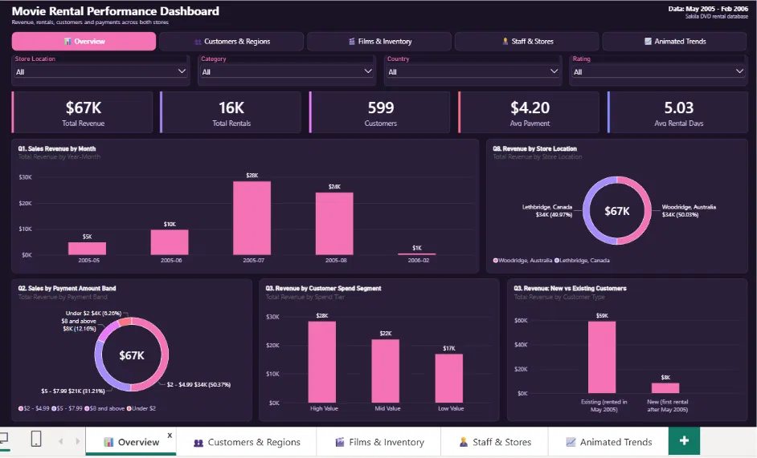
Overview page
Revenue, rentals, customers and payments across both stores
Notes:
KPIs: $67K revenue, 16K rentals, 599 customers, $4.20 average payment and 5.03 average rental days.

Slide 27
Overview: Q1, Q2, Q3 and Q8
Q1. Sales revenue by month
Revenue climbs from $5K (May) and $10K (June) to a $28K peak in July, then $24K in August. Feb 2006 has only one day of data.
Q2. Sales by payment band
The dataset has no payment method, so I used payment amount bands. $2-$4.99 payments bring $34K (50%) and $5-$7.99 bring $21K (31%).
Q3. Customer segments
High Value customers generate the most ($28K), then Mid ($22K) and Low ($17K). Existing customers bring $59K vs $8K from new ones.
Q8. Store performance by location
Woodridge (Australia) and Lethbridge (Canada) are equal at $34K each (50.03% vs 49.97%).

Slide 28
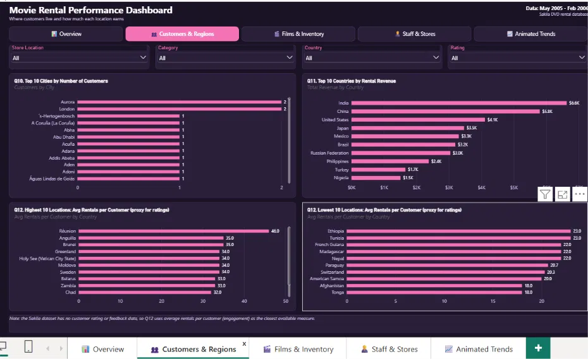
Customers & Regions page
Where customers live and how much each location earns
Notes:
Customers are spread across about 600 cities and 108 countries.

Slide 29
Customers & Regions: Q10, Q11 and Q12
Q10. Customers by city
Customers are spread thinly: only Aurora and London have 2 customers, every other city has 1.
Q11. Revenue by country
India leads with $6.6K, then China $5.8K, the United States $4.1K, Japan $3.5K and Mexico $3.3K.
Q12. Highest and lowest locations
There are no customer ratings, so I used average rentals per customer. Reunion is highest (46) and Tonga and Afghanistan lowest (18).

Slide 30
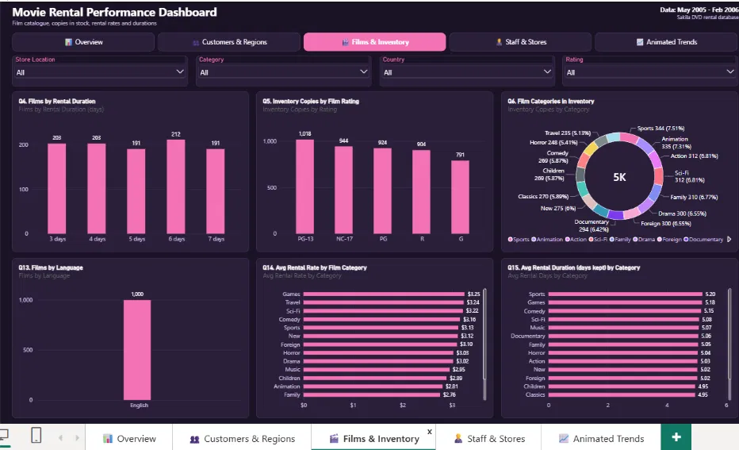
Films & Inventory page
Film catalogue, copies in stock, rental rates and durations
Notes:
Six charts cover rental duration, rating, category, language, rental rate and rental days.

Slide 31
Films & Inventory: Q4, Q5, Q6, Q13, Q14 and Q15
Q4. Films by rental duration
Films are spread evenly over 3 to 7 days (191 to 212 each); 6 days is the highest.
Q5. Inventory by film rating
PG-13 holds the most copies (1,018) and G the fewest (791).
Q6. Film categories in inventory
Sports (344) and Animation (335) lead; Travel (235) and Horror (248) are the smallest.
Q13. Films by language
All 1,000 films are English, so there is no language mix.
Q14. Highest rental rates
Games ($3.25), Travel ($3.24) and Sci-Fi ($3.22) are highest; Family is lowest ($2.76).
Q15. Rental duration by category
Sports (5.20 days) and Games (5.18) are kept longest; Classics is lowest (4.95).

Slide 32
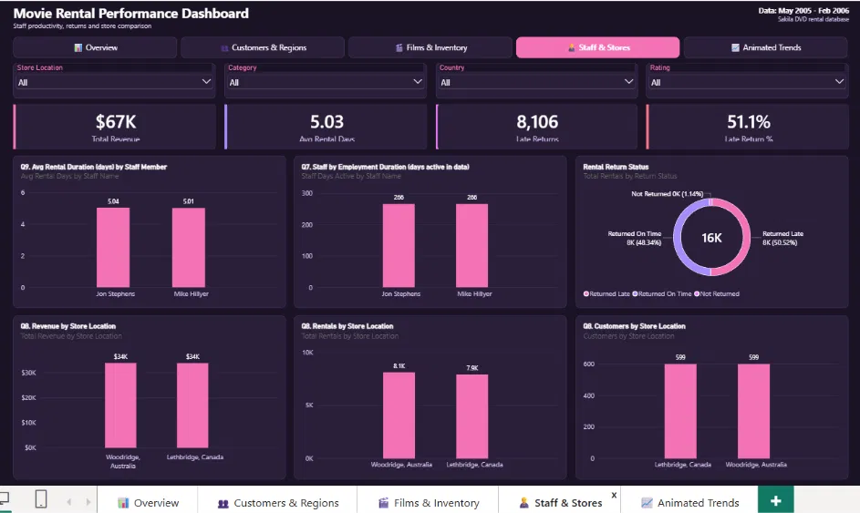
Staff & Stores page
Staff productivity, returns and store comparison
Notes:
Cards show $67K revenue, 5.03 average rental days, 8,106 late returns and a 51.1% late return rate.

Slide 33
Staff & Stores: Q7, Q8 and Q9
Q7. Staff by employment duration
Jon Stephens and Mike Hillyer are both active for 266 days in the data.
Q8. Store performance by location
Both stores earn $34K and serve all 599 customers; Woodridge has 8.1K rentals vs 7.9K.
Q9. Avg rental duration by staff
Jon Stephens 5.04 days and Mike Hillyer 5.01 days: almost no difference.
Bonus: return status
About half of rentals (50.5%) are returned late and 1.1% are never returned.

Slide 34
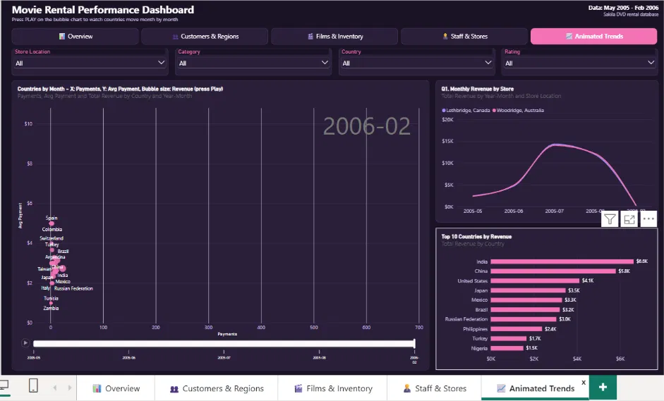
Animated Trends page (bonus)
Countries move month by month on the bubble chart
Monthly revenue by store
Both stores follow the same curve and peak in July.
Top 10 countries
India ($6.6K), China ($5.8K) and the US ($4.1K) lead.
Bubble chart
Press play to watch average payment and revenue move by country.
Notes:
This extra page is the bonus analysis: an animated view of countries by month.

Slide 35
Key insights and recommendations
What the data shows
Revenue peaks in July and August. Both stores and both staff perform almost equally. Repeat customers drive 96% of revenue, and about half of rentals come back late.
Marketing
Focus on India, China and the US, reward high-frequency customers and run offers on quiet days.
Films and inventory
Add copies in Sports, Sci-Fi and Animation, keep $4.99 films, and fix the 42 films with no copy.
Staff and stores
Train staff to follow up late and unreturned rentals, add cover at weekends and keep stock balanced across both stores.
Notes:
Limits: no customer rating data, only two stores and two staff, and data from May 2005 to Feb 2006 with most activity in July and August.

