Slide 1
Olympic Games Analysis
From raw data to insights: cleaning, data model, SQL EDA and Power BI report
Games 1896 to 2016 | 11 tables | 18 EDA questions | 18 Power BI questions
Notes:
Welcome. This deck walks through the Olympic Games analysis from raw data to insights: how I prepared the data, the SQL-based EDA, and the Power BI report.

Slide 2
How I worked with the data
1
Understand the data
2
Clean the data
11 tables on Games, sports, events, athletes, medals and regions
Handle NA medals, zero heights, duplicates and region rules
3
Transform the data
4
Build the data model
Build one fact table, Age Group, Decade and host city table
Link games to the fact table and host cities in Power BI
5
EDA with SQL
6
Power BI report
Answer 18 EDA questions with queries on the sportsanalysis schema
5 pages answering 18 questions with slicers, cards and charts
Notes:
This is the order I worked in. Each step feeds the next: clean data gives a reliable model, the model feeds both the SQL queries and the Power BI measures.

Slide 3
The dataset at a glance
Analysis area | Source tables
Games | games, city, games_city
Sports | sport, event, competitor_event
Events | event, sport
Participants | person, games_competitor
Medals | medal, competitor_event
Regions | noc_region, person_region
51
66
Olympic Games
Sports
757
129K
Events
Participants
41K
228
Eleven tables in total. Each table feeds one analysis area, which keeps the breakdown MECE.
Medals
Regions (NOCs)
Notes:
The dataset covers every Olympic Games from Athens 1896 to Rio 2016. The headline numbers come from the Power BI overview cards.

Slide 4
Data preparation
Cleaning, transformation and the data model

Slide 5
How I cleaned the data
Issue found
How I handled it
1
Medal value "NA" means no medal
Kept for participation counts, excluded from medal counts (medal_name <> 'NA')
2
Missing height and weight stored as 0
Excluded from averages so they do not pull the numbers down
3
Team events repeat a medal for each member
Used COUNT(DISTINCT) for games, events and athletes; noted that team medals count per member
4
Athletes can represent different countries
Took the region from person_region so each athlete maps to one region
5
Games with two host cities (1956)
Counted distinct Games so Stockholm and Melbourne do not double count
6
Defunct nations (Soviet Union, East Germany)
Kept as separate regions instead of merging them into modern countries
Notes:
These are the data quality issues I handled before analysis. Each one would have produced wrong counts if left alone.

Slide 6
How I transformed the data
One fact table
Age Group + Age Order
Decade column
Joined competitor, athlete, event, sport, medal and region tables into a single Fact table (consolidated_fact).
Grouped ages into Under 18, 18-24, 25-29, 30-34 and 35+. Age Order sorts the groups correctly.
Turned games_year into 1890s to 2010s on the games table for the Games by Decade chart.
Host city table
DAX measures
Result
Merged games_city with city to get gamescity with city_name, so each Games links to its host city.
Created 16 measures: Total Games, Summer and Winter Games, Participants, Medals, Average Age, Countries and more.
A small star-style model: games filters both the Fact table and gamescity.
Notes:
These are the transformations behind the report. The fact table and the Age Group and Decade columns are what make the charts possible.

Slide 7
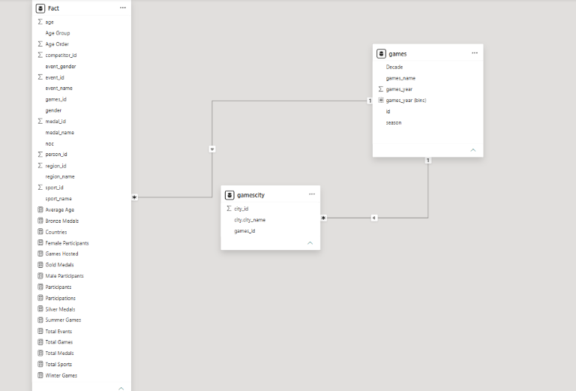
Data model and relationships
games to Fact
One-to-many on games_id. One Games has many athlete-event rows, so season, year and decade slicers filter every participant and medal.
games to gamescity
One-to-many on games_id. A Games can have more than one host city, which feeds the Hosted cities chart.
Fact and gamescity
No direct link. Both connect through games, which avoids ambiguous filter paths and keeps the model simple.
Fact holds all measures (Total Games, Participants, Total Medals and more).
Notes:
Walk through the three tables. Games is the one side; Fact and gamescity are the many side. Fact and gamescity never link directly, so filters flow through games.

Slide 8
EDA with SQL
18 questions: the query, the finding and what it means

Slide 9
Q1. Hosting frequency
Are there any trends or patterns in the frequency of hosting Olympic Games?
SQL QUERY
51
select
games_year,
lead(games_year) over( order by games_year) as next_year,
(lead(games_year) over( order by games_year)) - games_year as gap
from sportsanalysis.games
Games held, 1896 to 2016
Key finding
The standard gap is 4 years. Gaps of 0 (Summer and Winter in one year), 2, 8 and 12 years also appear.
What it means
Since 1994 an Olympics is held every 2 years, alternating Summer and Winter.
Notes:
Q1: Are there any trends or patterns in the frequency of hosting Olympic Games?
Key finding: The Games were held 51 times between 1896 and 2016. The standard gap is 4 years, but gaps of 0, 2, 8 and 12 years also appear.
What it means: Hosting frequency has effectively doubled since 1994: the Olympics are now held every two years, alternating Summer and Winter.
Data caveat: Gap mixes both seasons, so 0-year gaps are Summer and Winter held in the same year, not errors. Partition by season for a clean 4-year cycle.

Slide 10
Q2. Size of the Games over time
How has the duration of Olympic Games changed over time?
SQL QUERY
306
SELECT g.games_year, g.season, COUNT(DISTINCT ce.event_id) AS events
FROM sportsanalysis.games g
JOIN sportsanalysis.games_competitor gc ON gc.games_id = g.id
JOIN sportsanalysis.competitor_event ce ON ce.competitor_id = gc.id
GROUP BY g.games_year, g.season
Summer events in 2016 (42 in 1896)
Key finding
Summer events grew from 42 to 306. Winter grew from 17 (1924) to 98 (2014). Summer has levelled off since 2000.
What it means
Duration in days is not in the data, so event count measures the size of a Games.
Notes:
Q2: How has the duration of Olympic Games changed over time?
Key finding: Summer events grew from 42 (1896) to 306 (2016). Winter events grew from 17 (1924) to 98 (2014).
What it means: The Summer programme has stopped expanding since 2000, while the Winter programme is still growing.
Data caveat: True duration (days) cannot be measured because the tables have no start or end dates. Number of events is used as a proxy for the size of the Games.

Slide 11
Q3. Notable Games
Are there any notable events or occurrences associated with specific Olympic Games?
SQL QUERY
11,176
SELECT g.games_year, g.season, c.city_name, COUNT(DISTINCT gc.id) AS competitors
FROM sportsanalysis.games g
JOIN sportsanalysis.games_city gcity ON gcity.games_id = g.id
JOIN sportsanalysis.city c ON c.id = gcity.city_id
JOIN sportsanalysis.games_competitor gc ON gc.games_id = g.id
GROUP BY g.games_year, g.season, c.city_name
ORDER BY competitors DESC
competitors at Rio 2016
Key finding
Rio 2016, Beijing 2008 and Sydney 2000 are the biggest. Athens 1896 had 72. Sochi 2014 is the largest Winter Games.
What it means
Participation grew about 150-fold and is above 10,000 at every Summer Games since 1996.
Notes:
Q3: Are there any notable events or occurrences associated with specific Olympic Games?
Key finding: Rio 2016 had the most competitors (11,176), followed by Beijing 2008 (10,895) and Sydney 2000 (10,641). Athens 1896 had only 72.
What it means: Participation grew roughly 150-fold from the first Games to Rio, and has been above 10,000 in every Summer Games since 1996.
Data caveat: 1956 appears twice (Stockholm and Melbourne) with the same 2,858 competitors, because the equestrian events were held in Stockholm. Do not add the two rows together.

Slide 12
Q4. Emerging sports
Are there any emerging sports that have been recently added to the Olympics?
SQL QUERY
4
SELECT s.sport_name, MIN(g.games_year) AS yearadded
FROM sportsanalysis.sport s
JOIN sportsanalysis.event e ON e.sport_id = s.id
JOIN sportsanalysis.competitor_event ce ON ce.event_id = e.id
JOIN sportsanalysis.games_competitor gc ON gc.id = ce.competitor_id
JOIN sportsanalysis.games g ON g.id = gc.games_id
GROUP BY s.sport_name
HAVING MIN(g.games_year) >= 2000
ORDER BY yearadded DESC, s.sport_name
sports added since 2000
Key finding
Taekwondo, Trampolining and Triathlon arrived in 2000 and Rugby Sevens in 2016. None were added in between.
What it means
The programme grows by one or a few sports per decade, not in big jumps.
Notes:
Q4: Are there any emerging sports that have been recently added to the Olympics?
Key finding: Only four sports first appeared in 2000 or later: Taekwondo, Trampolining and Triathlon (all 2000) and Rugby Sevens (2016).
What it means: The Olympic programme evolves by adding one or a few sports per decade rather than by large expansions.
Data caveat: 'Emerging' is defined here as first appearing in 2000 or later, and the data ends at 2016.

Slide 13
Q5. Sport popularity
How has the popularity of certain sports changed over the years?
SQL QUERY
2,268
SELECT s.sport_name, g.games_year, COUNT(DISTINCT gc.person_id) AS participants
FROM sportsanalysis.sport s
JOIN sportsanalysis.event e ON e.sport_id = s.id
JOIN sportsanalysis.competitor_event ce ON ce.event_id = e.id
JOIN sportsanalysis.games_competitor gc ON gc.id = ce.competitor_id
JOIN sportsanalysis.games g ON g.id = gc.games_id
WHERE g.season = 'Summer'
GROUP BY s.sport_name, g.games_year
ORDER BY s.sport_name, g.games_year
Athletics participants in 2016
Key finding
Athletics leads, then Swimming (942), Rowing (546) and Cycling (513). Football and Cycling grew; Gymnastics and Rowing fell.
What it means
A few large sports hold most participants, and some old sports have disappeared.
Notes:
Q5: How has the popularity of certain sports changed over the years?
Key finding: Athletics is the largest Summer sport (2,268 participants in 2016; 29,629 in total across all editions), followed by Swimming (942), Rowing (546), Cycling (513) and Football (473).
What it means: Participation is concentrated in a few large sports. Some historic sports have disappeared, while newer sports like Triathlon and Taekwondo have stayed small but stable.
Data caveat: Summer Games only. A person who competes in two sports is counted in both. Sports like Figure Skating and Ice Hockey appear only because of early Summer editions.

Slide 14
Q6. Regional sports
Are there any sports that are specific to a particular region or culture?
SQL QUERY
39.6%
SELECT * FROM (
SELECT sport_name, region_name, athletes,
ROUND(100.0 * athletes / NULLIF(SUM(athletes) OVER (PARTITION BY sport_name), 0), 1) AS share_pct,
SUM(athletes) OVER (PARTITION BY sport_name) AS total,
ROW_NUMBER() OVER (PARTITION BY sport_name ORDER BY athletes DESC) AS rn
FROM (SELECT sport_name, region_name, COUNT(DISTINCT person_id) AS athletes
FROM sportsanalysis.consolidated_fact
GROUP BY sport_name, region_name) t
) x
WHERE rn = 1 AND total >= 100
ORDER BY share_pct DESC
of Rugby athletes are French
Key finding
No sport belongs to one region. Top shares: Rugby (France), Golf (USA 37.9%) and Tug-Of-War (Sweden 23.3%).
What it means
Curling, Baseball and Rugby show regional identity, but most sports are spread widely.
Notes:
Q6: Are there any sports that are specific to a particular region or culture?
Key finding: No sport is dominated by a single region. The highest shares are Rugby (France 39.6%), Golf (USA 37.9%) and Tug-Of-War (Sweden 23.3%).
What it means: Sports with real regional identity exist (Rugby, Golf, Curling, Baseball), but most sports are spread across many nations.
Data caveat: Shares are of distinct athletes over all Games and cover only sports with 100+ athletes. Only the top region per sport is shown.

Slide 15
Q7. Gender gap in events
Are there any sports that have a higher number of events for one gender compared to others?
SQL QUERY
68 vs 7
SELECT s.sport_name,
COUNT(*) FILTER (WHERE e.event_name LIKE '%Women%') AS women_events,
COUNT(*) FILTER (WHERE e.event_name LIKE '%Men''s%' AND e.event_name NOT LIKE '%Women%') AS men_events
FROM sportsanalysis.event e
JOIN sportsanalysis.sport s ON s.id = e.sport_id
GROUP BY s.sport_name
ORDER BY ABS(COUNT(*) FILTER (WHERE e.event_name LIKE '%Women%')
- COUNT(*) FILTER (WHERE e.event_name LIKE '%Men''s%' AND e.event_name NOT LIKE '%Women%')) DESC
men's vs women's Shooting events
Key finding
Men have 456 events and women 211 in the table. The gap is biggest in Shooting, Athletics, Cycling and Swimming.
What it means
Older sports carry the gap; newer sports have equal numbers.
Notes:
Q7: Are there any sports that have a higher number of events for one gender compared to others?
Key finding: Men's events outnumber women's events: 456 against 211 in the table. Shooting has the largest gap (7 women's vs 68 men's), then Athletics (27 vs 56), Cycling (12 vs 32) and Swimming (18 vs 36).
What it means: The gender gap in event count is mainly in long-established sports; newer sports are designed with equal numbers of men's and women's events.
Data caveat: Counts are cumulative over all editions, so renamed or discontinued events inflate old sports like Shooting. Mixed or unlabelled events are excluded.

Slide 16
Q8. New events
Are there any new events that have been introduced in recent editions of the Olympics?
SQL QUERY
31
SELECT event_name, sport_name, MIN(games_year) AS first_year
FROM sportsanalysis.consolidated_fact
GROUP BY event_name, sport_name
HAVING MIN(games_year) >= 2012
ORDER BY first_year DESC
events introduced since 2012
Key finding
14 debuted in 2012, 12 in 2014 and 5 in 2016. Seventeen of the 31 are women's events.
What it means
New events favour women's competition and youth sports like slopestyle and Rugby Sevens.
Notes:
Q8: Are there any new events that have been introduced in recent editions of the Olympics?
Key finding: 31 events made their debut in 2012 or later: 14 in 2012, 12 in 2014 and 5 in 2016.
What it means: New events favour women's competition and youth-oriented sports, in line with the trends seen in Q7.
Data caveat: 'New' means the event name first appears in 2012 or later. A renamed event (for example the 200 m canoe events replacing 500 m) also shows up as new.

Slide 17
Q9. Discontinued events
Are there any events that have been discontinued or removed from the Olympics?
SQL QUERY
358
SELECT event_name, games_season, MAX(games_year) AS last_year
FROM sportsanalysis.consolidated_fact
GROUP BY event_name, games_season
HAVING MAX(games_year) < CASE WHEN games_season = 'Summer' THEN 2016 ELSE 2014 END
ORDER BY last_year DESC
events no longer held
Key finding
337 Summer and 21 Winter events were dropped; 161 vanished before 1920. Baseball and Softball left in 2008.
What it means
The programme renews itself: old events leave as new ones arrive (see Q8).
Notes:
Q9: Are there any events that have been discontinued or removed from the Olympics?
Key finding: 358 events (337 Summer, 21 Winter) were last held before the final Games in the data (2016 Summer, 2014 Winter). 161 of them disappeared before 1920.
What it means: The programme is constantly renewed: old events are dropped as new ones are added (Q8).
Data caveat: Events that were renamed or reclassified count as discontinued. Cutoffs assume the data ends at 2016 (Summer) and 2014 (Winter).

Slide 18
Q10. Height and weight trends
Are there any notable trends in the height and weight of participants over time?
SQL QUERY
175.9 cm
SELECT games_decade,
ROUND(AVG(person_height), 1) AS avg_height_cm,
ROUND(AVG(person_weight), 1) AS avg_weight_kg
FROM sportsanalysis.consolidated_fact
WHERE person_height > 0 AND person_weight > 0
GROUP BY games_decade
ORDER BY games_decade
average height since 1990
Key finding
Height fell from 178.1 cm (1900s) to 173.6 cm (1960s), then recovered and has been flat since 1990.
What it means
Modern athletes are very similar in size from decade to decade.
Notes:
Q10: Are there any notable trends in the height and weight of participants over time?
Key finding: Average height peaked in the 1900s (178.1 cm) and weight in the 1900s (74.7 kg), fell to a low in the 1950s to 1960s (about 173.6 cm and 69.6 kg), and has been stable since the 1990s (about 175.9 cm and 71 kg).
What it means: Modern athletes are very similar in size from decade to decade. Older swings likely reflect changes in sport and gender mix and small samples.
Data caveat: Rows with missing height or weight (0) are excluded. Early decades have few athletes (1890s average is 172.0 cm). Men and women are averaged together.

Slide 19
Q11. Dominant countries
Are there any dominant countries or regions in specific sports or events?
SQL QUERY
33.7%
SELECT * FROM (
SELECT sport_name, region_name, medals,
ROUND(100.0 * medals / SUM(medals) OVER (PARTITION BY sport_name), 1) AS share_pct,
SUM(medals) OVER (PARTITION BY sport_name) AS total,
ROW_NUMBER() OVER (PARTITION BY sport_name ORDER BY medals DESC) AS rn
FROM (SELECT sport_name, region_name, COUNT(*) AS medals
FROM sportsanalysis.consolidated_fact
WHERE medal_name <> 'NA'
GROUP BY sport_name, region_name) t
) x
WHERE rn = 1 AND total >= 200
ORDER BY share_pct DESC
of Swimming medals go to the USA
Key finding
The USA tops 8 of 35 sports, led by Swimming, Diving and Basketball. Cuba leads Baseball and Germany leads Luge.
What it means
Medal dominance follows national tradition; the top country holds 10 to 35% of a sport.
Notes:
Q11: Are there any dominant countries or regions in specific sports or events?
Key finding: The USA has the highest medal share in 8 of the 35 sports shown, led by Swimming (33.7%), Diving (30.7%) and Basketball (29.4%). Cuba leads Baseball with 33.3%.
What it means: Medal dominance follows national tradition and investment, and the top country usually holds 10 to 35% of a sport's medals.
Data caveat: Medals are counted per competitor per event, so team medals are counted once per member and inflate team sports. Only sports with 200+ medals and the top region are shown.

Slide 20
Q12. Success factors
What factors contribute to the success or performance of participants from different countries?
SQL QUERY
+2.6 cm
SELECT CASE WHEN medal_name <> 'NA' THEN 'Medalist' ELSE 'Non-medalist' END AS grp,
ROUND(AVG(games_competitor_age), 1) AS avg_age,
ROUND(AVG(CASE WHEN person_height > 0 THEN person_height END), 1) AS avg_height,
ROUND(AVG(CASE WHEN person_weight > 0 THEN person_weight END), 1) AS avg_weight
FROM sportsanalysis.consolidated_fact
GROUP BY 1
taller: medalists vs non-medalists
Key finding
Medalists are slightly older (26.0 vs 25.5), taller (177.6 vs 175.0 cm) and heavier (73.9 vs 70.2 kg).
What it means
Size helps a little, but no single factor explains success.
Notes:
Q12: What factors contribute to the success or performance of participants from different countries?
Key finding: Medalists are slightly older (26.0 vs 25.5 years), taller (177.6 vs 175.0 cm) and heavier (73.9 vs 70.2 kg) than non-medalists.
What it means: Physical size gives a small advantage, but the effect is modest and age is almost identical, so no single factor explains success.
Data caveat: Results are pooled across all countries and sports, not split by country. Sport mix and team-event duplicates affect the averages. A split by region or sport is needed to answer this at country level.

Slide 21
Q13. Consistent performers
Are there any countries that consistently perform well in multiple Olympic editions?
SQL QUERY
50 of 51
SELECT region_name, COUNT(DISTINCT game_id) AS games_with_medals
FROM sportsanalysis.consolidated_fact
WHERE medal_name <> 'NA'
GROUP BY region_name
ORDER BY games_with_medals DESC
Games with a USA medal
Key finding
Sweden, Canada, France and Switzerland medalled in 49 Games. Twenty-eight regions medalled only once.
What it means
Consistent winners are long-standing nations that compete in Summer and Winter.
Notes:
Q13: Are there any countries that consistently perform well in multiple Olympic editions?
Key finding: The USA won medals in 50 of the 51 Games, followed by Sweden, Canada, France and Switzerland (49 each), then Austria and Finland (48).
What it means: Consistent performers are long-standing Olympic nations that compete in both Summer and Winter Games.
Data caveat: It counts Games with at least one medal, so it measures consistency, not strength. Defunct nations (Soviet Union, East Germany) have lower counts.

Slide 22
Q14. Medals by region and sport
Are there any sports or events that have a higher number of medalists from a specific region?
SQL QUERY
33.3%
SELECT * FROM (
SELECT sport_name, region_name, medals,
ROUND(100.0 * medals / SUM(medals) OVER (PARTITION BY sport_name), 1) AS share_pct,
SUM(medals) OVER (PARTITION BY sport_name) AS total,
ROW_NUMBER() OVER (PARTITION BY sport_name ORDER BY medals DESC) AS rn
FROM (SELECT sport_name, region_name, COUNT(*) AS medals
FROM sportsanalysis.consolidated_fact
WHERE medal_name <> 'NA'
GROUP BY sport_name, region_name) t
) x
WHERE rn = 1 AND total >= 200
ORDER BY share_pct DESC
of Baseball medals go to Cuba
Key finding
This is the same query as Q11: the USA leads Swimming and Diving; Winter sports go to Germany, Austria and South Korea.
What it means
An event-level version of the query would show finer detail than sport level.
Notes:
Q14: Are there any sports or events that have a higher number of medalists from a specific region?
Key finding: This result is identical to Q11 because the source SQL is the same query. The USA leads Swimming (33.7%), Diving (30.7%) and Basketball (29.4%); Cuba leads Baseball (33.3%).
What it means: Medal concentration by region is strong in many sports. An event-level version of this query would show where individual events are dominated.
Data caveat: Duplicate of Q11. Consider rewriting at event level (event_name) for a different view.

Slide 23
Q15. Surprising medal wins
What are some notable instances of unexpected or surprising medal wins?
SQL QUERY
8
SELECT region_name,
COUNT(DISTINCT person_id) AS athletes,
SUM(CASE WHEN medal_name = 'Gold' THEN 1 ELSE 0 END) AS golds
FROM sportsanalysis.consolidated_fact
GROUP BY region_name
HAVING SUM(CASE WHEN medal_name = 'Gold' THEN 1 ELSE 0 END) > 0
ORDER BY athletes ASC
athletes: Kosovo's whole gold-winning team
Key finding
Of 111 medal-winning regions, 23 won exactly one gold, including Kosovo (8 athletes), Burundi (25) and Suriname (31).
What it means
Small delegations winning gold are the clearest surprises in the data.
Notes:
Q15: What are some notable instances of unexpected or surprising medal wins?
Key finding: 23 of the 111 medal-winning regions have won exactly one gold. Kosovo won one gold with only 8 athletes, Burundi with 25, Suriname with 31 and Grenada with 40.
What it means: Small delegations winning a gold (Kosovo, Burundi, Suriname, Grenada, Mozambique, Tajikistan) are the clearest surprises in the data.
Data caveat: Athletes is the total of distinct persons over all years. Golds are counted per competitor, so team golds inflate regions like Australasia. 'Surprising' is measured only by size of delegation.

Slide 24
Q16. Regional growth and decline
Are there any regions that have experienced significant growth or decline in Olympic participation?
SQL QUERY
11,264
SELECT nr.region_name, g.games_year, COUNT(DISTINCT gc.person_id) AS participants
FROM sportsanalysis.competitor_event ce
LEFT JOIN sportsanalysis.medal m ON m.id = ce.medal_id
JOIN sportsanalysis.event e ON ce.event_id = e.id
JOIN sportsanalysis.sport s ON e.sport_id = s.id
JOIN sportsanalysis.games_competitor gc ON ce.competitor_id = gc.id
JOIN sportsanalysis.person_region pr ON gc.person_id = pr.person_id
JOIN sportsanalysis.noc_region nr ON pr.region_id = nr.id
JOIN sportsanalysis.games g ON gc.games_id = g.id
GROUP BY nr.region_name, g.games_year
ORDER BY nr.region_name, g.games_year
athletes in 2016 (73 in 1896)
Key finding
From 1996 to 2016 Brazil grew most (+243, host in 2016). South Korea (-96) and the USA (-92) shrank the most.
What it means
Growth comes from emerging nations and host effects.
Notes:
Q16: Are there any regions that have experienced significant growth or decline in Olympic participation?
Key finding: Participation grew from 73 athletes in 1896 to 11,264 in 2016. Summer Games have been about 10,600 to 11,300 since 1996, while Winter grew from 1,921 (1994) to 2,764 (2014).
What it means: Growth is mainly from emerging nations and host effects (Brazil); declines come from nations whose delegations shrank.
Data caveat: Regions come from person_region, which assigns one region per person, so defunct nations (Soviet Union, East Germany, Unified Team) show athletes after they dissolved. Their large 'declines' (Unified Team -193, Russia -113, Soviet Union -102) are a data artefact; ignore them. Both Summer and Winter Games are included in each year.

Slide 25
Q17. Geography and sport
How do cultural or geographical factors influence the performance of regions in specific sports?
SQL QUERY
71%
SELECT region_name,
SUM(CASE WHEN games_season = 'Winter' THEN 1 ELSE 0 END) AS winter_medals,
SUM(CASE WHEN games_season = 'Summer' THEN 1 ELSE 0 END) AS summer_medals
FROM sportsanalysis.consolidated_fact
WHERE medal_name <> 'NA'
GROUP BY region_name
ORDER BY winter_medals DESC
of Winter medals held by 10 regions
Key finding
Canada leads Winter (610), then the USA (602). Only 46 of 150 regions have a Winter medal.
What it means
Climate and geography shape results: cold, mountainous and Nordic regions win Winter medals.
Notes:
Q17: How do cultural or geographical factors influence the performance of regions in specific sports?
Key finding: Winter medals are concentrated: the top 10 regions hold 4,271 of 6,001 Winter medals (71%), against 34,536 Summer medals overall. Canada leads Winter (610), then USA (602), Soviet Union (469), Norway (443), Sweden (428) and Finland (426).
What it means: Climate and geography clearly shape results: cold, mountainous and Nordic regions win Winter medals, while large, warm and populous nations win most Summer medals.
Data caveat: Medals are counted per competitor per event, so team medals are counted once per member.

Slide 26
Q18. Impact on the medal tally
Are there any regions that have had a notable impact on the overall medal tally?
SQL QUERY
5,414
SELECT region_name,
COUNT(*) AS total_medals,
SUM(CASE WHEN medal_name = 'Gold' THEN 1 ELSE 0 END) AS gold,
SUM(CASE WHEN medal_name = 'Silver' THEN 1 ELSE 0 END) AS silver,
SUM(CASE WHEN medal_name = 'Bronze' THEN 1 ELSE 0 END) AS bronze
FROM sportsanalysis.consolidated_fact
WHERE medal_name <> 'NA'
GROUP BY region_name
USA medals, 2,533 of them gold
Key finding
Soviet Union (2,658), Germany (2,395), UK (1,971) and France (1,686) follow. The top 10 hold 52% of 40,537 medals.
What it means
The medal table is concentrated: the USA has twice as many as second place.
Notes:
Q18: Are there any regions that have had a notable impact on the overall medal tally?
Key finding: The USA leads the all-time table with 5,414 medals (2,533 gold), followed by the Soviet Union (2,658), Germany (2,395), UK (1,971) and France (1,686).
What it means: The medal table is heavily concentrated in a few nations, and the USA has a very large lead.
Data caveat: Results are sorted in descending order by total medals here (the source SQL had no ORDER BY). Team medals are counted per member. Historical entities (Soviet Union, East Germany, Germany) are separate regions and are not combined.

Slide 27
Power BI report
5 report pages answering 18 questions

Slide 28
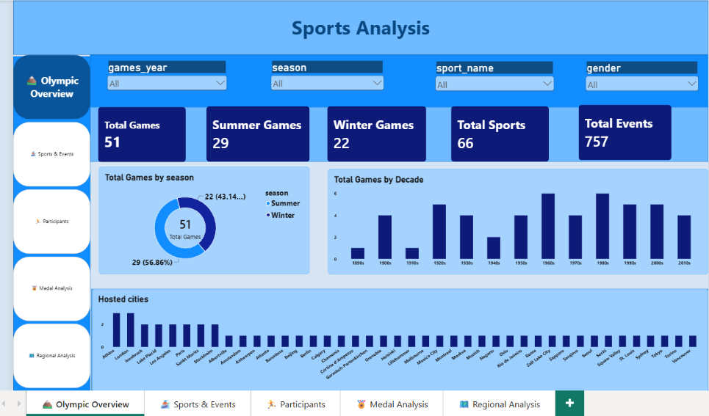
Page 1: Olympic Overview
What it shows
Total Games, Summer and Winter Games, sports and events, plus Games by season, by decade and hosted cities.
Slicers
games_year, season, sport_name, gender
Answers
Q1, Q2 and Q3
Notes:
Overview page: five KPI cards, season donut, decade column chart and hosted cities chart.

Slide 29
Overview insights (Q1 to Q3)
Games held in each season
Visual
Q1
51 Games in total: 29 Summer (56.86%) and 22 Winter (43.14%). Summer is the larger half of the Games.
Donut: Total Games by season
Distribution of Games by decade
Visual
Q2
The 1960s and 1980s have the most Games (6 each). The 1890s and 1910s have only 1 each, and the 1940s have 2 because of the wars.
Column chart: Total Games by Decade
Cities that hosted the most Games
Visual
Q3
Athens and London lead with 3 each. Innsbruck, Lake Placid, Los Angeles, Paris, St. Moritz and Stockholm hosted twice; the rest once.
Column chart: Hosted cities
Notes:
Q1 to Q3 are answered by the overview page.

Slide 30
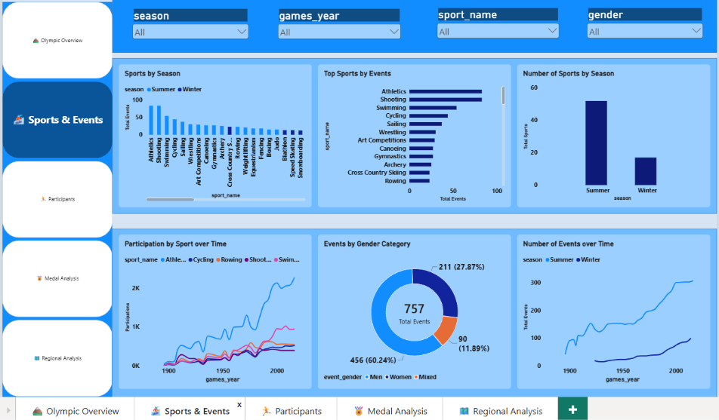
Page 2: Sports and Events
What it shows
Which sports have the most events, how participation changed over time and how events split by season and gender.
Slicers
season, games_year, sport_name, gender
Answers
Q4 to Q9
Notes:
Sports and Events page: six charts covering sports, events, gender and trends over time.

Slide 31
Sports and events insights (Q4 to Q6)
Distribution of sports: Summer vs Winter
Visual
Q4
About 52 sports are Summer and about 17 are Winter (read from the chart). The total of 66 is lower because a few sports, like Figure Skating, appear in both.
Column chart: Number of Sports by Season
Sports with the most events
Visual
Q5
Athletics and Shooting lead with roughly 80 events each, followed by Swimming (about 55), Cycling and Sailing.
Bar chart: Top Sports by Events
How participation in each sport evolved
Visual
Q6
Athletics grew steeply to about 2.3K athletes in 2016. Swimming reached about 940, and Rowing, Cycling and Shooting about 500.
Line chart: Participation by Sport over Time
Notes:
Chart values read from the screenshot are approximate (marked "about").

Slide 32
Sports and events insights (Q7 to Q9)
Events in each sport
Visual
Q7
Large sports hold many events (Athletics 83, Swimming 54) while small sports have only a few. Winter sports (dark bars) sit at the lower end of the chart.
Column chart: Sports by Season (events)
Events by gender
Visual
Q8
757 events: Men 456 (60.24%), Women 211 (27.87%) and Mixed 90 (11.89%). Men's events are more than double women's.
Donut: Events by Gender Category
How events changed over time
Visual
Q9
Summer events rose from about 40 in 1896 to about 300 by 2016 and have been flat since 2000. Winter events rose from about 17 to about 98.
Line chart: Number of Events over Time
Notes:
Q7 uses Athletics 83 events (27 women + 56 men) and Swimming 54 (18 women + 36 men) from the EDA.

Slide 33
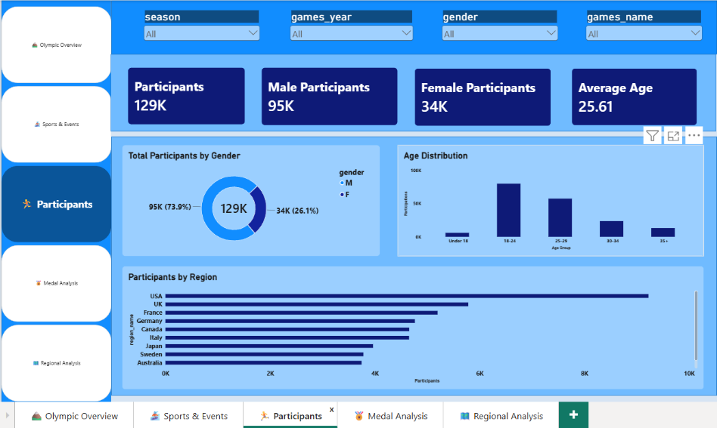
Page 3: Participants
What it shows
Gender split, age distribution and the regions that send the most athletes, with average age.
Slicers
season, games_year, gender, games_name
Answers
Q10, Q11 and Q12
Notes:
Participants page: four KPI cards plus gender, age and region charts.

Slide 34
Participants insights (Q10 to Q12)
Participants by gender
Visual
Q10
129K participants: 95K men (73.9%) and 34K women (26.1%). About three of every four athletes are men.
Donut: Total Participants by Gender
Countries with the most participants
Visual
Q11
The USA leads by a wide margin (about 9K), then the UK (about 5.8K) and France (about 5.2K). Germany, Canada and Italy follow.
Bar chart: Participants by Region
Age distribution across Games
Visual
Q12
Average age is 25.61. The 18-24 and 25-29 groups hold roughly three quarters of participations. Under 18 and 35+ are small.
Column chart: Age Distribution
Notes:
Age distribution counts participations, so the bars add up to more than 129K participants.

Slide 35
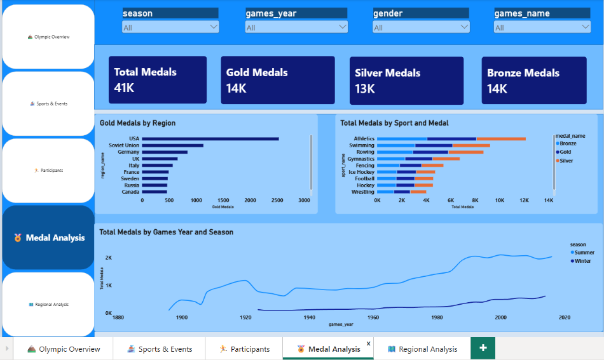
Page 4: Medal Analysis
What it shows
Total, Gold, Silver and Bronze medals, medals by region and sport, and medals by Games year and season.
Slicers
season, games_year, gender, games_name
Answers
Q13, Q14 and Q15
Notes:
Medal page: four KPI cards and three charts.

Slide 36
Medal insights (Q13 to Q15)
Medals awarded in each Olympics
Visual
Q13
41K medals in total (Gold 14K, Silver 13K, Bronze 14K). Summer Games now award about 2K each, Winter Games about 0.6K.
Line chart: Total Medals by Games Year and Season
Countries with the most gold medals
Visual
Q14
The USA leads with about 2.5K golds, then the Soviet Union (about 1.1K), Germany, the UK and Italy.
Bar chart: Gold Medals by Region
Medal distribution across sports
Visual
Q15
Athletics leads with about 12K medals, then Swimming (about 9K), Rowing, Gymnastics and Fencing. Gold, Silver and Bronze are split almost evenly.
Stacked bar: Total Medals by Sport and Medal
Notes:
Medals are counted per athlete, so team events inflate team sports.

Slide 37
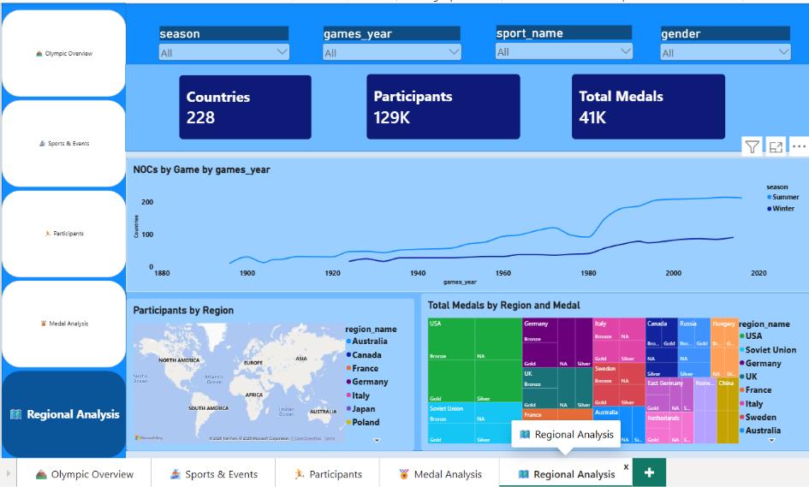
Page 5: Regional Analysis
What it shows
Number of regions per Games, participants by region on a map, and medals by region and medal type.
Slicers
season, games_year, sport_name, gender
Answers
Q16, Q17 and Q18
Notes:
Regional page: three KPI cards, a line chart, a map and a treemap.

Slide 38
Regional insights (Q16 to Q18)
Regions (NOCs) in each Games
Visual
Q16
228 regions in total. Summer Games have had over 200 regions each since the 1990s; Winter Games reached about 90.
Line chart: NOCs by Game
Regions with the most participants
Visual
Q17
The USA sends the most athletes (about 9K), then the UK, France, Germany and Canada. The map shows where athletes come from.
Map: Participants by Region
Distribution of medals among regions
Visual
Q18
The USA holds the largest block (5,414 medals), then the Soviet Union and Germany. The top 10 regions hold 52% of all medals.
Treemap: Total Medals by Region and Medal
Notes:
Q18 shares come from the EDA: top 10 regions hold 21,240 of 40,537 medals.

Slide 39
What the insights suggest
1
Hosting
2
Sport selection
Choose host cities from more regions. Only Athens and London have hosted 3 times, so hosting is concentrated.
Keep core sports, review very low-participation sports and add events that attract many regions.
3
Gender balance
4
Regional representation
Add women's and mixed events. Women have 211 events against 456 for men, and 26% of athletes.
Support regions with low participation or no medals, for example through qualification routes.
Notes:
These recommendations come from the insights and should be validated with more data before decisions are made.

Slide 40
Conclusion
Growth
Concentration
Opportunity
51 Games, 129K participants and 228 regions show how far the Olympics have grown since 1896.
The USA leads medals, and 10 regions hold 52% of all medals.
Women are 26% of athletes and 28% of events, and Winter participation is concentrated in a few regions.
Thank you
Notes:
To close: the Games have grown, the medal table is concentrated, and there is room to improve gender balance and regional reach.

