Slide 1
Barriers to Mental Health Treatment Access: An Analysis of 2023 NSDUH Data
Dana Moua, Jayashree Kanukollu, Isha Jain

Slide 2
Introduction
Mental health includes our….
Emotional, psychological, and social well-being.
Affects how we think, feel, and act
Helps determine how we handle stress and make choices.
We used NSDUH data to further analyze this topic.
Notes:
We chose this data because we wanted to further analyze the numerous factors that may influence our mental health, and see whether

Slide 3
NSDUH Data
NSDUH stands for National Survey on Drug Use and Health
What is the Data?
Effectiveness of the Data!!
NSDUH is a nationally-representative, annual survey of the U.S. population.
“The large size of the NSDUH sample and the richness in measures… allow us to develop high-quality predictive models (Bobashev et al.).”
The sample is selected using a multistage area probability sampling method.
Participants include civilian, non-institutionalized individuals aged 12 or older from the 50 U.S. States and the District of Columbia (Farokhina et al.).
Notes:
https://link.springer.com/article/10.1186/s12913-021-06221-w
https://www.sciencedirect.com/science/article/pii/S2772724623000847

Slide 4
Previous studies using this data
This data has been used to….
Examine how demographics, substance use, mental and other health indicators predict multiple visits to emergency departments within a year (Bobashev et al.).
How lifetime use of alcohol and cannabis changes for each additional year of age during adolescence, and whether this change varies by sex and race/ethnicity (Farokhina et al.). .

Slide 5
Important Variables
AGE3: Recode - Final Edited Age
1 = Respondent is 12 or 13 years old
2 = Respondent is 14 or 15 years old
3 = Respondent is 16 or 17 years old
4 = Respondent is between 18 and 20 years old
5 = Respondent is between 21 and 23 years old
6 = Respondent is 24 or 25 years old
7 = Respondent is between 26 and 29 years old
8 = Respondent is between 30 and 34 years old
9 = Respondent is between 35 and 49 years old
10 = Respondent is between 50 and 64 years old
11 = Respondent is 65 years old or older
CATAG3: RC-Age Category Recode (5 Levels)
1 = 12-17 Years Old
2 = 18-25 Years Old
3 = 26-34 Years Old
4 = 35-49 Years Old
5 = 50 or Older
CATAGE: RC-AGE CATEGORY
1 = 12-17 Years Old
2 = 18-25 Years
3 = 26-34 Years
4 = 35 or Older
KSSLR6MONED: K6 Total Score In Past Month (level of psychological distress over the past 30 days)
RANGE = 0 - 24
. = Aged 12-17 or missing
ANYHLTI2: Covered By Any Health Insurance - Recode
1 = Yes
2 = No
94 = DON'T KNOW
97 = REFUSED
98 = OTHER MISSING
IRINSUR4: Rc-Overall Health Insurance - Imputation Revised
1 = Yes, respondent is covered by health insurance
2 = No, respondent is not covered by health insurance
AMDEYR: (ADULT) PAST YEAR MAJOR DEPRESSIVE EPISODE (MDE)
. = Aged 12-17/Unknown (Otherwise)
1 = Yes (AMDELT=1 & ADPB2WK=1)
2 = No (AMDELT=2 or [AMDELT=1 & ADPB2WK=2])
INCOME: RC-TOTAL FAMILY INCOME RECODE
1 = Less than $20,000
2 = $20,000 - $49,999
3 = $50,000 - $74,999
4 = $75,000 or More
MHTRTPY: Rc-Rcvd Mental Health Treatment - Past Year
0 = No (All source variables=0)
1 = Yes (Any source variable=1)

Slide 6
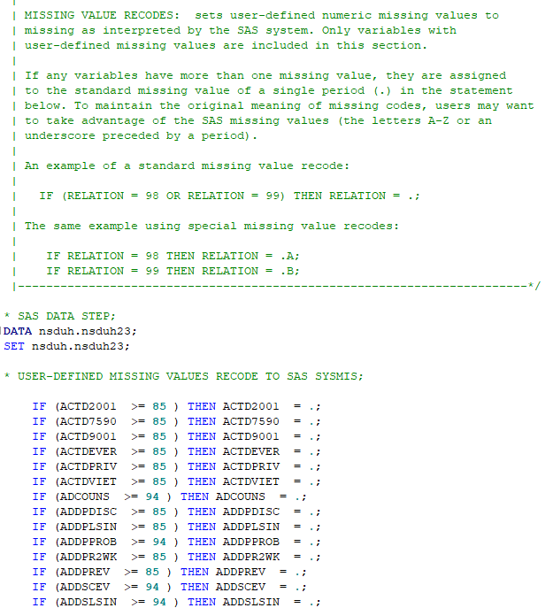
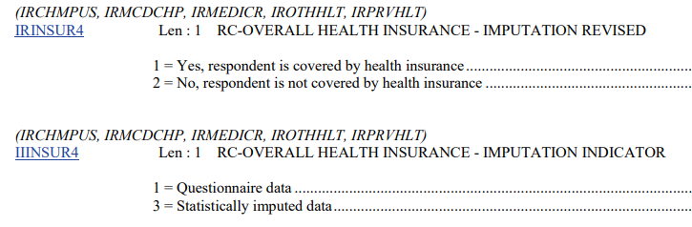

Handling missing data
Supplemental Syntax:
Re-coded missing data
Assigned labels and formats to variables
NSDUH imputes missing data, it fills in missing responses but only for selected variables and only in standardized ways.
IR - Imputation Revised
II - Imputation Indicator value

Slide 7
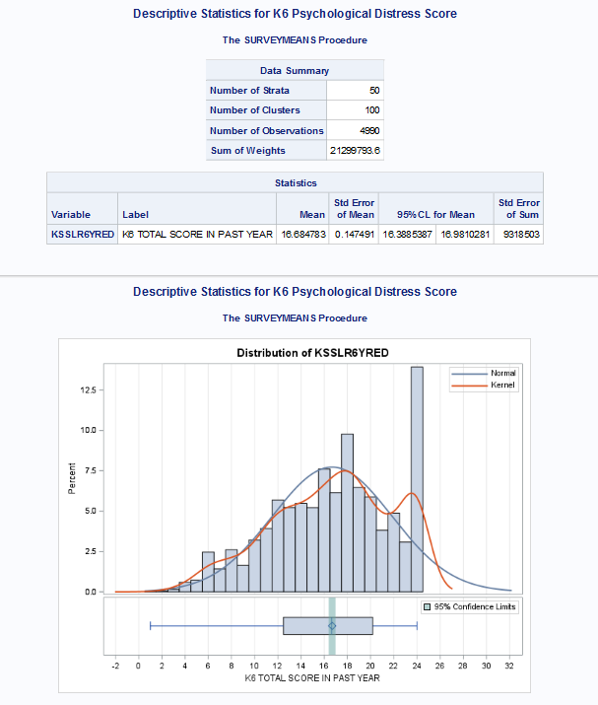
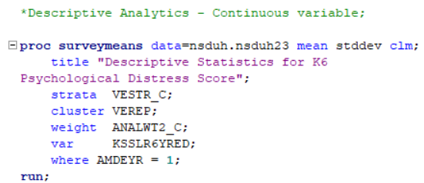
Descriptive Statistics - Continuous Variable
According to 2023 NSDUH data, what is the average K6 psychological distress score (in the past year) among adults who experienced a major depressive episode in the past year?
Code:
Interpretation:
The average K6 psychological distress score among adults who reported a ‘worst month’ in the past year was 16.68, indicating a high level of psychological distress consistent with serious mental health impairment.

Slide 8
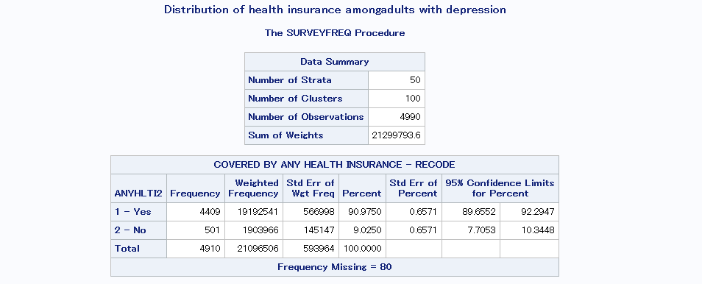
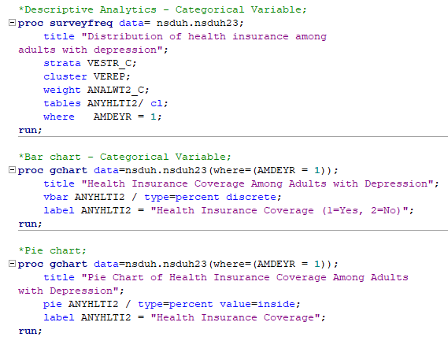
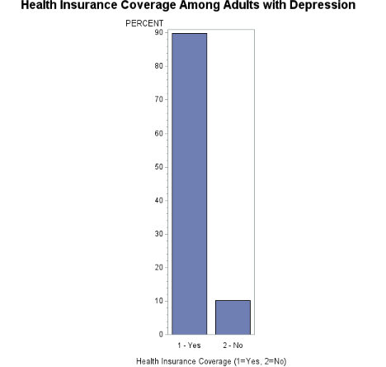
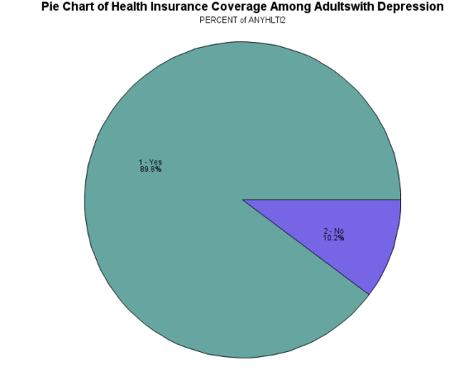
Descriptive Statistics - Categorical Variable
What is the distribution of health-insurance coverage among adults with a past-year major depressive episode (MDE)?
Code:
Interpretation:
About 91% of adults who experienced a major depressive episode in the past year had health insurance coverage, while roughly 9% were uninsured.

Slide 9
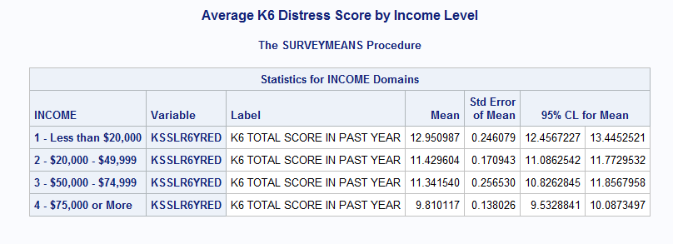
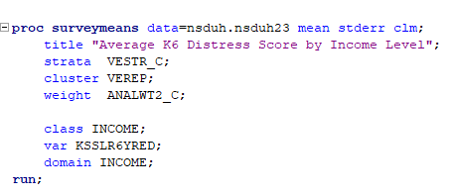
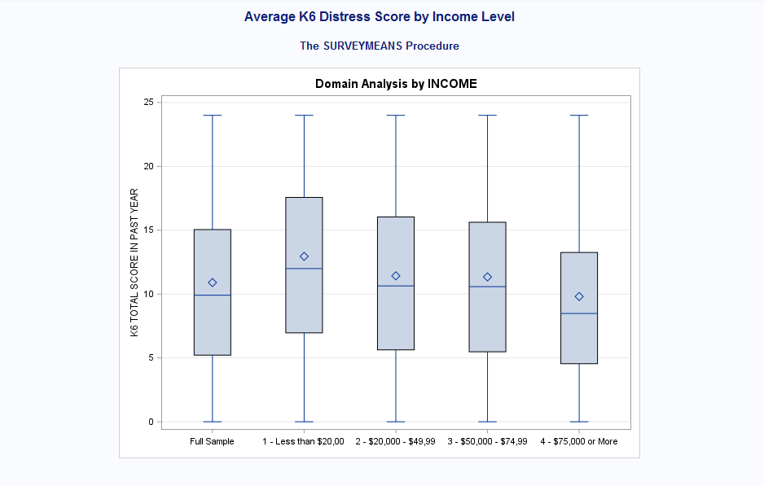
Descriptive Statistics - Continuous by categorical
How does K6 psychological distress vary across income levels among adults in the NSDUH?
Code:
Interpretation:
Psychological distress levels tended to be higher among adults in lower income groups. Adults earning less than $20,000 had the highest average distress score (12.95), while those earning $75,000 or more had the lowest (9.81).
The boxplot also shows that lower-income groups have higher medians and wider variability, suggesting greater emotional distress and more uneven mental health within financially strained populations.

Slide 10
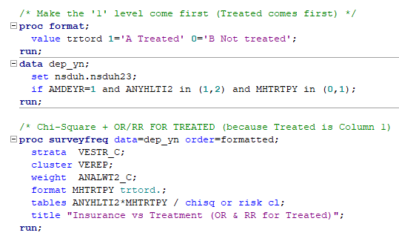
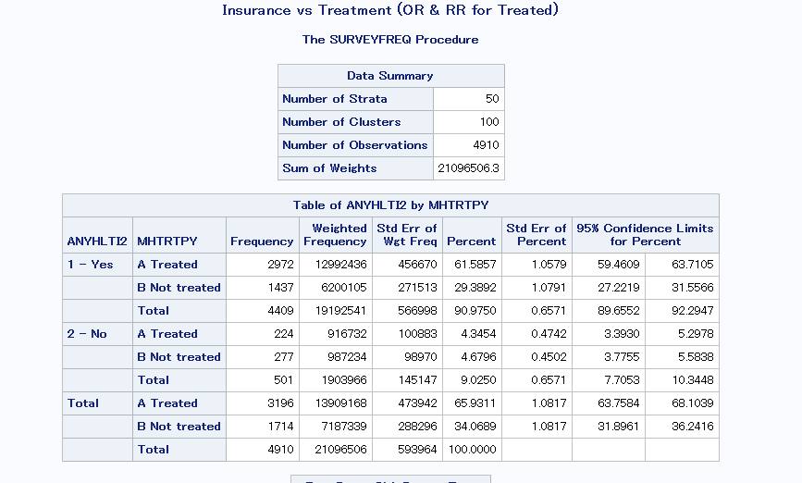
Chi Square Test
Is there an association between having health insurance and receiving mental-health treatment among adults with depression?

Slide 11
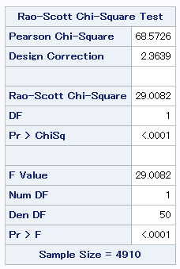
Chi Square Test
Is there an association between having health insurance and receiving mental-health treatment among adults with depression?
Interpretation:
The p value for the chi square test is significantly lower than 0.05 with a value of p<0.0001
This means that we can reject the null hypothesis that insurance status and treatment are independent and accept the alternate hypothesis that there is an association between insurance and treatment.

Slide 12
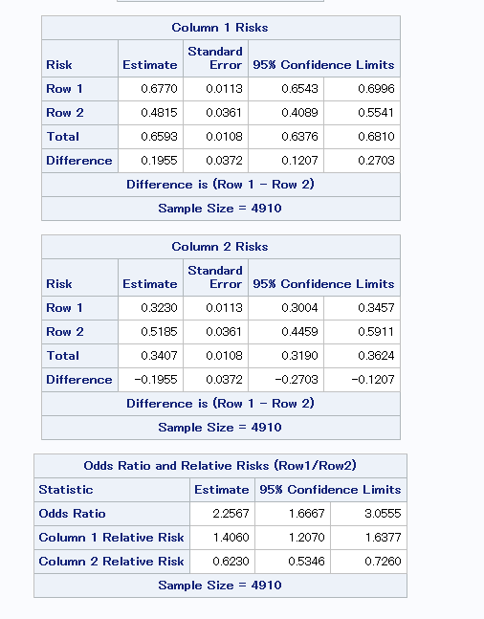
Chi Square Test
Is there an association between having health insurance and receiving mental-health treatment among adults with depression?
Interpretation:
Relative Risk:
0.6770/0.4815 = 1.406
Insured adults are about 1.41× as likely to receive treatment than uninsured adults. (Roughly 40% more likely to receive treatment.)
Odds Ratio = 2.2567
That means the odds of receiving treatment are about 2.3× higher for insured vs uninsured adults.

Slide 13
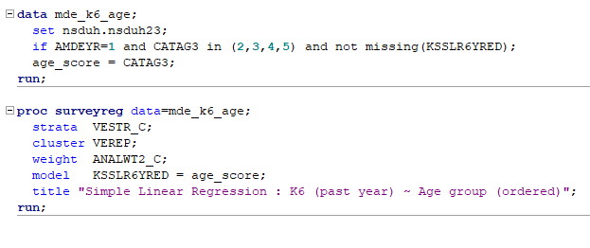
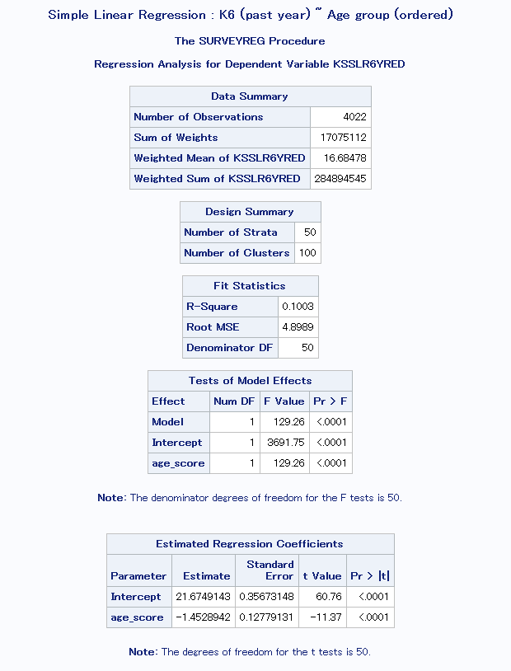
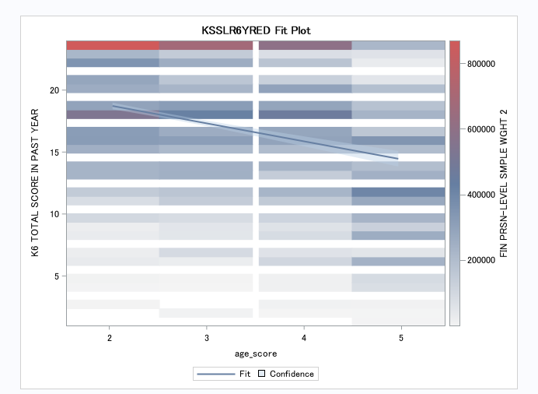
Simple Linear Regression
For adults with a past-year MDE, how much does past-year K6 change with age?
Code:
Interpretation:
After accounting for the NSDUH design, older adults with a past-year MDE report lower K6 distress. Each higher age category corresponds to ~1.45 fewer K6 points (p<0.0001).
Age alone explains about 10% of K6 variability; the fit plot shows a clear downward trend with age.”

Slide 14
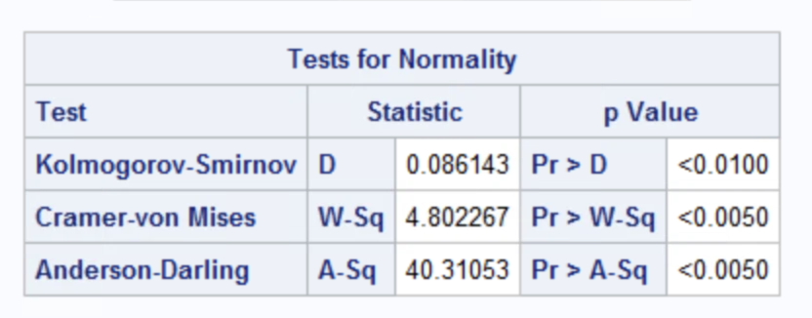
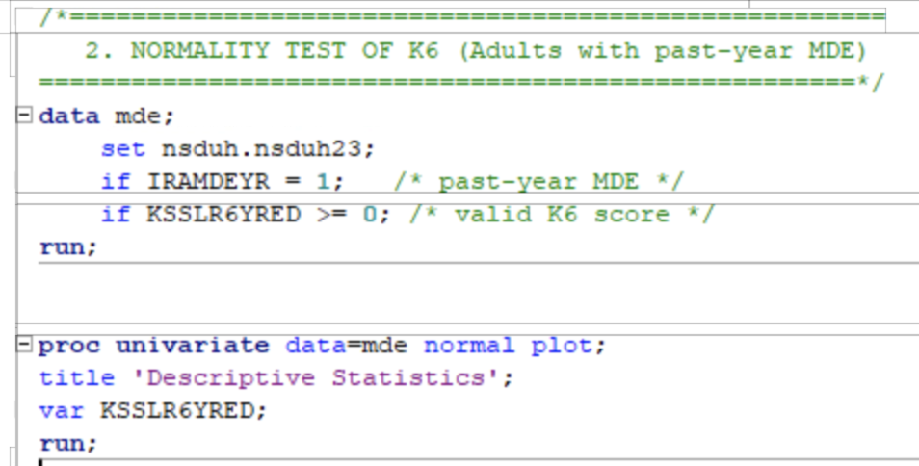
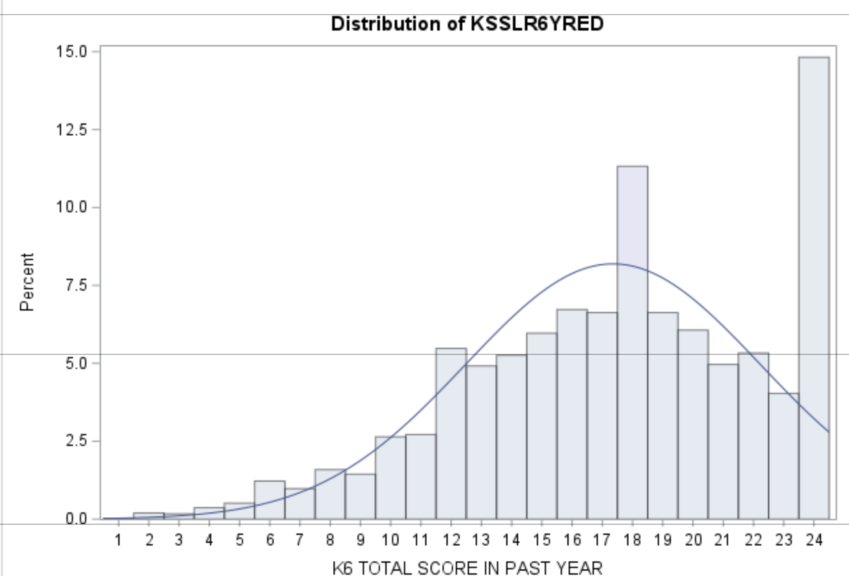
Test of Normality
Is the distribution of K6 total score (past year) approximately normal among adults with a past-year MDE?
Code:
Interpretation:
The distribution of K6 psychological distress scores among adults with a past-year MDE is significantly non-normal, indicating that distress levels are heavily skewed. This suggests that individuals with past-year MDE tend to report consistently high distress, rather than a mix of low, moderate, and high scores.
Notes:
The K6 (Kessler Psychological Distress Scale) total score ranges from 0 to 24, with higher scores indicating greater psychological distress, screening for severe mental illness. MDE is looking at major depressive order.
The p-values in this table are for testing the null hypothesis that the AGE variable is normally distributed. In this case, all three tests indicate an issue with normality since the p-values for all three tests are all <0.05. That is, we reject the null hypothesis (normal) and accept the alternate hypothesis (non-normal).

Slide 15
Independent t-test
Is there a difference in K6 distress scores between adults who did receive MH treatment and those who did not?
Two-sample t-test (also called independent samples t-test)
Compares the difference between the 'means' of two groups while
taking their variance or distribution into account.
Notes:
Key assumptions underlying the two-sample t-test are
1. random samples are independent
2. populations are normally distributed with equal variances
3. If the data are non-normal, then nonparametric tests such as the Mann-Whitney U test are available

Slide 16
Independent t-test
Is there a difference in K6 distress scores between adults who did receive MH treatment and those who did not?
Population parameters:
μ1 = K6 scores for adults who did receive MH treatment
μ2 =K6 scores for adults who did not receive MH treatment
∗ H0: μ2 = μ1
∗ H1: μ2 ≠ μ1
Notes:
Key assumptions underlying the two-sample t-test are
1. random samples are independent
2. populations are normally distributed with equal variances
3. If the data are non-normal, then nonparametric tests such as the Mann-Whitney U test are available

Slide 17
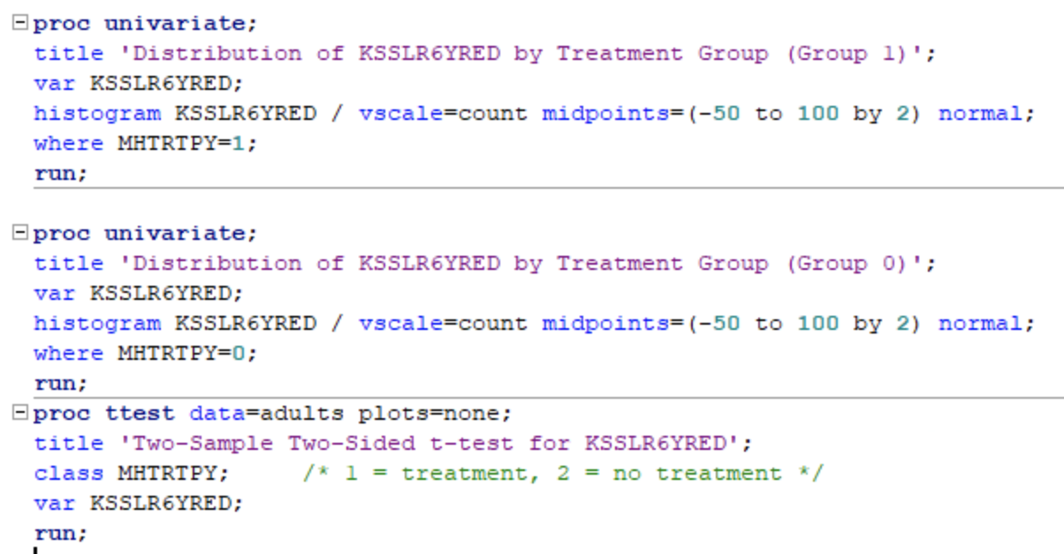
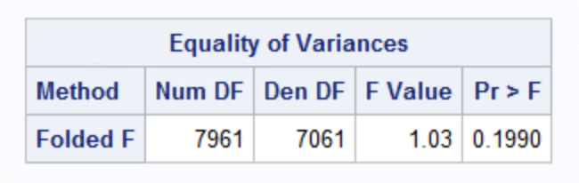
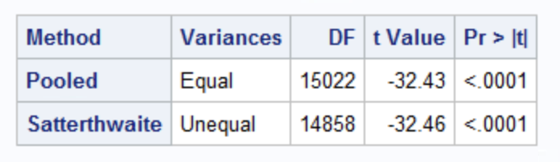
Independent t-test
Is there a difference in K6 distress scores between adults who did receive MH treatment and those who did not?
Code:
Step 1: High p-value indicates variances are equal
Step 2: Use Pooled t-test
class represents grouping variable
P-value is small enough to reject the null hypothesis and conclude that there is a difference in means
Notes:
Key assumptions underlying the two-sample t-test are
1. random samples are independent
2. populations are normally distributed with equal variances
3. If the data are non-normal, then nonparametric tests such as the Mann-Whitney U test are available

Slide 18
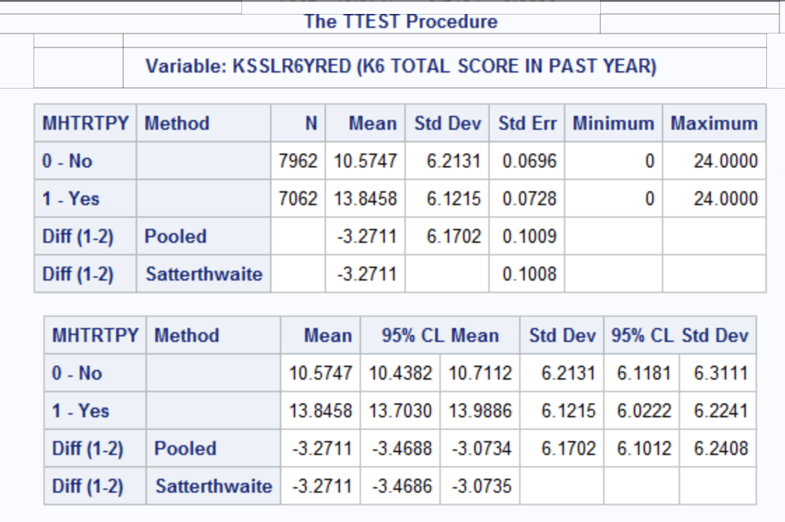
Independent t-test
Is there a difference in K6 distress scores between adults who did receive MH treatment and those who did not?
Interpretation:
There is statistical evidence that the
two groups of adults have
different K6 scores based on MH treatment since p=<.0001.
The 95% CI for the difference in means is:
(-3.4688, -3.0734). Since the CI does not cross 0, the results are statistically
significantly different.
Notes:
An independent samples t-test was conducted to compare K6 psychological distress scores among adults who did and did not receive mental-health treatment in the past year. The results indicated a statistically significant difference between the two groups (Satterthwaite t = −32.46, p < 0.0001). Adults who received treatment reported substantially higher distress (M = 13.85, SD = 6.12) compared to those who did not (M = 10.57, SD = 6.21). This suggests that individuals engaged in mental-health services tend to experience greater psychological distress, which is consistent with treatment-seeking patterns among people with elevated symptom burden.

Slide 19
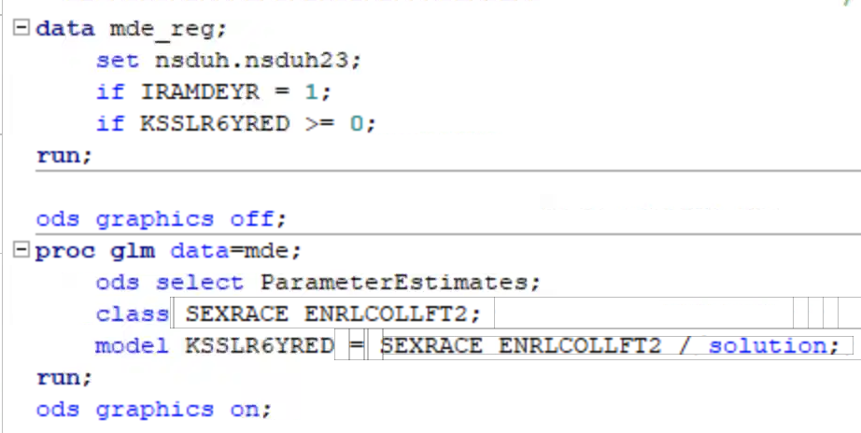
Multiple Regression
Which demographic and socioeconomic factors best predict psychological distress (past year) among adults with a past-year MDE?
Code:
Notes:
Use Proc GLM for regression when you want to use the class statement or to specify the reference level.
Summary of Findings
"We performed a multiple regression analysis using the GLM procedure in SAS with a large sample size of over 4,000 participants.
Significant Predictors:
When controlling for all other factors, five of the six variables we examined were statistically significant predictors of psychological distress: Marital Status, Age Category, Sex/Race, Self-Rated Health, and Enrollment Status.
Interestingly, IRSEX (Gender) was found not to be a unique, significant predictor when all other variables were included in the model.
Conclusion and Implication
"While many factors play a role, these results strongly suggest that, among adults with a past-year MDE, an individual's age and their self-perception of health are the most crucial demographic and socioeconomic factors distinguishing higher versus lower levels of psychological distress. Future research and targeted interventions should focus intensely on these two groups."

Slide 20
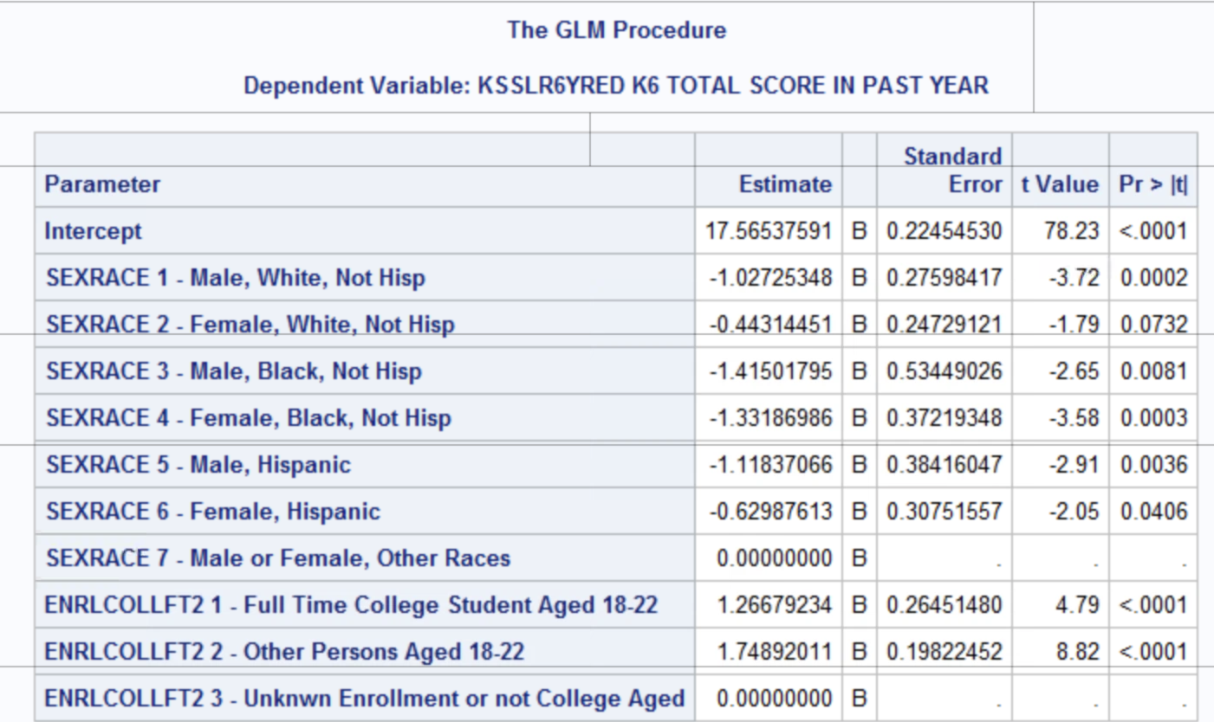
Multiple Regression
K6 score as a function of ethnicity and college level. The expected K6 Score for all other races (not White black or Hispanic), with unknown college experience or not college aged, is 17.6.
Expected score for college aged student men who are white:
17.6 -1.02+1.266= 17.85
Expected score for college aged non-students who are other races:
17.6+1.74=19.3
Interpretation is relative to the reference category

Slide 21
Multiple Regression
Interpretation:
All of the education categories are significantly associated with K6 scores (p<0.0001 for all).
Most ethnicity categories are significantly associated, with the exception being Black males, non-Hispanic (p-value 0.07).
Notes:
“In the multiple regression model, K6 scores were compared to the reference groups automatically chosen by SAS: individuals of Other races (SEXRACE=7) and Unknown Enrollment / Not College Aged (ENRLCOLLFT2=3). All education categories were significantly associated with K6 scores (p < 0.0001), with full-time college students showing higher scores relative to the reference. Most sex-race categories differed significantly from Other races, with the exception of Black males, who did not differ significantly (p = 0.07). These associations reflect differences relative to the reference groups, after adjusting for both sex-race and education.”

Slide 22
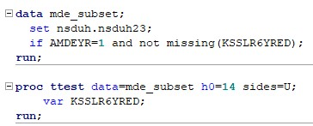
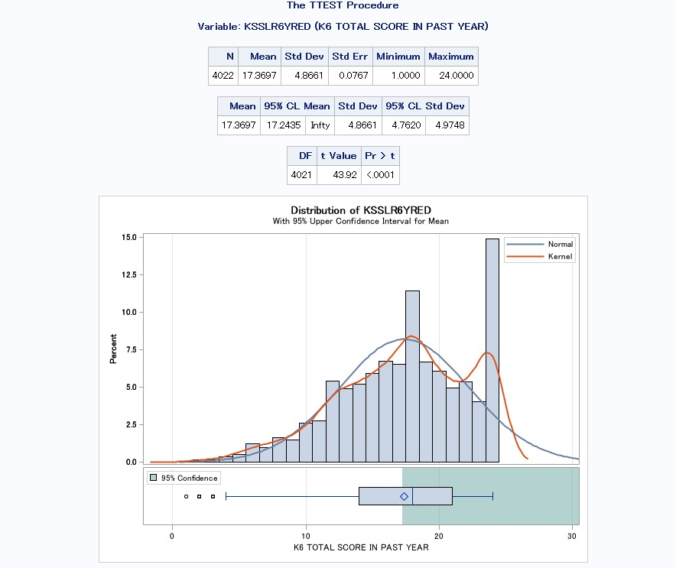
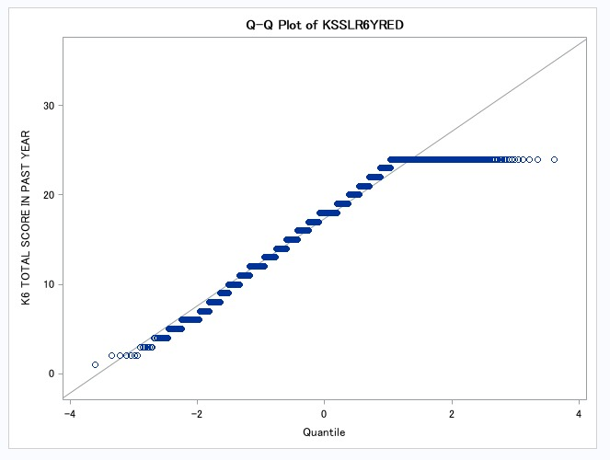
Hypothesis test for μ
Do adults with a past-year MDE have a mean K6 total score (past year) greater than 14? (H0: μ = 14)
Interpretation:
The mean psychological distress score (K6) among adults with a past-year Major Depressive Episode (MDE) was significantly higher than 14, the benchmark value.
This conclusion is supported by the very large t-value (43.92) and the extremely small p-value (< 0.0001), indicating strong statistical evidence that psychological distress is elevated in this population.
Notes:
Here, I tested whether adults with a past-year Major Depressive Episode have a mean K6 psychological distress score greater than 14.
-After subsetting the data to include only adults with MDE, the t-test showed a mean score of about 17.37. The t-value was very large, and the p-value was less than 0.0001.
-This tells us the mean distress level is significantly higher than 14.
- The graphs support this by showing the distribution and confirming that the normality assumption is reasonable.
-Overall, adults with past-year MDE experience elevated psychological distress, and the results are statistically strong

Slide 23

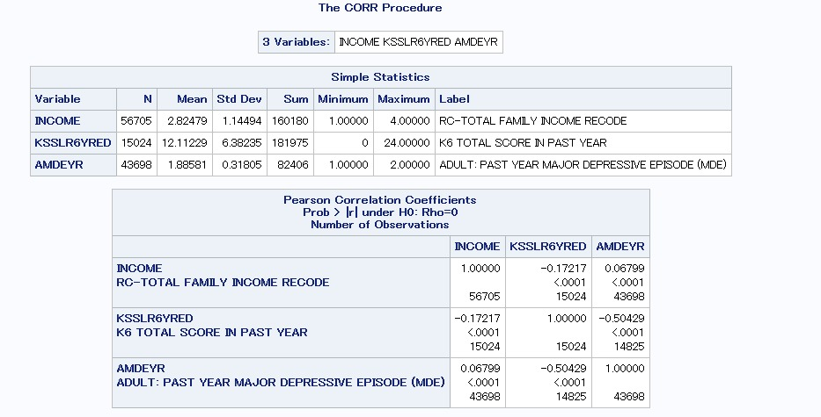
Correlation
What is the relationship between family income and psychological-distress severity (past year) among adults with a past-year MDE?
Interpretation:
Income showed a small negative correlation with psychological distress (K6), indicating that individuals with lower family income tend to report slightly higher distress.
K6 scores also displayed a moderate negative correlation with past-year MDE (AMDEYR), meaning individuals with higher psychological distress were more likely to have experienced a Major Depressive Episode.
All correlations were statistically significant (p < .0001), showing that these relationships, though varying in strength, are meaningful within the 2023 NSDUH data.

Slide 24
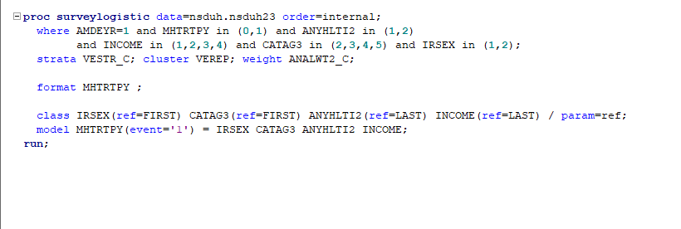
Logistic Regression
Which demographic and socioeconomic factors predict the likelihood of receiving mental-health treatment among adults with a past-year MDE (2023 NSDUH)?

Slide 25
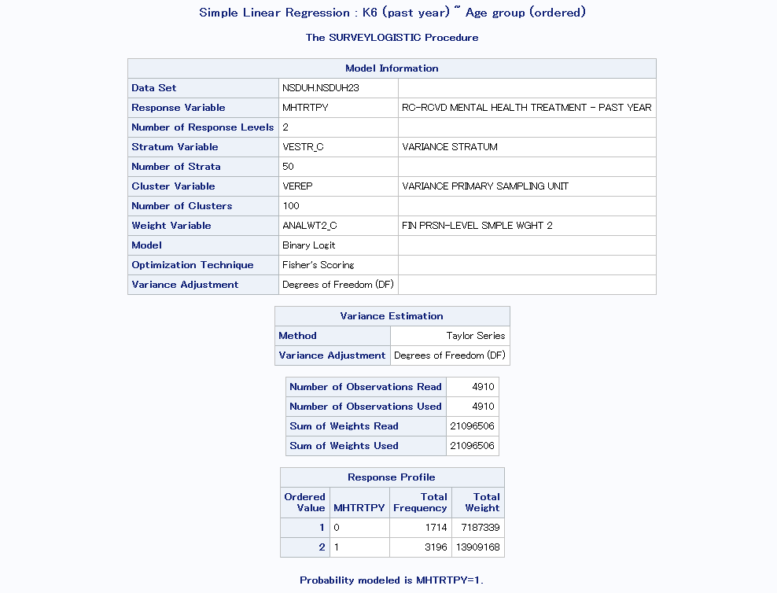
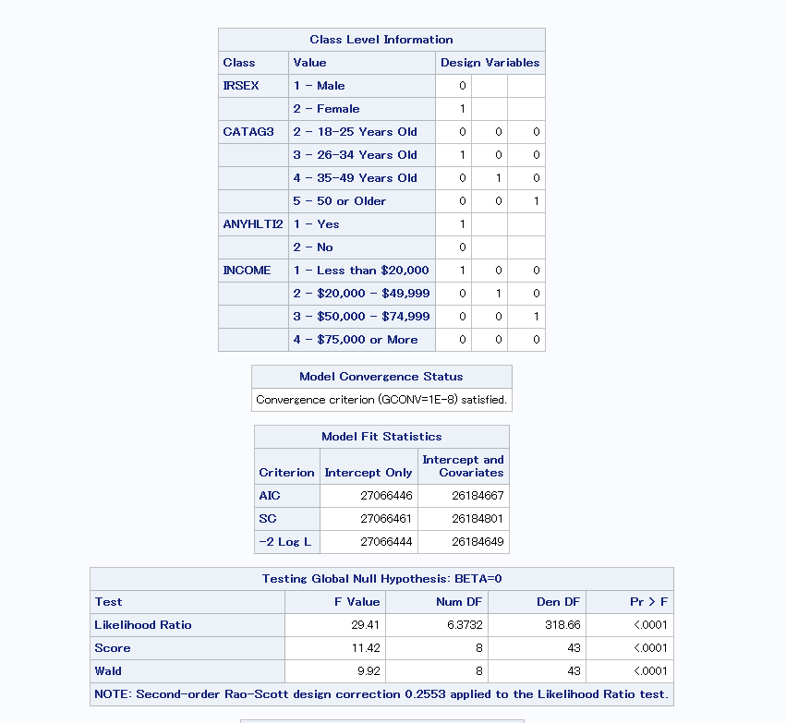
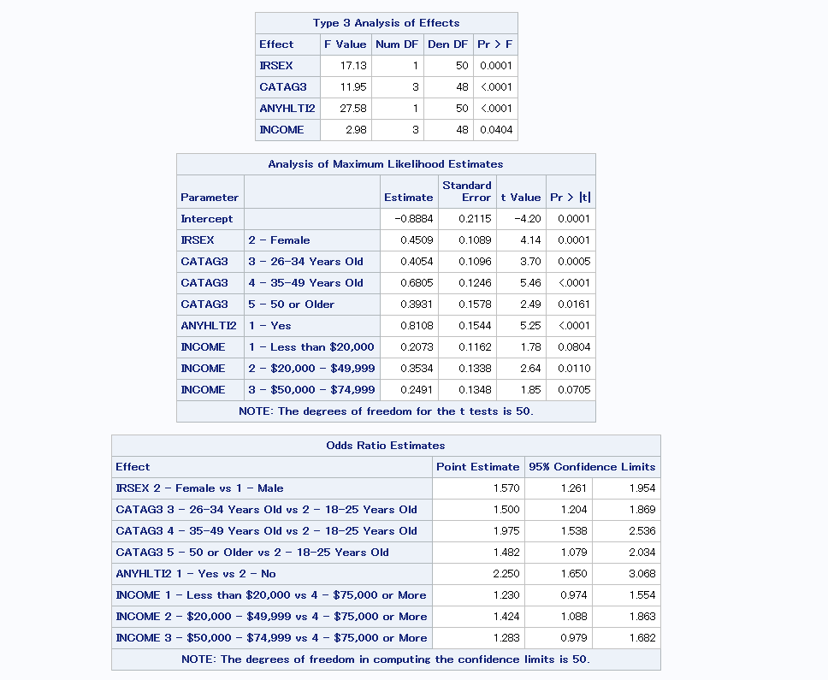
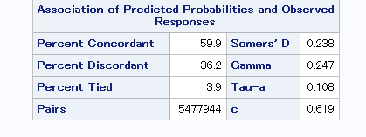

Slide 26
Interpretation:Females and older adults were more likely to receive mental-health treatment than younger males.
Having health insurance greatly increased the likelihood of receiving treatment.
Lower and middle income groups showed slightly higher treatment use than the highest-income group.
All predictors were statistically significant, and the model showed moderate predictive ability (c = 0.619).

Slide 27
CONCLUSION
Summary of What We Learned About the Data
The dataset provided meaningful insights into mental-health patterns among U.S. adults, including psychological distress levels, socioeconomic characteristics, and treatment behaviors.
Individuals with a past-year Major Depressive Episode (MDE) showed substantially higher K6 distress scores than those without MDE.
Income and psychological distress demonstrated a measurable relationship, suggesting socioeconomic factors influence mental well-being.
Logistic regression revealed that demographic and health variables (such as age group, sex, chronic health conditions, income, and MDE status) play significant roles in predicting whether someone receives mental-health treatment.

Slide 28
Critique of Methods & Suggestions for Improvement
Some variables required additional cleaning or recoding to improve model interpretability and reduce noise in the analysis.
The dataset is large and complex; more thorough exploratory data analysis could strengthen the quality of insights.
A more refined selection of predictor variables could improve the logistic regression model fit and predictive accuracy.
Future analysis should test assumptions (normality, linearity, independence) more rigorously before choosing statistical methods.

Slide 29
What I Would Do Differently or Next Steps if Continuing the Analysis
Explore more detailed subgroup analyses (e.g., distress levels within income brackets, differences by age).
Include additional variables such as insurance status, education, employment, region, or trauma history to enrich the prediction model.
Try alternative modeling approaches (decision trees, random forests, gradient boosting) to compare against logistic regression.
Develop clearer visualizations or dashboards to communicate findings to broader audiences.

Slide 30
What We Found Most Interesting and Most Challenging
Enjoyable / Interesting:
Seeing real-world patterns in mental-health treatment and understanding the role socioeconomic status plays.
Working with a nationally representative dataset that mirrors real public-health research.
Discovering how predictive analytics can reveal underlying relationships that aren’t obvious at first glance
How features of a complex survey design (like weighting or clustering) require specialized procedures in SAS

Slide 31
Challenging:
Importing and managing the large SAS transport files and navigating the variable coding structure.
Understanding the complexity of multi-category variables and health-related survey measures.
Selecting appropriate statistical methods and ensuring the assumptions were met for each test.

Slide 32
REFERENCES
Bobashev, G., Warren, L., & Wu, L.-T. (2021). Predictive model of multiple emergency department visits among adults: analysis of the data from the National Survey of Drug Use and Health (NSDUH). BMC Health Services Research, 21(1). https://doi.org/10.1186/s12913-021-06221-w
Mehdi Farokhnia, Harris, J. C., Speed, S. N., Leggio, L., & Johnson, R. M. (2024). Lifetime use of alcohol and cannabis among U.S. adolescents across age: Exploring differential patterns by sex and race/ethnicity using the 2019 NSDUH data. Drug and Alcohol Dependence Reports, 10, 100214–100214. https://doi.org/10.1016/j.dadr.2023.100214
‌
‌

Slide 33
THANK YOU

Slide 34
Appendix 1
Source of your dataset:
2023 National Survey on Drug Use and Health (NSDUH): https://www.samhsa.gov/data/data-we-collect/nsduh-national-survey-drug-use-and-health/datafiles
Brief overall description of the data:
The NSDUH is a yearly survey of people in the U.S. aged 12 and older that looks at their use of tobacco, alcohol, prescription drugs, and other substances. It also gathers detailed information on mental health, substance use disorders, and access to treatment.

Slide 35
Appendix 2
Tasks assigned to each team member
Isha: Introduction
Variables
Test of normality
Independent t-test
Multiple regression
Dana:Cleaning and handling the data
Descriptive statistics (continuous, categorical, continuous by categorical)
Chi square test
Simple Linear Regression
Jayashree: Hypothesis test
Correlation
Logistic regression
Conclusion

Slide 36
Appendix 3
We were able to cover all topics within the allotted Presentation time

