Slide 1
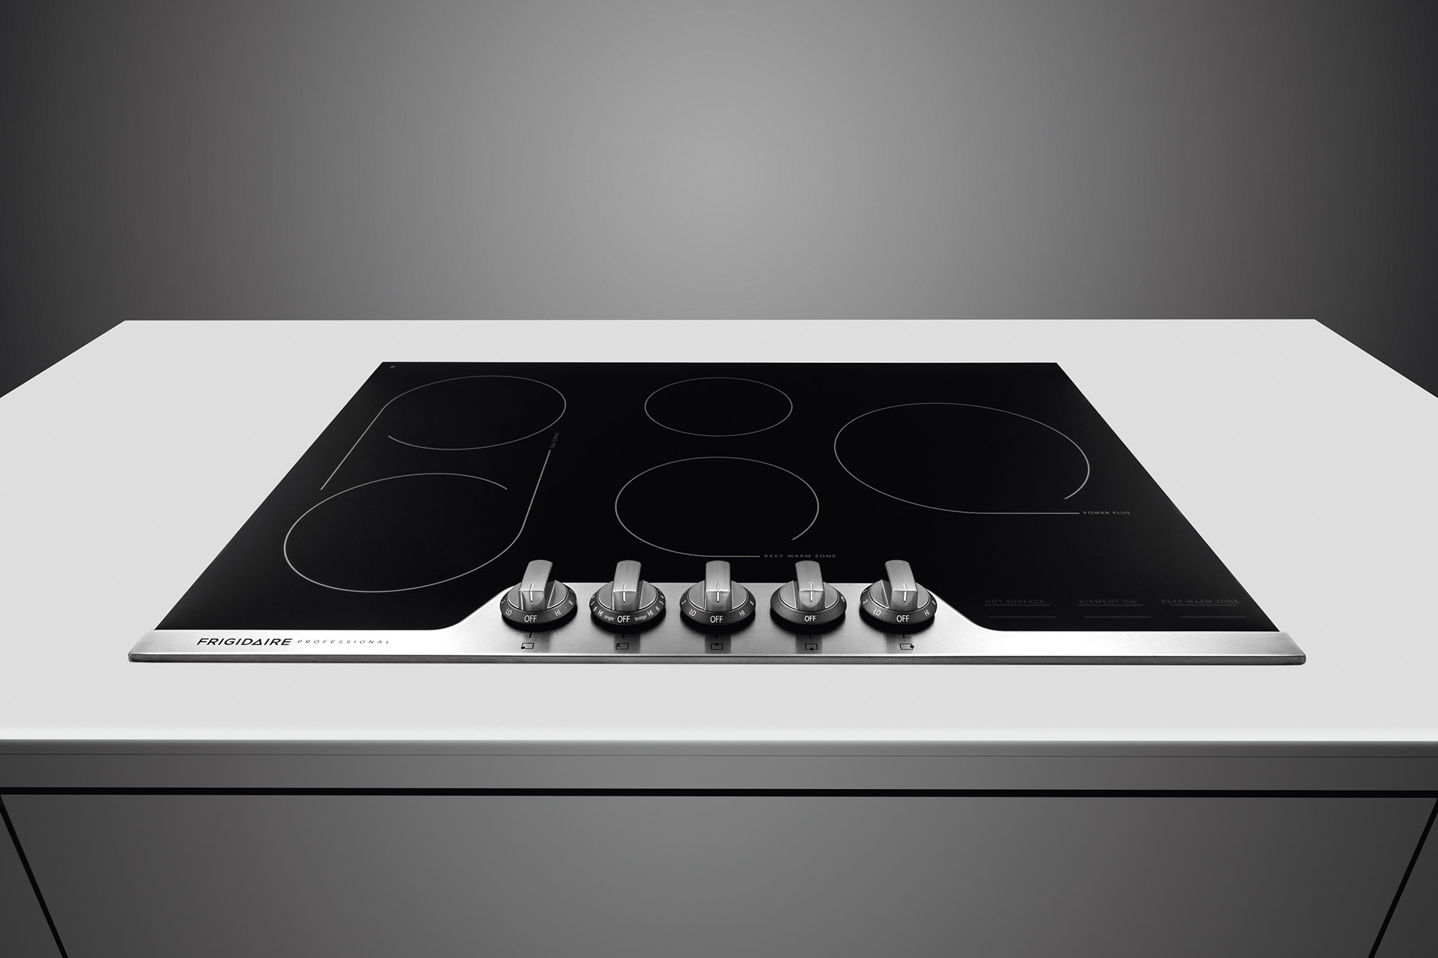
SMART STOVE | CDAC Bangalore
Presented By
Jayashree Lakshmi

Slide 2
Contents
Existing Situation
Proposed Solution
Architecture Block Diagram

Slide 3
Existing Situation
Kitchen is a major part of the home which is having several utilities. Cooking being a multitask requires a certain level of skill and precision, also kitchen is an environment where safety is a prime concern. There is still lot of scope to improve users comfort and safety in this environment.
If un-monitored there is a chance of hazardous situations because of overheating
There are very few fail safe mechanisms in case of smoke or gas detection
Refilling the gas is a major concern for the kitchen user

Slide 4
Proposed Solution
Smart Stove
Indication of burner status to the user when away from home.
Control of stove knob from mobile apps.
Monitor the amount of gas used. This data can be used for automatic refilling and give energy usage report to the user.
Automatic shut down of the stove in case of smoke detection.

Slide 5
System Components
Optical sensors can be used to detect the mechanical position of the knob.
Motor and gear units can be used to control the knob.
Digital gas flow meters can be used to record the amount of gas consumed and to regulate the gas flow.
Smoke detectors can be used to detect smoke in the kitchen
Micronotroller will hold the control logic for the proposed solution and also relays the system data to the Wifi chip
Wifi chip collects the data from the MC and sends to the cloud in the form of TCP/IP packet

Slide 6

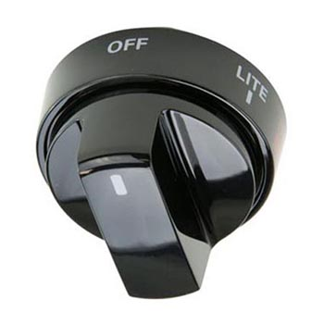

Architecture Block Diagram of Proposed System
Digital Gas Flow Meter
IOT Cloud
Stove Knob
Optical Sensor
Motor & Gear Unit
Microcontroller
Smoke Detector

Slide 7


