Slide 1

K MEANS ALGORITHM

Slide 2
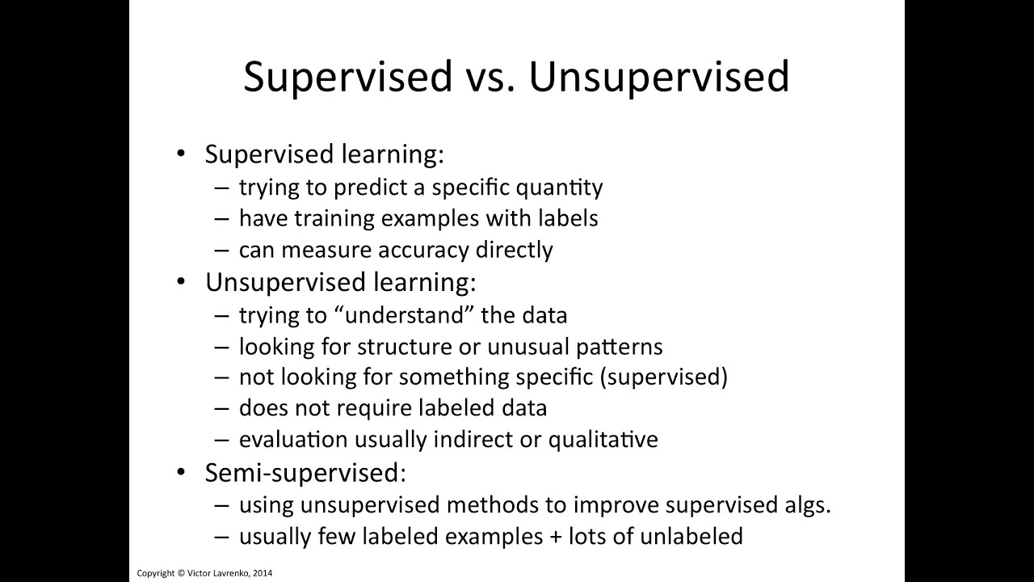

Slide 3
K-means algorithm
• Given k, the k-means algorithm works as follows:
1. Choose k (random) data points (seeds) to be the initial centroids, cluster centers
2. Assign each data point to the closest centroid
3. Re-compute the centroids using the current cluster memberships
4. If a convergence criterion is not met, repeat steps 2 and 3

Slide 4
The k-means algorithm is an algorithm to cluster n objects based on attributes into k partitions, where k < n.
K-means algorithm is the simplest partitioning method for clustering analysis and widely used in data mining applications.
Each cluster is represented by the center of the cluster and the algorithm converges to stable centroids of clusters.

Slide 5
K-means convergence (stopping) criterion
• no (or minimum) re-assignments of data points to different clusters, or
• no (or minimum) change of centroids, or

Slide 6
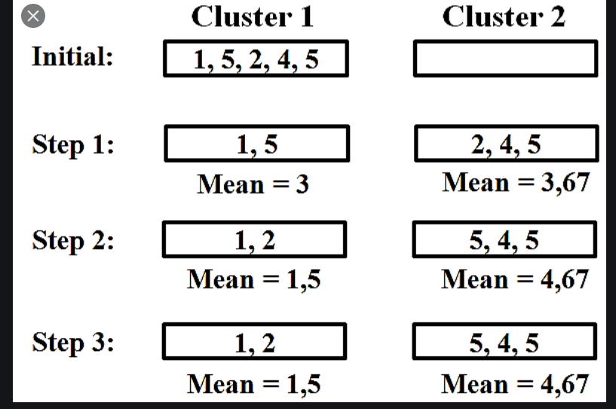

Slide 7
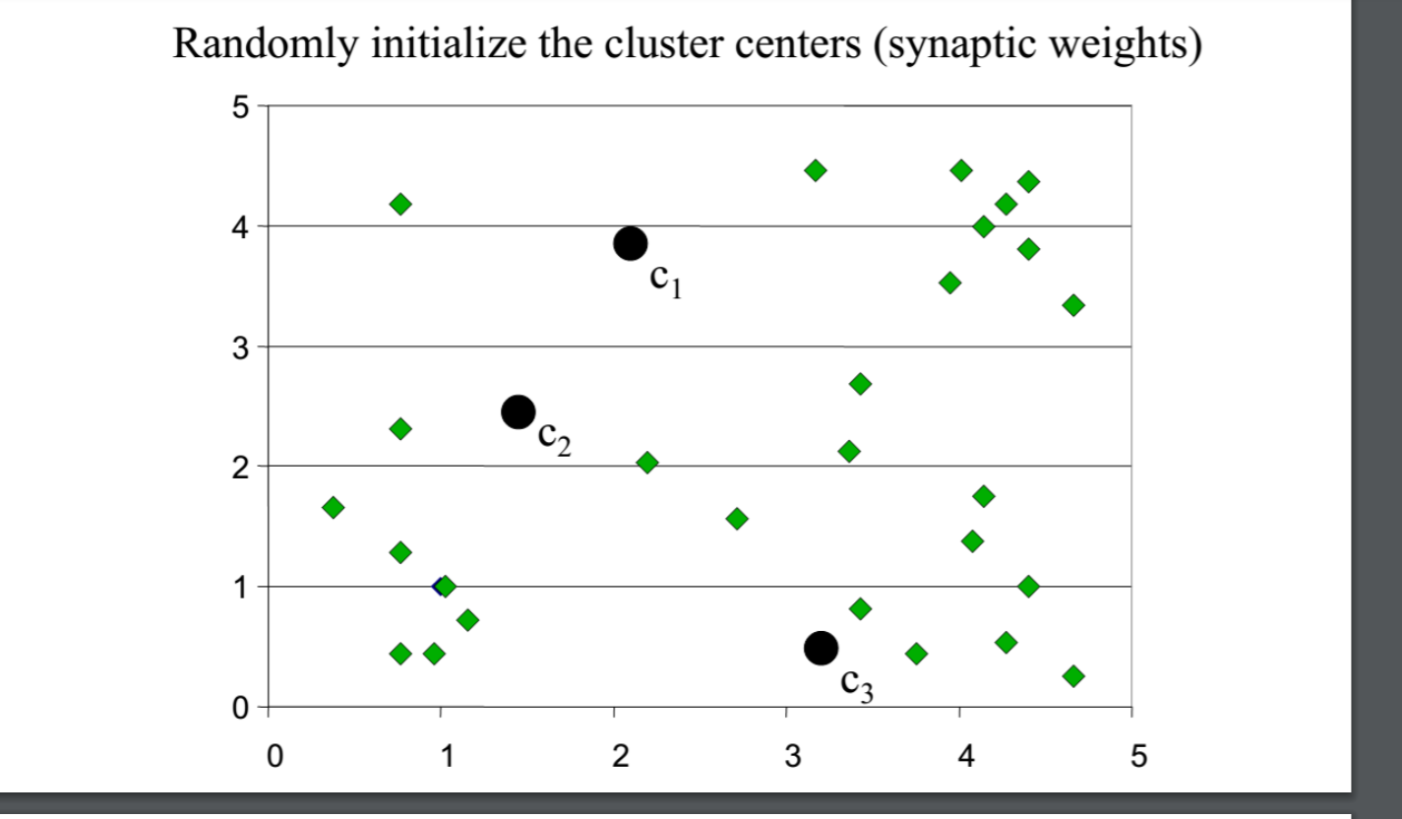
K-means clustering example: step 1

Slide 8
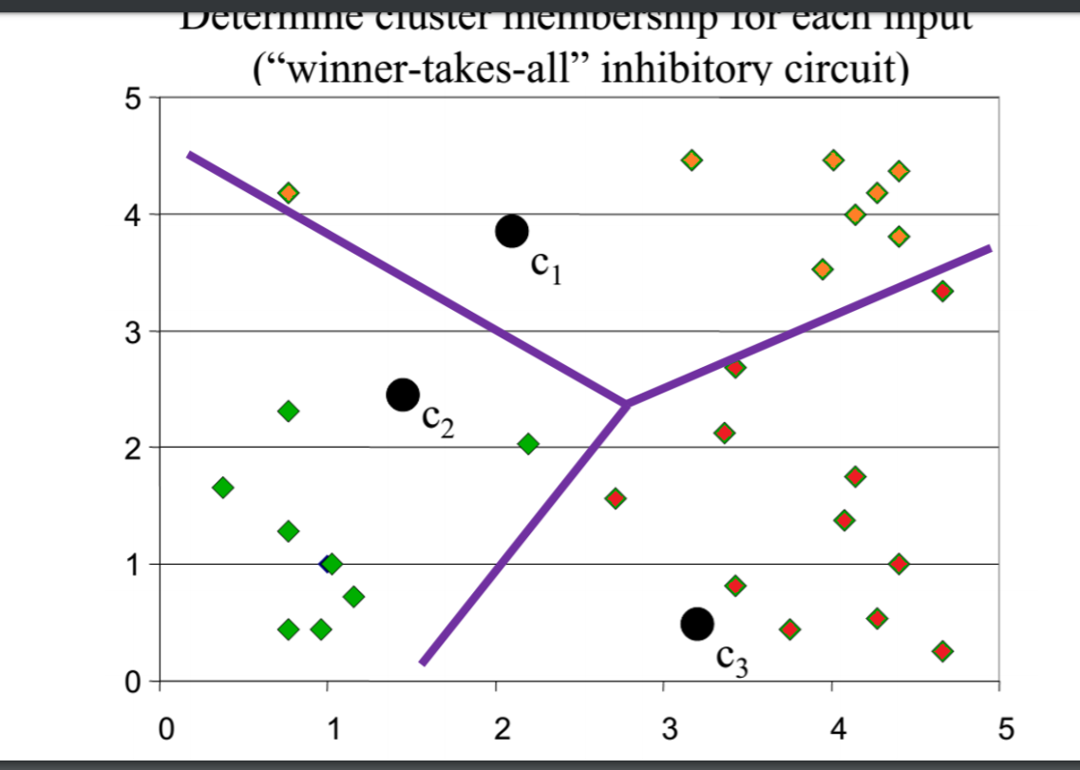
K-means clustering example – step 2

Slide 9
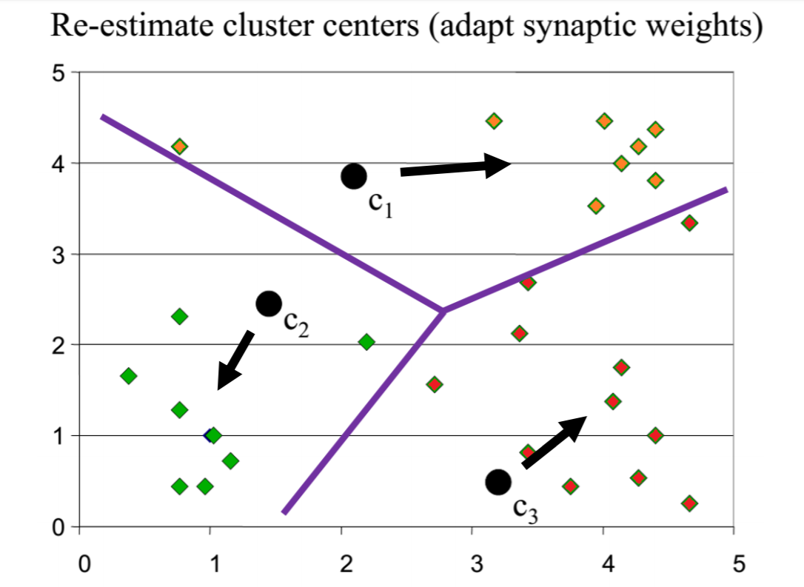
K-means clustering example – step 3

Slide 10
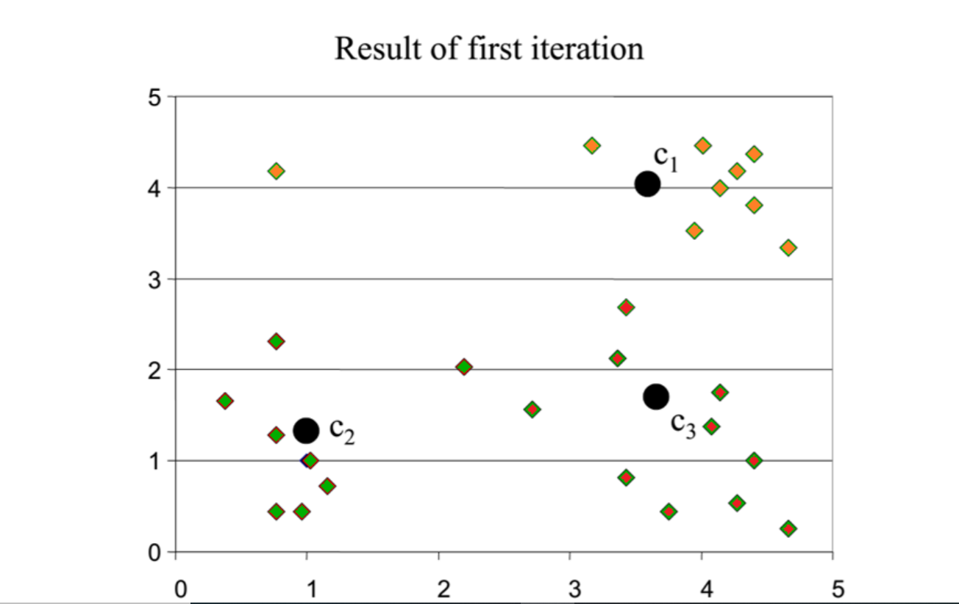
K-means clustering example

Slide 11
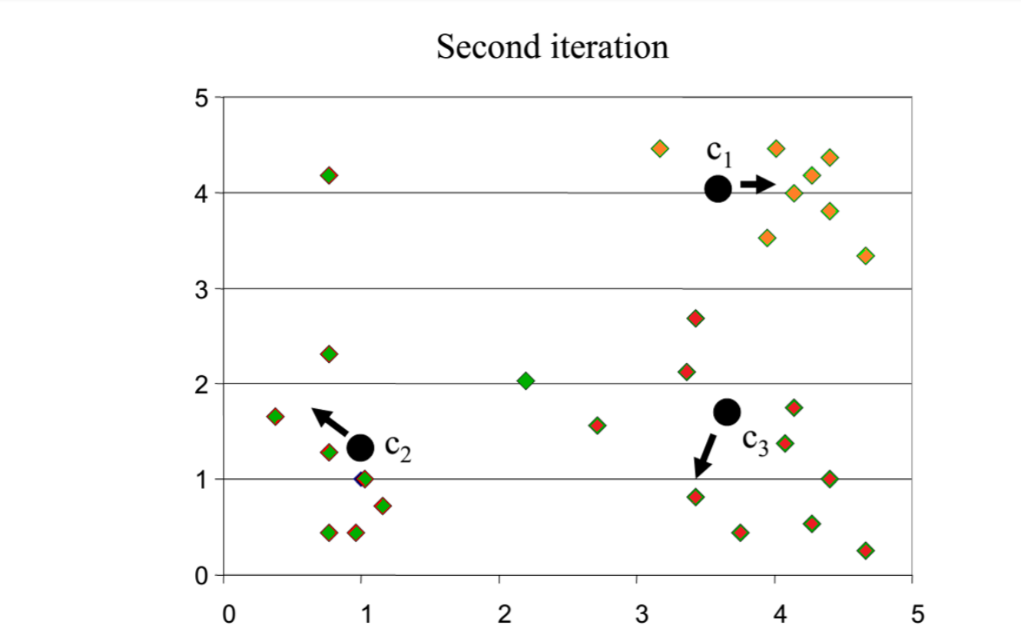
K-means clustering example

Slide 12
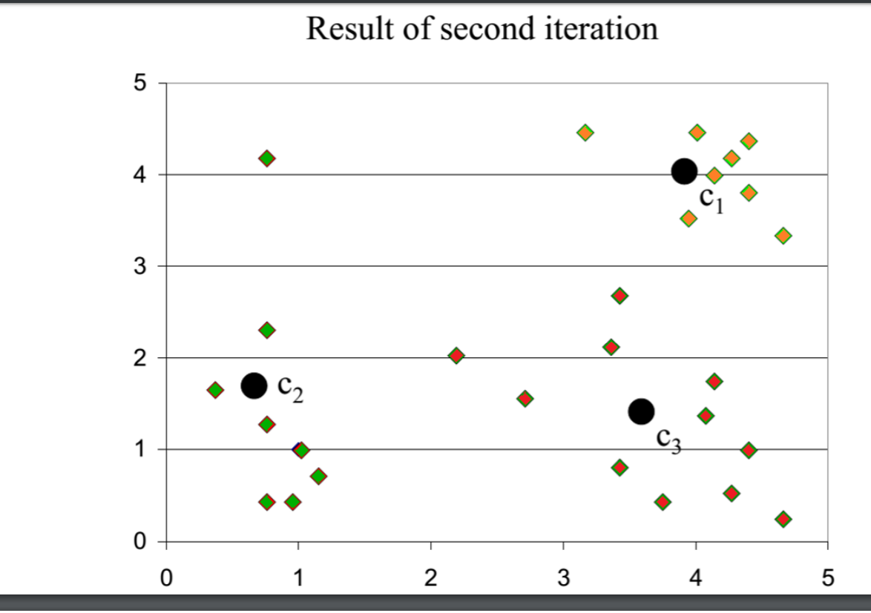
K-means clustering example

Slide 13
Why use K-means?
Strengths:
– Simple: easy to understand and to implement
– Efficient: Time complexity: O(tkn), where n is the number of data points, k is the number of clusters, and t is the number of iterations.
– Since both k and t are small. k-means is considered a linear algorithm.
• K-means is the most popular clustering algorithm. The global optimum is hard to find due to complexity.

Slide 14
Weaknesses of K-means
The algorithm is only applicable if the mean is defined.
For categorical data, k-mode ,the centroid is represented by most frequent values
The user needs to specify k.
The algorithm is sensitive to outliers
Outliers are data points that are very far away from other data points.
Outliers could be errors in the data recording or some special data points with very different values.

Slide 15
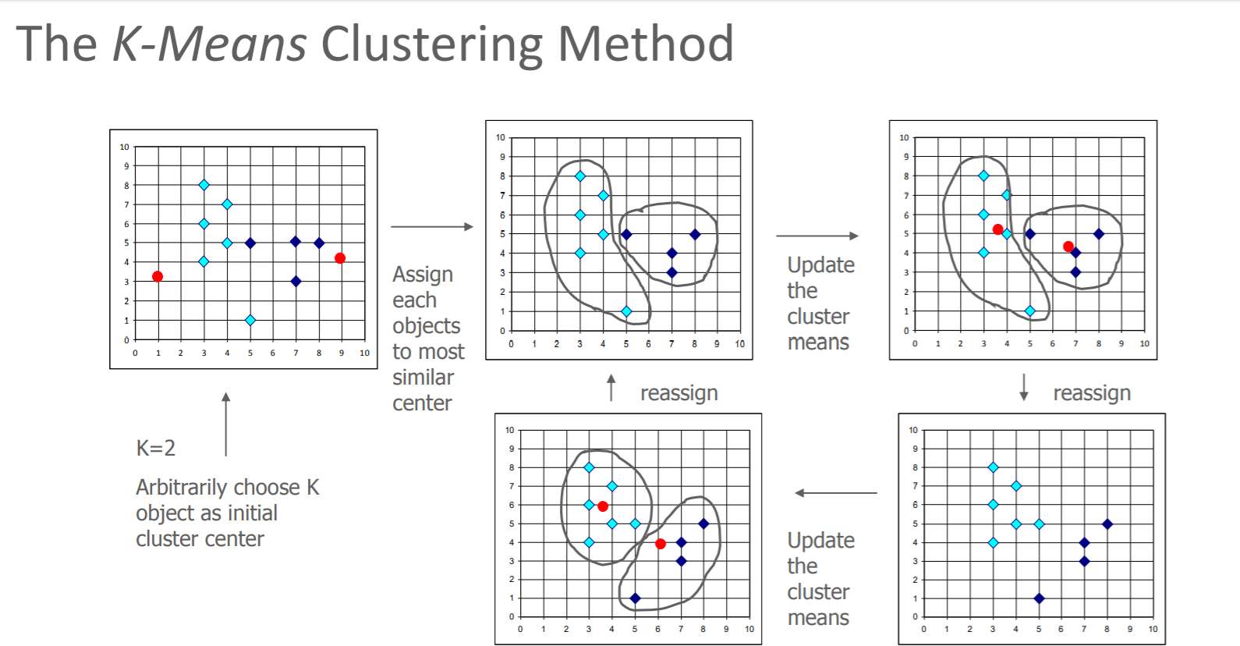

Slide 16
THANK YOU:

