Slide 1
PREDICTION OF RAINFALL USING MAMDANI INFERENCE SYSTEM
GUIDED BY : PROF. MONALISA MONDAL

Slide 2
Aim of the project
We have to determine the rainfall of a particular area by assuming the input to be temperature and wind speed with 3 input descriptors for input variables and rainfall is the output variable for which it has 3 descriptors. We have to derive the set of rules for controller action and defuzzification with a detailed figure by using fuzzy inference Rules. We had used Mamdani approach for the above description.

Slide 3
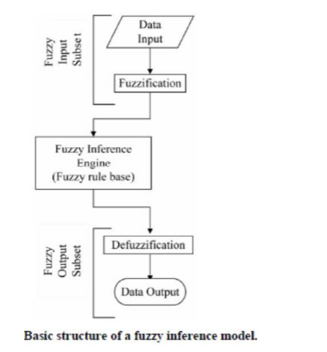
FUZZY INFERENCE SYSTEM
Fuzzy inference is the process of mapping with a given set of input and output through a set of fuzzy rules.
Two type of inference system
Mamdani inference method
Sugeno inference method

Slide 4
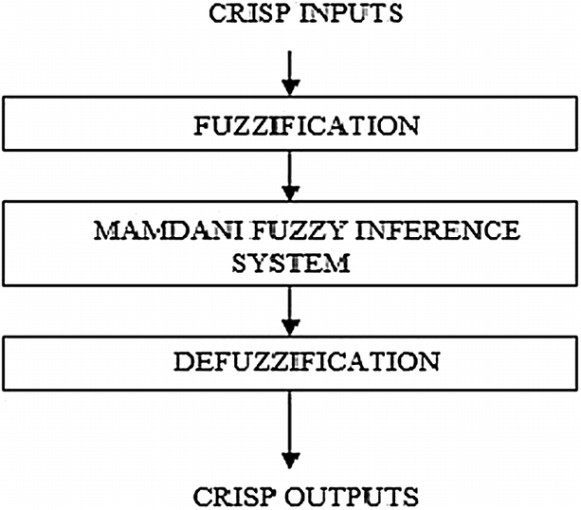
Mamdani inference method
This system was proposed in 1975 by Ebhasim Mamdani. Basically, it was anticipated to control a steam engine and boiler combination by synthesizing a set of fuzzy rules obtained from people working on the system.
Step 1 − Set of fuzzy rules need to be determined in this step.
Step 2 − In this step, by using input membership function, the input would be made fuzzy.
Step 3 − Now establish the rule strength by combining the fuzzified inputs according to fuzzy rules.
Step 4 − In this step, determine the consequent of rule by combining the rule strength and the output membership function.
Step 5 − For getting output distribution combine all the consequents.
Step 6 − Finally, a defuzzified output distribution is obtained.

Slide 5

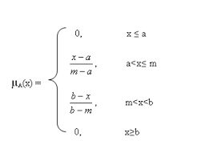
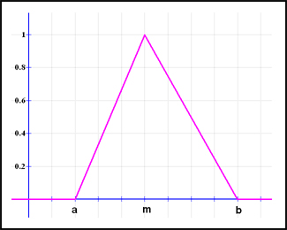
TRIANGULAR MEMBERSHIP FUNCTION
A membership function for a fuzzy set A on the universe of discourse X is defined as µ_{A}:X → [0,1], where each element of X is mapped to a value between 0 and 1. This value, called membership value or degree of membership, quantifies the grade of membership of the element in X to the fuzzy set A. Membership functions allow us to graphically represent a fuzzy set. The x axis represents the universe of discourse, whereas the y axis represents the degrees of membership in the [0,1] interval. Simple functions are used to build membership functions. Because we are defining fuzzy concepts, using more complex functions does not add more precision.
Triangular function is defined by a lower limit a, an upper limit b, and a value m, where a < m < b.

Slide 6
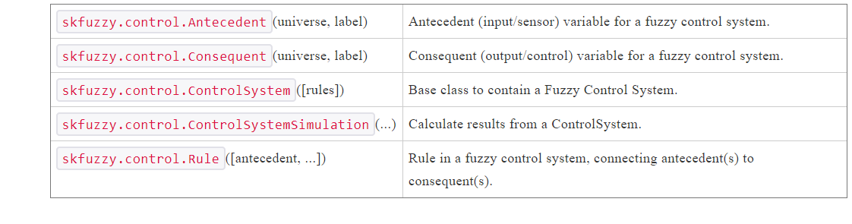
Skfuzzy subpackages

Slide 7
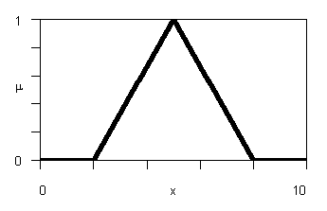
Code description:
Language used: python
Import packages:
import numpy as np
import skfuzzy as fuzz
from skfuzzy import control as ctrl
Input descriptors given
Temperature: poor , average , good
Wind speed: poor, average, good
Output descriptor
Rainfall- low, medium, high

Slide 8
Temperature and speed are input variables with 3 input descriptors and rainfall is output variable with 3 descriptors
temp = ctrl.Antecedent(np.arange(0, 11, 1), 'temp’)
Creates the antecedent(input) fuzzy variable that is temperature within a range from 0 to 10.
windspeed = ctrl.Antecedent(np.arange(0, 11, 1), 'windspeed’)
Creates the antecedent(input) fuzzy variable that is windspeed within a range from 0 to 10.
rainfall = ctrl.Consequent(np.arange(0, 26, 1), 'rainfall’)
creates the desired consequent(output) fuzzy variable that is rainfall within a range from 0 to 25.

Slide 9
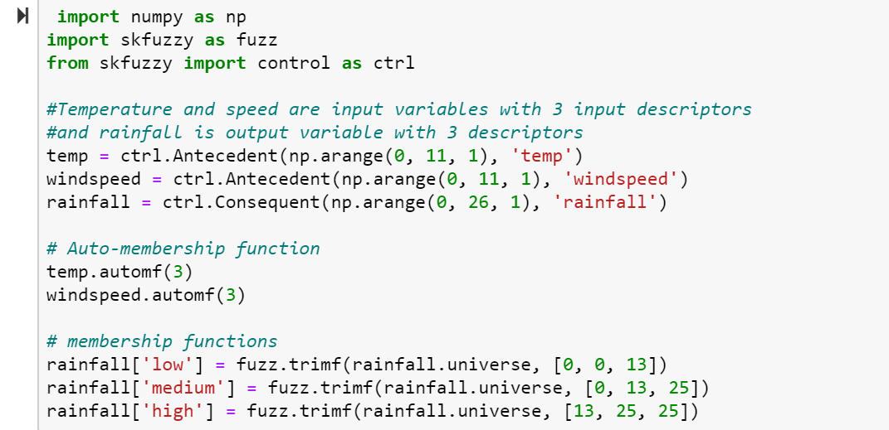
Auto-membership function population is possible with .automf(3, 5, or 7) and 3 is being chosen
temp.automf(3)
windspeed.automf(3)
Customs triangular membership functions(trimf) is built interactively with a familiar, Pythonic API.
rainfall['low'] = fuzz.trimf(rainfall.universe, [0, 0, 13])
rainfall['medium'] = fuzz.trimf(rainfall.universe, [0, 13, 25])
rainfall['high'] = fuzz.trimf(rainfall.universe, [13, 25, 25])

Slide 10
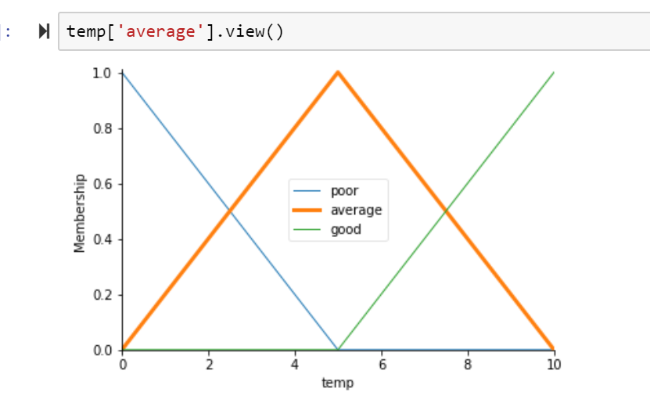
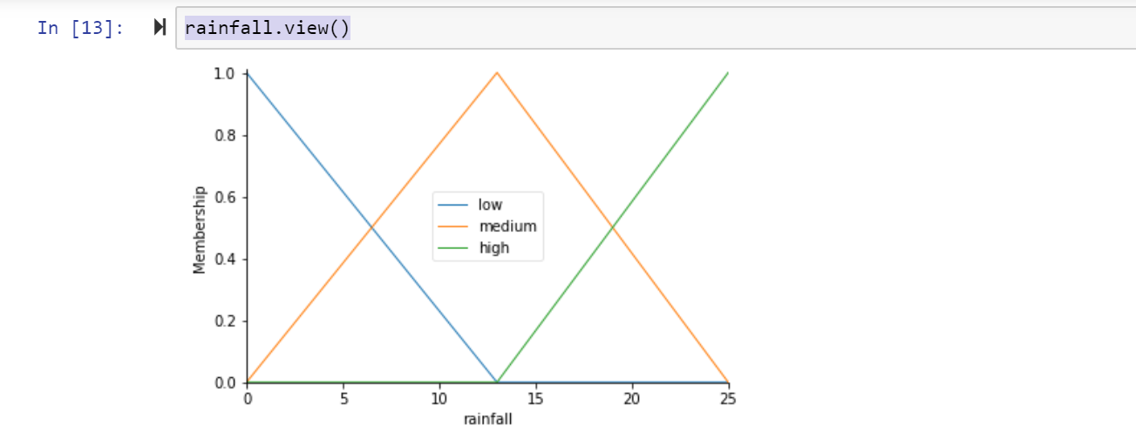
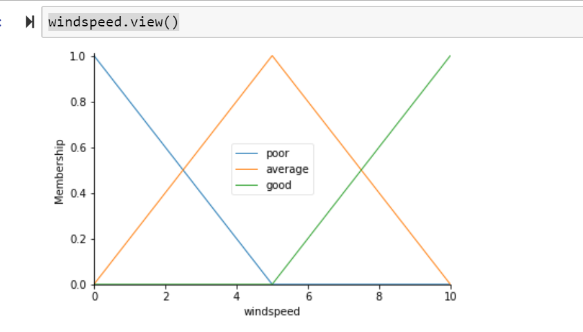
The view method is used which helps in understanding what the membership looks like.
temp['average'].view()
windspeed.view()
rainfall.view()

Slide 11
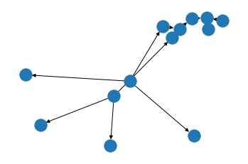
Now,to make these triangles useful, we define the fuzzy relationship between input and output variables and thus the rules can be formed as below.
rule1 = ctrl.Rule(temp['poor'] | windspeed['poor'], rainfall['low’])
rule2 = ctrl.Rule(temp['average'] | windspeed['average'], rainfall['medium'])
rule3 = ctrl.Rule(temp['good'] | windspeed['good'], rainfall['high'])
rule1.view()

Slide 12
rain_ctrl = ctrl.ControlSystem([rule1, rule2, rule3])
we have our rules defined, we can simply create a control system.
In order to simulate this control system, we will create a ControlSystemSimulation.
rain = ctrl.ControlSystemSimulation(rain_ctrl)
Simulate our control system by simply specifying the input,temp as 9 and windspeed 9 ,and then calling the compute.
rain.input['temp'] = 9
rain.input['windspeed'] = 9
rain.compute()

Slide 13
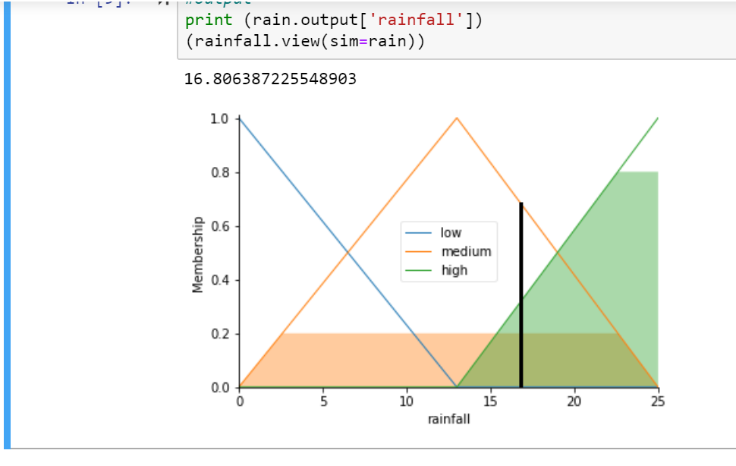

after computation the result is viewed as such.
print (rain.output['rainfall'])
(rainfall.view(sim=rain))

Slide 14
Conclusion:
Fuzzy inference system is the most important modeling tool based on fuzzy set theory. The FIS are built by domain experts and are used in automatic control, decision analysis, and various other expert systems. Fuzzy logic modeling for this modest application brings the advantage of controlling at any moment the situation as for x temperature and y wind speed predicts z amount of rainfalls.

Slide 15
THANK YOU
PRESENTED BY : SONALIKA SAHU(UCSE18008)
JAYASHREE BISWAL (UCSE17004)

