Slide 1
Routing
ROUTING PROTOCOLS
GUIDED BY- PROF.GOUTAM MALI

Slide 2
CONTENTS
Distinguish between intradomain and interdomain routing
Understand distance vector routing and RIP
Understand link state routing and OSPF

Slide 3
WHY ROUTING IS REQUIRED
Basically, we need network routing to be able to connect two different networks together. Initially we started with a need to share data between two or more computers, which started the need for a local network. After people started creating their own local networks, there grew a need to connect these local networks together, and to do this required some way of routing data between the two networks, without having all data being shared to everyone, everywhere.

Slide 4
ROUTER
Routing
A router is a device that determines the next network point to
Allow different networks to communicate with each other
A router creates which a packet should be forwarded toward its destination and maintain a table of the available routes and their conditions and uses this information to determine the best route for a given packet.
A packet will travel through a number of network points with routers before arriving at its destination.
There can be multiple routes defined. The route with a lower weight/metric will be tried first.

Slide 5
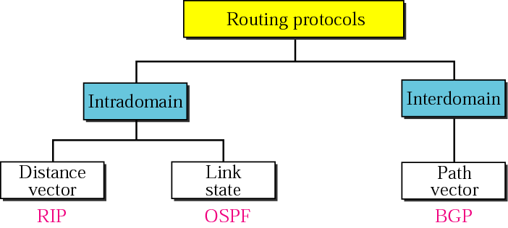

Slide 6
S.NO | INTRADOMAIN ROUTING | INTERDOMAIN ROUTING
1. | Routing algorithm works only within domains. | Routing algorithm works within and between domains.
2. | It need to know only about other routers within their domain. | It need to know only about other routers within and between their domain.
3. | Protocols used in intradomain routing are known as Interior-gateway protocols. | Protocols used in interdomain routing are known as Exterior-gateway protocols.
4. | In this Routing, routing takes place within an autonomous network. | In this Routing, routing takes place between the autonomous networks.
5. | Intradomain routing protocols ignores the internet outside the AS(autonomous system). | Interdomain routing protocol assumes that the internet contains the collection of interconnected AS(autonomous systems).
6. | Some Popular Protocols of this routing are RIP(resource information protocol) and OSPF(open shortest path first). | Popular Protocols of this routing is BGP(Border Gateway Protocol) used to connect two or more AS(autonomous system).

Slide 7
DISTANCE VECTOR ROUTING.
In distance vector routing, the least cost route between any two nodes is the route with minimum distance. In this protocol each node maintains a vector (table) of minimum distances to every node
Each router periodically shares its knowledge about the entire internet with its neighbors
Sharing knowledge about the entire AS. At the start, a router ’s knowledge may be sparse ,but how much it knows is unimportant, it sends whatever it has
Sharing only with neighbors , Sends its knowledge only to neighbors
Sharing at regular intervals

Slide 8
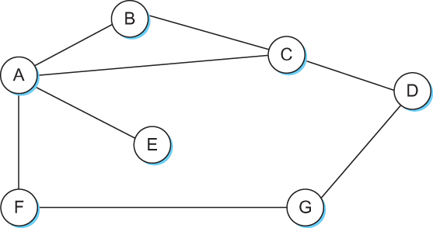
Each node constructs a one dimensional array (a vector) containing the “distances” (costs) to all other nodes and distributes that vector to its immediate neighbors
Starting assumption is that each node knows the cost of the link to each of its directly connected neighbors

Slide 9
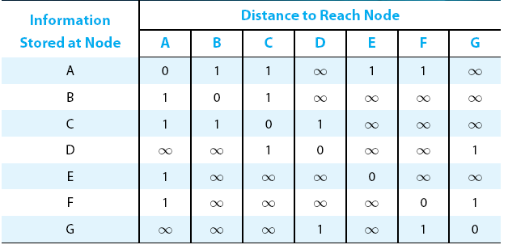
Distance Vector
Initial distances stored at each node (global view)
Notes:
The University of Adelaide, School of Computer Science
Chapter 2 — Instructions: Language of the Computer

Slide 10
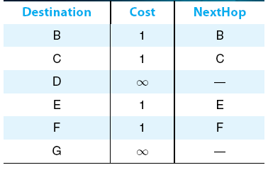
Distance Vector
Initial routing table at node A
Notes:
The University of Adelaide, School of Computer Science
Chapter 2 — Instructions: Language of the Computer

Slide 11
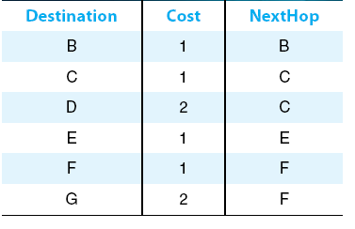
Distance Vector
Final routing table at node A
Notes:
The University of Adelaide, School of Computer Science
Chapter 2 — Instructions: Language of the Computer

Slide 12
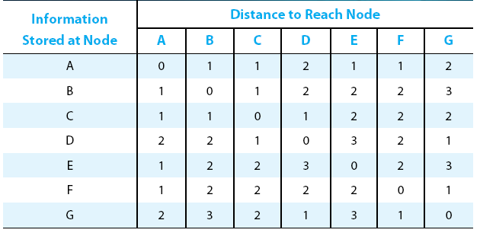
Distance Vector
Final distances stored at each node
Notes:
The University of Adelaide, School of Computer Science
Chapter 2 — Instructions: Language of the Computer

Slide 13
Distance Vector
  When a node detects a link failure
    F detects that link to G has failed
    F sets distance to G to infinity and sends update to A
    A sets distance to G to infinity since it uses F to reach G
    A receives periodic update from C with 2-hop path to G
    A sets distance to G to 3 and sends update to F
    F decides it can reach G in 4 hops via A
Notes:
The University of Adelaide, School of Computer Science
Chapter 2 — Instructions: Language of the Computer

Slide 14
One technique to improve the time to stabilize routing is called split horizon
  When a node sends a routing update to its neighbors, it does not send those routes it learned from each neighbor back to that neighbor
  For example, if B has the route (E, 2, A) in its table, then it knows it must have learned this route from A, and so whenever B sends a routing update to A, it does not include the route (E, 2) in that update
In a stronger version of split horizon, called split horizon with poison reverse
  B actually sends that back route to A, but it puts negative information in the route to ensure that A will not eventually use B to get to E
  For example, B sends the route (E, ∞) to A
Notes:
The University of Adelaide, School of Computer Science
Chapter 2 — Instructions: Language of the Computer

Slide 15
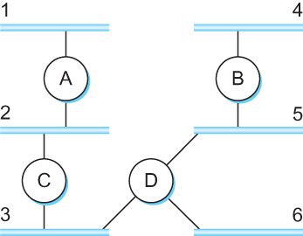
ROUTING INFORMATION PROTOCOL
RIP: Routing Information Protocol
-The Routing Information Protocol (RIP) is an intradomain routing protocol used inside an autonomous system.
It is a very simple protocol based on distance vector routing.
-Routing running RIP send their advertisements every 30 seconds.
Problems in RIP
-Slow Convergence
-Instability
Example of network running RIP:

Slide 16
Router C would advertise to router A the fact that it can reach networks 2 and 3 (to which it is directly connected) at a cost of 0, networks 5 and 6 at cost 1, and network 4 at cost 2.
The principles of routing algorithm are just the same. For example , if router A learns from router b that network X can be reached at a lower cost via B than via the next hop in the routing table , A updates the cost and next hop information for the network number accordingly.
A router also sends an update message whenever an update from another router causes it to change in routing table.

Slide 17
Link State Routing
Three keys
Sharing knowledge about the neighborhood
Each router sends the state of its neighborhood to every other router in the area
Sharing with every other router
Each router sends the state of its neighborhood to every other router in the area by flooding
Sharing when there is a change
Each router shares the state of its neighborhood only when there is a change.

Slide 18
Link State Routing:
-OSPF uses link state routing to update the routing table in an area.
-Link state routing: a process by which each router shares its knowledge about its neighbor with every router in the area.
The idea behind link state routing:
Each router should have the exact topology of the internet at every moment
Thus, every router should have the whole picture of the internet , and a router can calculate the shortest path between itself and each network
-It use Dijkstra’s algorithm to build a routing table.

Slide 19
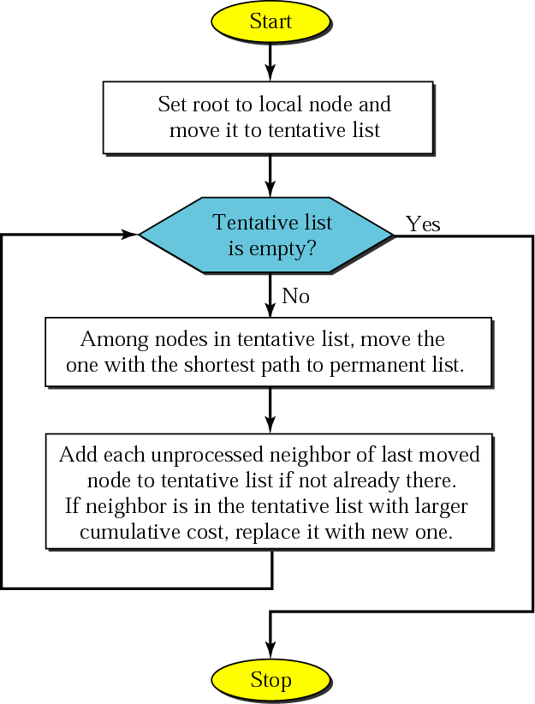
Dijkstra algorithm

Slide 20
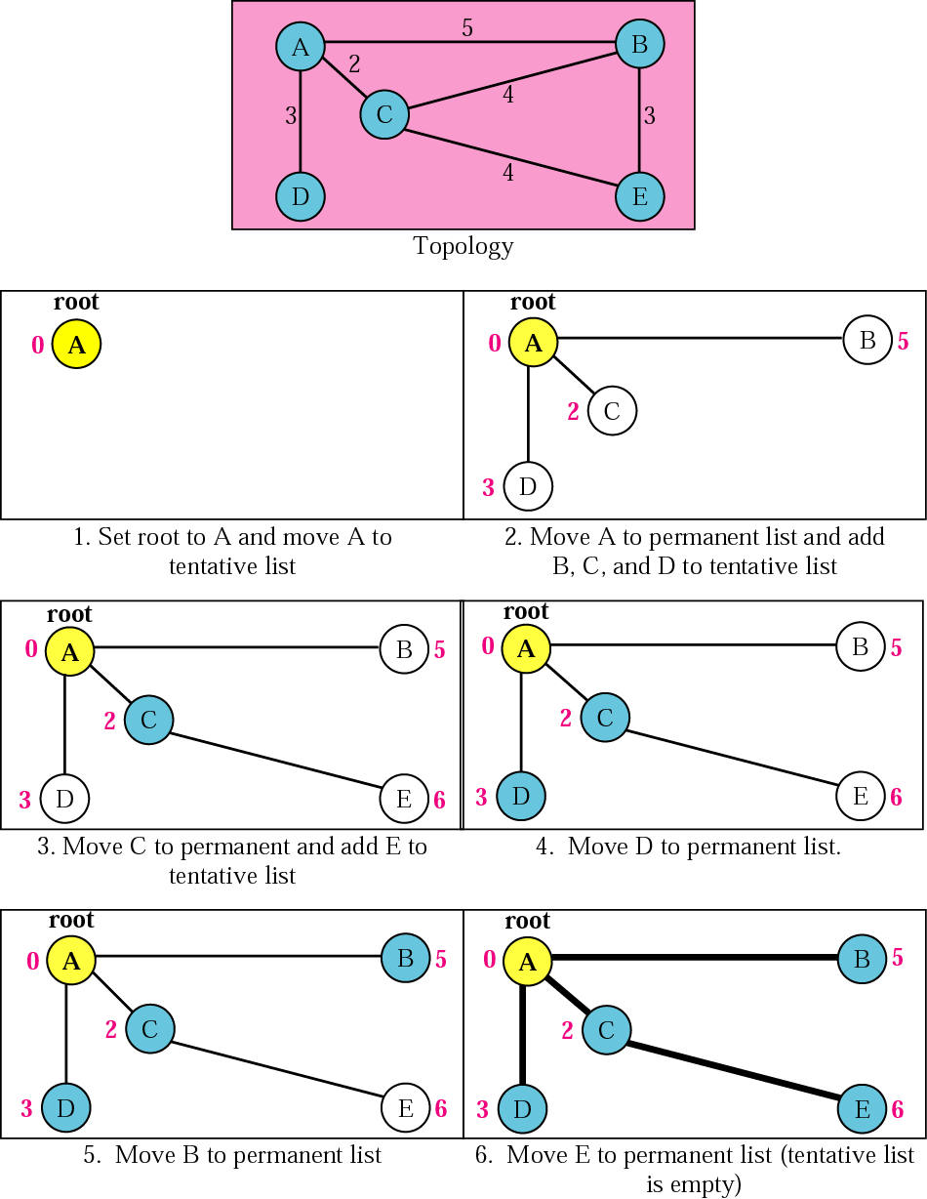
Example of formation of shortest path tree

Slide 21
RELIABLE FLOODING
Reliable flooding is the process of making sure that all the nodes participating in the routing protocol get a copy of the link state information from all the other nodes. As the term flooding suggests , the idea is for a node to send its link-state information out on all of its directly connected links ; each node that receives this information then forwards it out on all of its links. This process continues until the information has reached all the nodes in the network.
The newest information must be flooded to all the nodes as quickly as possible , while old information must be removed from the network and not allowed to circulate. (to reduce the total amount of routing traffic in the network)

Slide 22
Link State Routing
Strategy: Send to all nodes (not just neighbors) information about directly connected links (not entire routing table).
Link State Packet (LSP)
  id of the node that created the LSP
  cost of link to each directly connected neighbor
  sequence number (SEQNO)
  time-to-live (TTL) for this packet
Reliable Flooding
  store most recent LSP from each node
  forward LSP to all nodes but one that sent it
  generate new LSP periodically; increment SEQNO
  start SEQNO at 0 when reboot
  decrement TTL of each stored LSP; discard when TTL=0
Notes:
The University of Adelaide, School of Computer Science
Chapter 2 — Instructions: Language of the Computer

Slide 23


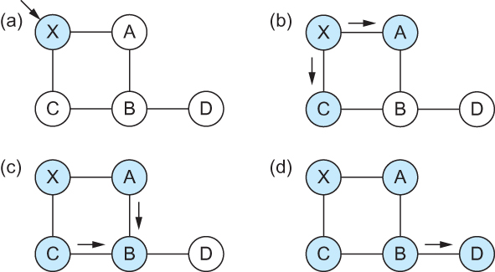

Link State
Reliable Flooding
Flooding of link-state packets. (a) LSP arrives at node X; (b) X floods LSP to A and C; (c) A and C flood LSP to B (but not X); (d) flooding is complete
Notes:
The University of Adelaide, School of Computer Science
Chapter 2 — Instructions: Language of the Computer

Slide 24
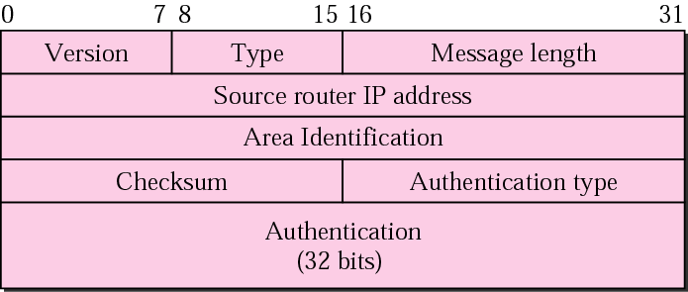
OSPF
The Open Shortest Path First (OSPF) protocol is an intradomain routing protocol based on link state routing. Its domain is also an autonomous system.
OSPF divides an autonomous system into areas. All networks
inside an area must be connected.
OSPF COMMON HEADER:

Slide 25
FEATURES OF OSPF
Authentication of routing messages- the information is dispersed from one node to others. Therefore the entire network can be impacted by bad information from one node.
Load balancing- OSPF allows multiple routes to the same place to be assigned the same cost and will cause traffic to be distributed even over those routes , thus making better use of available network capacity.
Additional Hierarchy- OSPF introduces another of hierarchy into routing by allowing a domain to be partitioned into areas.

Slide 26
DIFFERENCE BETWEEN OSPF AND RIP
The RIP is a distance Vector protocol whereas the OSPF is a link state protocol.
Hop count restriction: The RIP allows only up to 15 hops on a maximum and it was set to avoid long waits by the router. But there is no such maximum count restriction with the OSPF.
The algorithm used: The RIP routers use the distance vector algorithm whereas the OSPF uses the shortest path algorithm to determine the transmission routes. One such shortest path algorithm is the Dijkstra.
Complexity level: The RIP is relatively simpler whereas the OSPF is a complex one.
When is it Best suited? The RIP is best suited for smaller networks as it has hop count restrictions. The OSPF is best for larger networks as there is no such restriction.
OSPF is better since it converges faster than RIP.

Slide 27
END………
MADE BY-JAYASHREE BISWAL

