Slide 1
CART Algorithm Analysis: Classification and Regression
A Comprehensive Study using Python’s Scikit-learn

Slide 2
Exploratory Data Analysis: Digits Dataset
Loaded using load_digits() from sklearn.datasets.
Contains images of digits (8x8 pixel grids) and corresponding target labels (0-9).
Dataset Structure:
Keys: ['data', 'target', 'frame', 'feature_names', 'target_names', 'images', 'DESCR'].
Shape: (1797,64)
Data: (1797, 64) (1797 samples, 64 features for pixel intensity).
Target: (1797,).

Slide 3
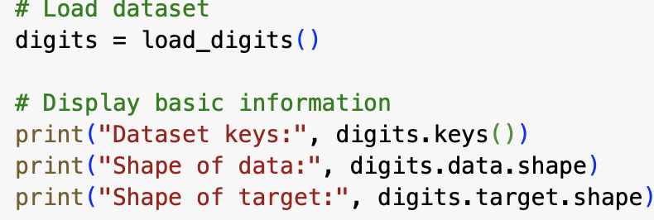
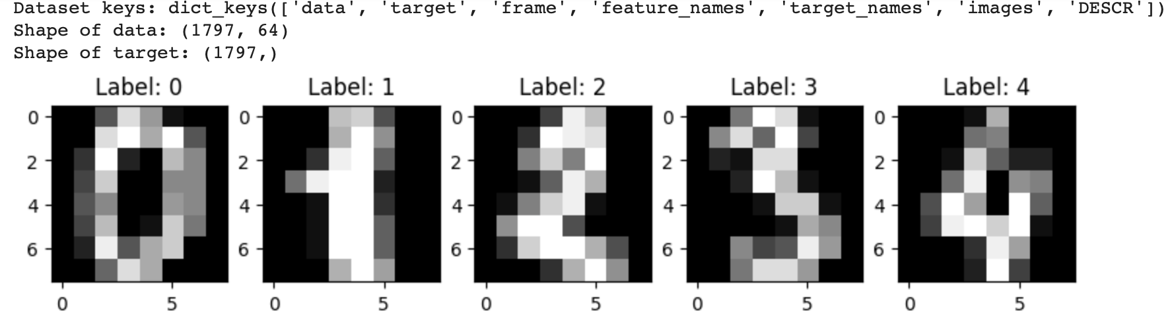
Exploratory Data Analysis: Digits Dataset

Slide 4
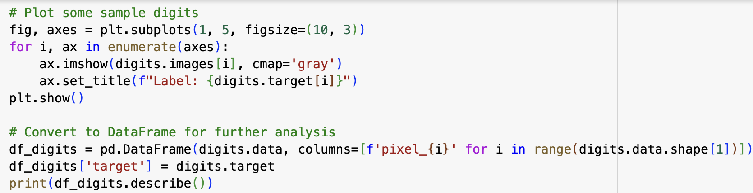
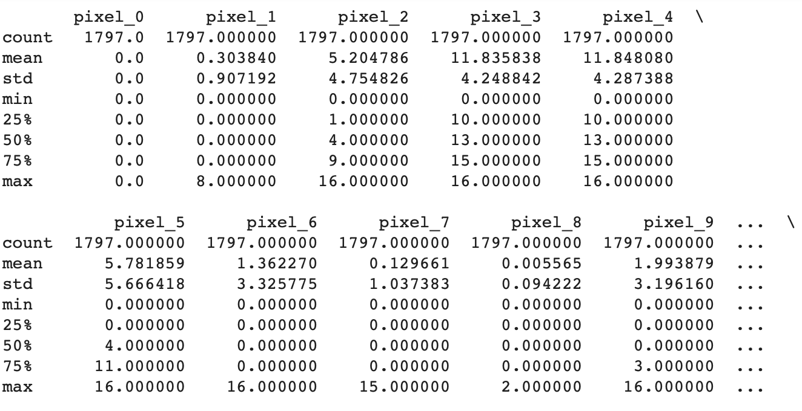
Exploratory Data Analysis: Digits Dataset

Slide 5
Exploratory Data Analysis: Digits Dataset
Observations:
Class Distribution:
Digit classes are uniformly distributed, ensuring balanced classification.
Feature Representation:
Each sample is represented by 64 pixel intensity values.
Pixel intensities range from 0 (white) to 16 (black).
Visual Insights:
Digit patterns align well with their labels, confirming reliable data quality for classification.

Slide 6
Exploratory Data Analysis: Regression Dataset
Loaded using fetch_california_housing() from sklearn.datasets.
Target feature: MedHouseVal (Median House Value).
Dataset Structure:
Total entries: 20,640.
Features: ['MedInc', 'HouseAge', 'AveRooms', 'AveBedrms', 'Population', 'AveOccup', 'Latitude', 'Longitude'].
Visualization:
Histograms generated for each feature to understand distribution.

Slide 7
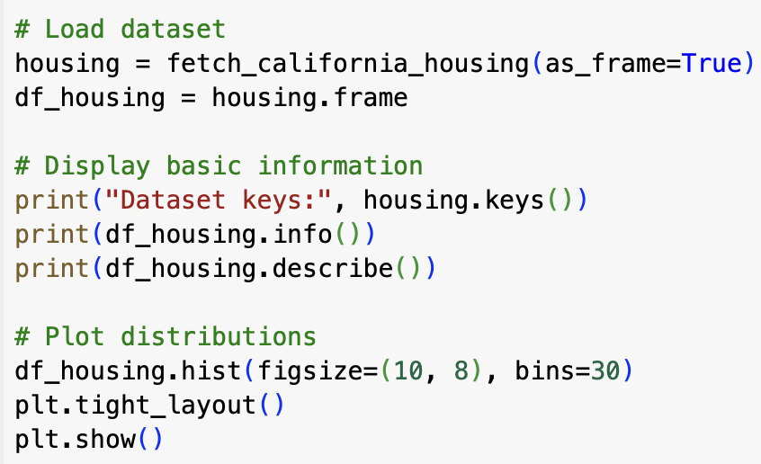
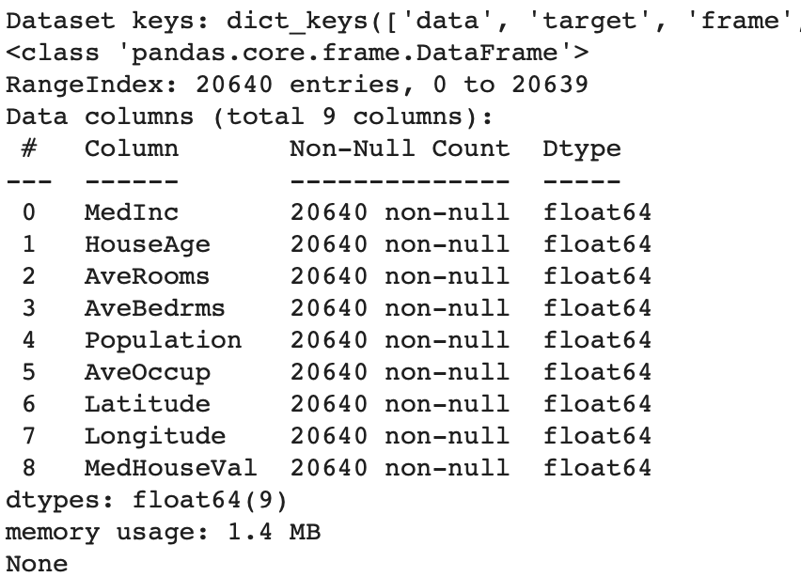
Exploratory Data Analysis: Regression Dataset

Slide 8
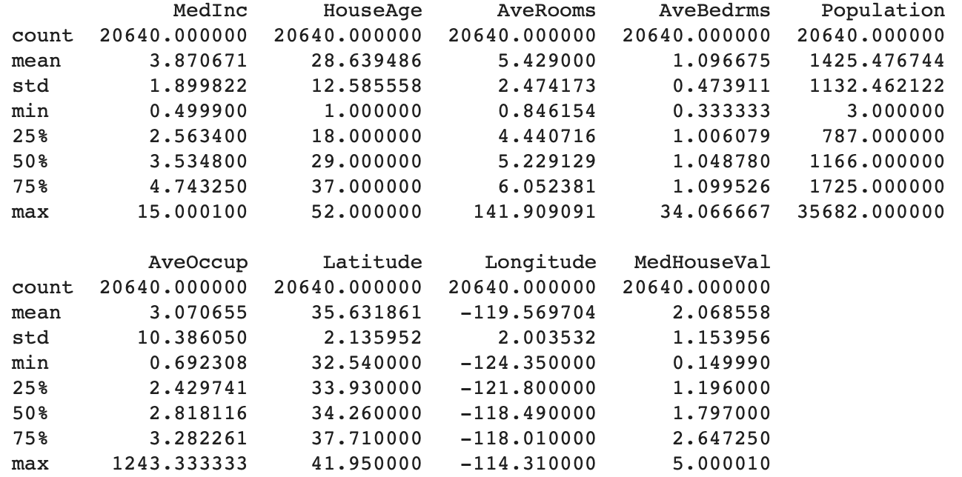
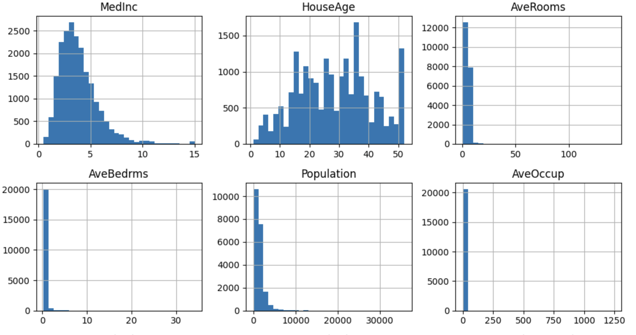
Exploratory Data Analysis: Regression Dataset

Slide 9
Exploratory Data Analysis: Regression Dataset
Correlation Analysis:
Strongest Positive Correlation: MedInc (Median Income) has the highest positive correlation with MedHouseVal (0.69), indicating that house prices rise with income levels.
Weak Correlations: Features like AveBedrms and AveRooms show weaker correlations with the target.
Negative Correlation: Latitude and Longitude have slight negative correlations, suggesting location impacts housing value.

Slide 10
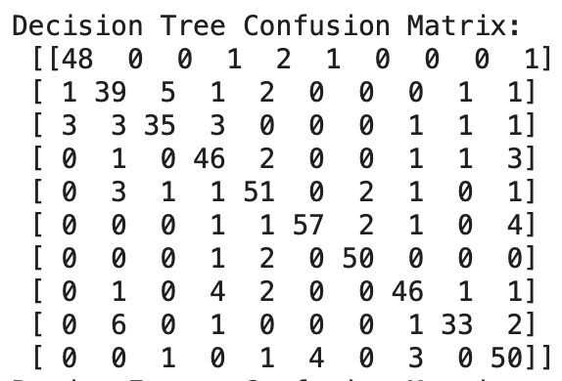
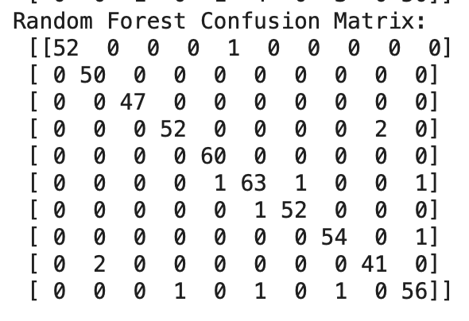
Classification Using Default Parameters
DecisionTreeClassifier:
Simpler model, prone to overfitting on the training data.
Shows more errors in the confusion matrix, particularly for digits with similar shapes (e.g., 3 and 5).
RandomForestClassifier:
Combines multiple decision trees, reducing variance and improving accuracy.
Confusion matrix shows minimal misclassifications, indicating robustness.

Slide 11
Classification Using Default Parameters
Additional Insights:
Error Analysis:
Decision Tree struggles with complex cases due to its limited depth and lack of ensemble averaging.
Random Forest mitigates this by aggregating predictions across trees.
Data Characteristics:
Misclassifications often involve digits with overlapping features (e.g., 1 and 7, or 8 and 3).
More data preprocessing or feature engineering (e.g., normalization or PCA) might further improve results.

Slide 12
Classification with Tuning
Objective:
Improve model performance by hyperparameter tuning for both:
•DecisionTreeClassifier
•RandomForestClassifier
•Compare tuned model results to default parameters.
Tuning Approach:
•Used GridSearchCV for exhaustive search over parameter grids.
•Parameters tuned:
• Decision Tree: max_depth, min_samples_split
• Random Forest: n_estimators, max_depth

Slide 13
Classification with Tuning
Results:
Best Parameters:
Decision Tree:
max_depth: 15
min_samples_split: 2
Random Forest:
max_depth: 20
n_estimators: 50
Performance:
Confusion matrices and accuracy scores will improve compared to default parameters due to optimized depth and tree ensemble size.

Slide 14
Classification with Tuning
Observations:
Decision Tree Improvements:
Optimal max_depth prevents overfitting by limiting tree size.
Smaller min_samples_split allows finer splits, improving classification for complex digits.
Random Forest Improvements:
Increased max_depth captures more data patterns without significant overfitting.
Adjusted n_estimators ensures sufficient diversity among trees for better predictions.

Slide 15
Conclusion and Future Steps

Slide 16
Conclusion
Exploratory Data Analysis (EDA):
The Hand-written Digits dataset provided a balanced and interpretable basis for classification tasks.
The California Housing dataset demonstrated key correlations, with Median Income (MedInc) being a strong predictor for Median House Value (MedHouseVal).
Classification Task (Default Parameters):
Decision Tree: Performed reasonably well but showed higher misclassification rates.
Overfitting and lack of ensemble averaging limited accuracy.
Random Forest: Outperformed Decision Tree due to ensemble learning, reducing misclassifications significantly.

Slide 17
Future Steps
Classification Task (Tuned Parameters):
Tuning improved the performance of both classifiers:
Decision Tree: Controlled depth and fine splits enhanced accuracy.
Random Forest: Adjusting tree depth and ensemble size further improved predictions, confirming its robustness for complex datasets.
Future Steps:
Enhanced Preprocessing:
Apply feature scaling or dimensionality reduction techniques like PCA to improve classification for the digits dataset.
Investigate outlier removal or transformation for skewed features in the housing dataset.

Slide 18
Future Steps
Advanced Model Tuning:
Experiment with additional hyperparameters like criterion for both classifiers to further improve decision boundaries.
Use Bayesian optimization or RandomizedSearchCV for efficient parameter search.
Explore Other Algorithms:
Compare CART algorithms with more advanced models like Gradient Boosting or XGBoost to evaluate their performance.
Dataset Expansion:
Introduce more diverse or larger datasets to test model scalability and generalization.

Slide 19
Jayashree Johnson
THANK YOU

