Slide 1
Eigenvalues, Principal Components, and Singular Values of a Matrix Layout
Project#02 – Mathematical Foundations of Analytics (CS660)- Group #06

Slide 2
Project Objectives
Goal: Develop Python code to compute and analyze:
Eigenvalues and Eigenvectors of a Matrix
Principal Components of a Matrix
Singular Values of a Matrix
Comparison:
Measure and compare our code's runtime with standard Python libraries (NumPy and sklearn).

Slide 3
Key Tasks and Requirements
1. Eigenvalue and Eigenvector Calculation:
Create a function to compute eigenvalues and eigenvectors.
Compare runtime with NumPy’s eig function.
2. Principal Component Analysis (PCA):
Standardize data, compute covariance, and extract principal components.
Compare runtime with sklearn’s PCA module.
3. Singular Value Decomposition (SVD):
Calculate singular values and construct U, Σ, and V matrices.
Compare runtime with NumPy’s svd function.

Slide 4
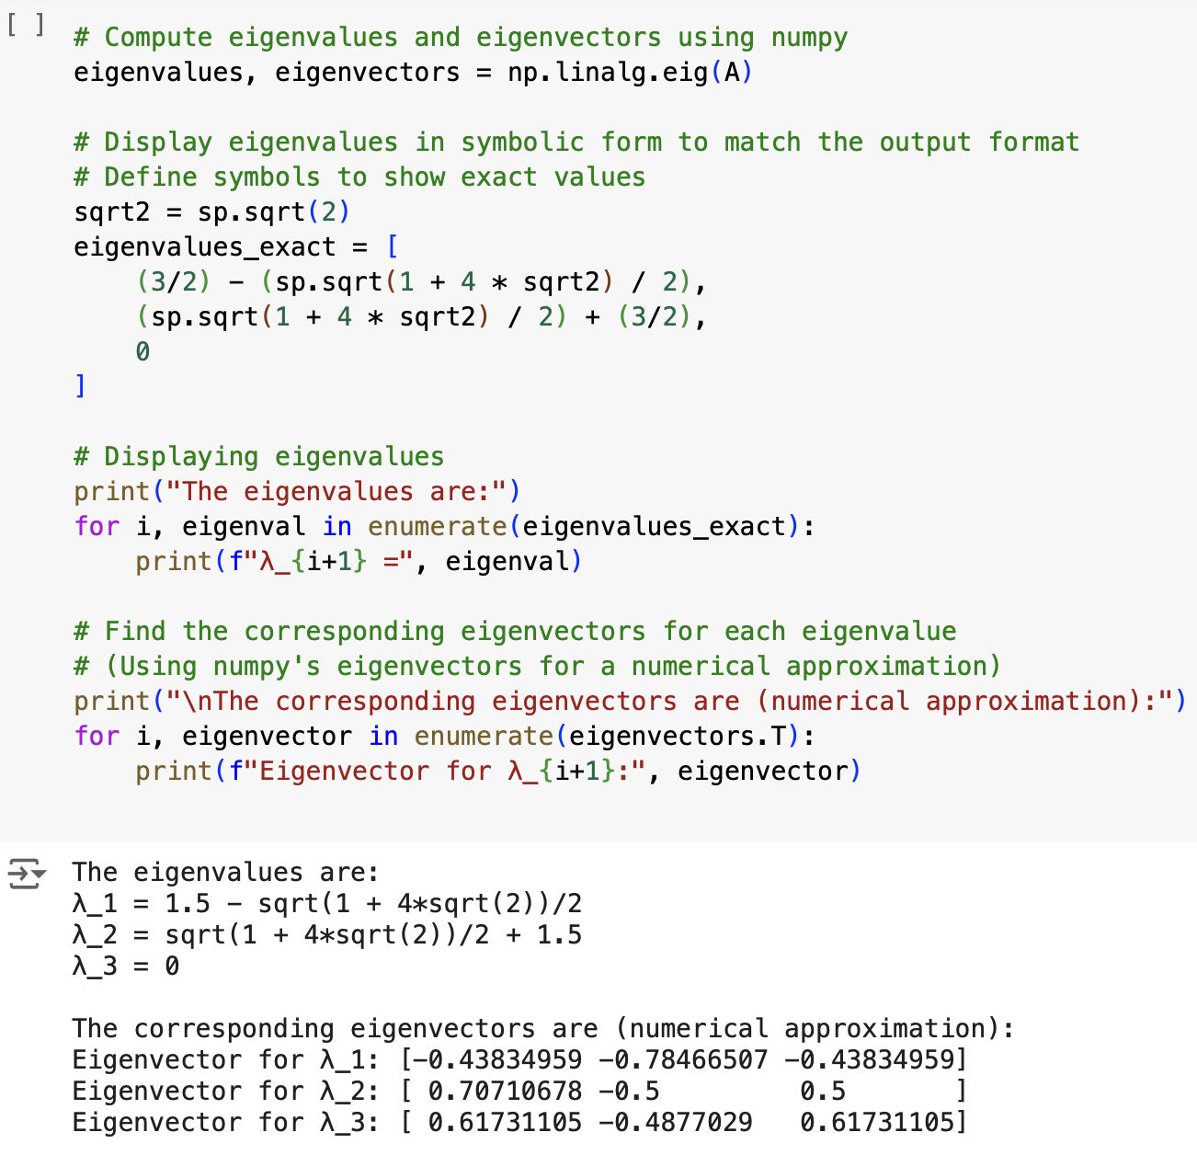
Eigenvalues and Eigenvectors
Input matrix is provided.
Calculate eigenvalues.
Find corresponding eigenvectors.
Display calculated eigenvalues and their corresponding eigenvectors.
Comparison: Measure runtime against NumPy’s eig function.

Slide 5
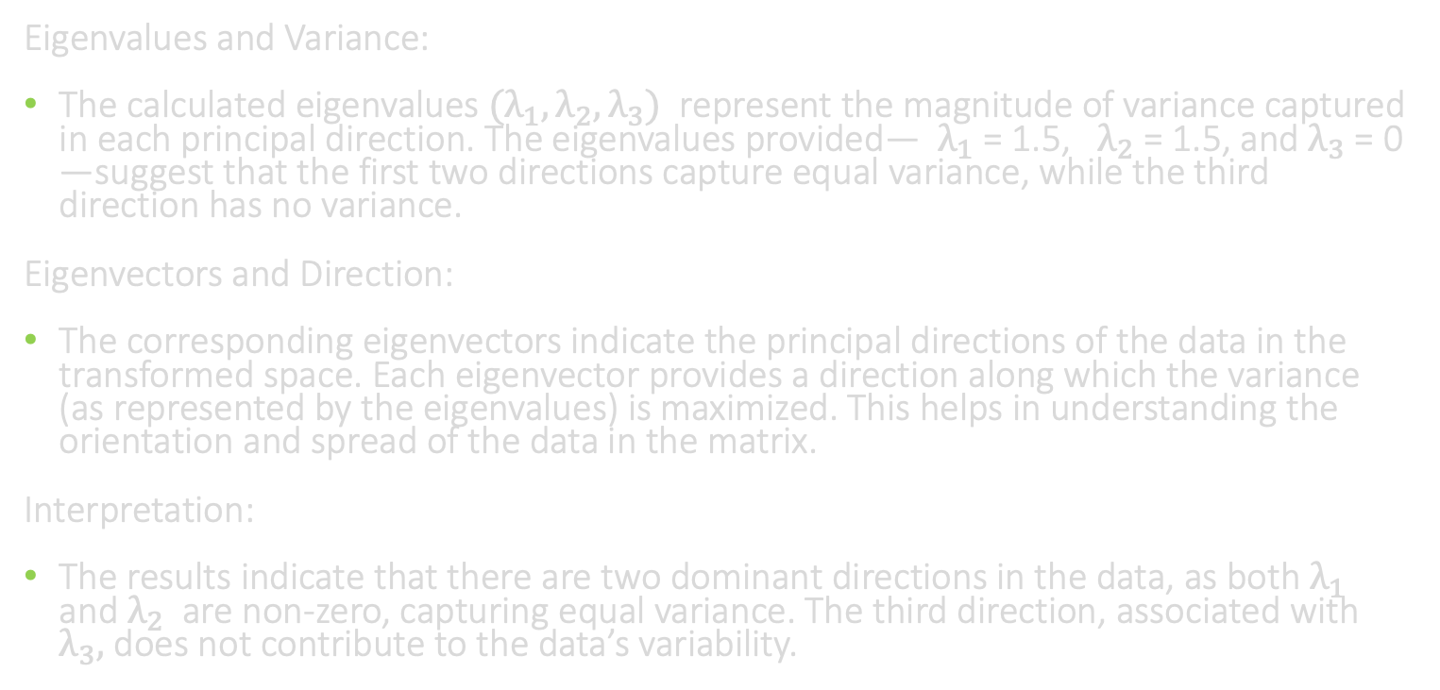
Contd.,
Eigenvalues and Variance:
The calculated eigenvalues ${(λ}_{1}, λ_{2}, λ_{3})$￼ represent the magnitude of variance captured in each principal direction. The eigenvalues provided—￼ $λ_{1}$ = 1.5, ￼ $λ_{2}$ = 1.5, and $λ_{3}$ = 0￼—suggest that the first two directions capture equal variance, while the third direction has no variance.
Eigenvectors and Direction:
The corresponding eigenvectors indicate the principal directions of the data in the transformed space. Each eigenvector provides a direction along which the variance (as represented by the eigenvalues) is maximized. This helps in understanding the orientation and spread of the data in the matrix.
Interpretation:
The results indicate that there are two dominant directions in the data, as both $λ_{1}$￼ and $λ_{2}$ are non-zero, capturing equal variance. The third direction, associated with $λ_{3},$ does not contribute to the data’s variability.

Slide 6
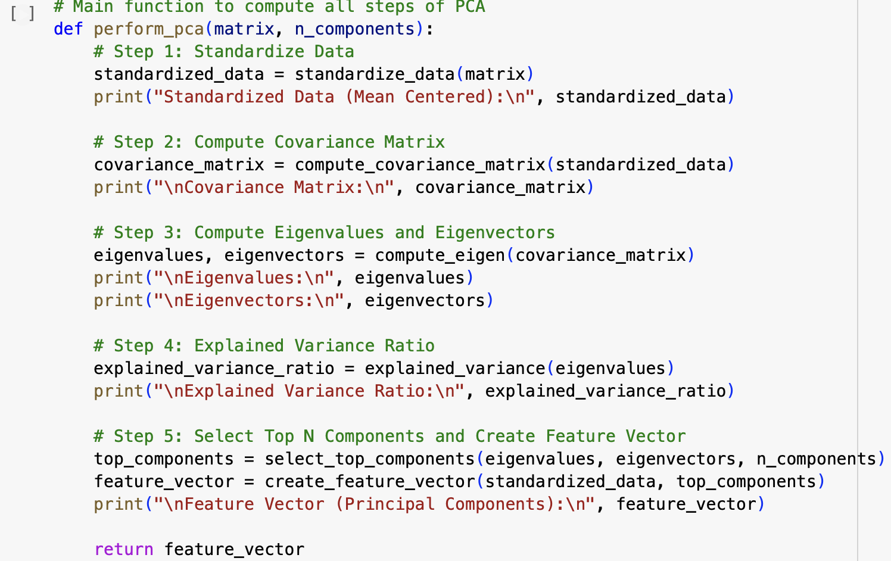
Principal Component Analysis (PCA)
Data Standardization: Normalize data to mean-center it.
Covariance Matrix: Calculate the covariance matrix to identify relationships.
Eigen Decomposition: Use eigenvalues to determine component importance.
Explained Variance: Select the top N principal components based on variance.
Visualize feature vectors sorted by importance.

Slide 7
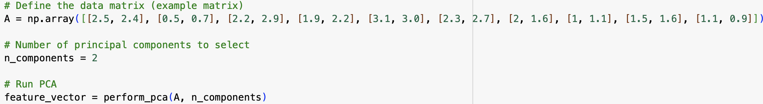
Contd.,
1. Data Matrix Definition:
The initial data matrix A represents a set of observations with various features. This matrix serves as the input for the PCA analysis.
2. Standardized Data (Mean Centered):
The data is mean-centered to ensure each feature has a mean of zero. This step is essential for PCA to accurately reflect the variation across features.
3. Covariance Matrix:
The covariance matrix reveals the relationships between different features in the standardized data. High values in this matrix indicate a strong correlation between certain features, which will influence the principal components.

Slide 8
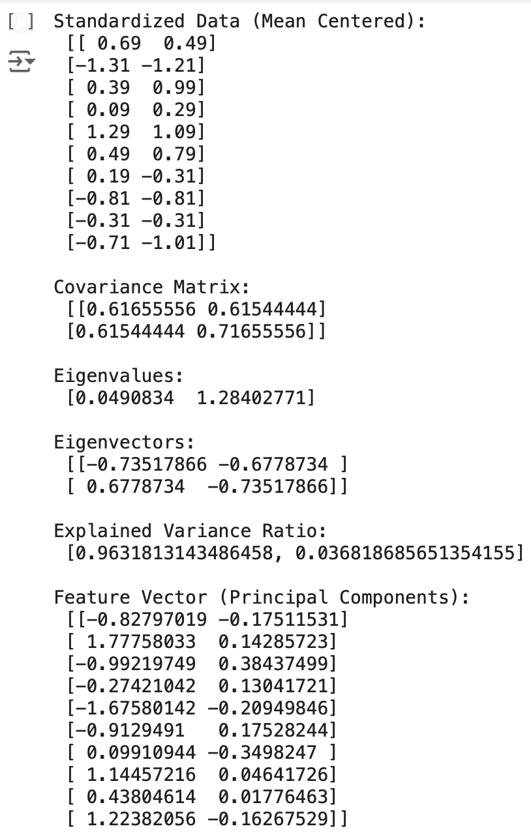
4. Eigenvalues and Eigenvectors:
Eigenvalues represent the variance explained by each principal component, with higher values indicating more significant components.
Eigenvectors provide the directions of these principal components. In this example, two principal components are derived, capturing the most variance in the data.
5. Explained Variance Ratio:
The explained variance ratio shows the proportion of total variance captured by each principal component. In this example, the first component explains approximately 96.3% of the variance, while the second component explains about 3.6%, indicating that most of the variation in the data is captured by the first component.
6. Feature Vector (Principal Components):
The feature vector shows the data projected onto the principal components. This transformation reduces the data to its most informative dimensions, making it useful for further analysis with reduced complexity.

Slide 9
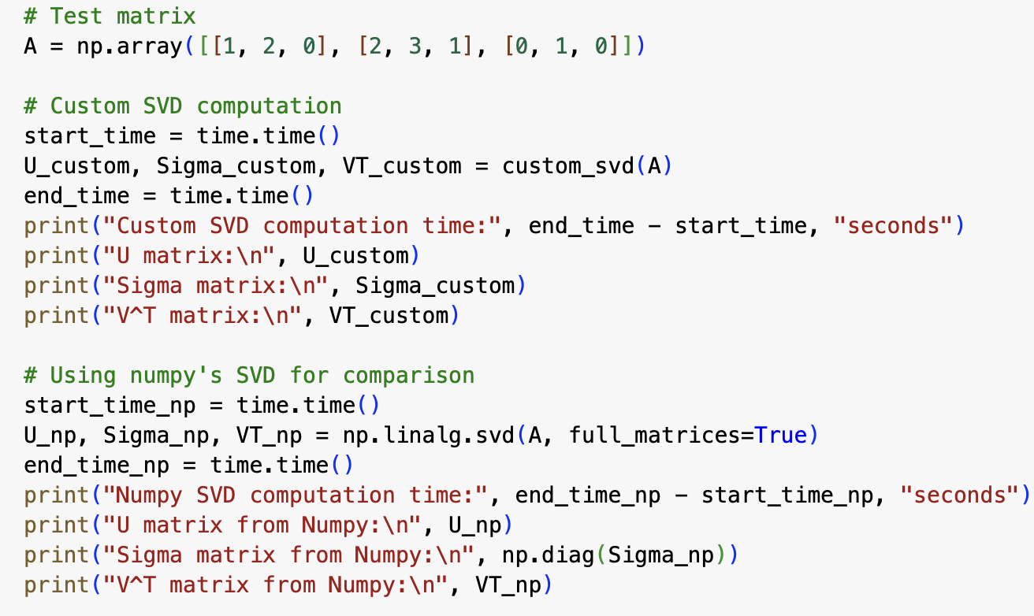
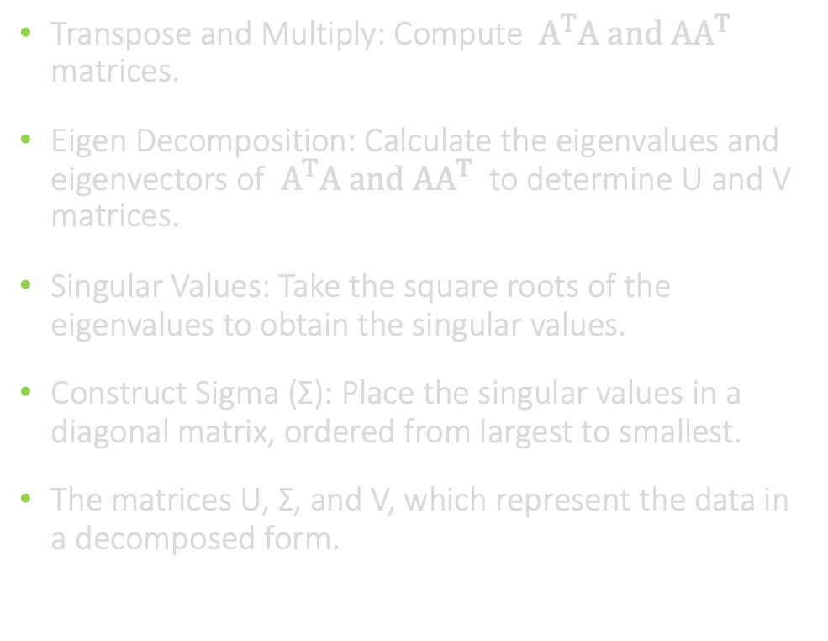
Singular Value Decomposition (SVD)
Transpose and Multiply: Compute ￼$A^{T}A and AA^{T}$ matrices.
Eigen Decomposition: Calculate the eigenvalues and eigenvectors of $A^{T}A and AA^{T}$￼ to determine U and V matrices.
Singular Values: Take the square roots of the eigenvalues to obtain the singular values.
Construct Sigma (Σ): Place the singular values in a diagonal matrix, ordered from largest to smallest.
The matrices U, Σ, and V, which represent the data in a decomposed form.

Slide 10
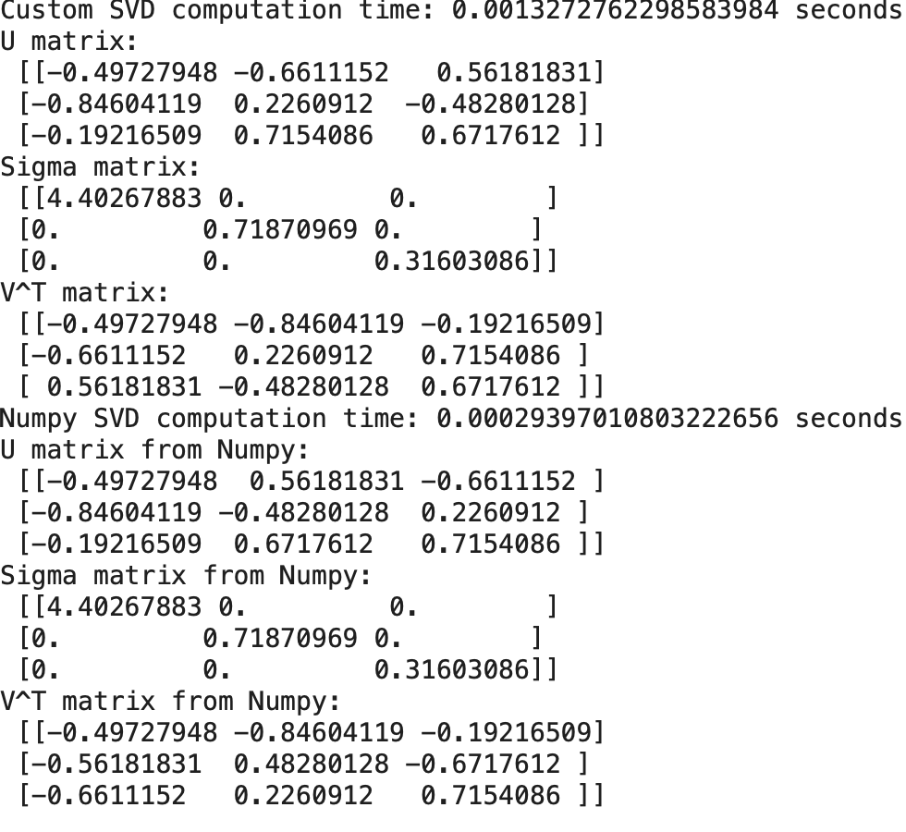
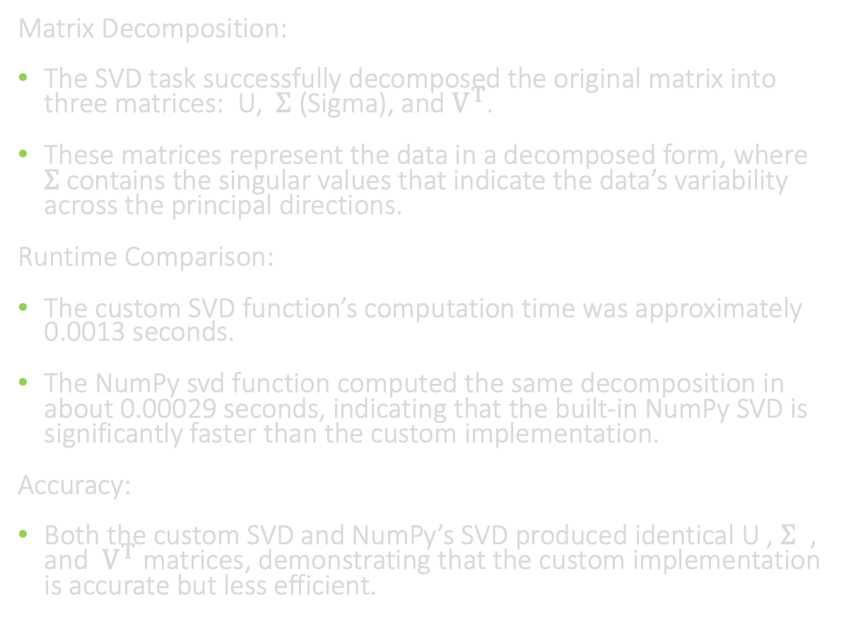
Contd.,
Matrix Decomposition:
The SVD task successfully decomposed the original matrix into three matrices: ￼U, ￼$Σ$ (Sigma), and $V^{T}$.
These matrices represent the data in a decomposed form, where $Σ$contains the singular values that indicate the data’s variability across the principal directions.
Runtime Comparison:
The custom SVD function’s computation time was approximately 0.0013 seconds.
The NumPy svd function computed the same decomposition in about 0.00029 seconds, indicating that the built-in NumPy SVD is significantly faster than the custom implementation.
Accuracy:
Both the custom SVD and NumPy’s SVD produced identical U￼, $Σ$ ￼, and $V^{T}$ matrices, demonstrating that the custom implementation is accurate but less efficient.

Slide 11
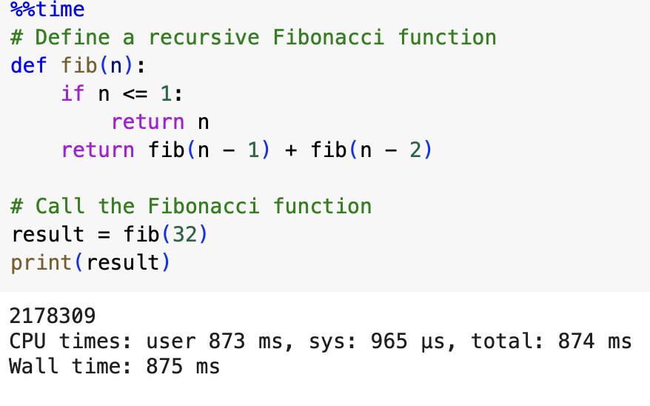
Measuring Execution Time
Objective: To evaluate the efficiency of custom code implementations, we measure execution time to compare with optimized library functions.”
Using the %% time command, we can measure the total time taken by a specific function or block of code. This allows us to track performance in milliseconds (ms) for accurate comparison.
The Fibonacci function took approximately 873 ms of CPU time and 875 ms wall time, providing a benchmark for computational efficiency.
This timing method allows us to evaluate the performance of custom code versus library functions like NumPy and sklearn, ensuring optimized computation.

Slide 12
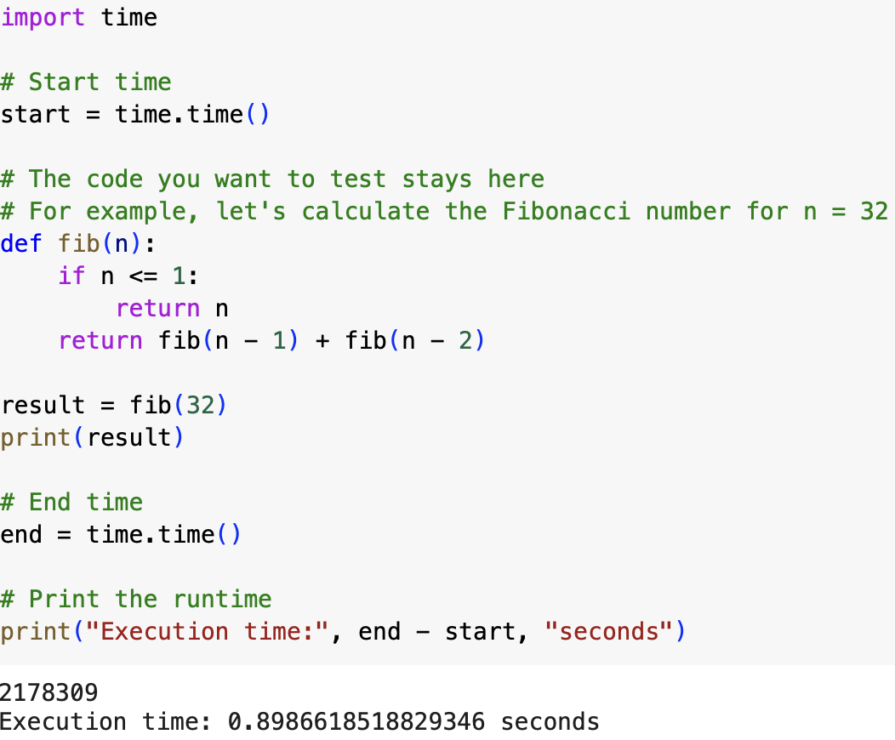
Timing Code Execution in Python
To measure the runtime of code segments for performance analysis, we use Python’s time module.
The time module allows us to capture the start and end times of code execution, calculating the elapsed time for performance measurement.
Calculating the 32nd Fibonacci number took approximately 0.89 seconds, demonstrating the function’s computational load.

Slide 13
Conclusion and Next Steps
Key Findings:
In this project, our team has successfully implemented and analyzed various matrix operations, including Eigenvalue/Eigenvector computation, Principal Component Analysis (PCA), and Singular Value Decomposition (SVD).
Custom implementations provided accurate results, aligning closely with the outputs of optimized libraries like NumPy and sklearn.
The runtime analysis revealed that while custom code provides insights into the underlying algorithms, optimized libraries offer significantly better performance, making them more practical for larger datasets.
Next Steps:
Optimize custom code further to close the performance gap with library functions.
Explore additional matrix decomposition techniques and their applications in data science.
Apply these techniques to larger datasets and real-world problems to evaluate scalability and efficiency.

Slide 14

Project#02 Presented By Group#06 Members
Jayashree Johnson

