Slide 1
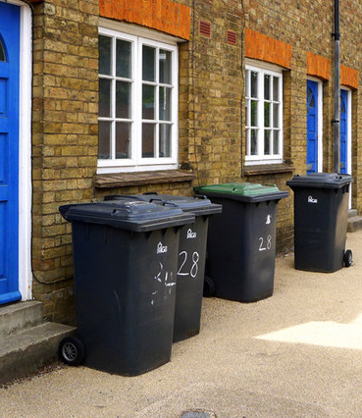
IOT BASED DUMPSTER MONITORING SYSTEM
PRESENTED BY:
Saisupraja Bhaskaran
Jayashree Chandra Poojary

Slide 2
PRESENTATION FLOW
Introduction
Project objectives
Literature survey
Existing system and Proposed system
Methodology
Future scope
Conclusion
References

Slide 3
INTRODUCTION
Detection, monitoring and management of wastes is one of the major problems in today’s busy era. The traditional way of manually checking the wastes in dumpsters is an inconvenient way and requires more human effort, time and cost. This can be easily avoided by the Dumpster Monitoring System. This system will tell us whether the trash can is empty or full through the web server and you can know the status of your ‘Trash Can’ or ‘Dumspters’ from anywhere in the world over the Internet. IOT based dumpster management system is an efficient technology which will be successful in monitoring the pollution level and controlling it to some extent. It can be used for almost all the public places where we can get a stable and reliable access to the Internet or Wi-Fi. It can also be used in industrial garbage bins and also large-scale dumping grounds and will help Government bodies to manage waste and will result in the reduction of air pollution.

Slide 4
PROJECT OBJECTIVES
We focused on moving a step forward in waste management using IOT based technology. Usually, garbage vans or trucks come to our premises to pick the garbage and dump that requires manual effort and expenses and maintenance of the vehicles to be taken care of. What if the area's garbage bins are empty or less filled or empty? Extra effort of human beings are required also other costs. Thus, to prevent this kind of situation, we came up with this project where the garbage bins will be continuously monitored and the garbage will only be picked when necessary.

Slide 5
LITERATURE SURVEY
Vikrant Bhor1 created a paper demonstrates the execution of smart garbage ,management system utilizing IR sensor, microcontroller and GSM module. This framework guarantees the cleaning of dustbins soon when the waste level achieves its most extreme. In the event that the dustbin is not cleaned in particular time, then the record is sent to the higher expert who can make proper move against the concerned contractor.
During the early days of the last 2 centuries, garbage removal trucks were simply open bodied dump trucks pulled by a bunch of horses. They became motorized in the early part of the 20th century and the first closed trucks to eliminate odours and segregate the waste with a dumping lever mechanism were introduced in the 1920s in Britain.

Slide 6
LITERATURE SURVEY
The metro cities and major economic hubs generate the maximum volume of waste, but a survey of 20 smaller cities selected to be developed as smart cities show that most of them are struggling to monitor and manage waste. So, there should be an improvement in the waste management techniques.
Prof.J.S.Chitode in July 2014, a sincere attempt was made to provide a comprehensive and sincere review of the generation, characteristics, , collection and transportation. The project on solid waste monitoring and management system has been successfully implemented with the integration of communication technologies such as Zigbee, GSM and for truck monitoring system.

Slide 7
EXISTING SYSTEM
Till now, we only witnessed traditional trash cans and dumping grounds almost in all the houses and also public places.
Due to this system, it is very much difficult for the government agencies to manage and recycle the waste in an effective manner.
Also due to this system, many living organisms such as stray dogs and cows, to name some suffer from fatal disorders due to intake of plastics and some toxic substances.
Air pollution and contaminated water that occurs due to this waste management system is also one of the most growing concerns for today's environment.

Slide 8
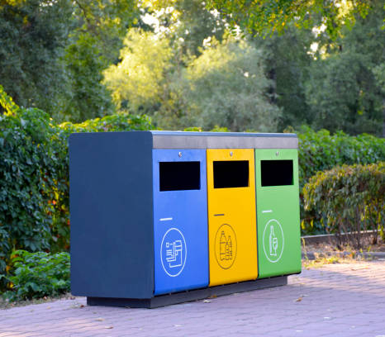
PROPOSED SYSTEM
This system will monitor the waste level in the garbage bins and message directly to the user or corporation.
It emphasizes on "DIGITAL INDIA".
As the system is simple, problem with any equipment in future can be easily replacable without any delay.
Efficient management of waste, reduces cost used in frequent maintainance of garbage vehicles and mannual labour.

Slide 9
METHODOLOGY
We are using Ultrasonic Sensor to detect whether the trash can is filled with garbage or not and measure filled distance.
Arduino to read the sensor and send signal.
ESP8266 Wi-Fi module to connect Arduino to the web server.
We are using prompt code that will notify the user about the status of the bin.

Slide 10
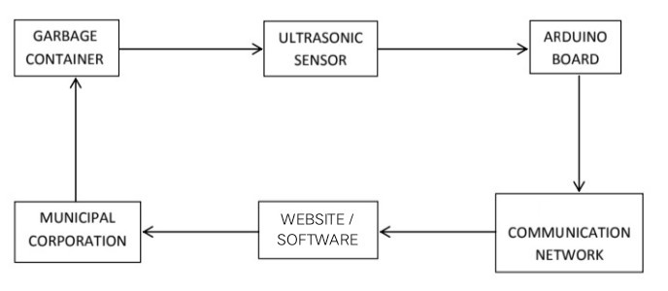
METHODOLOGY
BLOCK DIAGRAM

Slide 11
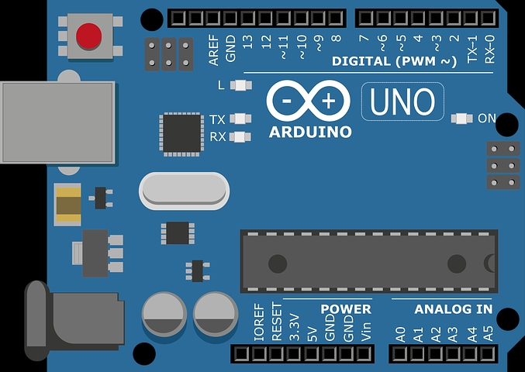
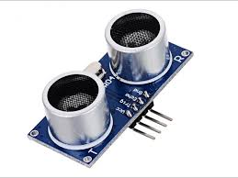
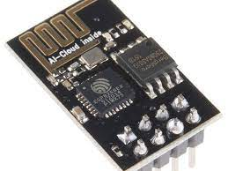
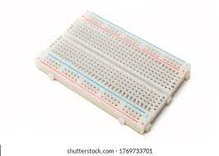
METHODOLOGY
COMPONENTS
Arduino Uno Board
Ultrasonic Sensor
Wi-Fi module
Breadboard

Slide 12
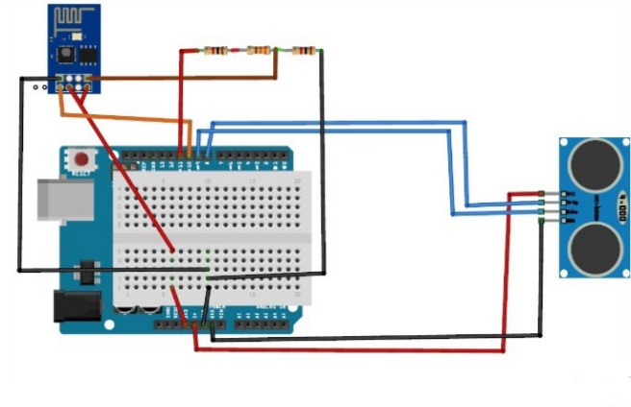
CIRCUIT DIAGRAM

Slide 13
FUTURE SCOPE
In future, a high level application which monitors the garbage bins frequently and notifies the user whenever filled.
Each level of the dustbin can be recorded instead of just recording the filled level.
This system can be used with time stamp where real-time clock will be made available to the authority stating at what time Garbage bins was full and at what time was the garbage collected from the smart Garbage Bins.
By putting the entire thing on cloud, people from anywhere can check the status of the bins, and the limitation of constrained area is removed.

Slide 14
CONCLUSION
Nowadays, as per the population the generated garbage is simultaneously increasing, let it be wet garbage or dry or any other type of garbage. The most important thing to focus upon is the management of garbage. Thus, by implementing this project we focused upon how to continuously monitor the garbage bins of our area and thus will directly lessen the manual effort and vehicle expenses and maintenance too. We can implement this system anywhere in schools, companies or in certain areas when a person can too have an application where the garbage updates will appear. Thus, that individual can call the appropriate people. In future, a team can be created which will be in charge of handling and also to take care of its maintenance. Also people for application handling can be created as well. The system can be used as a benchmark by the people who are willing to take one step further for increasing the cleanliness in their respective areas.

Slide 15
REFERENCES
www.fm.virginia.edu
www.circuitdigest.com
www.rccitt.org
www.ijitee.org
www.nap.edu

Slide 16
THANK YOU

