Slide 1
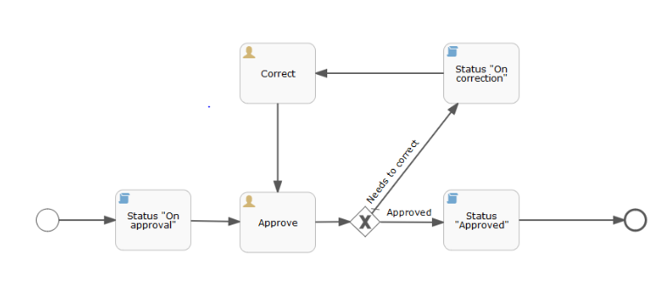

BPMN Engine
Journey Execution
BPMN Framework
Workflow Executor

Slide 2
Performance Test Results
BPMN Engine
Server & Database
Intel(R) Core(TM)i3-6100U CPU X5570 @ 2.30GHz, 4 cores
16 GB RAM
Window 10 pro
Java(TM) SE Runtime Environment (build 1.8.0_131-b11)
Redis 4.0.9 , Single Node Instance
JVM 2GB
Throughput Test
Finished performance test with 1090000 workflow instances, with an average time of 25.16 seconds for a batch of 5000 workflow instances. See corresponding Log file, containing all parameters.

Slide 3
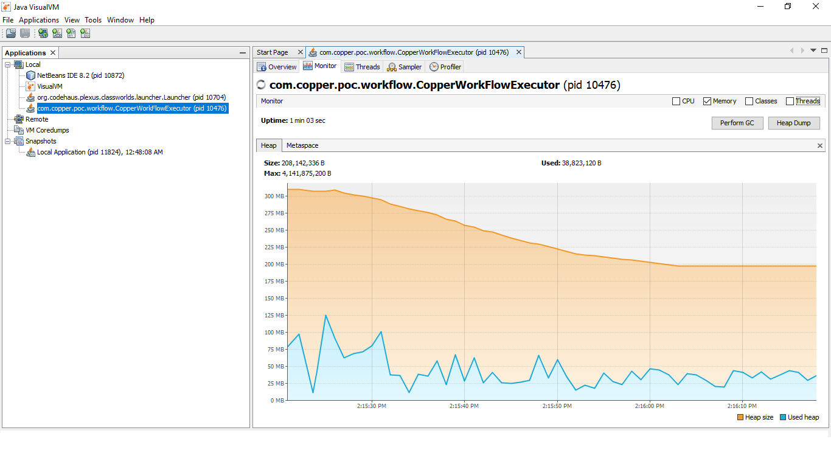
Performance Test Results - Memory & CPU Graphs During Start of Test

Slide 4
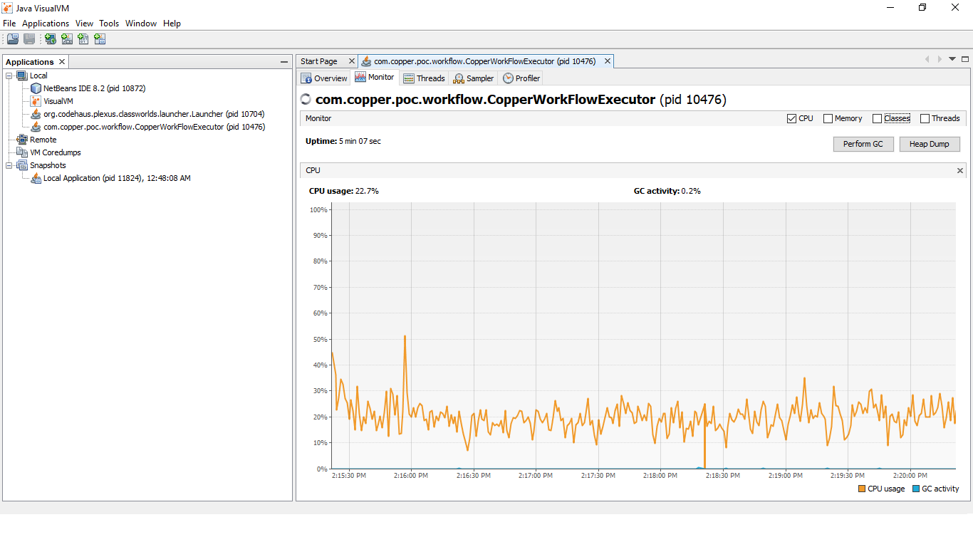
Performance Test Results - Memory & CPU Graphs During Start of Test

Slide 5
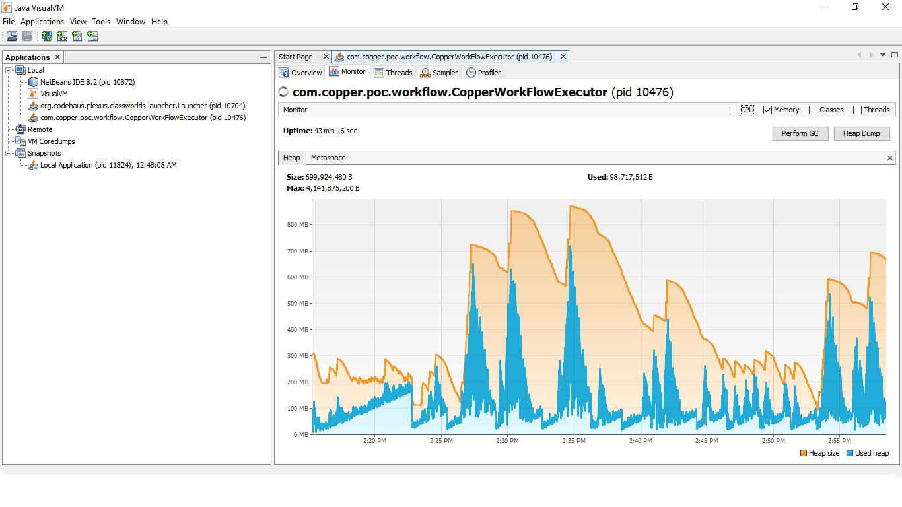
Performance Test Results : Memory & CPU Graphs after completing 500000 workflows

Slide 6
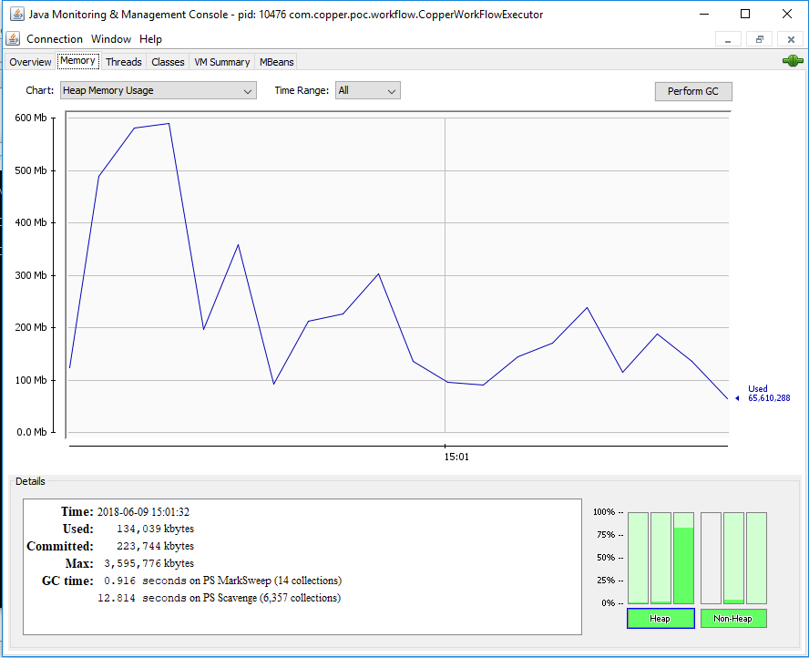
Performance Test Results : Memory & CPU Graphs after completing 500000 workflows

Slide 7
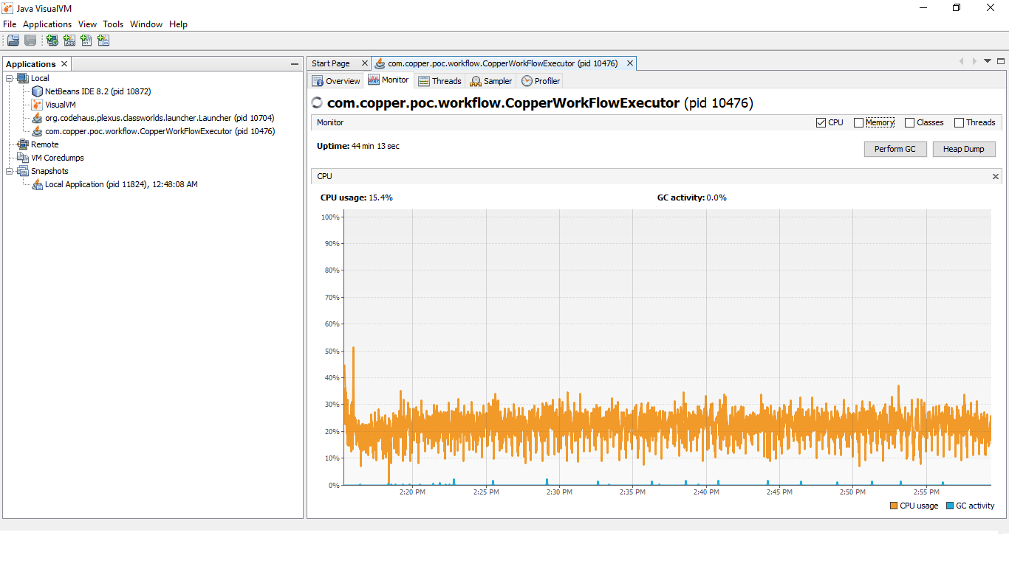
Performance Test Results : Memory & CPU Graphs after completing 500000 workflows

Slide 8
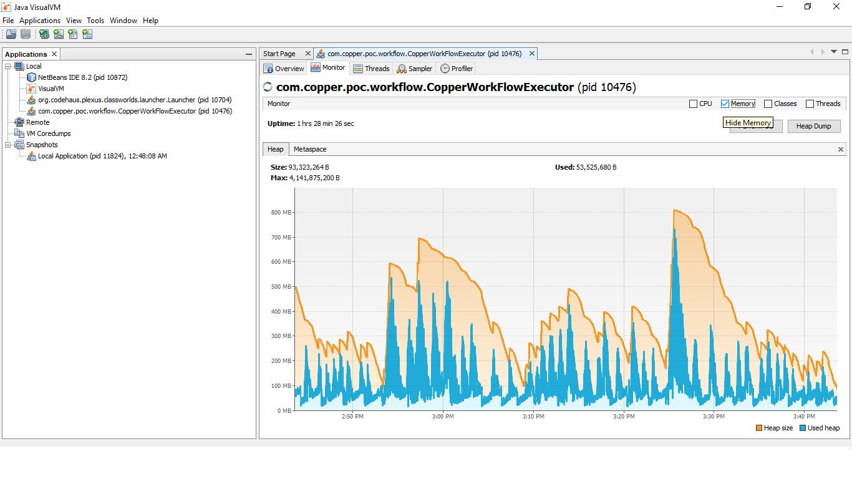
Performance Test Results : Memory & CPU Graphs after completing 1090000 workflows

Slide 9
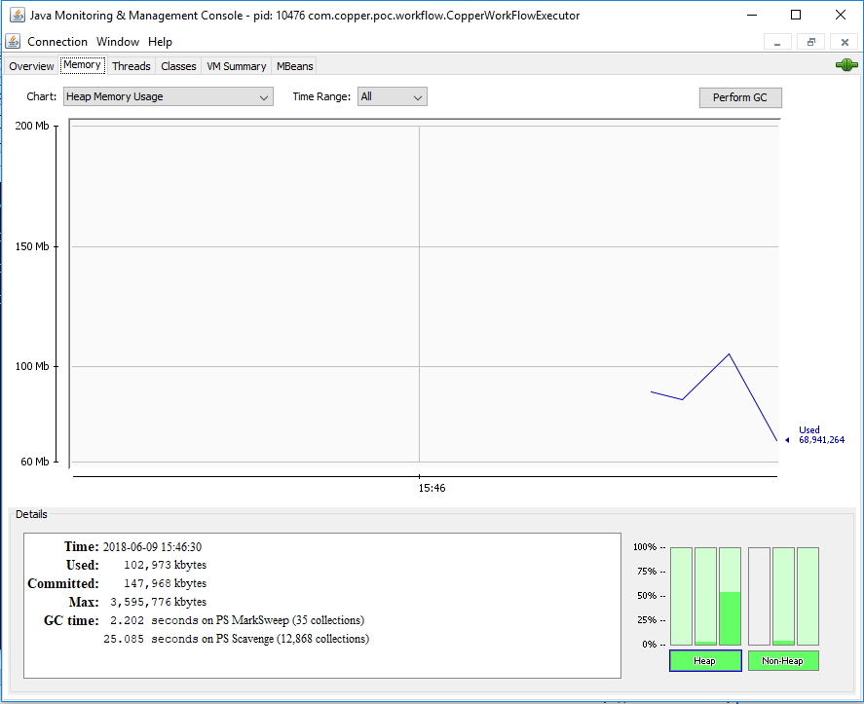
Performance Test Results : Memory & CPU Graphs after completing 1090000 workflows

Slide 10
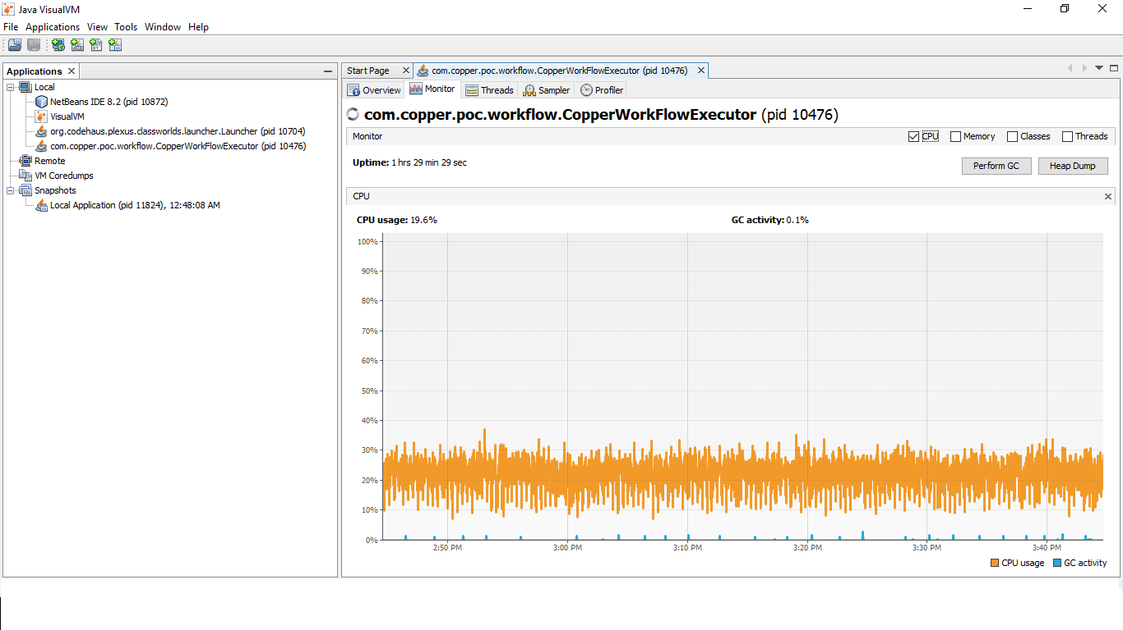
Performance Test Results : Memory & CPU Graphs after completing 1090000 workflows

