Slide 1
Unfolding Java Technologies
Welcome All to Java World !!
Jayasimha B J
Java Architect & Technical Consultant.

Slide 2
Agenda
Object Oriented Programming
Maven Automation Build Tool
Advanced Java Programming
JDBC & Java Persistent API(JPA)
HTTP & Servlet
RESTFul Web Services
Springs Framework

Slide 3
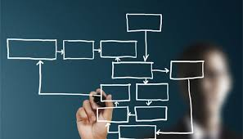
Object Oriented Programming

Slide 4

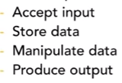
Programming Language
“A programming language is a formal computer language or constructed language designed to communicate instructions to a machine, particularly a computer. Programming languages can be used to create programs to control the behavior of a machine or to express algorithms.”

Slide 5
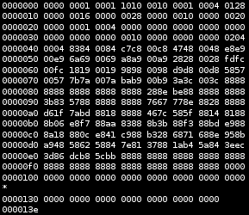
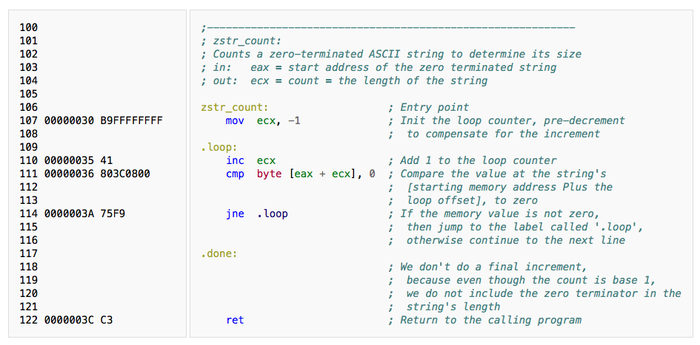
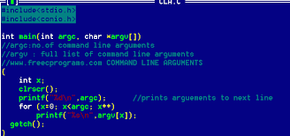
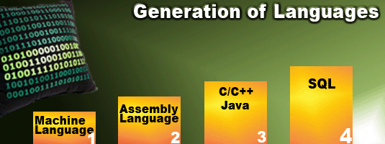
Programming Language

Slide 6
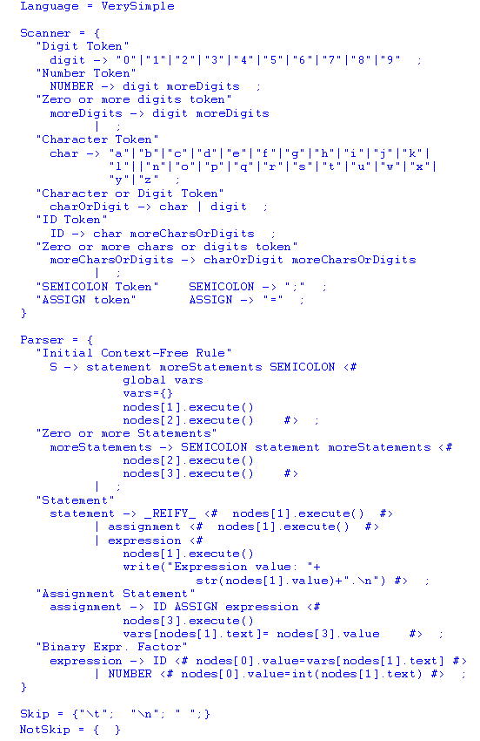
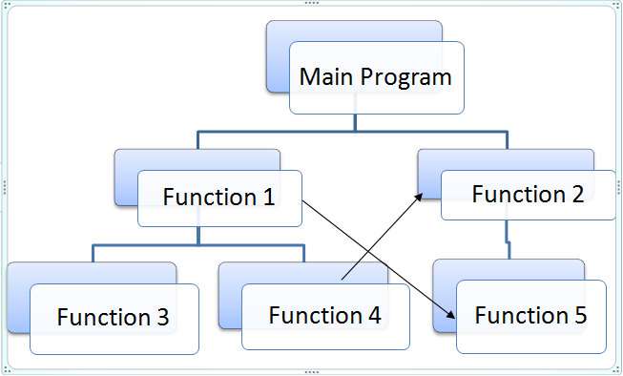
Procedure Oriented Language (C)

Slide 7
Object-Oriented Programming
“Object-oriented programming (OOP) is a programming language model organized around objects rather than "actions" and data rather than logic. Historically, a program has been viewed as a logical procedure that takes input data, processes it, and produces output data.”

Slide 8
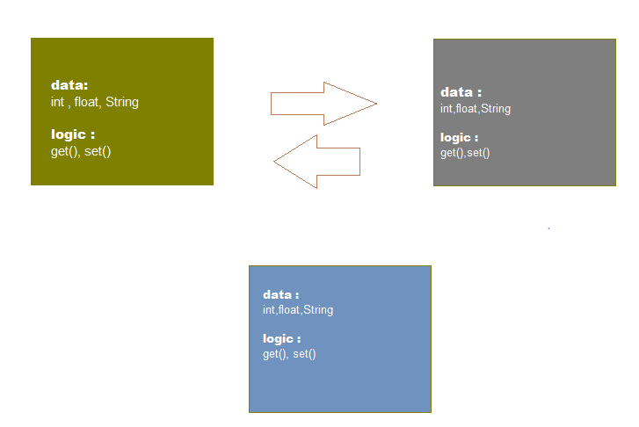
An Object

Slide 9

Class
It’s Blueprint, the definition, the description

Slide 10
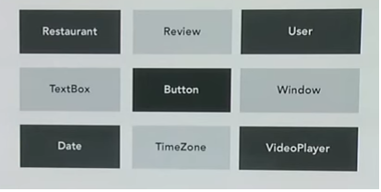
Example Class

Slide 11
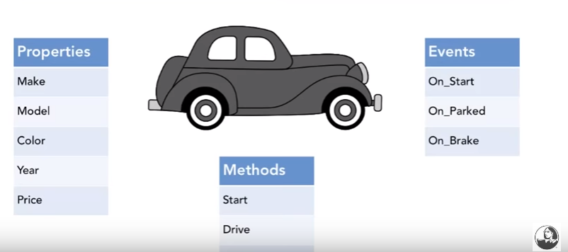
What Does Class Define ?

Slide 12

OBJECT
The Object is created from Class

Slide 13
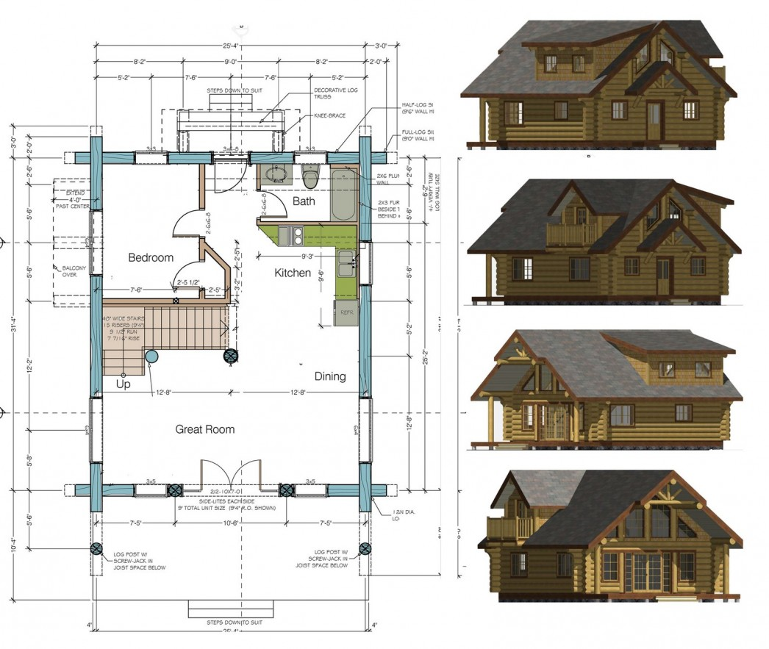
OBJECT
One Class can create multiple Objects

Slide 14
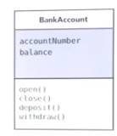
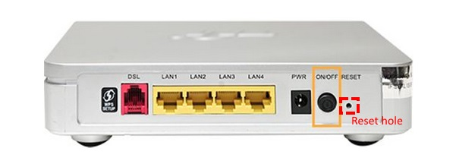
Object Oriented Paradigm – Encapsulation
Encapsulation in java is a process of wrapping code and data together into a single unit.

Slide 15
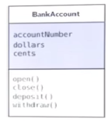
Object Oriented Paradigm – Encapsulation
Why Encapsulation ?
Cohesion - In object-oriented
  programming, cohesion expresses
  a qualitative measure of belonging.
Loose coupling One likely outcome
  of highly cohesive classes is looser coupling.
Maintainability

Slide 16
Object Oriented Paradigm – Inheritance
“In object-oriented programming, inheritance is when an object or class is based on another object, using the same implementation (inheriting from an object or class) specifying implementation to maintain the same behavior (realizing an interface; inheriting behavior). Such an inherited class is called a subclass of its parent class or super class”.

Slide 17
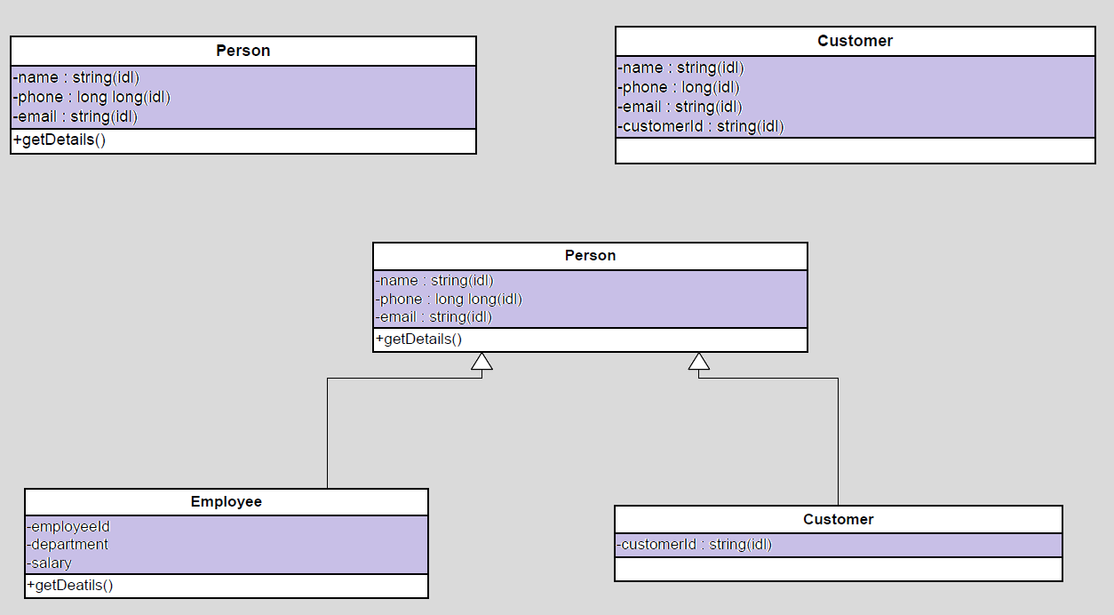
Object Oriented Paradigm – Inheritance

Slide 18
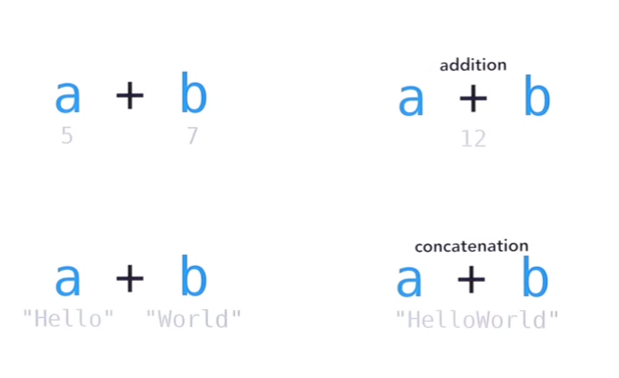
Object Oriented Paradigm – Polymorphism
Polymorphism is the ability of an object to take on many forms.

Slide 19
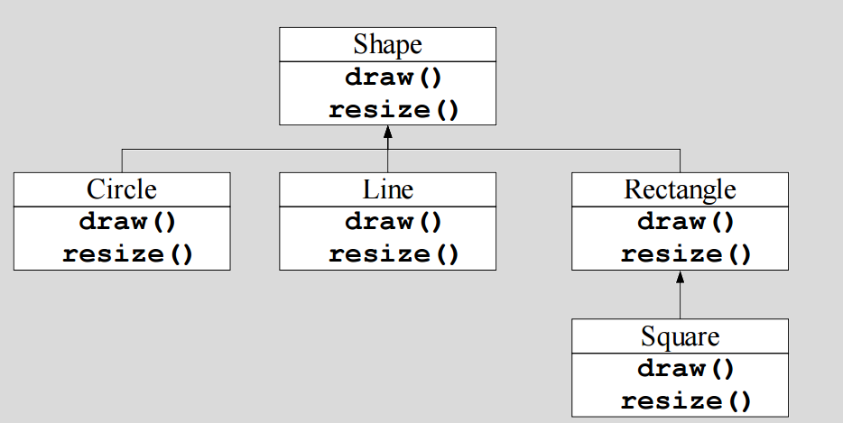
Object Oriented Paradigm – Polymorphism
Polymorphism is the ability of an object to take on many forms.

Slide 20
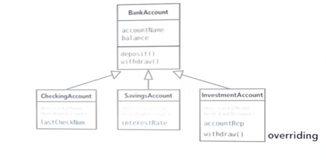
Object Oriented Paradigm – Polymorphism
Polymorphism is the ability of an object to take on many forms.

Slide 21
Phenomenon and Concept
A Phenomenon is a thing in the “real” world that has individual existence.
A Concept is a generalization, derived from a set of phenomena and based on the common properties of these phenomena.

Slide 22
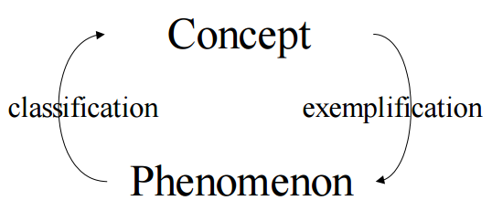
Classification and Exemplification
A classification is a description of which phenomena that belongs to a concept.
An exemplification is a phenomenon that covers the concept.

Slide 23
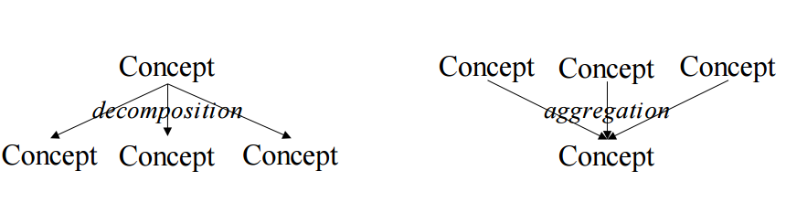
Aggregation and Decomposition
An aggregation consists of a number of (sub-)concepts which collectively is considered a new concept.
A decomposition splits a single concept into a number of (sub-)concepts.

Slide 24
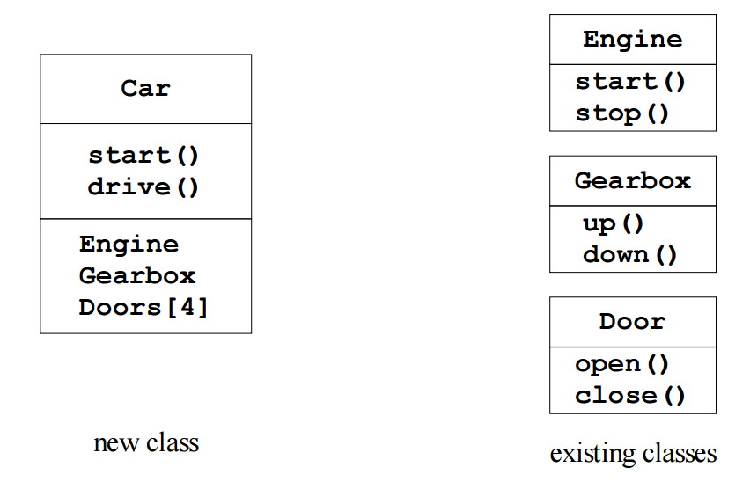
Aggregation and Decomposition, Example
Idea: make new objects by combining existing objects.
Reusing the implementation

Slide 25
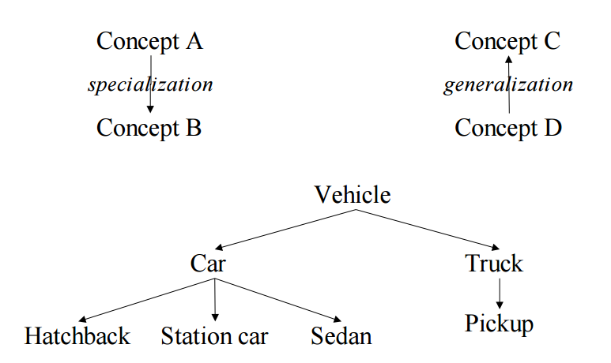
Generalization and Specialization
Generalization creates a concept with a broader scope.
Specialization creates a concept with a narrower scope.

Slide 26
Summarize
Aggregation and decomposition
  “has-a” relationship
Generalization and specialization
  “is-a” or “is-like-a” relationship

Slide 27
Thanks
Q & A

