Slide 1
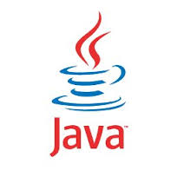
Java Programming

Slide 2
What’s Java
Open source “Object Oriented” & “Platform Independent” programming language, First
released by SunMicrosystem.

Slide 3
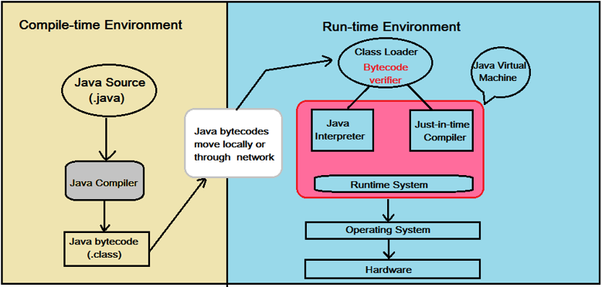
Platform Independent

Slide 4
Why Java
Practicality
Backward Compatibility
Scalability, Performance, Reliability
Maturity With Innovation

Slide 5
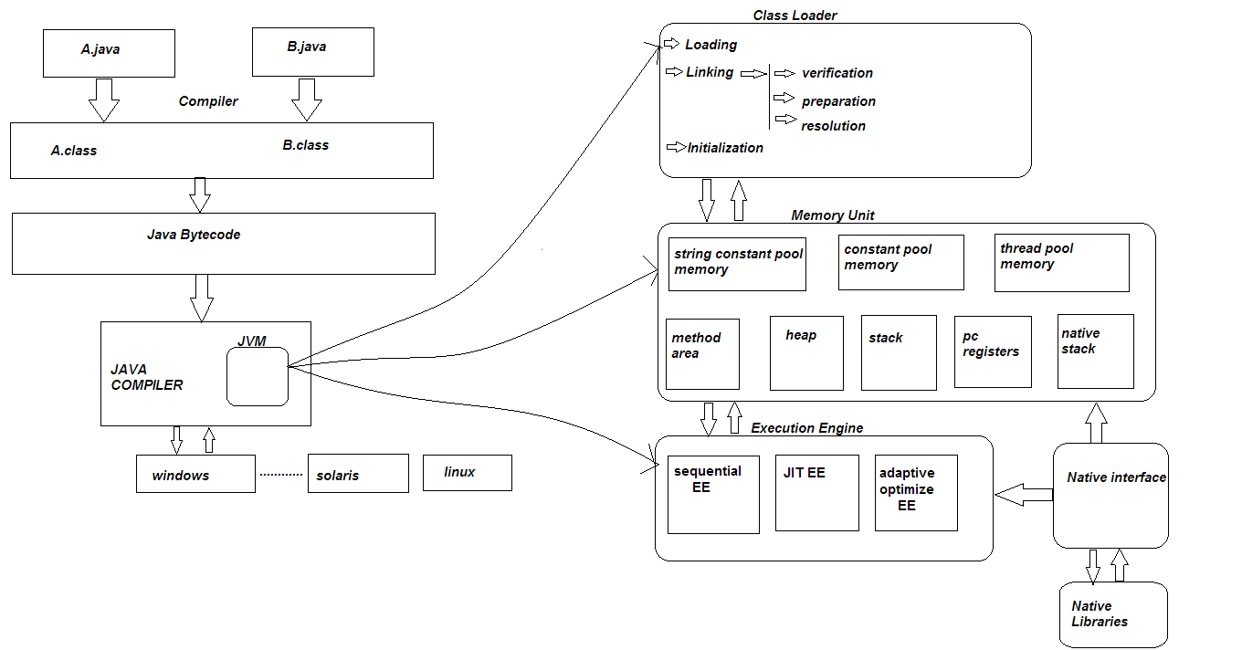
JVM Architecture

Slide 6
Java Program Structure
  Practical Demonstration .. !

Slide 7
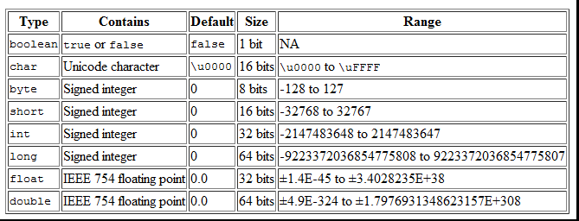
Primitive Data Types

Slide 8
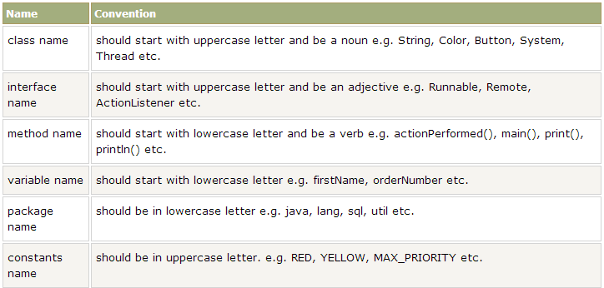
Java Naming Conventions

Slide 9
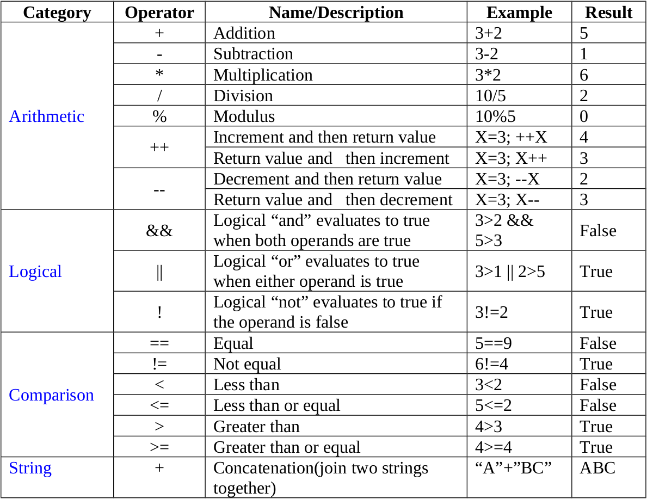
Java – Operators

Slide 10
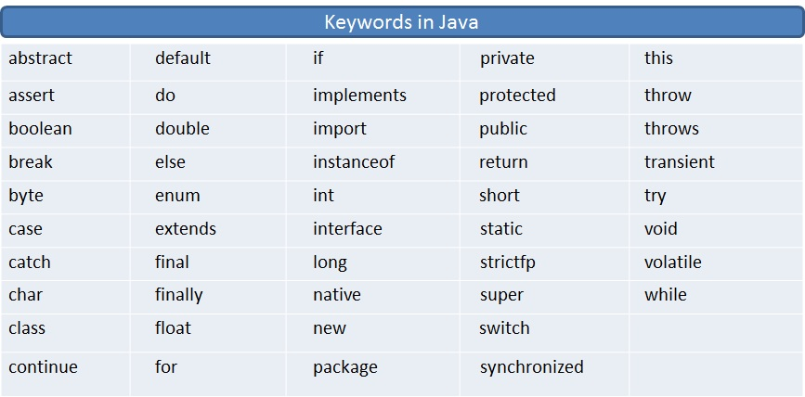
Java - Keywords

Slide 11
Java Literals
A literal is a source code representation of a fixed value. They are represented directly in the code without any computation.
Literals can be assigned to any primitive type variable
  Example: byte a = 68; char a = 'A'

Slide 12
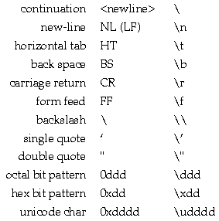
Java Literals
Character Literals

Slide 13
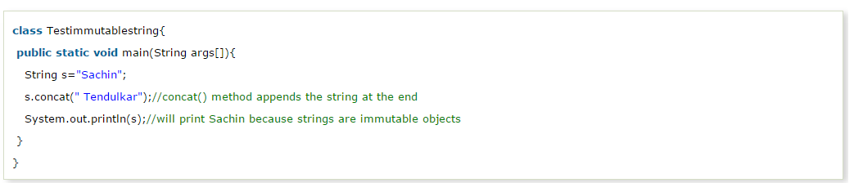
Java - Strings

Slide 14
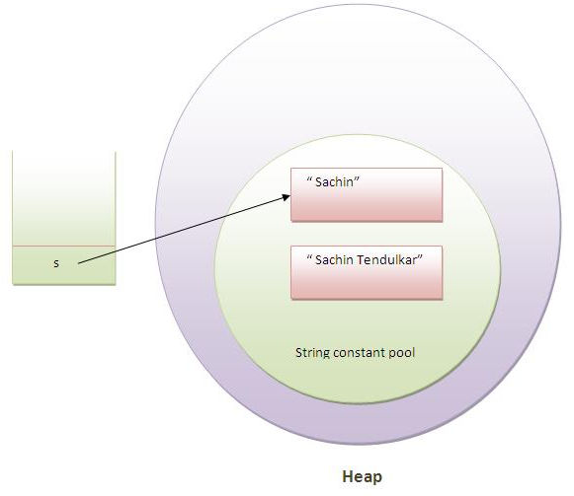
Java - Strings

Slide 15
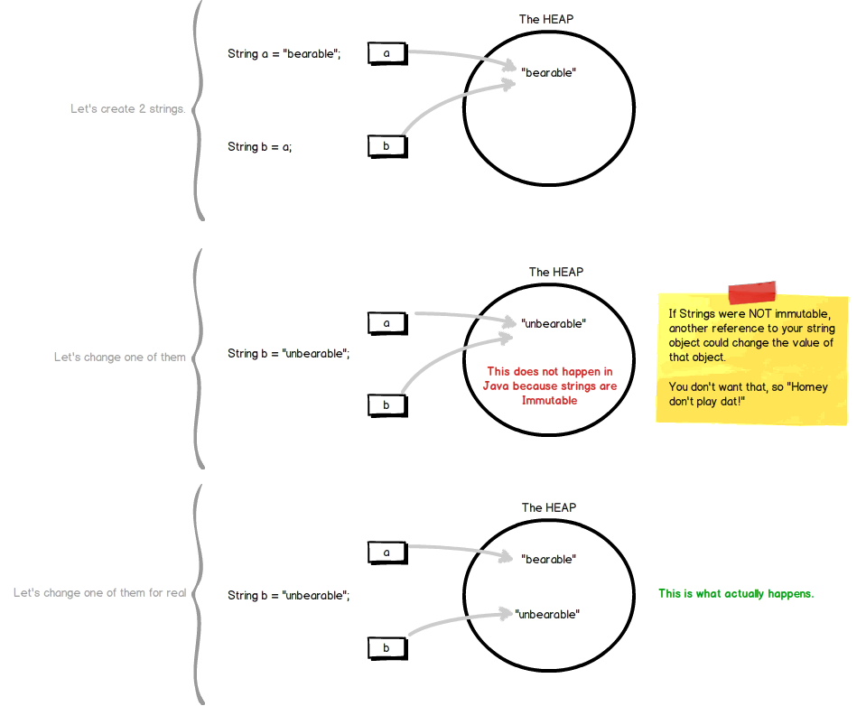
Java - Strings

Slide 16
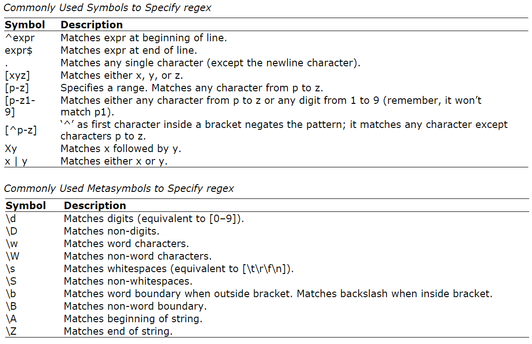
Java – Regular Expression

Slide 17
Java - Conditional Logic ,Loops & Arrays
Practical Demonstration.. !!

Slide 18
Java – Object Oriented Paradigm
Encapsulation
Inheritance
Polymorphism

Slide 19
Java - Exception Handling
What Is an Exception?
The term exception is shorthand for the phrase
"exceptional event.“

Slide 20
Java - Exception Handling
Definition
An exception is an event, which occurs during the execution of a program, that disrupts the normal flow of the program's instructions.

Slide 21
Java - Exception Handling
How it works ?
When an error occurs within a method, the method creates an object and hands it off to the runtime system.
The object, called an exception object, contains information about the error, including its type and the state of the program when the error occurred.
Creating an exception object and handing it to the runtime system is called throwing an exception

Slide 22
Java - Exception Handling
The Catch or Specify Requirement
  Valid Java programming language code must honor the Catch or Specify Requirement.
  This means that code that might throw certain exceptions must be enclosed by either of the following,
    A try statement that catches the exception. The try must provide a handler for the exception, as described in Catching and Handling Exceptions.
    A method that specifies that it can throw the exception. The method must provide a throws clause that lists the exception, as described in Specifying the Exceptions Thrown by a Method.

Slide 23
Java - Exception Handling
The Three Kinds of Exceptions
  Checked exception
    These are exceptional conditions that a well-written application should anticipate and recover from
  Error
    These are exceptional conditions that are external to the application, and that the application usually cannot anticipate or recover from
  Runtime Exception
    These are exceptional conditions that are internal to the application, and that the application usually cannot anticipate or recover from

Slide 24
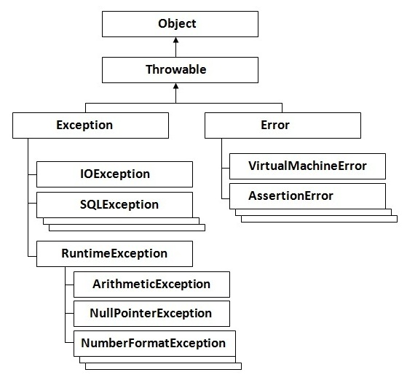
Java - Exception Handling

Slide 25
Java - Exception Handling
The finally Block
  The finally block always executes when the try block exits. This ensures that the finally block is executed even if an unexpected exception occurs.
  But finally is useful for more than just exception handling
    It allows the programmer to avoid having cleanup code accidentally bypassed by a return, continue, or break.
    Putting cleanup code in a finally block is always a good practice, even when no exceptions are anticipated.

Slide 26
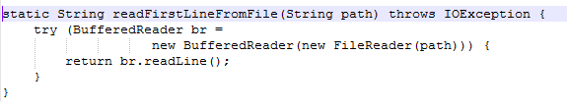
Java - Exception Handling
The try-with-resources Statement
  The try-with-resources statement is a try statement that declares one or more resources.
    A Resource is an object that must be closed after the program is finished with it
    The try-with-resources statement ensures that each resource is closed at the end of the statement

Slide 27
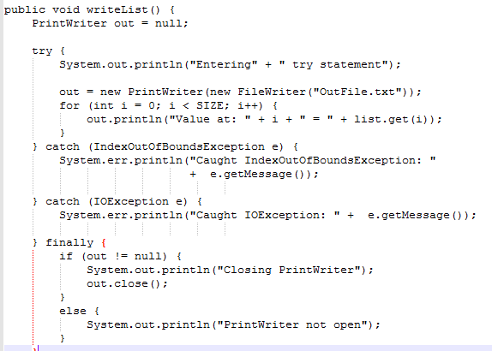
Java - Exception Handling
Putting It All Together

Slide 28
Java - Exception Handling
Specifying the Exceptions Thrown by a Method
  Sometimes, it's appropriate for code to catch exceptions that can occur within it.
  In other cases, however, it's better to let a method further up the call stack handle the exception
public void writeList() throws IOException,
IndexOutOfBoundsException {}
How to Throw Exceptions
if (size == 0) {
throw new EmptyStackException();
}

Slide 29
Java - Exception Handling
Specifying the Exceptions Thrown by a Method
  Sometimes, it's appropriate for code to catch exceptions that can occur within it.
  In other cases, however, it's better to let a method further up the call stack handle the exception
public void writeList() throws IOException,
IndexOutOfBoundsException {}
How to Throw Exceptions
if (size == 0) {
throw new EmptyStackException();
}

Slide 30
Java - Exception Handling
Unchecked Exceptions — The Controversy
“If a client can reasonably be expected to recover from an exception, make it a checked exception. If a client cannot do anything to recover from the exception, make it an unchecked exception.”

Slide 31
Java – File I/O
I/O Streams
A stream is a conceptually endless flow of data. You can either read from a stream or write to a stream. A stream is connected to a data source or a data destination. Streams in Java IO can be either byte based (reading and writing bytes) or character based (reading and writing characters).

Slide 32
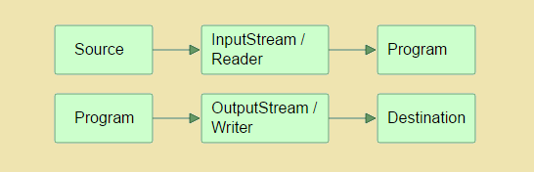
Java – File I/O
The InputStream, OutputStream, Reader and Writer
  A program that needs to read data from some source needs an InputStream or a Reader. A program that needs to write data to some destination needs an OutputStream or a Writer. This is also illustrated in the diagram below:

Slide 33
Java – File I/O
A stream is a conceptually endless flow of data. You can either read from a stream or write to a stream. A stream is connected to a data source or a data destination. Streams in Java IO can be either byte based (reading and writing bytes) or character based (reading and writing characters).

Slide 34
Java – File I/O
Java IO Purposes and Features
  Java IO contains many subclasses of the InputStream,
  OutputStream, Reader and Writer classes. The reason is,
  that all of these subclasses are addressing various
  different purposes.
    File Access
    Network Access
    Internal Memory Buffer Access
    Inter-Thread Communication (Pipes)
    Buffering
    Filtering
    Parsing
    Reading and Writing Text (Readers / Writers)
    Reading and Writing Primitive Data (long, int etc.)
    Reading and Writing Objects

Slide 35
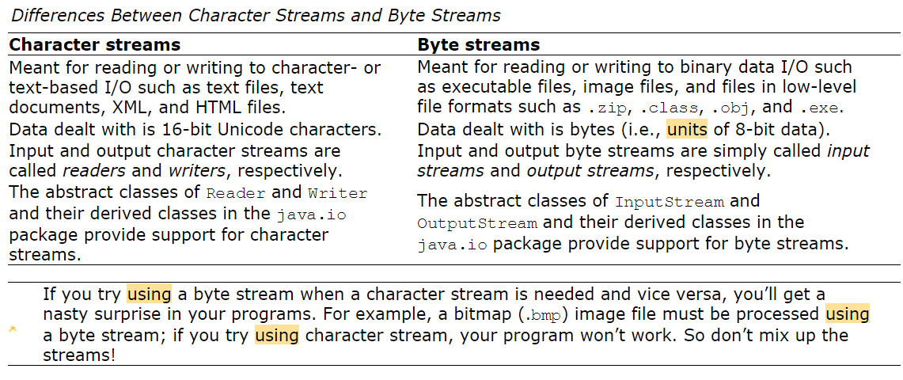
Java – File I/O

Slide 36
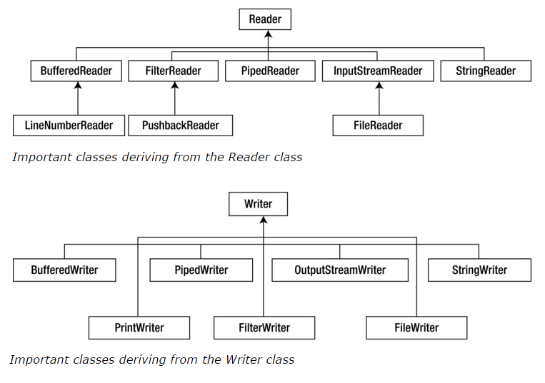
Java – File I/O
Character Streams

Slide 37
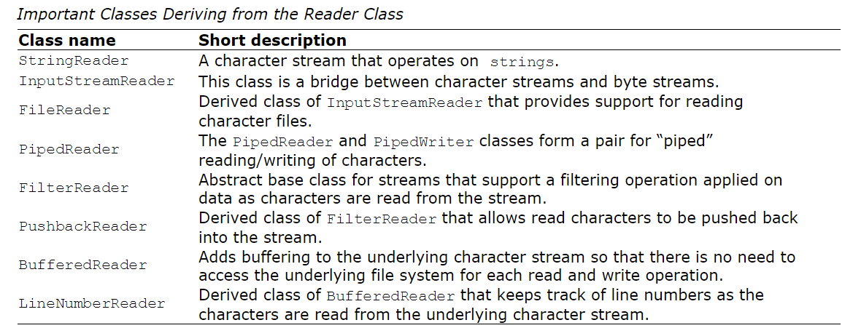
Java – File I/O
Character Streams

Slide 38
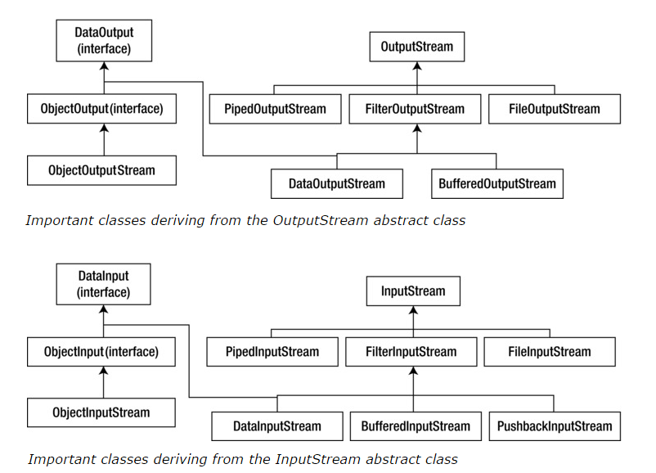
Java – File I/O
Byte Streams

Slide 39
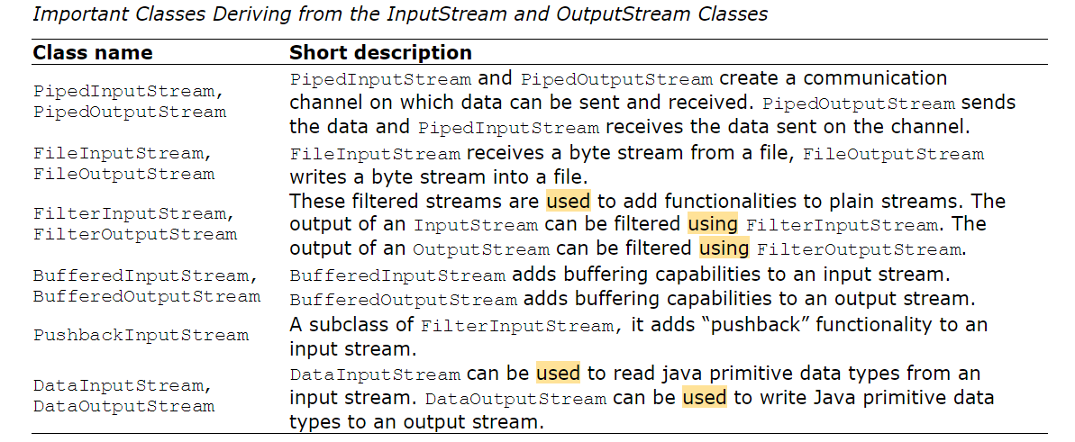
Java – File I/O
Byte Streams

Slide 40
Java - Collections
Collections
  A collection, sometimes called a container is simply an object that groups multiple elements into a single unit.
  Collections are used to store, retrieve, manipulate, and communicate aggregate data.
  Typically, they represent data items that form a natural group, such as a poker hand (a collection of cards), a mail folder (a collection of letters), or a telephone directory (a mapping of names to phone numbers).

Slide 41
Java - Collections
What Is a Collections Framework?
A collections framework is a unified architecture for representing and manipulating collections. All collections frameworks contain the following:
  Interfaces
    These are abstract data types that represent collections.
    Interfaces allow collections to be manipulated independently of the details of their representation
    In object-oriented languages, interfaces generally form a hierarchy.
  Implementations
    These are the concrete implementations of the collection interfaces. In essence, they are reusable data structures.
  Algorithms:
    These are the methods that perform useful computations, such as searching and sorting, on objects that implement collection interfaces.

Slide 42
Java - Collections
Benefits of the Java Collections Framework
  Reduces programming effort
  Increases program speed and quality
  Allows interoperability among unrelated APIs
  Reduces effort to learn and to use new APIs
  Fosters software reuse

Slide 43
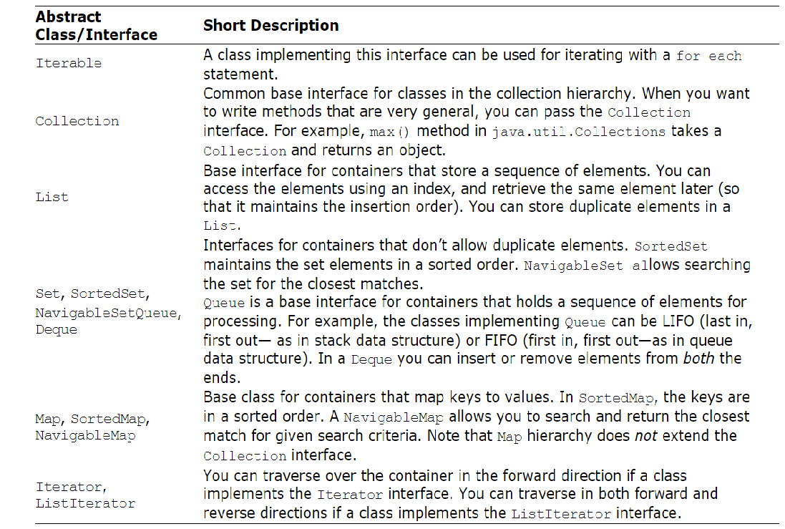
Java - Collections

Slide 44
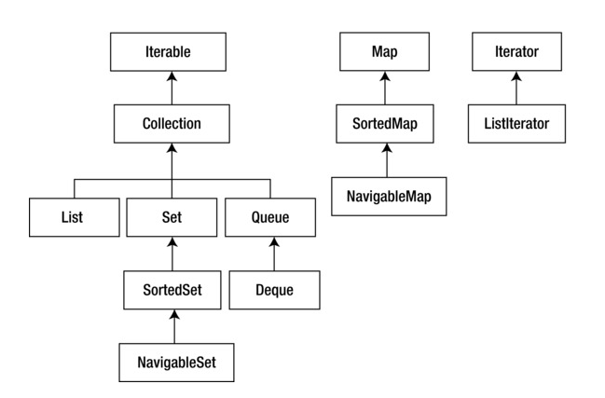
Java - Collections
Abstract Classes and Interfaces

Slide 45
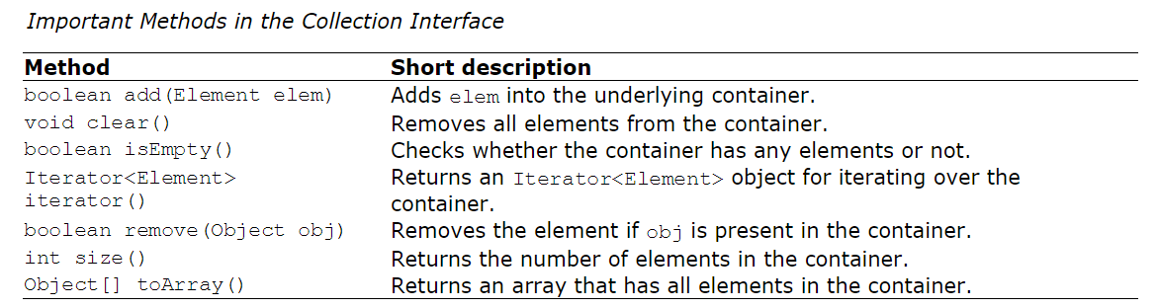
Java - Collections
The Collection Interface

Slide 46
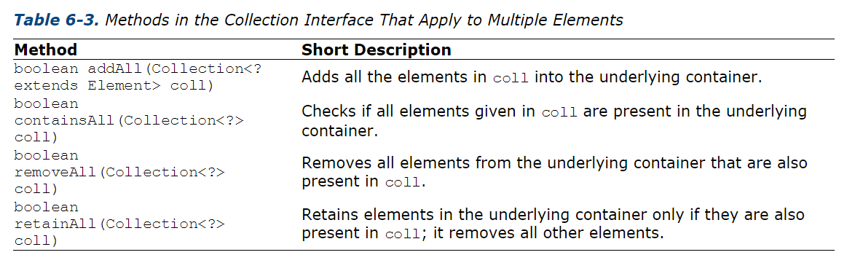
Java - Collections
The Collection Interface

Slide 47
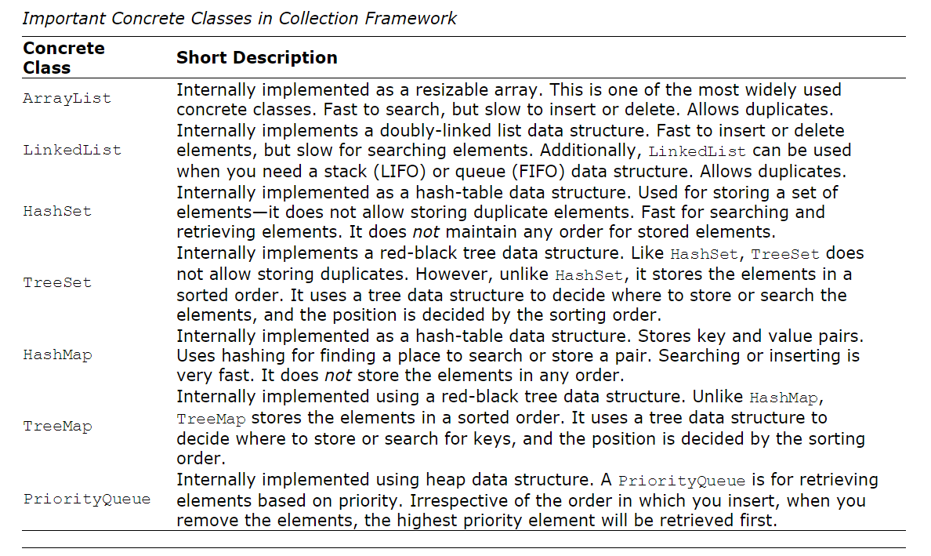
Java - Collections

Slide 48
Java - Collections
List Classes
  ArrayList Class
    ArrayList implements a resizable array.
    Internally, an ArrayList allocates a block of memory and grows it as required.
    So, accessing array elements is very fast in an ArrayList.
    When you add or remove elements, internally the rest of the elements are copied; so addition/deletion of elements is a costly operation.
  The LinkedList Class
    The LinkedList class internally uses a doubly-linked list
    Insertion and deletion is very fast in LinkedList
    When you want to add or remove elements frequently in a list of elements, it is better to use a LinkedList.

Slide 49
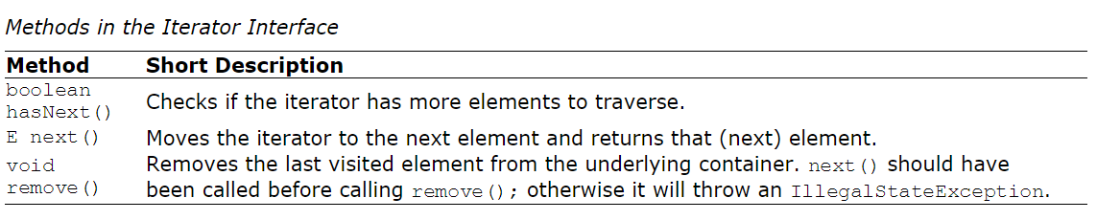
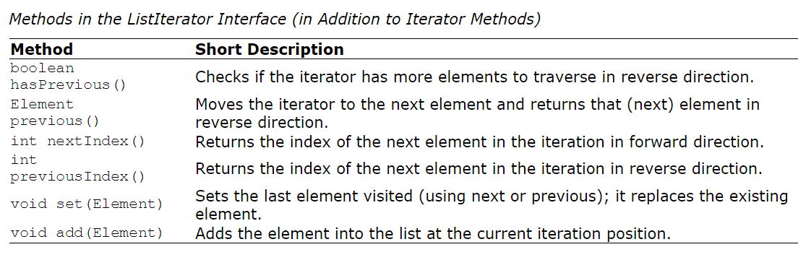
Java - Collections
The Iterator Interface
The ListIterator Interface

Slide 50
Java - Collections
The Queue Interface
  A Queue follows FIFO mechanism: the first inserted element will be removed first.
  For getting a queue behavior, you can create a LinkedList object and refer it through a Queue reference.
  When you call the methods from Queue reference, the object behaves like a Queue.

Slide 51
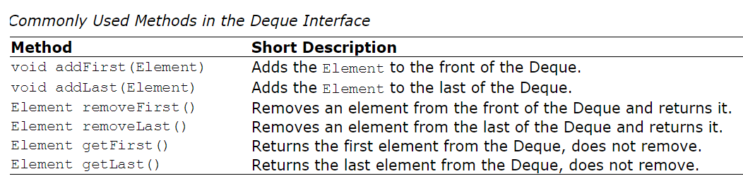
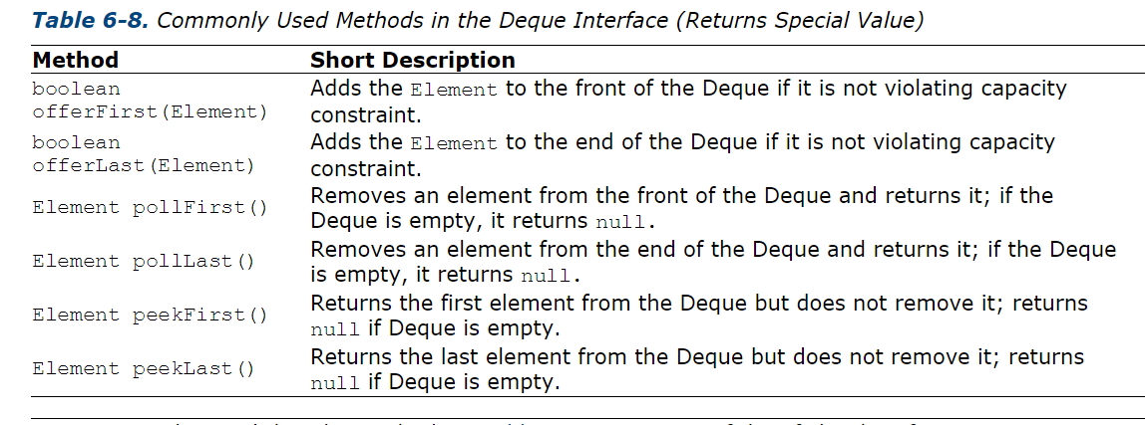
Java - Collections
The Deque Interface

Slide 52
Java - Collections
The Set Interface
  Set, as we studied in our math classes in high school, contains no duplicates
  Unlike List, a Set doesn’t remember where you inserted the element
  There are two important concrete classes for Set: HashSet and TreeSet.
HashSet
  A HashSet is for quickly inserting and retrieving elements
  it does not maintain any sorting order for the elements it holds.
TreeSet
  A TreeSet stores the elements in a sorted order
  It implements the SortedSet interface

Slide 53
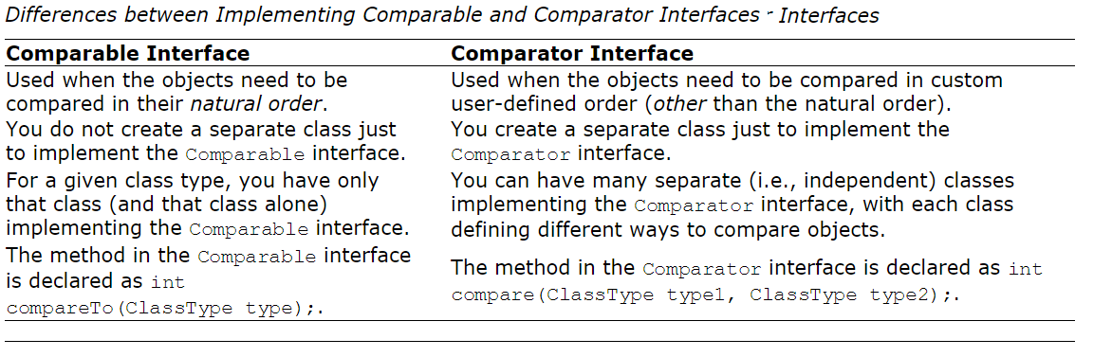
Java - Collections
Comparable and Comparator Interfaces

Slide 54
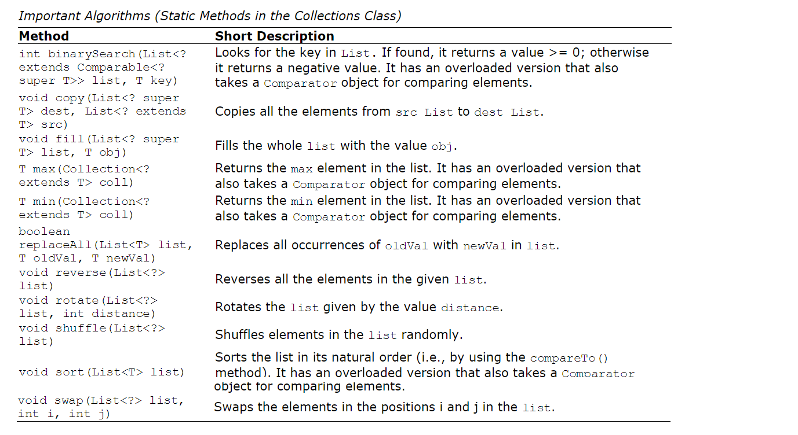
Java - Collections
Algorithms

Slide 55
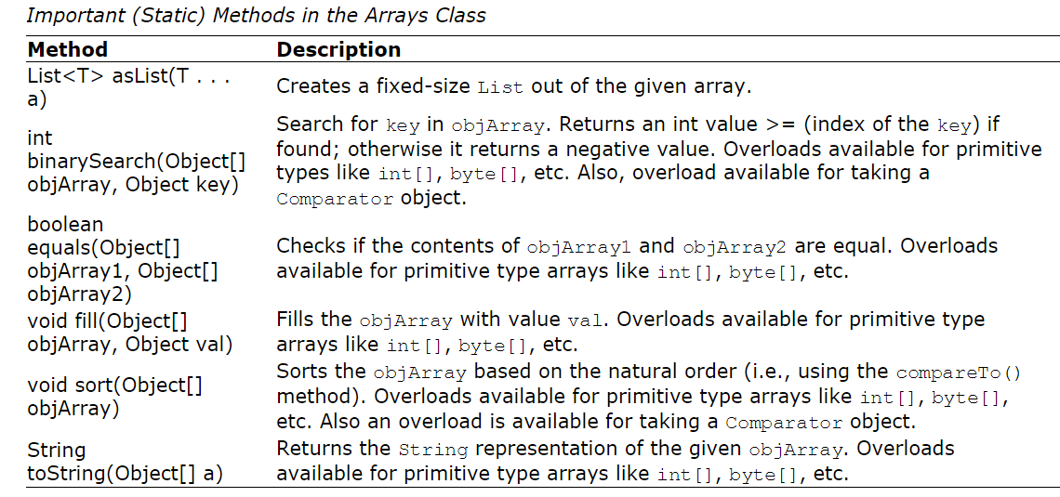
Java - Collections

Slide 56
Thanks
Q & A

