Slide 1
Introducing HTTP
What’s HTTP
  Hypertext Transfer Protocol (HTTP) is the foundation of data communication for WWW.
  This protocol defines how messages are formatted, transmitted, and processed over the Internet.
HTTP versions
  HTTP has been consistently evolving over time. So far, there are below versions
    HTTP/0.9 was the first documented version, which was released in the year 1991. This was very primitive and supported only the GET method.
    Later, HTTP/1.0 was released in the year 1996 with more features and corrections for the shortcomings in the previous release.
    HTTP/1.0 supported more request methods such as GET, HEAD, and POST. The next release was HTTP/1.1 in the year 1999.
    HTTP/2 (originally named HTTP 2.0) is current version. It is mainly focused on how the data is framed and transported between the client and the server.

Slide 2
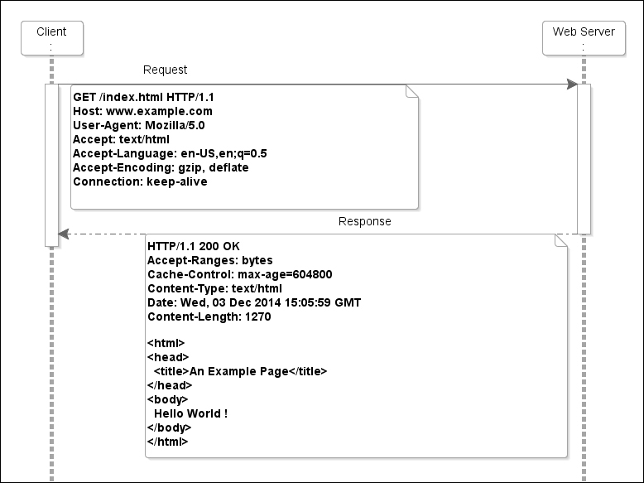
Introducing HTTP
Understanding the HTTP request-response model

Slide 3
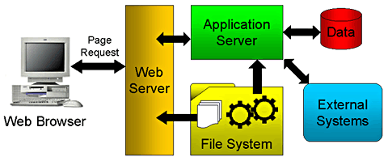
Web Application Architecture
An Web Application
  Front end
    Browser: IE, Firefox, Chrome, Safari…
  Server side
    Application Server
    Database Server
    File System
    ……

Slide 4
Introducing HTTP
Uniform resource identifier (URI)
  A URI is a text that identifies any resource or name on the Internet
  One can further classify a URI as a Uniform Resource Locator (URL) if the text used for identifying the resource also holds the means for accessing the resource such as HTTP or FTP.
  In general, all URLs are URIs.
  The following is one such example:
    https://www.packtpub.com/application-development

Slide 5
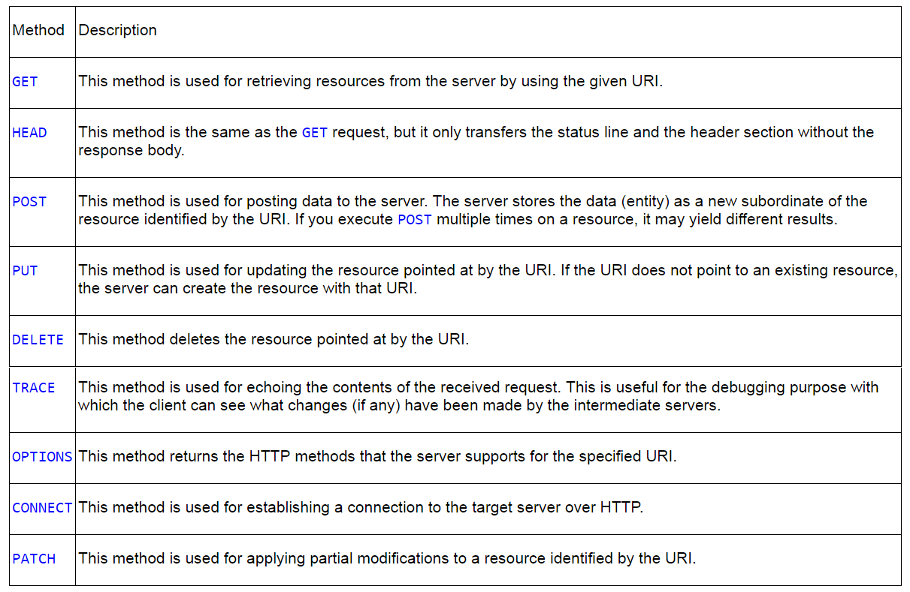
Introducing HTTP
HTTP request methods

Slide 6
Introducing HTTP
Representing content types using HTTP header fields
  The Content-Type header in an HTTP request or response describes the content type for the message body.
  The Accept header in the request tells the server the content types that the client is expecting in the response body.
  The content types are represented using the Internet media type.
  The Internet media type (also known as the MIME -Multipurpose Internet Mail Extensions type) indicates the type of data that a file contains
  Here is an example:
    Content-Type: text/html

Slide 7
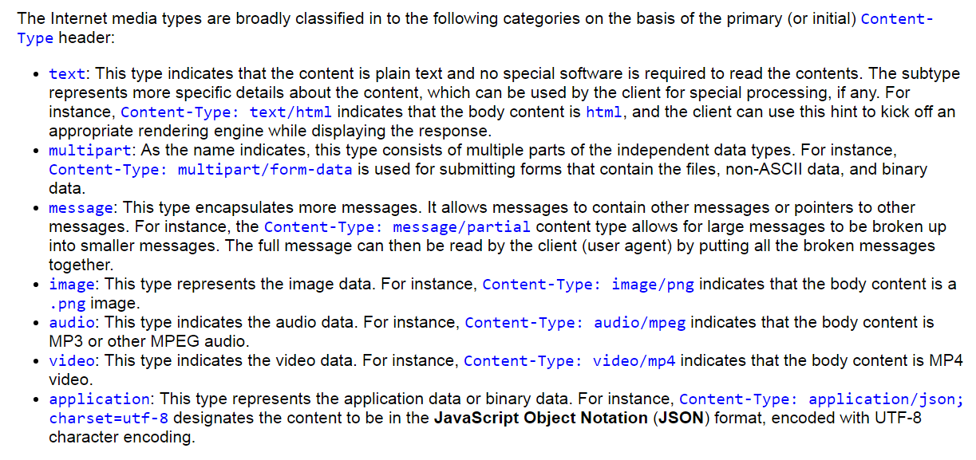
Introducing HTTP
content types

Slide 8
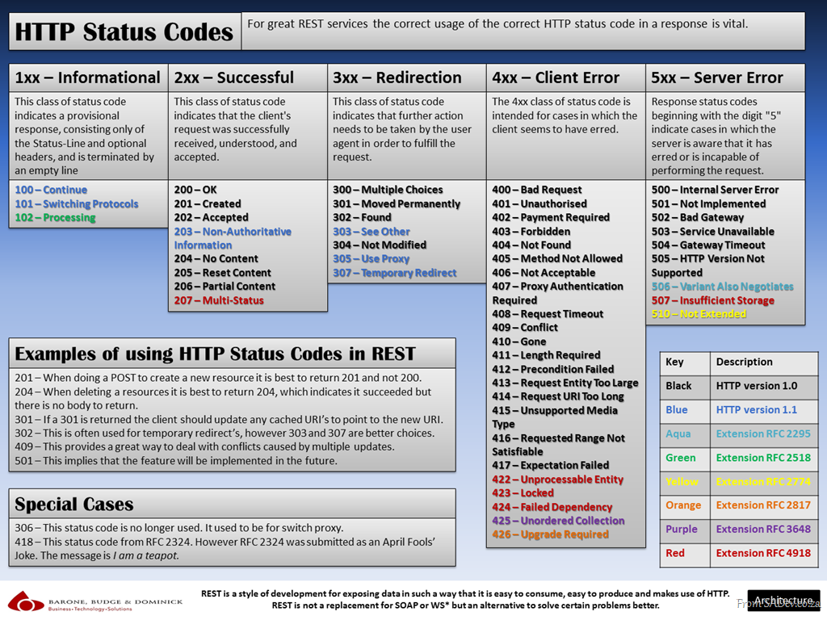
Introducing HTTP
HTTP status codes

Slide 9
Introducing Servlet
What is a Servlet
  A Servlet is a Java programming language class used to extend the capabilities of servers that host applications accessed by means of a request-response programming model.
  Although Servlets can respond to any type of request, they are commonly used to extend the applications hosted by web servers.
    For such applications, Java Servlet technology defines HTTP-specific servlet classes
    The javax.servlet and javax.servlet.http packages provide interfaces and classes for writing servlets.
  All Servlets must implement the Servlet interface, which defines lifecycle methods.
  When implementing a generic service, you can use or extend the GenericServlet class provided with the Java Servlet API
    The HttpServlet class provides methods, such as doGet and doPost, for handling HTTP-specific services.

Slide 10
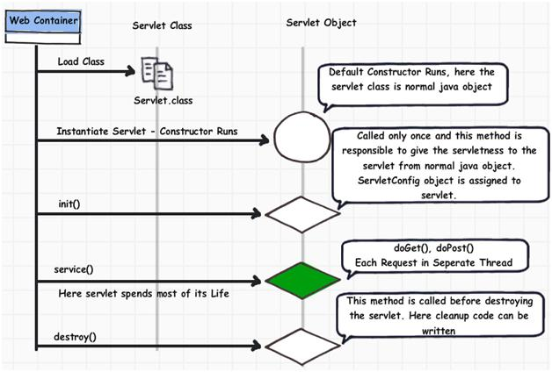
Introducing Servlet
Servlet LifeCycle

Slide 11
Introducing RESTful web services
The REST architectural style
  REST is not an architecture; rather, it is a set of constraints that creates a software architectural style, which can be used for building distributed applications.

Slide 12
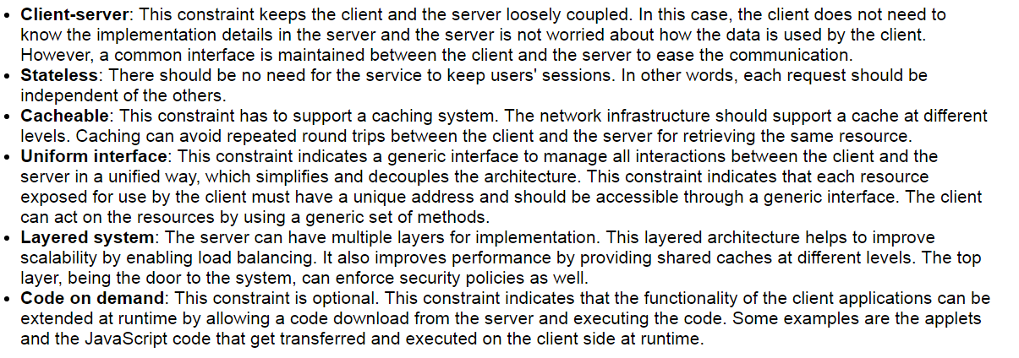
Introducing RESTful web services
Following constraints that define a RESTful system

Slide 13
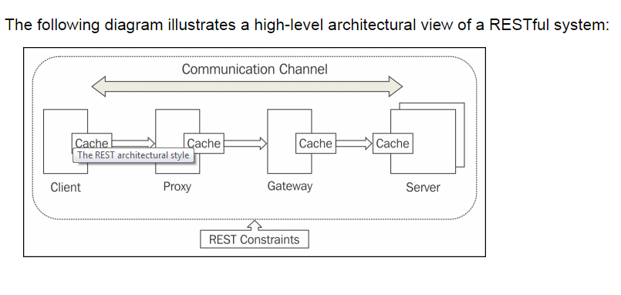
Introducing RESTful web services

Slide 14
Introducing RESTful web services
What is Web Service
  A web service is one of the very popular methods of communication between the client and server applications over the Internet. In simple words, web services are web application components that can be published, found, and used over the web. Typically, a web service has an interface describing the web service APIs, which is known as Web Services Description Language (WSDL). A WSDL file can be easily processed by machines, which blows out the integration complexities that you may see with large systems. Other systems interact with the web service by using Simple Object Access Protocol (SOAP)messages. The contract for communication is driven by the WSDL exposed by the web service. Typically, communication happens over HTTP with XML in conjunction with other web-related standards.

Slide 15
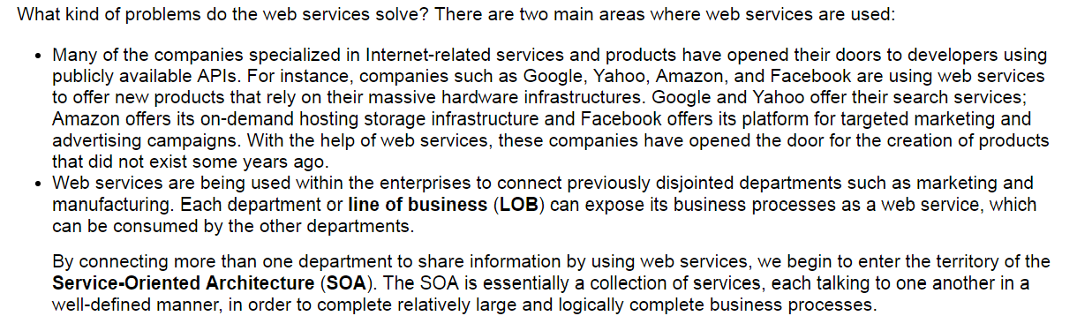
Introducing RESTful web services
Solving Problem

Slide 16
Introducing RESTful web services
The core architectural elements of a RESTful uniform interface
  Resources and their identifiers
  Representations of resources
  Generic interaction semantics for the REST resources
  Self-descriptive messages
  Hypermedia as the engine of an application state

Slide 17
Introducing RESTful web services
Resources
  A RESTful resource is anything that is addressable over the Web
  Some examples of the REST resources:
    A news story
    The temperature in NY at 4:00 p.m. EST
    A tax return stored in the IRS database
    A list of code revision history in a repository such as SVN or CVS
    A student in a classroom in a school
    A search result for a particular item in a Web index, such as Google

Slide 18
Introducing RESTful web services
URI
  A URI is a string of characters used to identify a resource over the Web.
    In simple words, the URI in a RESTful web service is a hyperlink to a resource, and it is the only means for clients and servers to exchange representations.
The client uses a URI to locate the resources over Web and then, sends a request to the server and reads the response.
In a RESTful system, the URI is not meant to change over time as it may break the contract between a client and a server.
More importantly, even if the underlying infrastructure or hardware changes (for example, swapping the database servers) for a server hosting REST APIs, the URIs for resources are expected to remain the same as long as the web service is up and running.

Slide 19
Introducing RESTful web services
The representation of resources
  The representation of resources is what is sent back and forth between clients and servers in a RESTful system.
Throughout the life of a web service, there may be a variety of clients requesting resources
Different clients can consume different representations of the same resource.
  Therefore, a representation can take various forms, such as an image, a text file, an XML, or a JSON format.
  However, all clients will use the same URI with appropriate Accept header values for accessing the same resource in different representations.

Slide 20
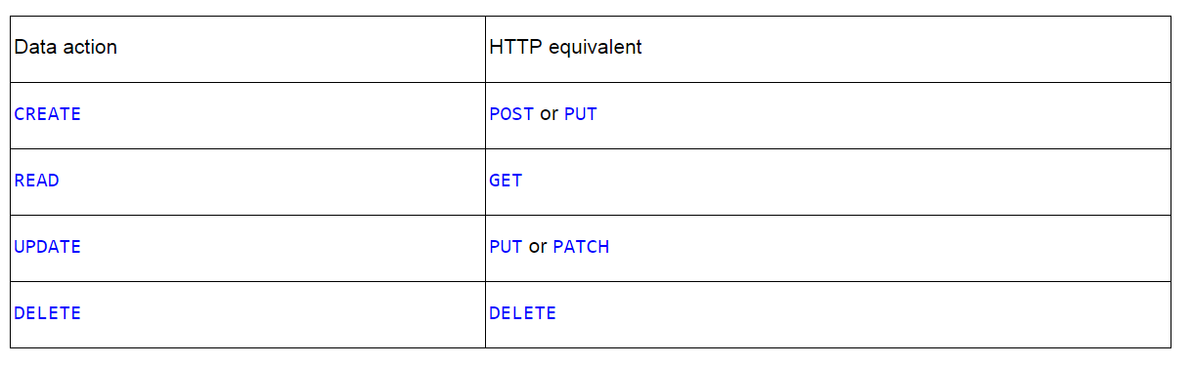
Introducing RESTful web services
Generic interaction semantics for REST resources
  In a RESTful system, we can easily map our CRUD actions on the resources to the appropriate HTTP methods such as POST, GET, PUT, and DELETE.
This is shown in the following table

Slide 21
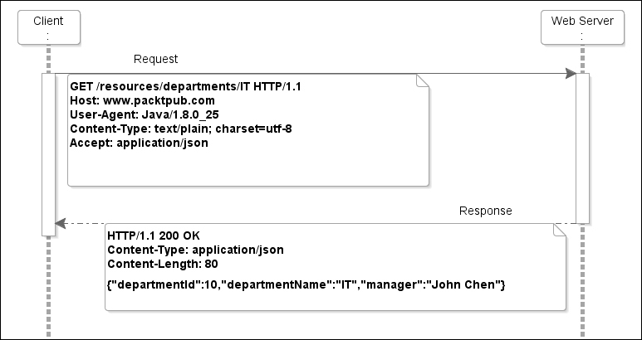
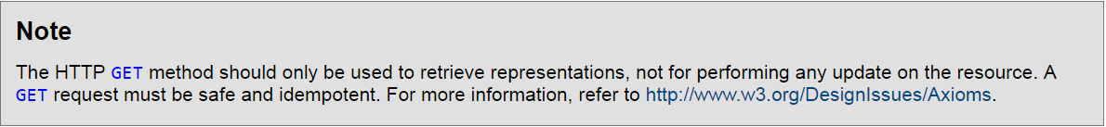
Introducing RESTful web services
GET

Slide 22
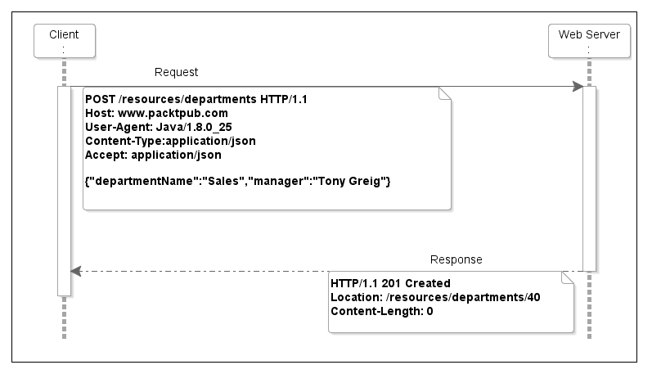
Introducing RESTful web services
POST

Slide 23
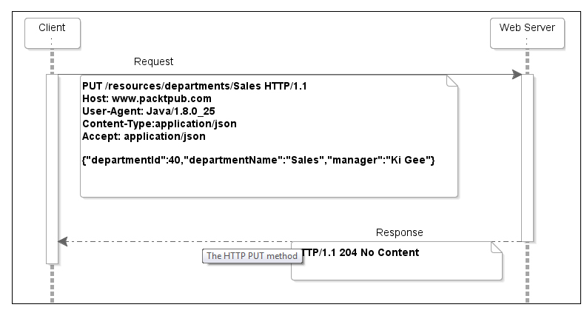
Introducing RESTful web services
PUT

Slide 24
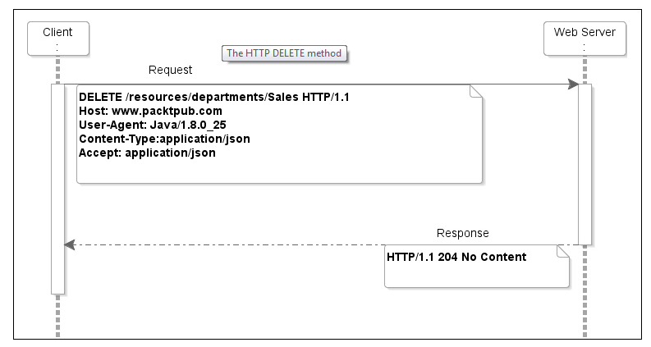
Introducing RESTful web services
DELETE

Slide 25
Introducing RESTful web services
Description and discovery of RESTful web services
  Entry points for the service
  Resource paths for accessing each resource
  HTTP methods allowed to access these resources, such as GET, POST, PUT, and DELETE
  Additional parameters that need to be supplied with these methods, such as pagination parameters, while reading large collections
  Format types used for representing the request and response body contents such as JSON, XML, and TEXT
  Status codes and error messages returned by the APIs
  Human readable documentation for REST APIs, which includes the documentation of the request methods, input and output parameters, response codes (success or error), API security, and business logic.

Slide 26
Introducing RESTful web services
Java APIs for JSON Processing
  JSON is a lightweight, text-based, platform neutral, data interchange format in which objects are represented in the attribute-value pair format. Historically, JSON originated from JavaScript.

Slide 27
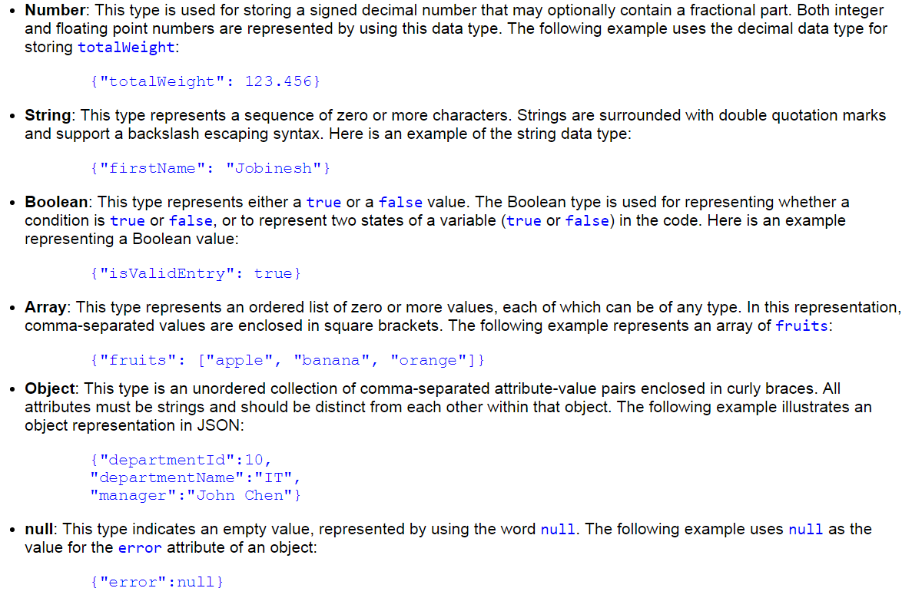
Introducing RESTful web services
Basic data types available with JSON

Slide 28
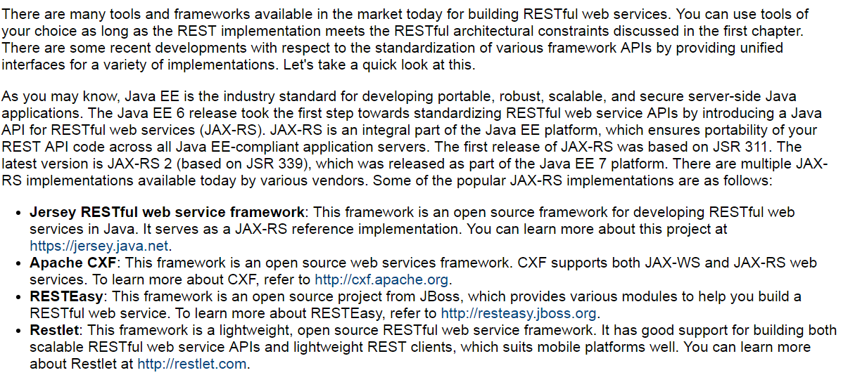
Introducing RESTful web services
An overview of JAX-RS

Slide 29
Introducing RESTful web services

Slide 30
Introducing RESTful web services
JAX-RS annotations
The main goal of the JAX-RS specification is to make the RESTful web service development easier than it has been in the past. As JAX-RS is a part of the Java EE platform, your code becomes portable across all Java EE-compliant servers.

Slide 31
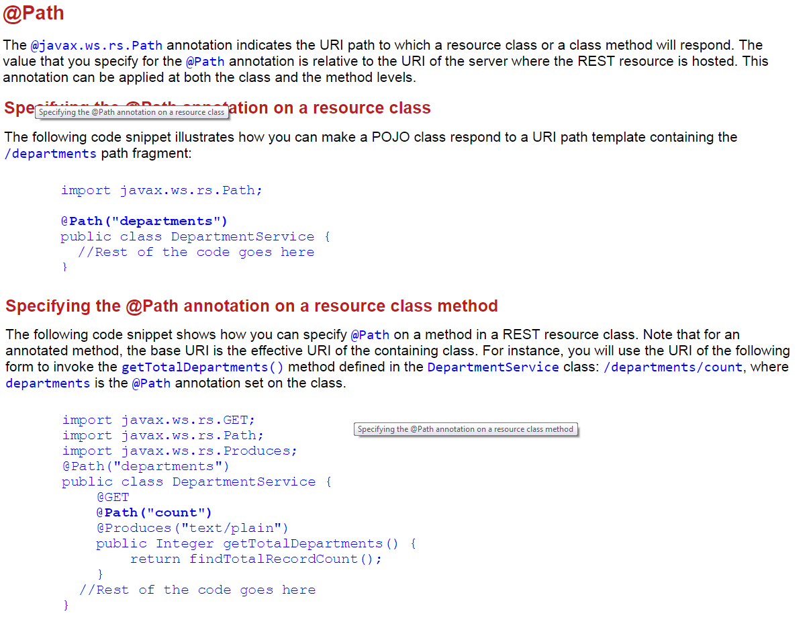
Introducing RESTful web services
Annotations for specifying request-response media types

Slide 32
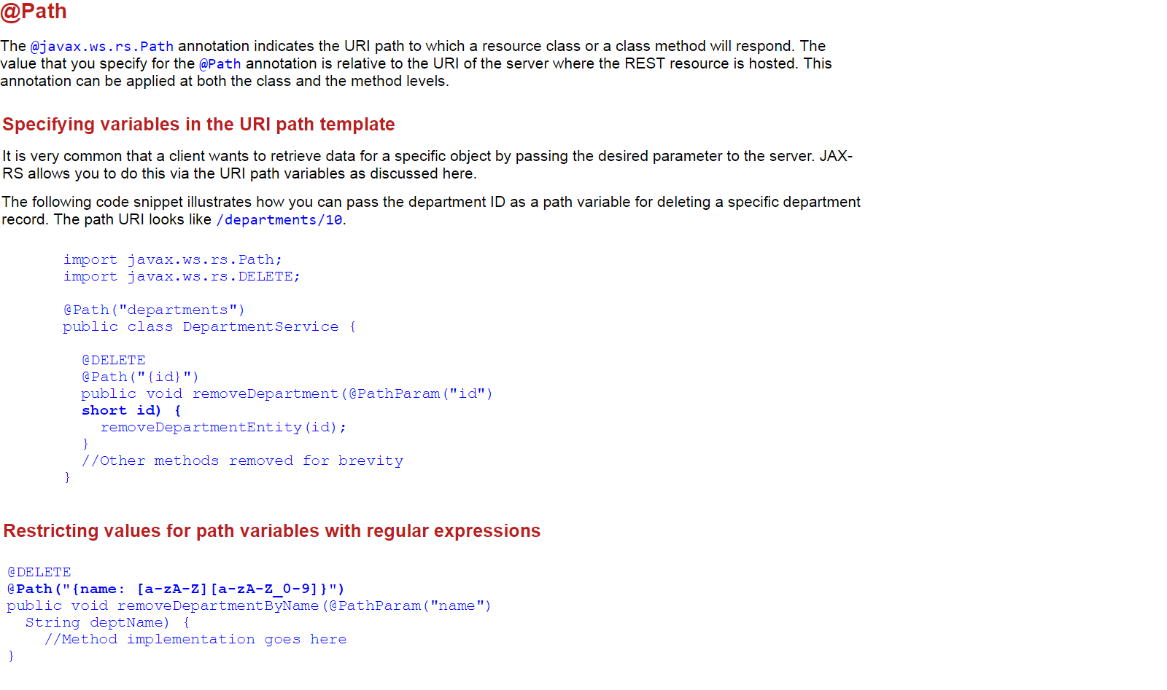
Introducing RESTful web services
Annotations for specifying request-response media types

Slide 33
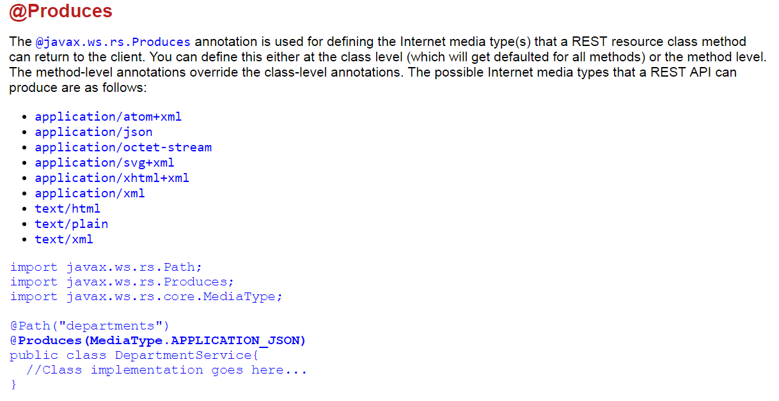
Introducing RESTful web services
Annotations for specifying request-response media types

Slide 34
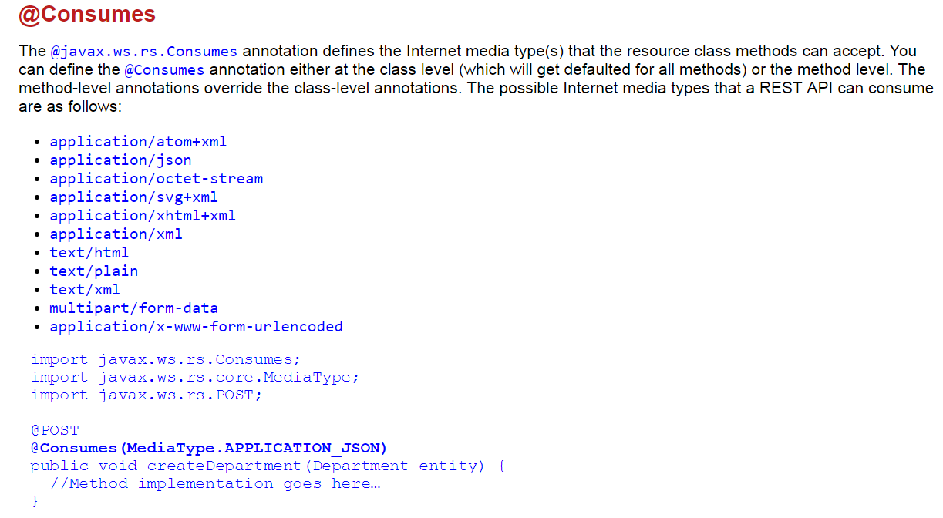
Introducing RESTful web services
Annotations for specifying request-response media types

Slide 35
Introducing RESTful web services

Slide 36
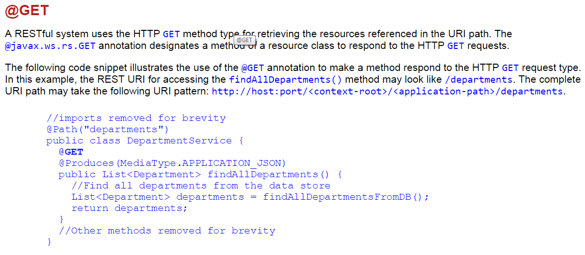
Introducing RESTful web services
Annotations for processing HTTP request methods

Slide 37
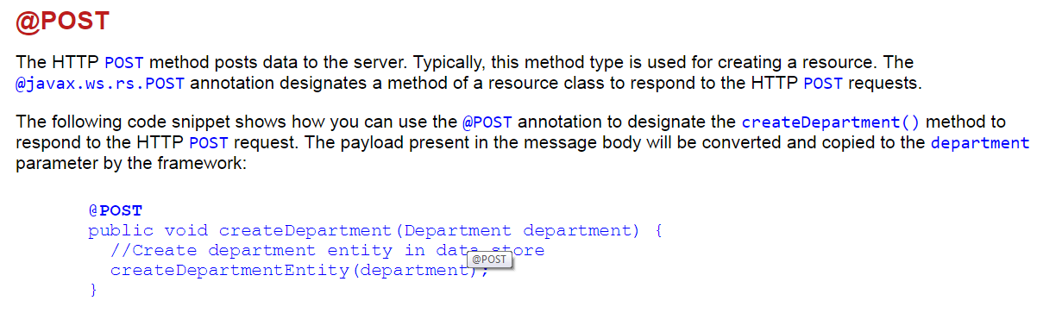
Introducing RESTful web services
Annotations for processing HTTP request methods

Slide 38
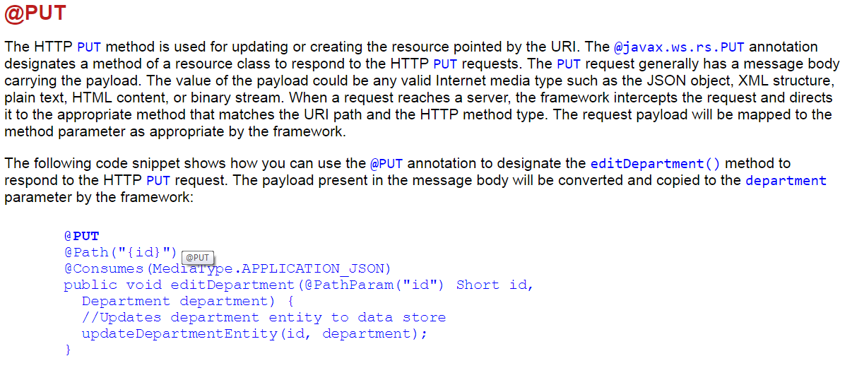
Introducing RESTful web services
Annotations for processing HTTP request methods

Slide 39
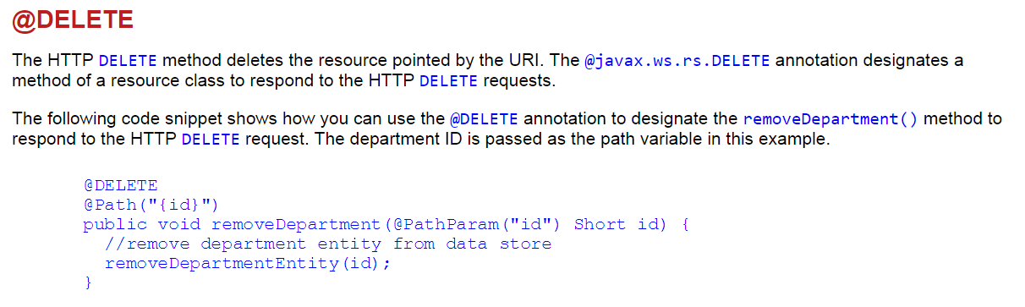
Introducing RESTful web services
Annotations for processing HTTP request methods

Slide 40
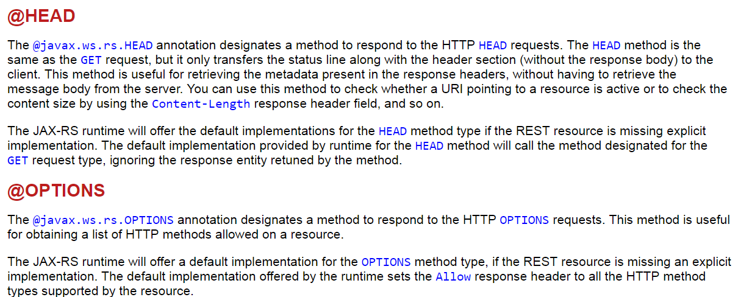
Introducing RESTful web services
Annotations for processing HTTP request methods

Slide 41
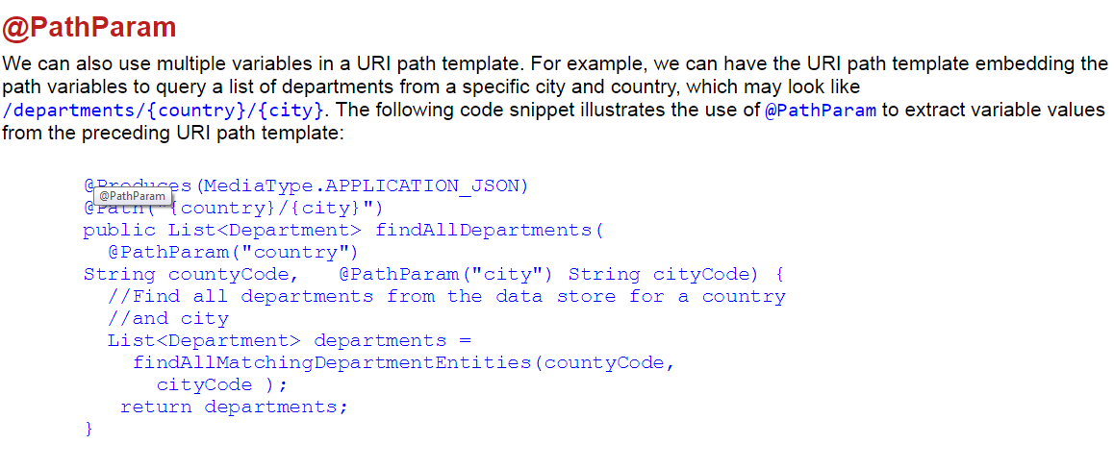
Introducing RESTful web services
Annotations for accessing request parameters

Slide 42
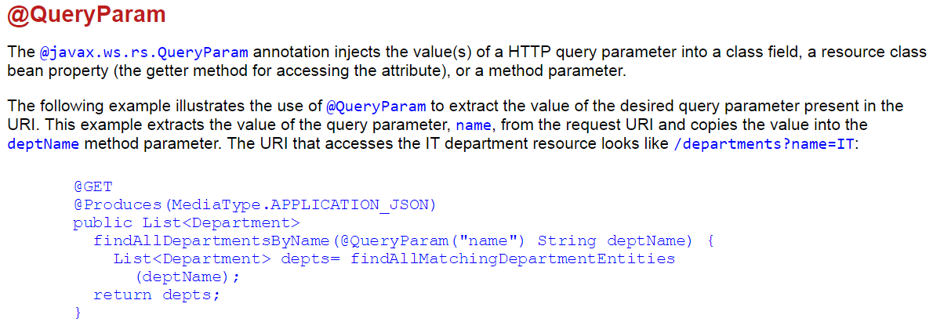
Introducing RESTful web services
Annotations for accessing request parameters

Slide 43
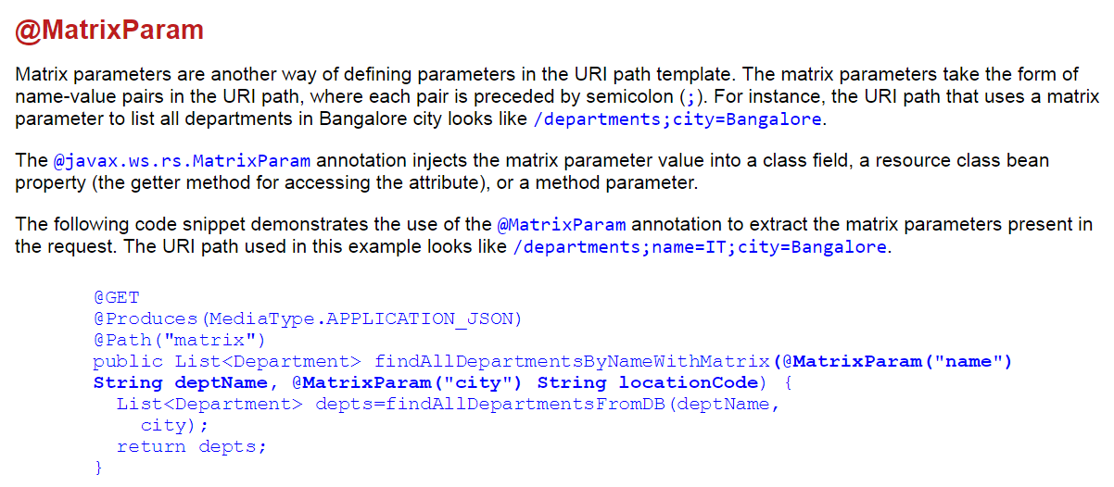
Introducing RESTful web services
Annotations for accessing request parameters

Slide 44
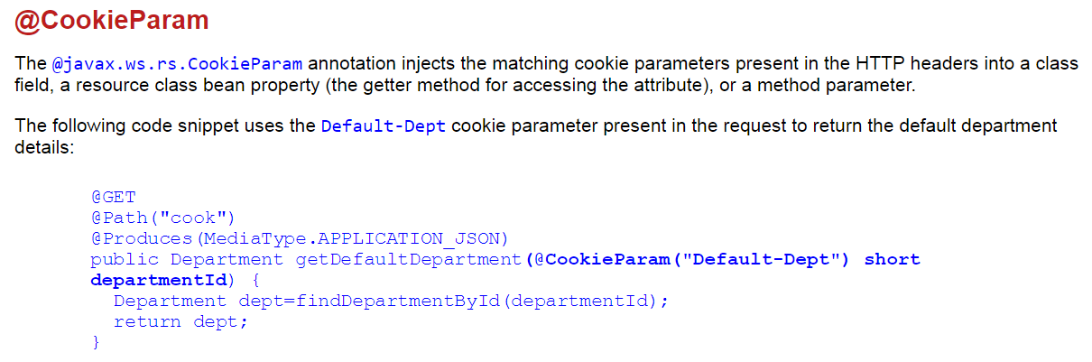
Introducing RESTful web services
Annotations for accessing request parameters

Slide 45
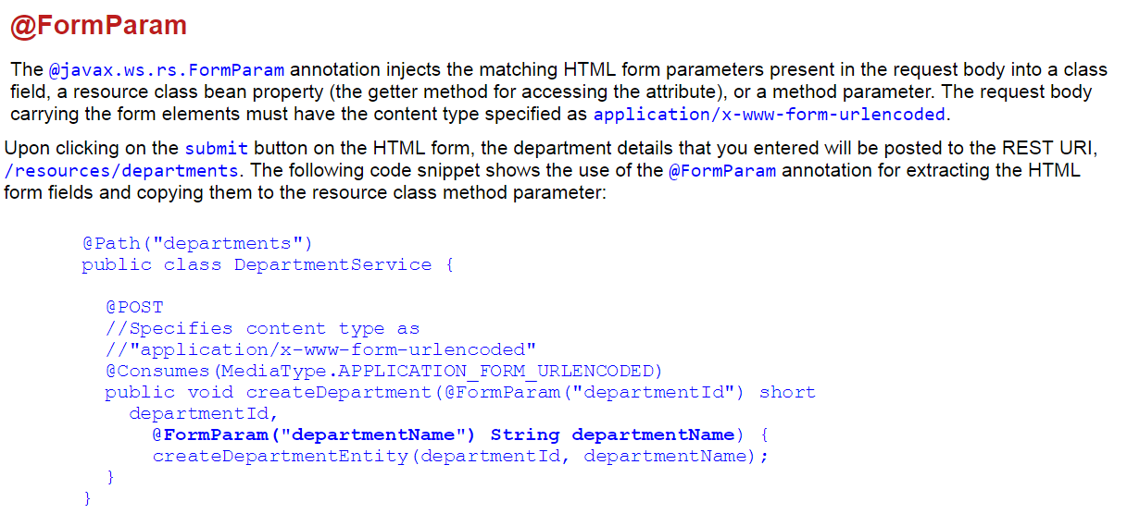
Introducing RESTful web services
Annotations for accessing request parameters

Slide 46
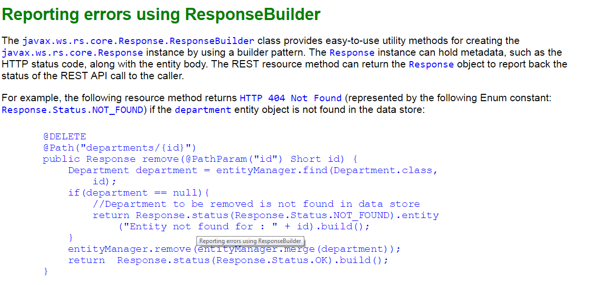
Introducing RESTful web services
Exception handling in JAX-RS

Slide 47
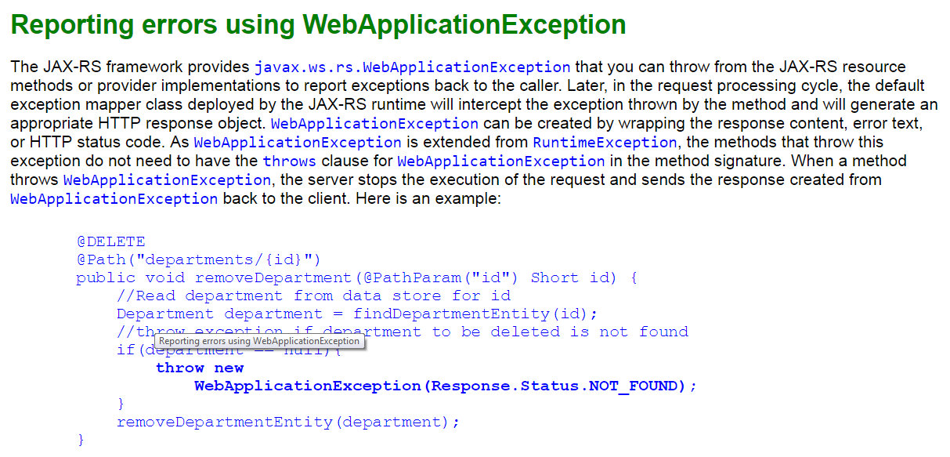
Introducing RESTful web services
Exception handling in JAX-RS

Slide 48
Thanks
Q & A

