Slide 1

Learning JDBC

Slide 2
Database Drivers
Think of a database as just another device connected to your computer
like other devices it has a driver program to relieves you of having to do low level programming to use the database
The driver provides you with a high level API to the database

Slide 3
ODBC
Open Data Base Connectivity
Developed by Microsoft for the Windows platform as the way for Windows applications to access Microsoft databases (SQL Server, FoxPro, Access)
Has become an industry standard
Most data base vendors supply native, odbc, and jdbc drivers for their data base products

Slide 4
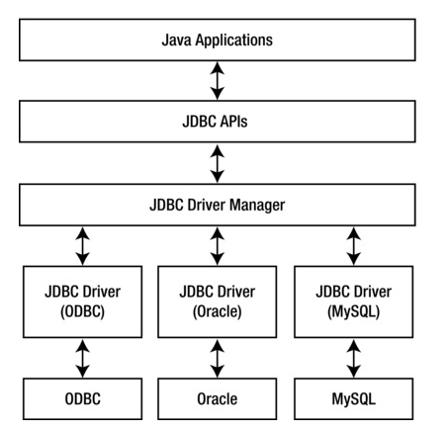
JDBC Architecture

Slide 5
Driver Types - Type 1 Drivers
Translate JDBC into ODBC and use Windows ODBC built in drivers
ODBC must be set up on every client
  driver must be physically on each machine for both java applications and applets
  for server side servlets ODBC must be set up on web server
driver sun.jdbc.odbc.JdbcOdbc provided by JavaSoft with JDK

Slide 6
Driver Types - Type 2 Drivers
Converts JDBC to data base vendors native SQL calls
Like Type 1 drivers; requires installation of binaries on each client

Slide 7
Driver Types - Type 3 Drivers
Translates JDBC to a DBMS independent network protocol
Typically talks directly with a middleware product which in turn talks to the RDBMS
  Jaguar, DBAnywhere, SequeLink
Most flexible driver type
All java

Slide 8
Driver Types - Type 4 Drivers
Converts JDBC directly to native API used by the RDBMS
Compiles into the application , applet or servlet; doesn’t require anything to be installed on client machine, except JVM
Handiest driver type

Slide 9
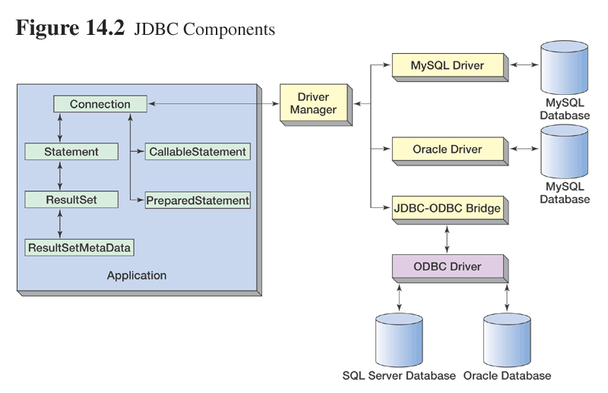
JDBC Components

Slide 10
Using JDBC
Load the driver
  The driver class libraries need to be in the CLASSPATH for the Java compiler and for the Java virtual machine
  Class.forName(string).newInstance();
    Class.forName("oracle.jdbc.driver.OracleDriver");
Establish a connection to the database
  Connection conn = DriverManager.getConnection(string);
  A connection string includes the literal jdbc:, followed by the name of the driver and a URL to the database
    Connection con = DriverManager.getConnection( "jdbc:oracle:thin:@oracle-prod:1521:OPROD", username, passwd);

Slide 11
Using JDBC
Create a statement
  Statement stmt = conn.createStatement();
Execute the statement
  ResultSet rs = stmt.executeQuery(querystring);
  Int result = stmt.executeUpdate(updatestring);
  ResultSetMetaData rsMeta = rs.getMetaData();
Both compiled queries and stored procedures can be processed via JDBC using PreparedStatement and CallableStatement objects

Slide 12
Transactions and JDBC
JDBC allows SQL statements to be grouped together into a single transaction
Transaction control is performed by the Connection object, default mode is auto-commit, I.e., each sql statement is treated as a transaction
We can turn off the auto-commit mode with con.setAutoCommit(false);
And turn it back on with con.setAutoCommit(true);
Once auto-commit is off, no SQL statement will be committed until an explicit is invoked con.commit();
At this point all changes done by the SQL statements will be made permanent in the database.

Slide 13
Handling Errors with Exceptions
Programs should recover and leave the database in a consistent state.
If a statement in the try block throws an exception or warning, it can be caught in one of the corresponding catch statements
How might a finally {…} block be helpful here?
E.g., you could rollback your transaction in a
catch { …} block or close database connection and free database related resources in finally {…} block

Slide 14
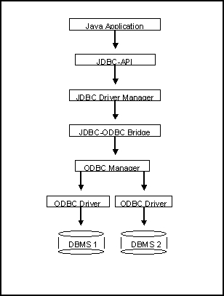
Another way to access database(JDBC-ODBC)

Slide 15
Sample Program
import java.sql.*;
class Test {
public static void main(String[] args) {
try {
Class.forName("sun.jdbc.odbc.JdbcOdbcDriver"); //dynamic loading of driver
String filename = "c:/db1.mdb"; //Location of an Access database
String database = "jdbc:odbc:Driver={Microsoft Access Driver (*.mdb)};DBQ=";
database+= filename.trim() + ";DriverID=22;READONLY=true}"; //add on to end
Connection con = DriverManager.getConnection( database ,"","");
Statement s = con.createStatement();
s.execute("create table TEST12345 ( firstcolumn integer )");
s.execute("insert into TEST12345 values(1)");
s.execute("select firstcolumn from TEST12345");

Slide 16
Sample Program
ResultSet rs = s.getResultSet();
if (rs != null) // if rs == null, then there is no ResultSet to view
while ( rs.next() ) // this will step through our data row-by-row
{ /* the next line will get the first column in our current row's ResultSet
as a String ( getString( columnNumber) ) and output it to the screen */
System.out.println("Data from column_name: " + rs.getString(1) );
}
s.close(); // close Statement to let the database know we're done with it
con.close(); //close connection
}
catch (Exception err) { System.out.println("ERROR: " + err); }
}
}

Slide 17
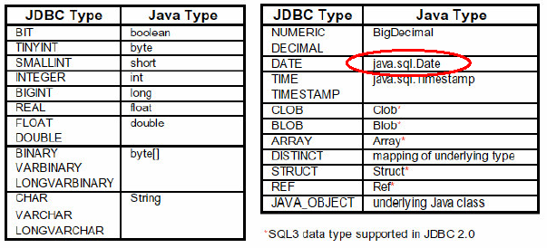
Mapping types JDBC - Java

Slide 18
JDBC – Scrollable Result Set
…
Statement stmt =
con.createStatement(ResultSet.TYPE_SCROLL_INSENSITIVE,
ResultSet.CONCUR_READ_ONLY);
String query = “select students from class where type=‘not sleeping’ “;
ResultSet rs = stmt.executeQuery( query );
rs.previous(); / / go back in the RS
rs.relative(-5); / / go 5 records back
rs.relative(7); / / go 7 records forward
rs.absolute(100); / / go to 100th record

Slide 19
JDBC 2 – Updateable ResultSet
…
Statement stmt =
con.createStatement(ResultSet.TYPE_FORWARD_ONLY,
ResultSet.CONCUR_UPDATABLE);
String query = " select students, grade from class
where type=‘really listening this presentation☺’ “;
ResultSet rs = stmt.executeQuery( query );
…
while ( rs.next() )
{
int grade = rs.getInt(“grade”);
rs.updateInt(“grade”, grade+10);
rs.updateRow();
}

Slide 20
Metadata from DB
A Connection's database is able to provide schema information describing its tables, its supported SQL grammar, its stored procedures
the capabilities of this connection, and so on.
This information is made available through
a DatabaseMetaData object.

Slide 21
Metadata from DB - example
…
Connection con = …. ;
DatabaseMetaData dbmd = con.getMetaData();
String catalog = null;
String schema = null;
String table = “sys%”;
String[ ] types = null;
ResultSet rs =
dbmd.getTables(catalog , schema , table , types );
…

Slide 22
JDBC – Metadata from RS
public static void printRS(ResultSet rs) throws SQLException
{
ResultSetMetaData md = rs.getMetaData();
// get number of columns
int nCols = md.getColumnCount();
// print column names
for(int i=1; i < nCols; ++i)
System.out.print( md.getColumnName( i)+",");
/ / output resultset
while ( rs.next() )
{ for(int i=1; i < nCols; ++i)
System.out.print( rs.getString( i)+",");
System.out.println( rs.getString(nCols) );
}
}

Slide 23
Thanks
Q & A

