Slide 1

Advanced User Interaction

Slide 2
Agenda
In this Session , We will explore:
  Checking for an WebElement's state
  User Interactions API for Mouse and Keyboard Events
  Automating File Upload using Robot Class
  Performing double-click on an element
  Performing drag-and-drop operation
  Executing the JavaScript code
  Capturing Screenshots with Selenium WebDriver
  Comparing Images
  Working with Browser Navigation
  Practical Session

Slide 3
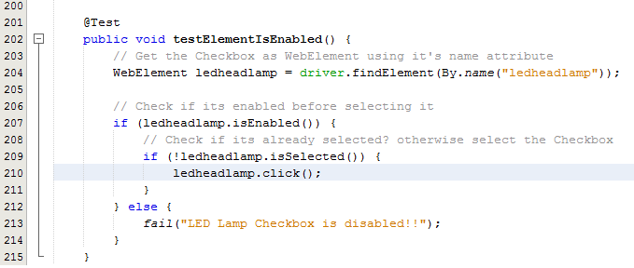
Checking WebElement’s State
isEnabled() : This method checks if an element is enabled. It returns true if enabled, else false if disabled.
isSelected() : This method checks if an element is selected (radio button, checkbox, and so on). It returns true if selected, else false if deselected.
isDisplayed() : This method checks if an element is displayed.

Slide 4
User Interaction API for Mouse & Keyboard Events
The Selenium WebDriver's Advanced User Interactions API allows us to perform operations from keyboard events and simple mouse events to complex events such as dragging-and-dropping, holding a key and then performing mouse operations using the Actions class, and building a complex chain of events exactly like a user doing these manually.
The Actions class implements the builder pattern to create a composite action containing a group of other actions.
Reference : https://seleniumhq.github.io/selenium/docs/api/java/org/openqa/selenium/interactions/Actions.html

Slide 5
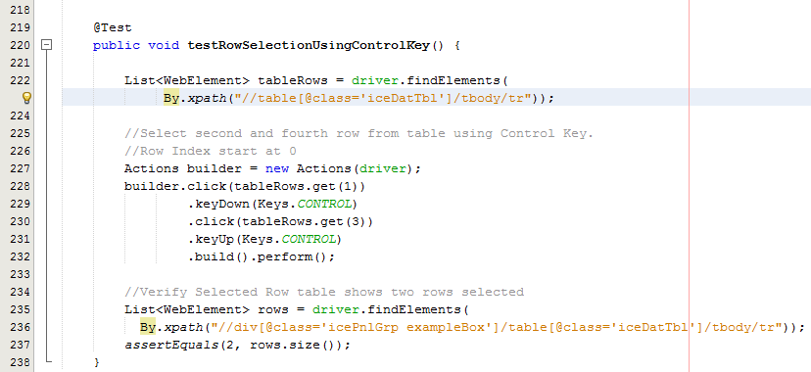
User Interaction API for Mouse & Keyboard Events
How to do it...
  We will use the Actions class to build a chain of events to select rows in a table.

Slide 6
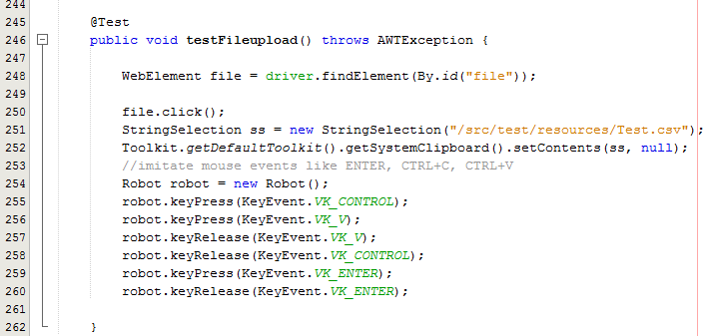
Automating File Upload using Robot Class
How to do it...

Slide 7
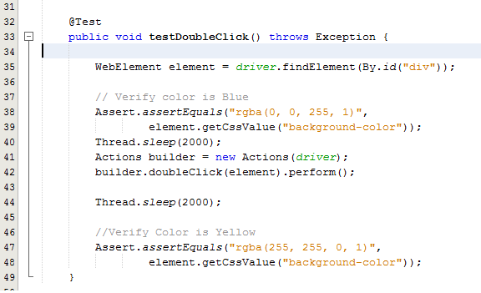
Performing Double Click on Element
How to do it...

Slide 8
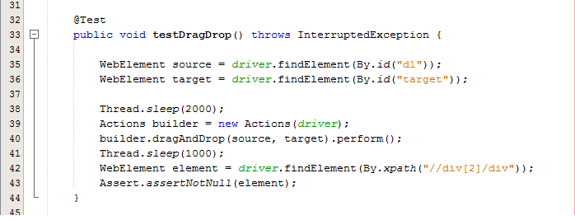
Performing Drag-Drop Operation
How to do it...

Slide 9
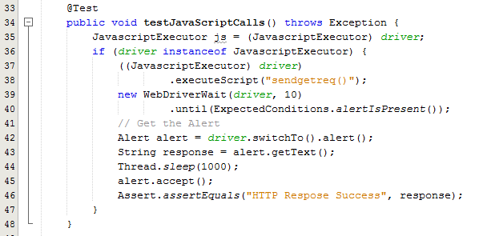
Executing Java Script
How to do it...

Slide 10
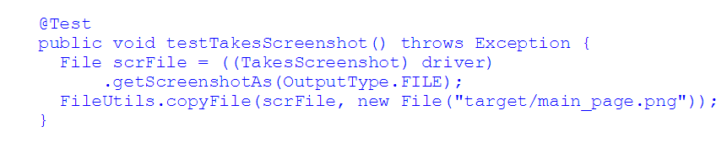
Taking Screenshot
How to do it...
  FileUtils class from the org.apache.commons.io.FileUtils class.

Slide 11
Comparing Images
Many a time, our tests need image-based comparison. For example, verifying whether correct icons are displayed, verifying whether correct images are displayed in web pages, or comparing the baseline screen layout with the actual layout.
Selenium Web Driver does have features to capture screenshots or images from the application under test; however, it does not have the feature to compare the images.
In this recipe, we will create an extension class to compare images and use it in our Selenium tests.
Refer : Sample Selenium POC for example

Slide 12
Web Browser Navigation
back(): This method moves back to the page in browser history.
    driver.navigate().back()
forward(): This method moves forward to the page in browser
driver.navigate().forward()
refresh() : This method reloads the current page.
driver.navigate().refresh()
to(String url) : This method loads the specified URL in the current browser window.
driver.navigate().to(URL)
driver.navigate().to(“String”)
maximize() : This method maximizes the window
driver.manage().window().maximize();

Slide 13
Thanks
Q & A

