Slide 1

Data-Driven Testing

Slide 2
Agenda
In this Session , We will explore:
  Data-Driven Test Workflow
  Benefits of Data-Driven Tests
  Creating a Data-Driven test using TestNG
  Reading test data from a CSV file using OpenCSV
  Reading test data from an Excel file using Apache POI
  Running Data Driven Test Parallely Using TestNG
  Practice Session, Build POC.

Slide 3
Data-Driven Test Workflow
In the Data-Driven approach, we can maintain the test data in form tables in a variety of formats, such as CSV files, Excel spreadsheets, and databases.
We implement test scripts after reading input and output values from data files row by row, then passing the values to the main test code. Then, the test code navigates through the application, executing the steps needed for the test case using the variables loaded with data values.
Data-driven tests are great for applications involving calculations for testing ranges of values, boundary values, and corner cases.

Slide 4
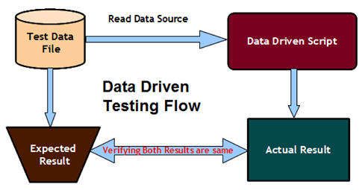
Data-Driven Test Workflow

Slide 5
Benefits of Data-Driven Test
With Data-driven tests, we can get greater test coverage while minimizing the amount of test code we need to write and maintain.
Data-driven testing makes creating and running a lot of test conditions very easy.
Test data can be designed and created before the application is ready for testing.
Data tables can also be used in manual testing.

Slide 6
Building Data-drive Tests
Selenium WebDriver, being a pure browser automation API, does not provide built-in features to support data-driven testing. However, we can add support for data-driven testing using various options in Selenium WebDriver like,
  TestNG, JUnit, Apache POI, OpenCSV, Apache MetaModel etc.
Practical session, will demonstrate building & running of Data-Driven parallel tests using TestNg.

Slide 7
Thanks
Q & A

