Slide 1

Finding WebElements

Slide 2
Agenda
We will explore various locator strategies supported by Selenium WebDriver, You will learn about:
  Using browser tools for inspecting elements and page DOM
  Finding an element using the findElement method
  Finding elements using the findElements method
  Finding links
  Finding elements by tag name
  Finding elements using CSS selectors
  Finding elements using Xpath
  Practical Session , Build POC

Slide 3
Introduction
Web applications, and the web pages within these applications, are commonly written in a mix of Hyper Text Markup Language(HTML), Cascading Style Sheets (CSS), and JavaScript code. Based on user actions like navigating to a website Uniform Resource Locator (URL) or clicking the submit button, a browser sends a request to a web server. Web server processes this request and sends back a response with HTML and related resources, such as JavaScript, CSS, Images, and so on, back to the Browser. The information received from a server is used by the browser to render a web page with various visual elements, such as textboxes, buttons, labels, tables, forms, checkboxes, radio boxes, lists, images, and so on, on the page. While doing so, the browser hides the HTML code and related resources from the user. The user is presented with a graphical user interface in the browser window.
When we want to automate browser interaction using Selenium, we need to tell Selenium how to find a particular element or set of elements on a web page programmatically and simulate user actions on these elements. Selenium provides various selector or locator methods to find elements based on the attribute/value criteria or selector value that we supply in the script.

Slide 4
findElement() Method
Finding elements in Selenium WebDriver is done by using the findElement() and findElements() methods provided by the WebDriver and WebElement interface.
The findElement() method returns an instance of a WebElement that is found in the page DOM based on specified locators, also called search criteria. If it does not find an element using the specified search criteria, it will throw the NoSuchElementFound exception.
The findElements() method returns a list of WebElements matching the search criteria. If no elements are found, it returns an empty list.
Find methods take a locator or a query object as an instance of a By class as an argument. Selenium WebDriver provides a By class to support various locator strategies.

Slide 5
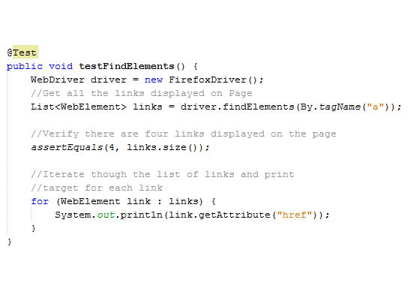
findElement() Method
How to do it...
  Create a test that will get all the links from a page, verify the count of links, and print a target for each link, as follows:

Slide 6
findElement() Method
Finding elements by tag name
Selenium WebDriver's By class provides a tagName() method to find elements by their HTML tag name. This is similar to the getElementsByTagName() DOM method in JavaScript.
This is used when you want to locate elements using their tag name, for example, locating all <tr> tags in a table.
How to do it...
WebElement loginButton = driver.findElement(By.tagName("button")); loginButton.click();

Slide 7
findElement() Method
The following table lists various locator strategies supported by Selenium WebDriver:
  By ID : driver.findElement(By.id(<element ID>))
  By Name : driver.findElement(By.name(<element name>))
  By Class name : driver.findElement(By.className(<elementclass>)):
  By Tag name : driver.findElement(By.tagName(<htmltagname>))
  By Link text : driver.findElement(By.linkText(<linktext>))
  By Partial Link text : driver.findElement(By.partialLinkText(<linktext>))
  By CSS : driver.findElement(By.cssSelector(<cssselector>))
  By Xpath : driver.findElement(By.xpath (<xpath queryexpression>))

Slide 8
Find Elements Using Xpath
XPath (the XML path language) is a query language used to select nodes from an XML document. All the major browsers implement DOM Level 3 XPath (using https://www.w3.org/TR/DOM-Level-3-XPath/ ) specification, which provides access to a DOM tree.
The XPath language is based on a tree representation of the XML document and provides the ability to navigate around the tree and to select nodes using a variety of criteria.
Selenium WebDriver supports XPath to locate elements using XPath expressions, also known as XPath query.
One of the important differences between XPath and CSS is that, with XPath, we can search elements backwards or forwards in the DOM hierarchy, while CSS works only in a forward direction. This means that using XPath we can locate a parent element using a child element and vice versa.

Slide 9
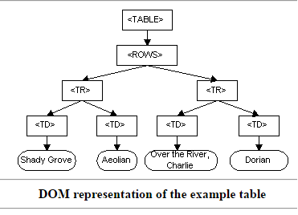
Understanding Document Object Model (DOM)
The Document Object Model is a programming API for documents. The object model itself closely resembles the structure of the documents it models. For instance, consider this table, taken from an HTML document
<TABLE>
<ROWS>
<TR>
  <TD>Shady Grove</TD>
  <TD>Aeolian</TD>
</TR>
<TR>
  <TD>Over the River, Charlie</TD>
  <TD>Dorian</TD>
  </TR>
</ROWS>
</TABLE>

Slide 10
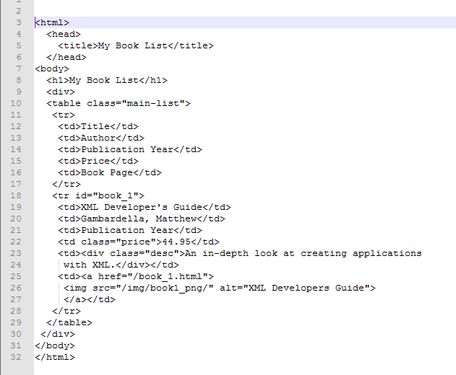
Xpath Terminologies
Node
  DOM represents an HTML document as trees of nodes. Here are examples of nodes from below HTML document:
    HTML
    title: This is the element node

Slide 11
Xpath Terminologies
Atomic Values
  Atomic values are nodes with no children or parents. For example:
    Gambardella, Matthew
    XML Developer's Guide
    44.95

Slide 12
Xpath Terminologies
Parents
  Each element and attribute has one parent. For example, the body element is the parent of div. Similarly, div is the parent of the table element.:

Slide 13
Xpath Terminologies
Children
  Element nodes may have zero, one, or more children. For example, there are two tr elements, which are children of the table element.

Slide 14
Xpath Terminologies
Siblings
  Nodes that have the same parent. For example, h1 and div are all siblings and their parent is the body element.

Slide 15
Xpath Terminologies
Ancestors
  A node's parent, parent's parent, and so on. For example, ancestors of the table element are div, body and html.

Slide 16
Xpath Terminologies
Descendants
  A node's children, children's children, and so on. For example, the descendants of the table element are tr, td and div.

Slide 17
Xpath – Selecting Nodes
nodename
  This will select all nodes with the name "nodename". For example
    “table” will select all the table elements.
/ (slash)
  This will select element(s) relative to the root element. For example: Have to drive the execution and test
    /html: This will select the root HTML element. A slash (/) is used in the beginning and it defines an absolute path.
    html/body/table: will select all table elements that are children of HTML.

Slide 18
Xpath – Selecting Nodes
//(doubleslash)
  This will select node(s) in the document from the current node that match the selection irrespective of its position. For example:
    //table will select all the table elements no matter where they are in the document
    //tr//td will select all the td elements
    //a//img will select all the img elements that are children of the "a" (anchor) element
Double slash (//) defines a descendant relationship if used in the middle;
    for example, /html//title returns the title element that is descendant of the html element.

Slide 19
Xpath – Selecting Nodes
. (dot)
  This represents the current node.
..(doubledot)
  This will select the parent of the current node.
    //table/.. will return the div element..
@ (at)
  This represents an attribute. For example
    //@id: This will select all the elements where the id attribute are defined no matter where they are in the document
    //img/@alt: This will select all the img elements where the @alt attribute is defined

Slide 20
Xpath – Find Element with Absolute Path
XPath absolute paths refer to the very specific location of the element, considering its complete hierarchy in the DOM. Here is an example where the Username Input field is located using the absolute path. When providing an absolute path, a space is given between the elements:
WebElement userName = driver.findElement(By.xpath("/html/body/div/div/form/input"));

Slide 21
Xpath – Find Element with Absolute Path
XPath absolute paths refer to the very specific location of the element, considering its complete hierarchy in the DOM. Here is an example where the Username Input field is located using the absolute path. When providing an absolute path, a space is given between the elements:
WebElement userName = driver.findElement(By.xpath("/html/body/div/div/form/input"));

Slide 22
Xpath – Find Element with Predicates
A predicate is embedded in square brackets and is used to find out specific node(s) or a node that contains a specific value.
In the previous example, the XPath query will return the first <input> element that it finds in the DOM. There could be multiple elements matching the specified XPath query. If the element is not the first element, we can also locate the element by using its index in the DOM. For example, in our login form, we can locate the Password field, which is the second <input> element on the page, in the following way:
WebElement userName = driver.findElement(By.xpath("//input[2]"));

Slide 23
Xpath – Find Element with Attributes value
We can find elements using their attribute values in XPath. In the following example, the Username field is identified using the ID attribute:
  WebElement userName = driver.findElement(By.xpath("//input[@id='username']"));
  WebElement previousButton = driver.findElement(By.xpath("//img[@alt='Previous']"));
  WebElement previousButton = driver.findElement(By.xpath("//input[@type='submit' and @value='Login']"));
  WebElement previousButton = driver.findElement(By.xpath("//input[@type='submit‘ or @value='Login']"));
  List<WebElement> imagesWithAlt = driver.findElements(By.xpath ("//img[not(@alt)]"));

Slide 24
Xpath – Find Element with Attributes value
Starting with: For example, if the ID of an element is ctrl_12, this will find and return elements with ctrl at the beginning of the ID.
  WebElement userName = driver.findElement(By.xpath("//input[starts-with(@id,'ctrl')]"));
Ending with: For example, if the ID of an element is a_1_userName, this will find and return elements with _userName at the end of the ID.
  WebElement previousButton = driver.findElement(By.xpath(“//input[ends-with(@id,'userName')]"));
Containing: For example, if the ID for an element is panel_login_userName_textfield, this will use the userName part in the middle to match and locate the element.
  WebElement previousButton = driver.findElement(By.xpath("// input[contains(@id,'userName')]"));

Slide 25
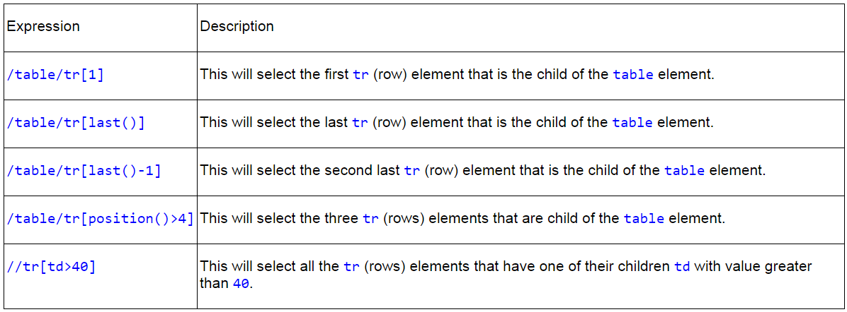
Xpath – Matching any attribute using a value
Here are more examples of using XPath predicates to find elements using their position and contents:

Slide 26
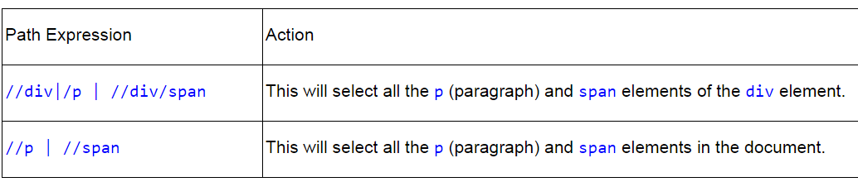
Xpath - Selecting several paths
Using the union | operator in XPath expressions, we can select several paths together, as shown in the following table:

Slide 27
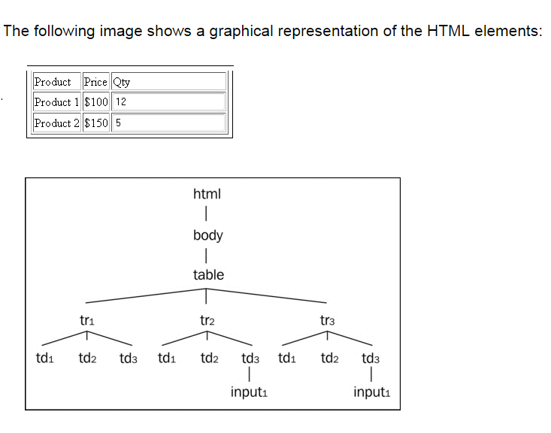
Xpath : Locating elements with XPath axes

Slide 28
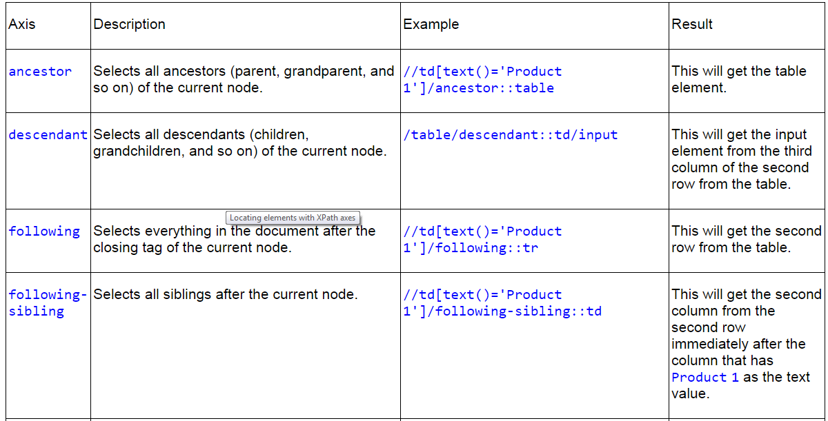

Slide 29
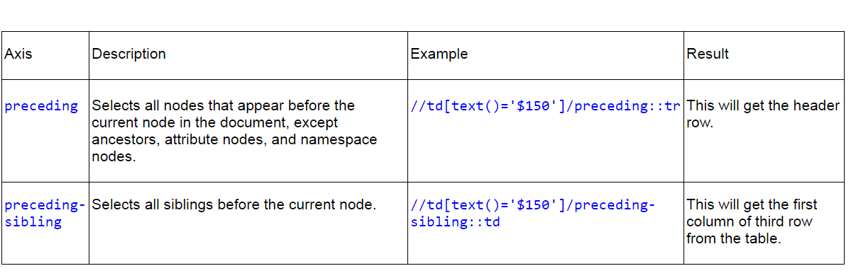
Xpath : Locating elements with XPath axes

Slide 30
Xpath – Selecting Unknown nodes
Matches any element node (*)
  /table/*: This will select all child elements of a table element
  //*: This will select all elements in the document
  //*[@class='price']: This will select any element in the document which has an attribute named class with a specified value, that is price
Matches any attribute node (@)
  //td[@*]: This will select all the td elements that have any attribute
  //*[@*='price']: This will select any element in the document which has an attribute named class with a specified value, that is price
Matches any node of any kind(node())
  //table/node(): This will select all the child elements of table

Slide 31
Finding Elements Using CSS
The Cascading Style Sheets (CSS) is a style sheet language used to describe the presentation semantics (the looks and formatting) of a document written in a markup language such as HTML or XML.
Major browsers implement CSS parsing engines to format or style the pages using CSS syntax. CSS was introduced to keep the presentation information separate from the markup or content. For more information on CSS and CSS selectors,
visithttp://en.wikipedia.org/wiki/Cascading_Style_Sheets.
In CSS, the pattern-matching rules determine which style should be applied to elements in the DOM. These patterns, called selectors, may range from simple element names to rich contextual patterns. If all conditions in the pattern are true for a certain element, the selector matches the element, and the browser applies the defined style in CSS syntax.

Slide 32
Finding Elements Using CSS Selector
Finding elements with an absolute path
WebElement userName = driver.findElement(By.cssSelector("html body div div form input"));
Finding elements with a relative path
WebElement userName = driver.findElement(By.cssSelector("input"));
Finding elements using the Class selector
WebElement loginButton = driver.findElement(By.cssSelector("input.login"));

Slide 33
Finding Elements Using CSS Selector
Finding elements using the ID selector
WebElement userName = driver.findElement(By.cssSelector("input#username"));
Finding elements using the attributes selector
WebElement userName = driver.findElement(By.cssSelector("input[name=username]"));
WebElement previousButton = driver.findElement(By.cssSelector("input[type='submit'][value='Login']"));
WebElement previousButton = driver.findElement(By.cssSelector("img[alt='Previous']"));

Slide 34
Finding Elements Using CSS Selector
Finding elements using the attributes name selector
List<WebElement> imagesWithAlt = driver.findElements(By.cssSelector("img[alt]"));
Finding elements using the Boolen NOT
List<WebElement> imagesWithoutAlt = driver.findElements(By.cssSelector("img:not([alt])"));
Selecting several paths
List<WebElement> elements =
driver.findElements(By.cssSelector("div, p"));
// This will select all the <div> and all the <p> elements:

Slide 35
CSS Selector – Partial Match On Attributes
Starting with (^=)
  input[id^='ctrl'] : If the ID of an element is ctrl_12, this will find and return elements with ctrl at the beginning of the ID.
Ending with ($=)
  input[id$='_userName'] : If the ID for an element is a_1_userName, this will find and return elements with _userName at the end of the ID.
Containing(*=)
  input[id*='userName'] : If the ID of an element is panel_login_userName_textfield, this will use the userName part in the middle to match and find the element.

Slide 36
Thanks
Q & A

