Slide 1

Parallel & Cross Browser Testing With Selenium Grid

Slide 2
Agenda
In this Session , We will explore:
  Understanding Selenium Grid Architecture
  Setting up Selenium Gird Server for Parallel Execution
  Creating & Executing Selenium Script In Parallel with TestNG
  Practice Session , Build POC.

Slide 3
Introduction
Organizations are adopting virtualization and cloud-based technologies to reduce costs and increase efficiency. Virtualization and cloud-based infrastructure can also be used to scale the test automation by reducing investment in physical hardware needed to set up the test environment. Using these technologies, web applications can be tested on a variety of browser and operating system combinations. Selenium WebDriver has unmatched support for testing applications in virtual environment, executing tests in parallel, reducing costs, and increasing speed and coverage.
Running tests in parallel requires two things:
  An infrastructure to distribute the tests.
  A framework that will run these tests in parallel in the given infrastructure.
We will first create a distributed infrastructure, and then create some tests that will be executed in this distributed test environment.

Slide 4
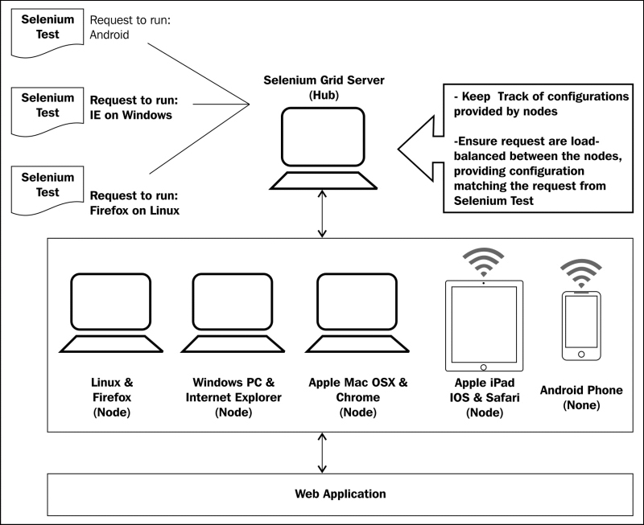
Selenium Grid Architecture

Slide 5
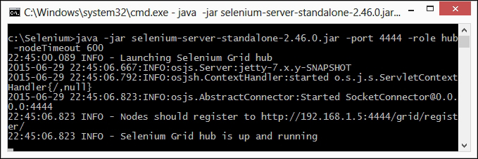
Setting Up Selenium Grid Server
Getting ready
  Download the latest Selenium Server standalone JAR file from http://docs.seleniumhq.org/download/.
How to do it...
  Launch the Selenium Server using the following command:
  java -jar selenium-server-standalone-2.46.0.jar -port 4444 -role hub -nodeTimeout 600

Slide 6
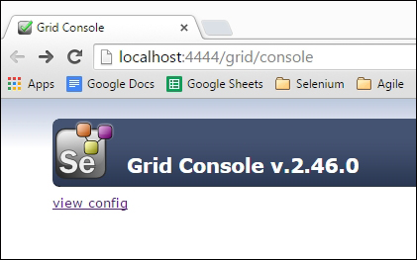
Setting Up Selenium Grid Server
How it works
  When we launch the Selenium Standalone Server in Hub role, it starts listening to nodes and Selenium tests on port 4444. If you browse to http://localhost:4444/grid/console on the Hub machine, it will display the following information in the browser

Slide 7
Setting Up Selenium Grid Server
RemoteWebDriver and DesiredCapabilities Classes
  To run tests with Selenium Grid, Selenium WebDriver tests nee to use the instance of the RemoteWebDriver and DesiredCapabilities classes to define which browser, version, and platform tests will be executed.
  Based on preferences set in the DesiredCapabilities instance, the Hub will point the test to a node that matches these preferences.
  DesiredCapabilities cap = new DesiredCapabilities();
  cap.setBrowserName("firefox");
  cap.setPlatform(org.openqa.selenium.Platform.WINDOWS);
  These preferences are set using the setBrowserName(), setVersion(), and setPlatform() methods of the DesiredCapabillities class.

Slide 8
Adding Nodes to Selenium Gird
Adding an IE node
  To launch and add a node to the Grid, type the following command
  java -Dwebdriver.ie.driver=“%path%\IEDriverServer.exe" -jar selenium-server-standalone-2.46.0.jar -role webdriver -browser "browserName=internet explorer, version=10,maxinstance=1,
  platform=WINDOWS" -hubHost %ipaddress% –port %number%
  To add a node to the Grid, we need to use the –role argument and pass webdriver as the value. We also need to pass the browser configuration for the node. This is passed through the browser argument.
  Pass browserName as internet explorer, the version as 10, maxinstance as 1
  and platform as WINDOWS.
  The maxinstance value tells the Grid how many concurrent instances of the browser will be supported by the node.
  To connect the node to the hub or Grid server, we need to specify the hubHost argument with the hostname or IP address of the Grid server.
  Lastly, we need to specify the port on which the node will be running.

Slide 9
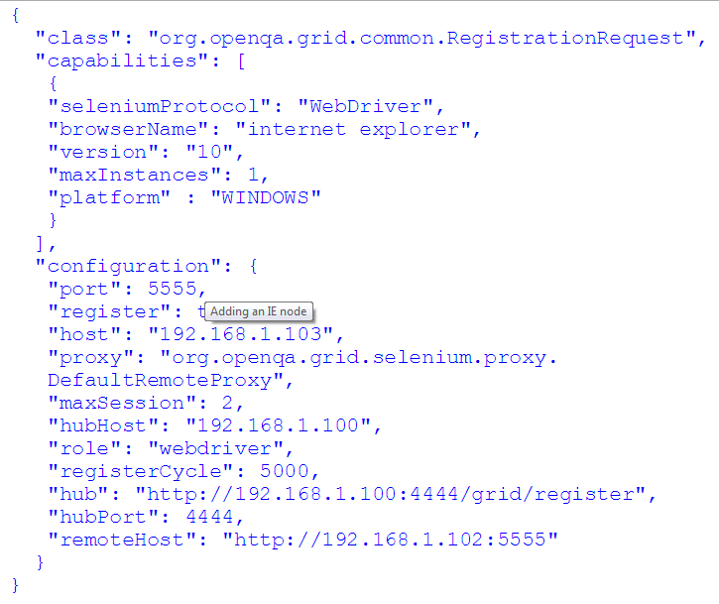
Adding Nodes to Selenium Gird
Alternatively, a node can be added by creating a configuration file in the JSON format and then using the following command
  java -Dwebdriver.ie.driver=“%path%\IEDriverServer.exe"-jar selenium-server-standalone-2.46.0.jar -role webdriver -nodeConfig selenium-node-win-ie10.cfg.json

Slide 10
Adding Nodes to Selenium Gird
  java -Dwebdriver.ie.driver=“%path%\IEDriverServer.exe"-jar selenium-server-standalone-2.46.0.jar -role webdriver -nodeConfig selenium-node-win-ie10.cfg.json

Slide 11
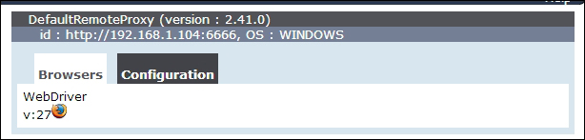
Adding Nodes to Selenium Gird
Adding a Firefox node
  java -jar selenium-server-standalone-2.47.1.jar -role webdriver -browser "browserName=firefox,version=38.0.5,
  maxinstance=2,platform=WINDOWS" -hubHost localhost –port 6666
  In this example, we set maxinstance to 2. This tells the Grid that this node will support two instances of Firefox. Once the node is started, the following configuration will appear in the Grid console:

Slide 12
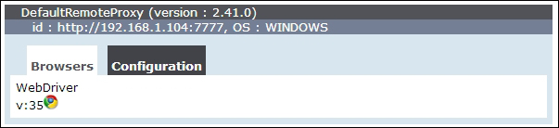
Adding Nodes to Selenium Gird
Adding a Chrome node
  java -Dwebdriver.chrome.driver=“%path%\chromedriver.exe" -jar selenium server-standalone-2.47.1.jar -role webdriver -browser "browserName=chrome,version=35 , maxinstance=2,
  platform=WINDOWS" -hubHost localhost -port 7777
  Once the node is started, the following configuration will appear in the Grid console:

Slide 13
Adding Nodes to Selenium Gird
Adding a Chrome node
  java -Dwebdriver.chrome.driver=“%path%\chromedriver.exe" -jar selenium server-standalone-2.47.1.jar -role webdriver -browser "browserName=chrome,version=35 , maxinstance=2,
  platform=WINDOWS" -hubHost localhost -port 7777
  Once the node is started, the following configuration will appear in the Grid console:

Slide 14
Creating & Executing Selenium Script In Parallel with TestNG
Lets do it practically .!!

Slide 15
Thanks
Q & A

