Slide 1

Synchronizing Test

Slide 2
Agenda
In this Session , We will explore:
  Synchronizing a test with an implicit wait
  Synchronizing a test with an explicit wait
  Synchronizing a test with custom-expected conditions
  Synchronizing a test with FluentWait

Slide 3
Introduction
While building automated scripts for a complex web application using Selenium WebDriver, we need to ensure that the test flow is maintained for reliable test automation.
When tests are run, the application may not always respond with the same speed. For example, it might take a few seconds for a progress bar to reach 100 percent, a status message to appear, a button to become enabled, and a window or pop-up message to open.
You can handle these anticipated timing problems by synchronizing your test to ensure that Selenium WebDriver waits until your application is ready before performing the next step. There are several options that you can use to synchronize your test. In this chapter, we will see various features of Selenium WebDriver to implement synchronization in tests.

Slide 4
Synchronizing Tests - Implicit Wait
The Selenium WebDriver provides an implicit wait for synchronizing tests. When an implicit wait is implemented in tests, if WebDriver cannot find an element in the DOM, it will “wait for a defined amount of time” for the element to appear in the DOM. Once the specified wait time is over, it will try searching for the element once again. If the element is not found in specified time, it will throw the NoSuchElement exception.
In other terms, an implicit wait polls the DOM for a certain amount of time when trying to find an element or elements if they are not immediately available. The default setting is 0.

Slide 5
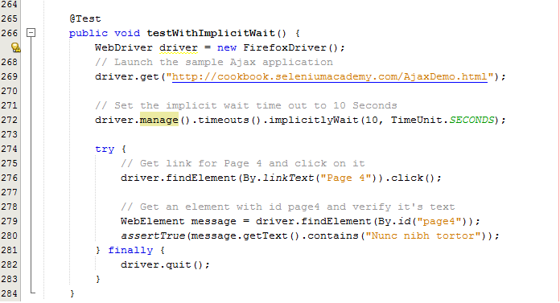
Synchronizing Tests - Implicit Wait
How to do it...

Slide 6
Synchronizing Tests - Explicit Wait
The Selenium WebDriver provides an explicit wait for synchronizing tests, which provides a better way to wait over an implicit wait. Unlike an implicit wait, you can write and use pre-defined conditions or custom conditions for wait before proceeding further in the code.
The Selenium WebDriver provides the WebDriverWait and ExpectedConditions classes to implement an explicit wait.
References :
https://seleniumhq.github.io/selenium/docs/api/java/org/openqa/selenium/support/ui/WebDriverWait.html
https://seleniumhq.github.io/selenium/docs/api/java/org/openqa/selenium/support/ui/ExpectedConditions.html

Slide 7
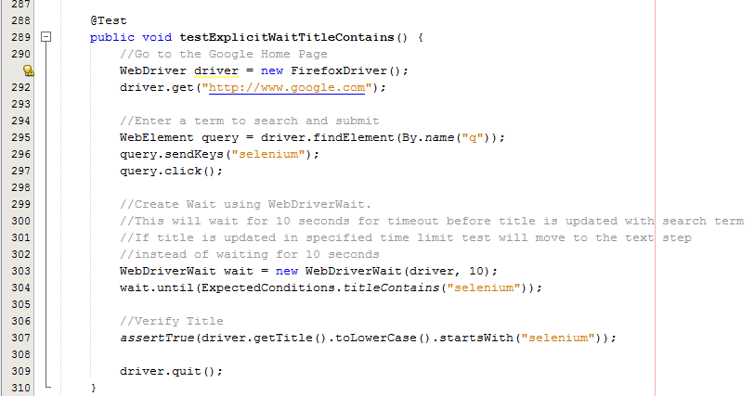
Synchronizing Tests – Explicit Wait
How to do it...

Slide 8
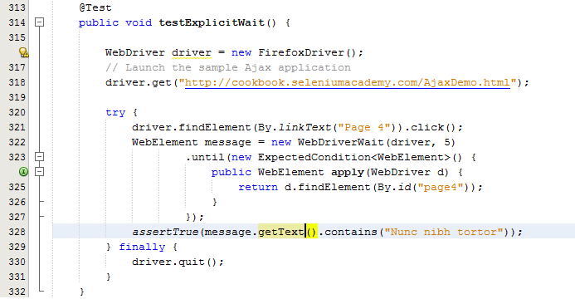
Synchronizing Tests – Explicit Wait Custom Expected Condition
How to do it...

Slide 9
Synchronizing Tests - Fluent Wait
The FluentWait class is an implementation of Selenium WebDriver's Wait interface. Using the FluentWait class, we can define the maximum amount of time to wait for an element or condition as well as the frequency with which to check for the condition. We can also configure it to ignore specific types of exceptions such as the NoSuchElement exception while searching for an element.
Unlike implicit and explicit wait, FluentWait uses a maximum timeout value and polling frequency. For example, if we set the maximum timeout value as 20 seconds and polling frequency as 2 seconds, WebDriver will check for an element every 2 seconds until the maximum value. In addition to this, we can configure FluentWait to ignore specific types of exceptions while waiting for the condition.
The FluentWait class is helpful in automating AJAX applications or scenarios where element load time varies often.

Slide 10
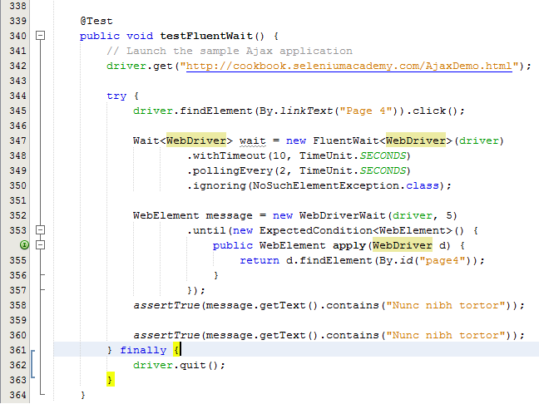
Synchronizing Tests – Fluent Wait
How to do it...

Slide 11
Thanks
Q & A

