Slide 1

Learning TestNG
Author: Jayasimha B J

Slide 2
Agenda
TestNG
  TestNG Overview
  TestNG Features
  Understanding Parallel Testing
  Building Test Scripts with TestNG
  Practical Session , Build POC

Slide 3
What is TestNG ?
TestNG is an open source automated testing framework, where NG means Next Generation.
TestNG is similar to JUnit (especially JUnit 4), but it is not a JUnit extension. It is inspired by JUnit. It is designed to be better than JUnit, especially when testing integrated classes.
The creator of TestNG is Cedric Beust.
Eliminating most of the limitations of the older framework, TestNG gives the developer the ability to write more flexible and powerful tests. As it heavily borrows from Java Annotations (introduced with JDK 5.0) to define tests, it can also show you how to use this new feature of the Java language in a real production environment.

Slide 4
TestNG Features
Supports Annotations.
TestNG based on Java and OO features.
Supports testing integrated classes (e.g., by default, no need to create a new test class instance for every test method).
Separates compile-time test code from run-time configuration/data info.
Flexible runtime configuration.
Introduces ‘test groups’. Once you have compiled your tests, you can just ask TestNG to run all the "front-end" tests, or "fast", "slow", "database" tests, etc.
Supports Dependent test methods, parallel testing, load testing, and partial failure.
Flexible plug-in API.
Support for multi threaded testing.

Slide 5
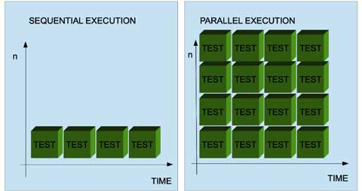
Understanding Parallel Tests

Slide 6
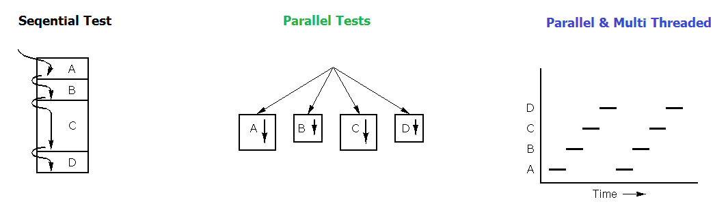
Prallel Test With Multi Threading

Slide 7
  Building Test Scripts with TestNG
  Let’s do it practically ..

