Slide 1

Working with WebElements

Slide 2
Agenda
We will explore the various methods of Selenium WebDriver that interact with HTML elements displayed on the page. We will cover the following recipes:
  PageObject Model Design Pattern
  Automating textboxes, text areas, and buttons
  Checking an element's text
  Checking an element's attribute and CSS values
  Automating dropdowns and lists
  Checking options in dropdowns and lists
  Checking selected options in dropdowns and lists
  Automating radio buttons and radio groups
  Automating checkboxes
  Working with WebTables
  Practice Session , Build POC

Slide 3
Introduction
Selenium WebDriver provides a very comprehensive API for working with different types of web elements performing User Interactions, executing JavaScript code, and supports various types of controls such as list, dropdown, radio buttons, and checkboxes.

Slide 4
PageObject Model
Developing a maintainable automation code is one of the keys to a successful test-automation project.
  Test-automation code should to be treated as production code, and similar standards and patterns should be applied while developing this code.
While developing Selenium WebDriver tests, we can use the Page Object model pattern.
  This pattern helps enhance the tests by making them
    Highly Maintainable
    Reduces the Code Duplication
    Provides a layer of Abstraction by hiding the inner implementation from tests.
    Reusability

Slide 5
PageObject Model Benefits
By applying object-oriented development principles, we can develop a class that serves as an interface to a web page in the application, modeling its properties and behavior.
This helps in creating a layer of separation between the test code and the code specific to the page by hiding technical implementations such as locators used to identify elements on the page, layout, and so on.
The Page Object design pattern provides an interface where a test can operate on that page in a manner similar to the user accessing the page, but by hiding its internals.

Slide 6
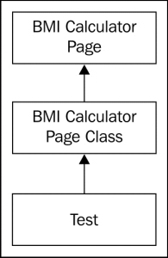
Page Factory Class for Exposing Web Element on Page
To implement the Page Object model in tests, we need to create a Page Object class for each page that is being tested.
For example, BMI Calculator Application

Slide 7
Automating textboxes, textareas and buttons
Clearing text from textbox and text-area elements
  To clear the existing text value from textbox and text-area elements, we can use the clear() method, as shown in following code example:
  // Find the text input element by its name
  WebElement element = driver.findElement(By.name("q"));
  // Clear the existing text value using clear method
  element.clear();

Slide 8
Automating textboxes, textareas and buttons
Entering text in textbox and text-area elements
  To enter text value in a textbox or a text-area element, we can use the sendKeys() method, as shown in following code example:
  // Enter something to search for
  element.sendKeys("Selenium testing tools cookbook");
Performing a click on a button element
  To click on a button element, we can use the click() method of the WebElement interface:
  // Find the button element by its name
  WebElement element = driver.findElement(By.name("btnG"));
  // Click on the button
  element.click();

Slide 9
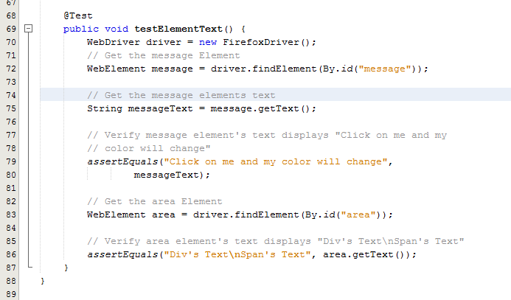
Checking Element’s Text
How to do it...
  While testing a web application, we need to verify that elements are displaying the correct values or text on the page. Selenium WebDriver's WebElement interface provides methods to retrieve and verify text from an element.

Slide 10
Checking Element’s Attributes & CSS Value
Developers configure various attributes of elements displayed on the web page during design or at runtime to control the behavior or style of elements when they are displayed in the browser.
  For example, the <input> element can be set to read-only by setting the readonly attribute.
We can retrieve and check an element's attribute using the getAttribute() method of the WebElement interface.
Various styles are applied on elements displayed in a web application so that they look neat and become more usable. Developers add these styles using Cascading Style Sheets (CSS).
  This can be done using the WebElement class's getCSSValue() method, which returns the value of a specified style attribute.

Slide 11
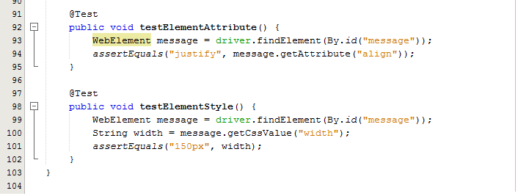
Checking Element’s Attributes & CSS Value
How to do it...

Slide 12
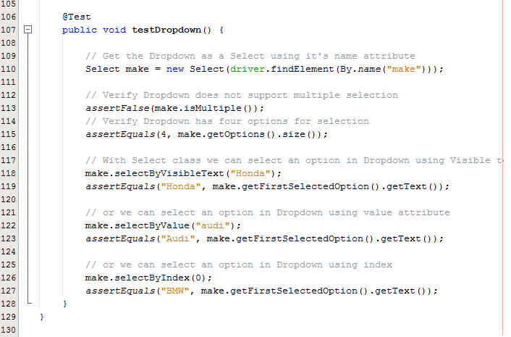

Automating Dropdowns & Lists
Selenium WebDriver supports testing dropdown and list elements using a special Select class.
  The Select class provides various methods and properties to interact with dropdowns and lists created with the HTML<select> element.

Slide 13
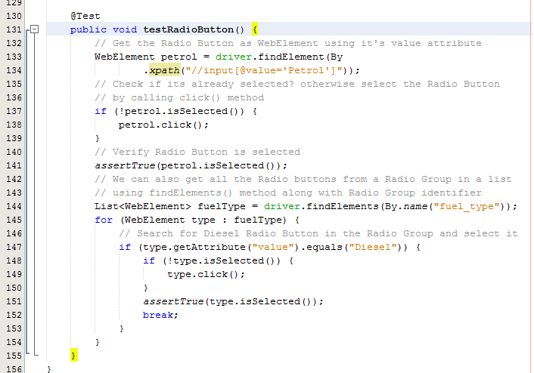
Automating Radio Buttons & Radio Groups
The Selenium WebDriver supports radio buttons and radio group elements using the WebElement interface. We can select and deselect the radio buttons using the click() method of the WebElement class, and check whether a radio button is selected or deselected using the isSelected() method.

Slide 14
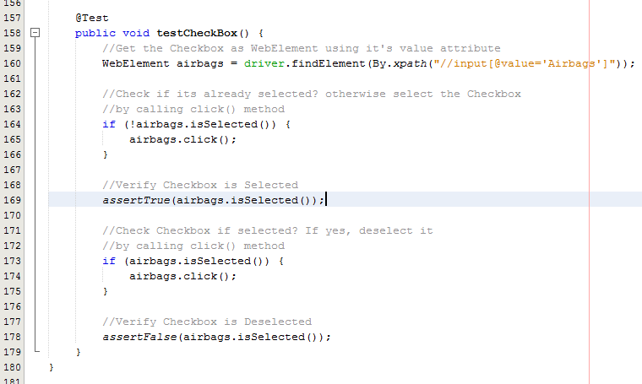
Automating Checkboxes
How to do it...

Slide 15
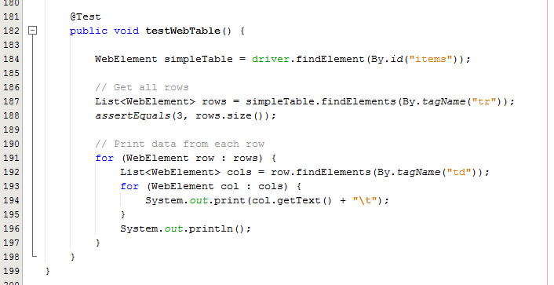
Working with Tables
How to do it...

Slide 16
Thanks
Q & A

