Slide 1

Library Management System
IT3003 – Advanced Programming Techniques
Team 19 – Code Craft

Slide 2

Introduction
Transition from traditional to online library management system has become a necessity.
Steer clear of false information and information overload.
Users can manage their accounts, and enjoy a personalized library experience, promoting a sense of security and ownership

Slide 3
Objectives
Ensure a positive user experience
1
Make sure that the resources in the library are properly managed.
2
Draw people toward the libraries
3

Slide 4
Hardware and Software Requirements
Hardware Requirements
A PC with the required hardware
Software Requirements
NetBeans IDE
XAMP Server
MySQL

Slide 5
Key Features
User Authentication
Mange Books
Manage users
Database handling

Slide 6
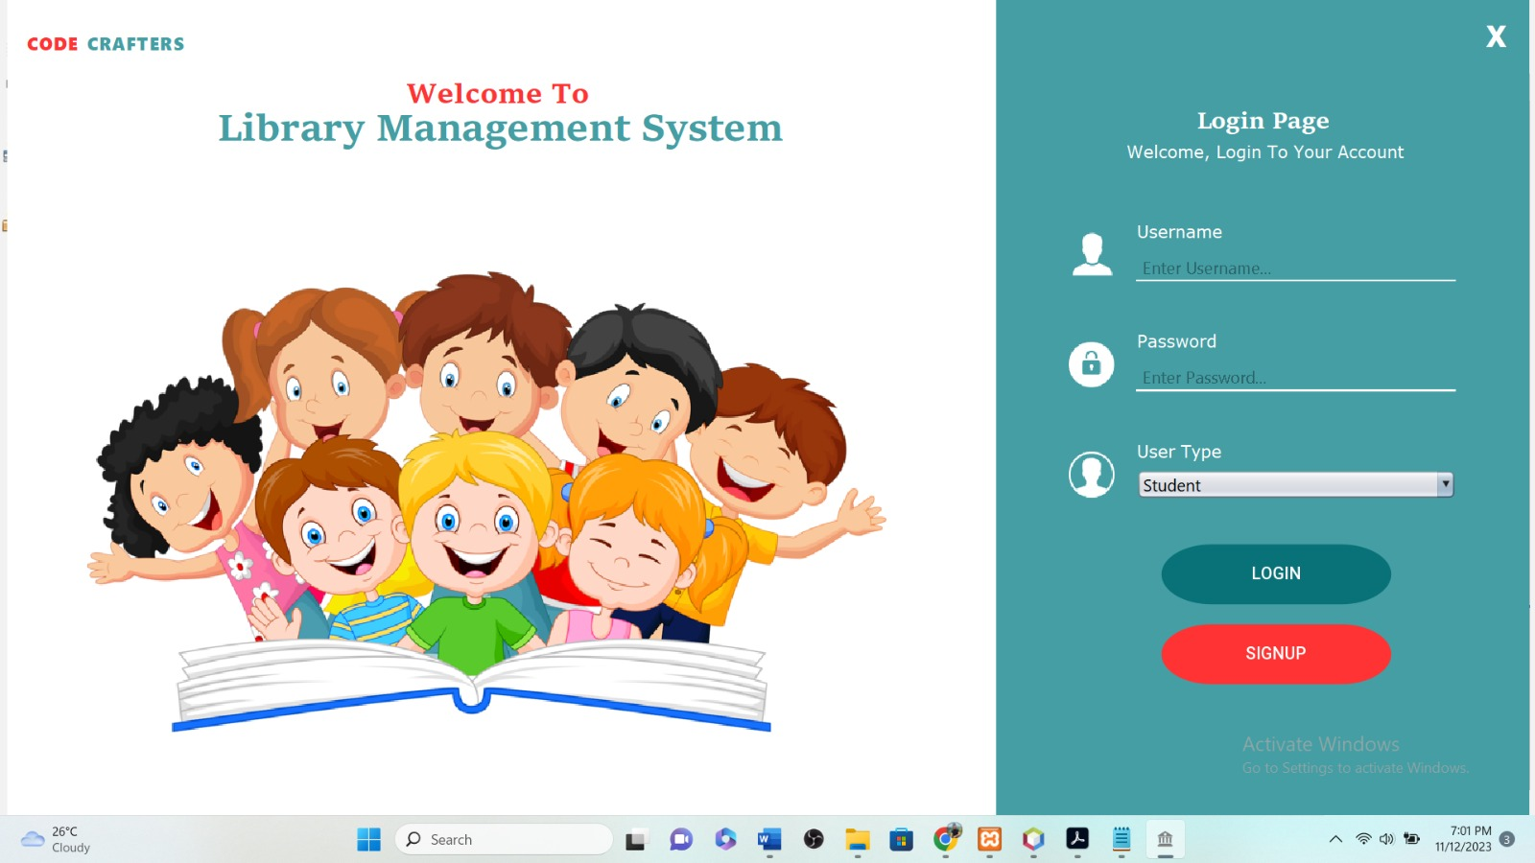
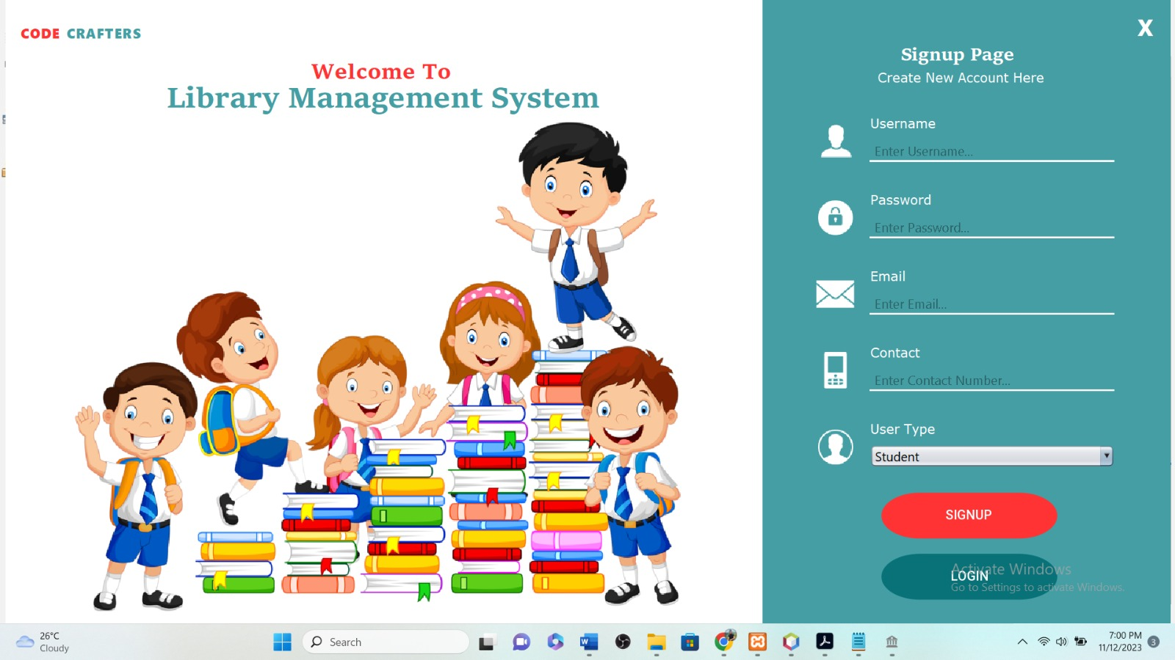
Functionalities
Login as student or Administration
Create new accounts

Slide 7
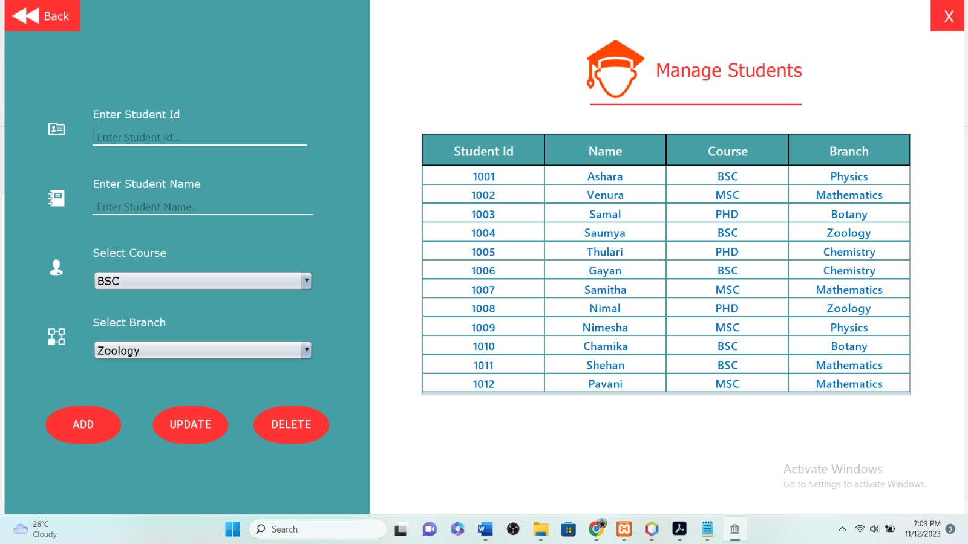
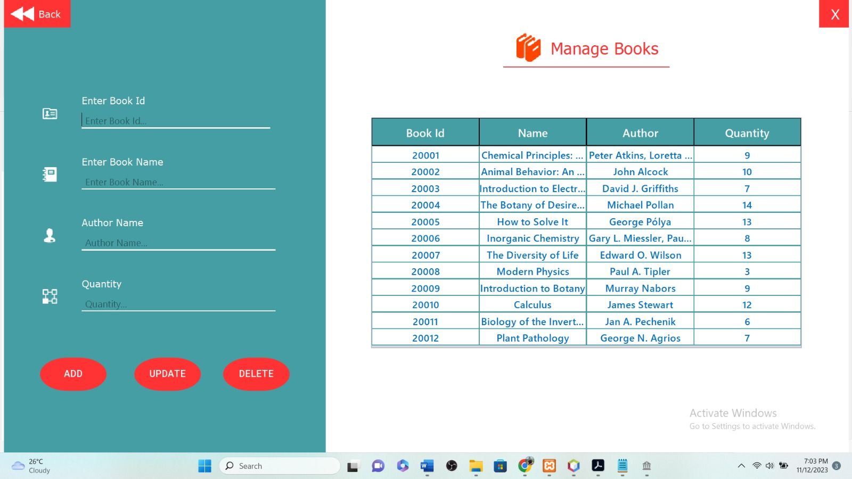
Manage Books
Mange student

Slide 8
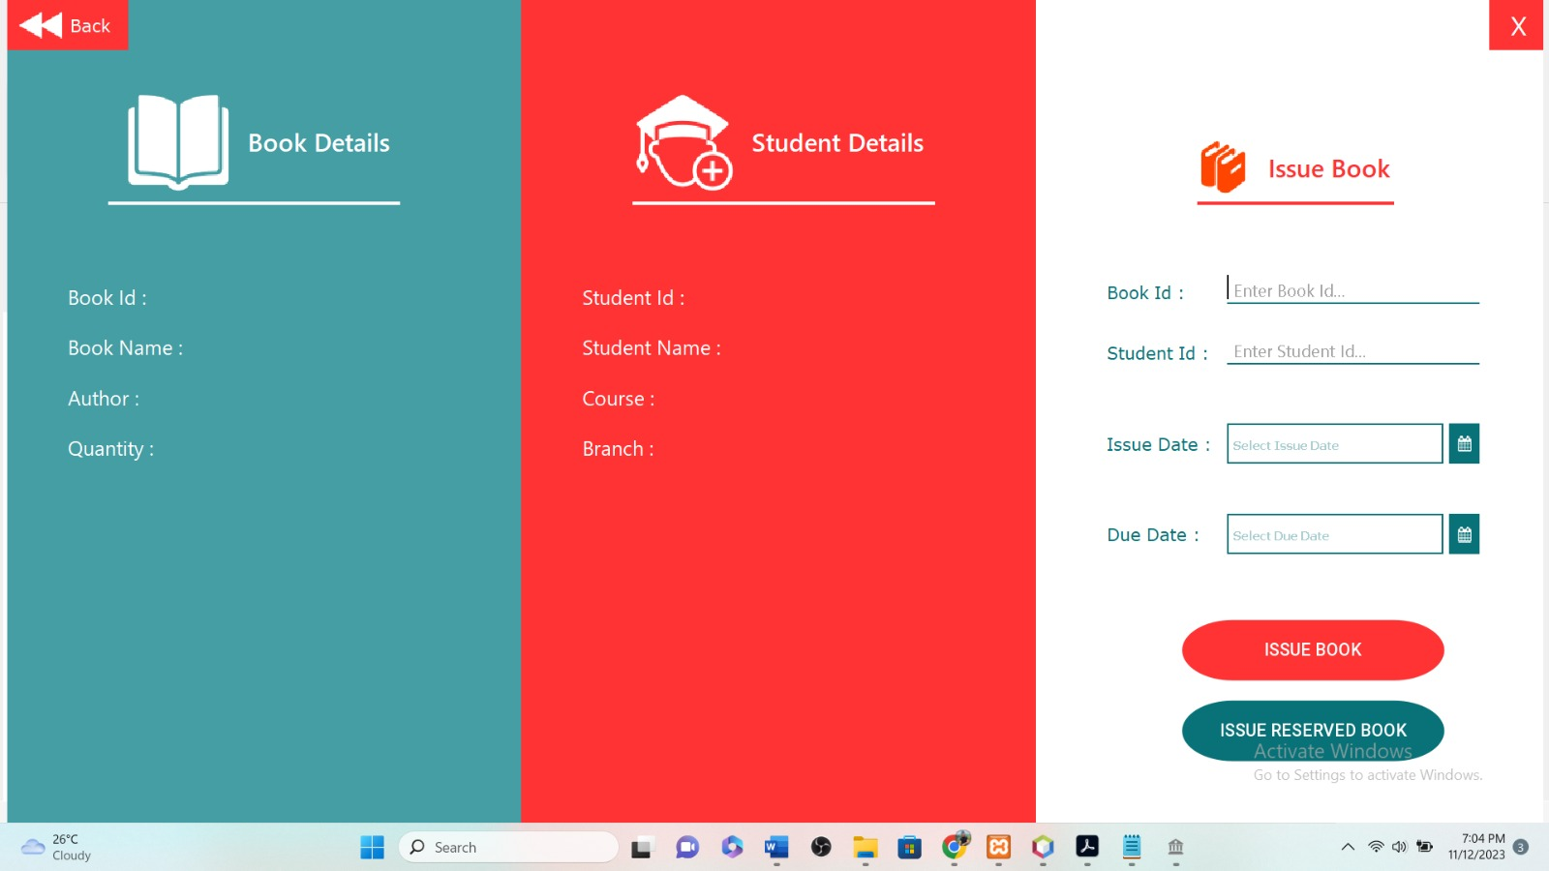
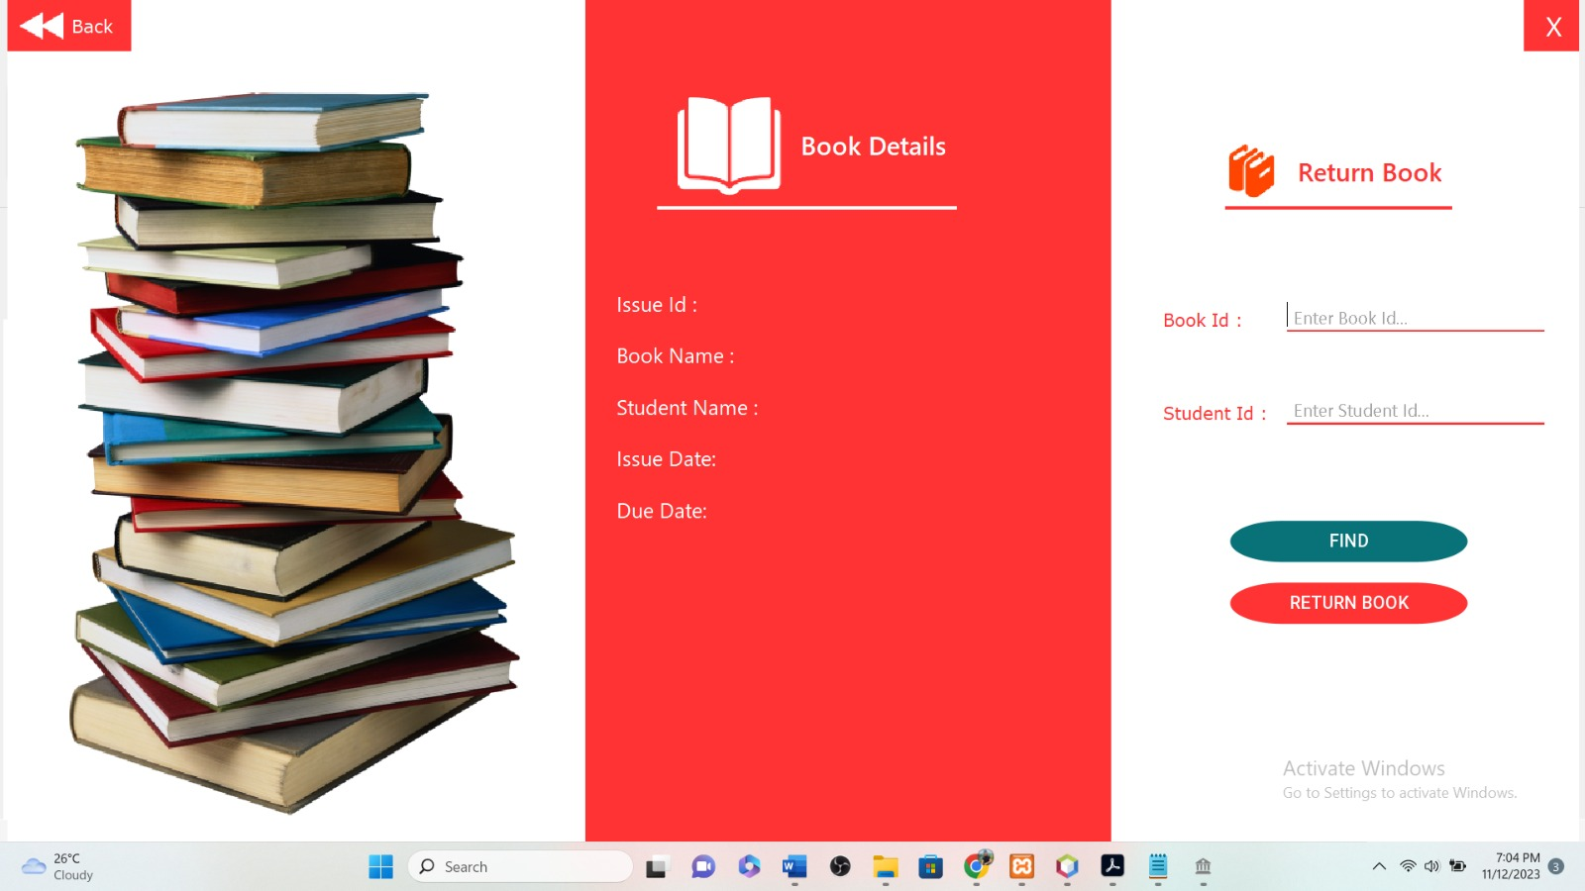
Reserve Books
Issue Books

Slide 9
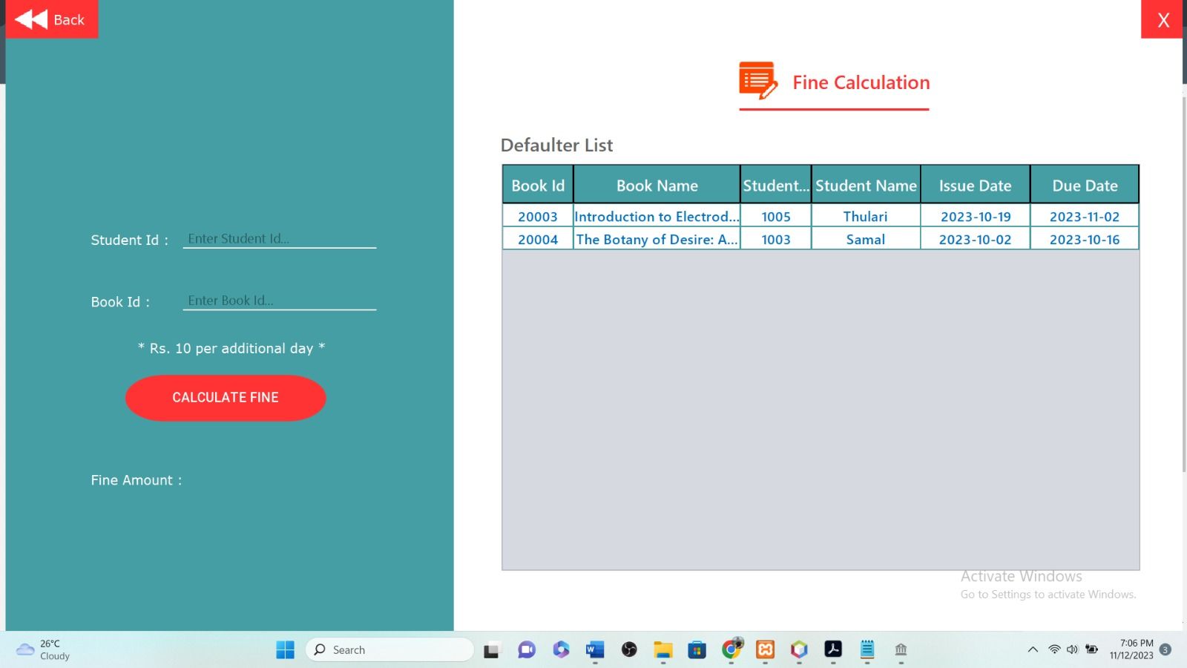
Return Books
Final Calculation

Slide 10

Challenges
Connecting to the Database

Slide 11
Modifications
Sending notifications to the users using emails, SMS, etc
Build a library management App for users
E- book Integration

Slide 12
Team Members
Malinda T.H.N. – 15246 ( Home Page for Librarian, connecting to the database)
Ashara Lindara - 15314 (Issue Book Page, Return Book Page)
Venura Shenan – 15405 (Sign-Up Page, Login Page)
S.T.H.Liyanage – 15406 (Home Page for Student)
Chamindi Saumya - 15413 (Fine Calculation Page)
Madhumali J.T.D. - 15540 (Issued Books Details Page, Reserved Book List Page)
T.S.Gamage - 15613 (Search Book Page, Reserve Book Page)
S. Kamalanathan - 15629 (View All Records Page)
A.G.Bernard – 15767 (Manage Books Page, Manage Students Page)

Slide 13


Thank you

