Slide 1
ENCRYPTION USING CRYPTOGRAPHY ALGORITHMS

Slide 2
PROJECT NAME: ENCRYPTION:
AIM:
Text Encryption using Cryptographic algorithms.

Slide 3
DESCRIPTION:
Encryption text using cryptography typically involves transforming plain text into ciphertext using algorithms and keys. Here’s a simple example of how you can encrypt text using python’s cryptography library

Slide 4
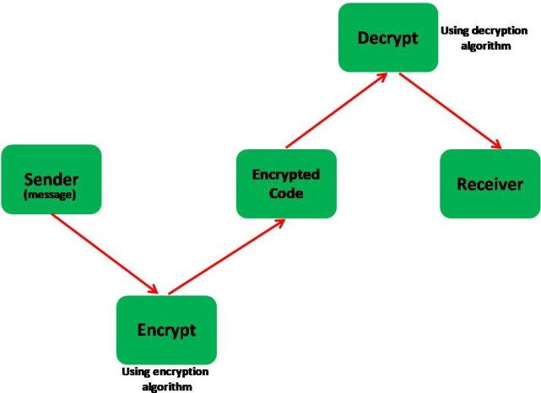
Encrytion and decryption:

Slide 5
Source code:
from cryptography.fernet import Fernet
# Generate a key for encryption (this key should be kept secret)
key = Fernet.generate_key()
cipher_suite = Fernet(key)
# Encrypting a message
message = "Hello, this is a secret message."
encoded_message = message.encode()
encrypted_message = cipher_suite.encrypt(encoded_message)
print("Original message:", message)
print("Encrypted message:", encrypted_message)
# Decrypting the message
decrypted_message = cipher_suite.decrypt(encrypted_message)
decoded_message = decrypted_message.decode()
print("Decrypted message:", decoded_message)

Slide 6
OUTPUT
Original message: Hello, this is a secret message.
Encrypted message: b'...'
Decrypted message: Hello, this is a secret message.

Slide 7
ALGORITHM
Generate a Key: First, generate a secret key using Fernet.generate_key(). This key is used for both encryption and decryption.
Create a Cipher Suite: Initialize a Fernet object with the generated key.
Encrypting a Message: Convert the message to bytes, encrypt it using cipher_suite.encrypt(), and store the encrypted message.
Decrypting a Message: To decrypt, use cipher_suite.decrypt() on the encrypted message to get back the original bytes. Convert these bytes back to a string using .decode().

Slide 8
RESULT:
Text encryption using cryptography.

