Slide 1
EY
Biodiversity
Challenge
Group 4:
Jayasree Lakshmi Narayanan | Samarth Verma | Haeun Kim |

Slide 2
TABLE OF CONTENT
01
04
Overview
How We Improved Model
02
05
Project Process
Value Case
03
06
Project Result
What We Have Learned

Slide 3
Overview
Our project aimed to predict frog presence in southeastern Australia using climate data from the TerraClimate dataset.
Frogs serve as key indicators of ecosystem health, and accurate predictions can guide conservation, farming, and ESG initiatives.
After advanced preprocessing and model testing, the ExtraTreesClassifier achieved the best performance with 83.10% test accuracy.
The project shows how machine learning can turn ecological data into actionable insights for environmental planning.
Notes:
Problem: The monitoring of frog presence is crucial for assessing environmental health. This project aims to predict frog presence in southeastern Australia with increased accuracy by leveraging TerraClimate data. To improve accuracy, we will incorporate all 14 climate variables, apply feature selection, and optimize the model through hyperparameter tuning and potentially ensemble methods. Through the refined classification model, this study will help track environmental changes through frog populations, offering valuable insights into biodiversity conservation. This model would make the best use of available datasets to improve from the benchmark and better predict the environmental impact from a key bioindicator.

Slide 4
Project Process

Slide 5
Dataset
Train Dataset (Training_Data.csv)
3792 frog presence (Occurrence Status =1)
2520 frog absence (Occurrence Status =0)
Includes latitude and longitude for model training
TerraClimate Dataset (TerraClimate_output.tiff)
Monthly climate data since 1958 at a 4 km spatial resolution
Contains 14 key climate variables impacting frog populations
Validation Data (Validation_Template.csv)
2000 new locations (latitude and longitude)
Used for validating model predictions

Slide 6
Data Pre-Processing Steps
Scope Narrowing
Focused on Southeastern Australia (Nov 2017 - Nov 2019)
Predicting frog presence or absence at given coordinates
Data Integration
Merged TerraClimate data with training data using latitude and longitude
Data Cleaning
Removed all null values
Eliminated outliers using Z-score method
Feature Selection
Dropped low-impact variable: Snow Water Equivalent (SWE)
Selected features based on correlation analysis and conceptual relevance
Conducted multiple trials with different feature combinations
Class Balancing
Addressed imbalance with RandomOverSampler

Slide 7
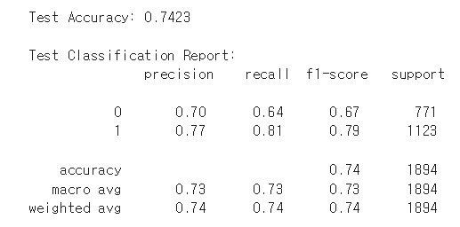
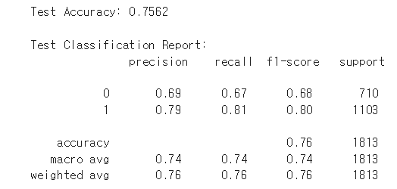
Removing Outliers
Before removing outliers, the F1-score was 0.74.
After applying Z-score outlier removal, the F1-score improved to 0.76.
→ Outlier handling improved model robustness and predictive performance
<Before Removing Outliers>
<After Removing Outliers>

Slide 8
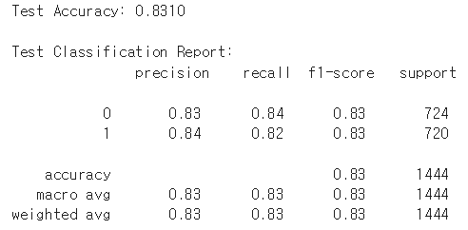
Class Balancing
Before balancing the classes, the F1-score was 0.76.
After applying RandomOverSampler , the F1-score increased to 0.83.
→ Class balancing significantly improved model robustness and predictive accuracy.
<Before Balancing the Class>
<After Balancing the Class>

Slide 9
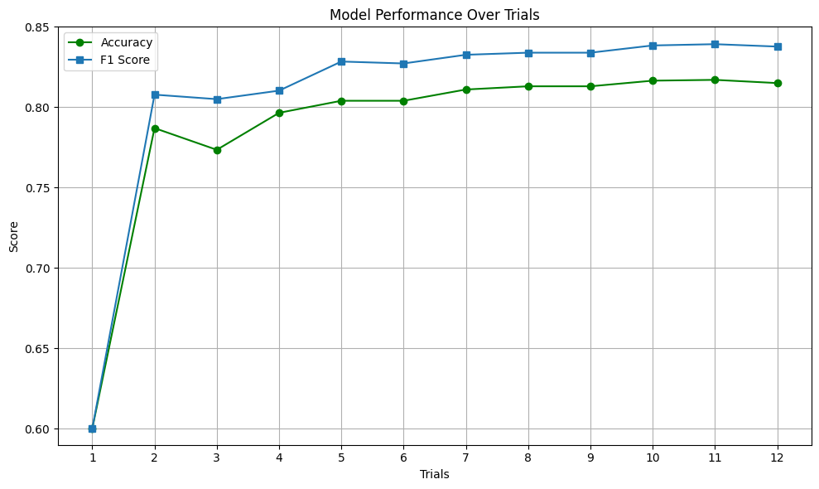
Trend of Model Scores by Trial
Best Model
Accuracy: 0.8170
Precision: 0.7520
Recall: 0.9493
F1 Score: 0.8392

Slide 10
Project Result

Slide 11
Final Model
Feature Selection: ['tmax', 'def', 'ppt', 'ws', 'q', 'soil', 'vpd', 'pet']
tmax: Maximum 2m temperature
def: Climatic water deficit
ppt: Accumulated precipitation
we: 10m wind speed
q: Runoff
soil: Soil moisture at end of month
vpd: Vapor pressure deficit
pet: Reference evapotranspiration
Result:
Accuracy: 0.8170
Precision: 0.7520
Recall: 0.9493
F1 Score: 0.8392
Model: Extra Tree Classification
n_estimators=210
criterion='entropy'
max_depth = 27
bootstrap=True
min_samples_split = 2
class_weight='balanced'

Slide 12
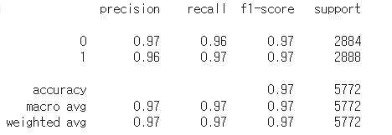
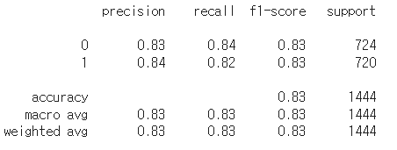
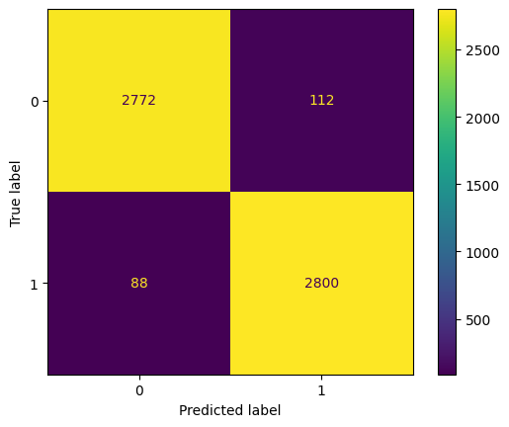
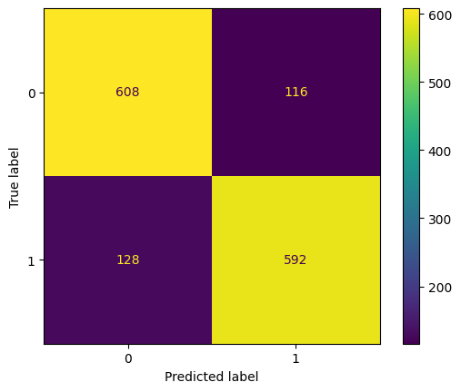
Complex Matrix
<Train Result>
<Test Result>

Slide 13
Model Result
Overfitting Observation
The model achieved an F1-score of 0.97 on the training set, but only 0.83 on the test set.
This performance gap shows overfitting, but generalization remained acceptable.
Why We Selected This Model
Despite the gap, this model achieved the highest F1-score (0.8392) on the validation set, compared to other candidates.
Showed consistent performance across both classes, with precision and recall balanced at 0.83.
Chosen for its strong real-world prediction capability

Slide 14
How We Improved Model

Slide 15
How to Improve?

Slide 16
How to Improve?
Various Machine Learning
Finding Proper Pre-Processing
Tested multiple models including Random Forest, XGBoost, LightGBM, Extra Trees, and Neural Network to identify the best-performing classifier.
Replaced IQR method with Z-score to remove extreme values without major data loss.
Switched from SMOTE (less effective for spatial data) to RandomOverSampler.
Feature Selection
Hyper-Parameter Tuning
Selected features based on correlation analysis and conceptual relevance.
Conducted multiple trials with different combinations of variables.
Performed Grid Search to identify optimal parameter ranges for each model.
Applied fine-tuning to further improve model performance and generalization

Slide 17
Various Machine Learning
Tested Random Forest, XGBoost, LightGBM, and Extra Trees Classifier.
Overall performance was similar across models.
Extra Trees achieved the highest Test Accuracy (83.10%)
Model | F1- Score | Test Accuracy
Random Forest | 0.83 | 0.8289
XGBoost | 0.83 | 0.8296
LightGBM | 0.82 | 0.8284
Extra Trees | 0.83 | 0.8310

Slide 18
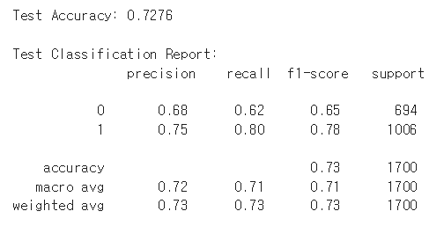
Finding Proper Pre-Processing - Outliers
<Before Removing Outliers>
<Removing Outliers with IQR>
Removing the outliers using IQR led to a decline in model performance.
Removing the outliers using Z-score improved model performance.
-> Selecting the appropriate pre-processing method is essential to optimize model accuracy.
<Removing Outliers with Z-Score>

Slide 19
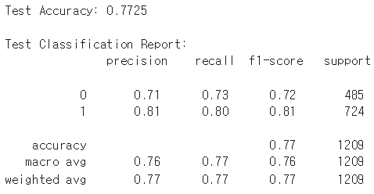
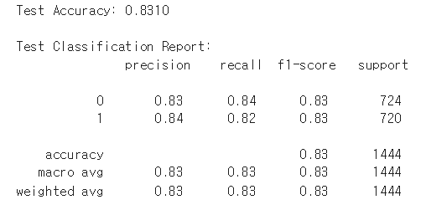
Finding Proper Pre-Processing - OverSampling
<Before OverSampling>
<Oversampling with SMOTE>
SMOTE:
Slight improvement in accuracy (0.7423 → 0.7725)
Synthetic samples generation results in spatial distortion limited performance gain
RandomOverSampler
Significant improvement in accuracy (0.8310)
Simple duplication without spatial distortion
Better suited for spatial and climate-based data
-> Selecting the appropriate pre-processing method is essential to optimize model accuracy.
<Oversampling with RandomOverSampler>

Slide 20
Feature Selection
Conducted multiple trials with different combinations of variables.
Observed that even small differences in variable combinations led to noticeable changes in model accuracy.
→ Feature selection improved model accuracy and demonstrated the importance of feature engineering.
Combination of Variables | Test Accuracy
tmax | tmin | vap | ppt | srad | ws | pet | q | def | soil | pdsi | vpd | 0.8174
tmax | tmin | ppt | ws | q | soil | vpd | pet | 0.8220
def | tmin | ppt | ws | q | soil | vpd | pet | 0.8269
tmax | def | ppt | ws | q | soil | vpd | pet | 0.8310

Slide 21
Value Case

Slide 22
Business Application
01
Predicting Frog Trace From the Global Warming
Conservation Planning: Frog habitat models help predict future biodiversity hotspots, enabling zoning, restoration, and protected area expansion to adapt to climate change.
Research and Policy Development: Frog migration analysis offers insights into climate impacts, guiding ecological studies and adaptation strategies.
Protecting Vulnerable Ecosystems: By translating climate data into actionable plans, governments and researchers can proactively safeguard biodiversity.
02
Predicting Frog to Protect From Batrachochytrium Under Climate Change
Environmental Sensitivity and Conservation: Frogs habitat modeling helps identify regions for climate-responsive conservation and cure planning.
Frog Populations Under Threat: Bd fungus, driven by climate and land use changes, poses a major threat to amphibians, causing population decline and habitat loss.
Actionable Insights for Protection: The prediction model aids pharmaceutical companies, veterinarians, and researchers in locating stable frog habitats for proactive disease prevention and species preservation.

Slide 23
Business Application
Frog Occurrence Predictions to Identify Ecologically Farmland
Farmland Identification: Frog occurrence models help identify farmland with ecological stability, essential for agriculture and biodiversity preservation.
Benefits for Farmers and Food Companies: Frog presence indicates stable environmental conditions, aiding farmers in land selection and supporting organic certifications like USDA Organic and Rainforest Alliance.
Economic and Environmental Value: Frogs contribute to farming by consuming insects and promoting sustainable agriculture, while their habitat predictions guide eco-friendly farming practices.
04
Identifying Ecological Restoration Zones for ESG Strategy
Ecological Restoration for ESG Strategies: Frog occurrence analysis identifies restoration zones where biodiversity recovery is feasible, supporting environmental efforts in corporate ESG plans.
Real-World Example: LG Uplus in South Korea demonstrates biodiversity conservation through initiatives like frog ladder programs in endangered habitats.
Corporate Benefits: Companies can enhance ESG performance, measure biodiversity recovery, and boost their reputation with stakeholders via actionable restoration projects.
03

Slide 24

🌿 1. Real-Time Biodiversity Monitoring Platform
Business Case
Transform the status analysis into a web-based and app-based platform with real-time API integration.
Make continuous updates and live predictions of frog habitat changes for researchers and agencies.
🦠 2. Ecological Risk Mapping
Predict not only frog presence but also regions vulnerable to Bd fungal infection under changing climate conditions.
Provide actionable data for food companies and farmers selecting eco-friendly cultivation sites.
🌾 3. Biodiversity Restoration for ESG Corporations
Helps corporations strategically to plan ecological restoration projects contributing to ESG narrative.
Helps to increase the brand value of ESG company as an eco-friendly company contributing to long-term financial and social value.

Slide 25
What We Learned

Slide 26

What We Learned
01
The importance of Pre-processing
Proper handling of missing values, outliers, and class imbalance significantly impacts model performance.
02
Application of Machine Learning Methods
We could gain the knowledge about the new machine learning techniques and have a chance to apply with real data.
Trying XGBoost, LightGBM, Random Forest, Extra Trees helped benchmark the best solution.
03
Thinking About the Business Application
Beyond technical performance thinking about business strengthened the projects practical value.

Slide 27
Thank you

