Slide 1
Risk Management- Desktop Application User Interface Design

Slide 2
Index
Dashboard
Create/Edit News
PIM Portfolio Alerts
Asset Allocation
Edit Comments
Filters & Reports Generated
My Custom Reports
Reports
Security Report
Manage User
Risk Severity Divergence Rate Configuration

Slide 3
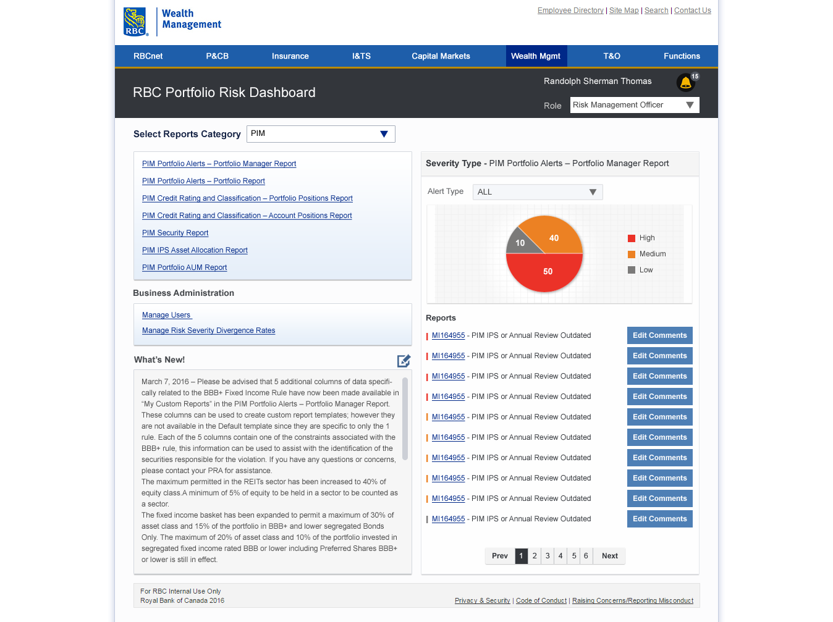


Dashboard

Slide 4
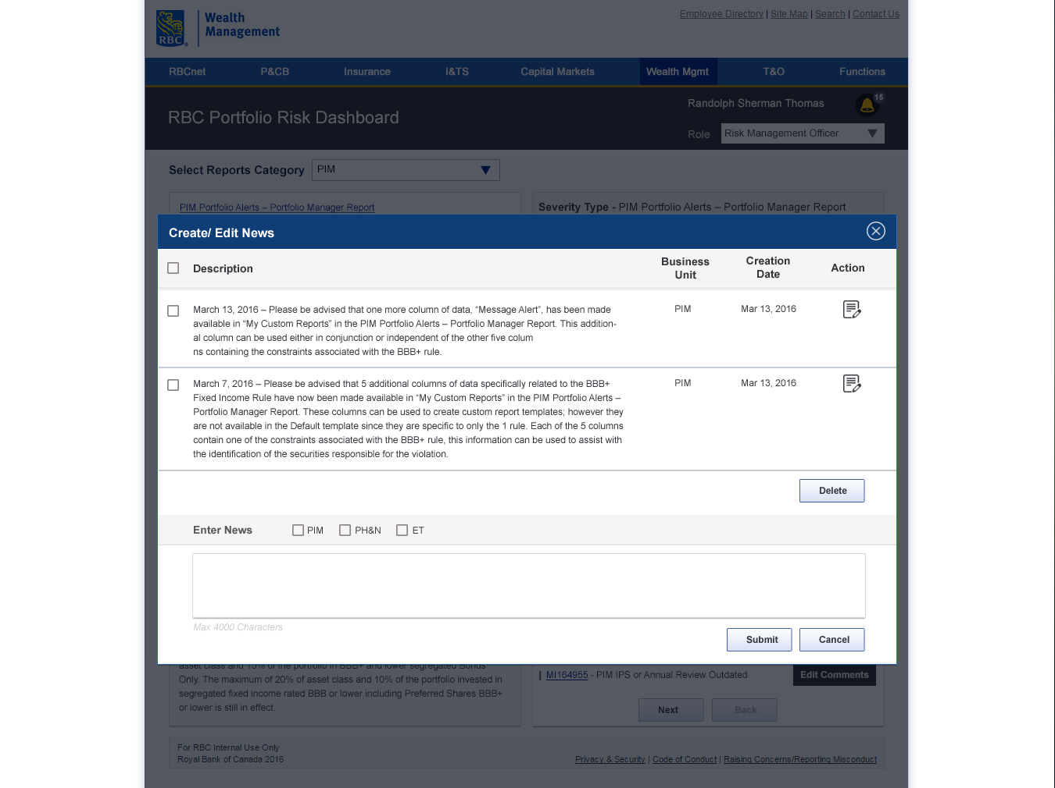
Create/Edit News

Slide 5
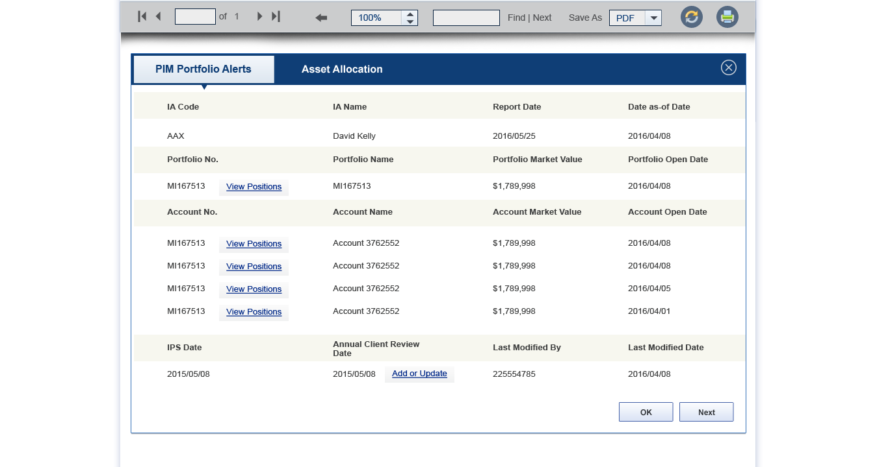
PIM Portfolio Alerts

Slide 6
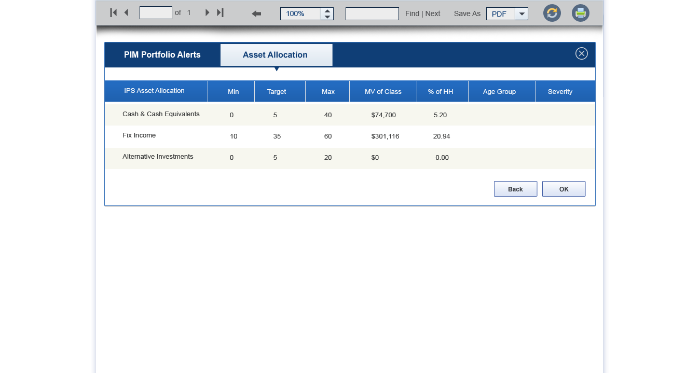
Asset Allocation

Slide 7
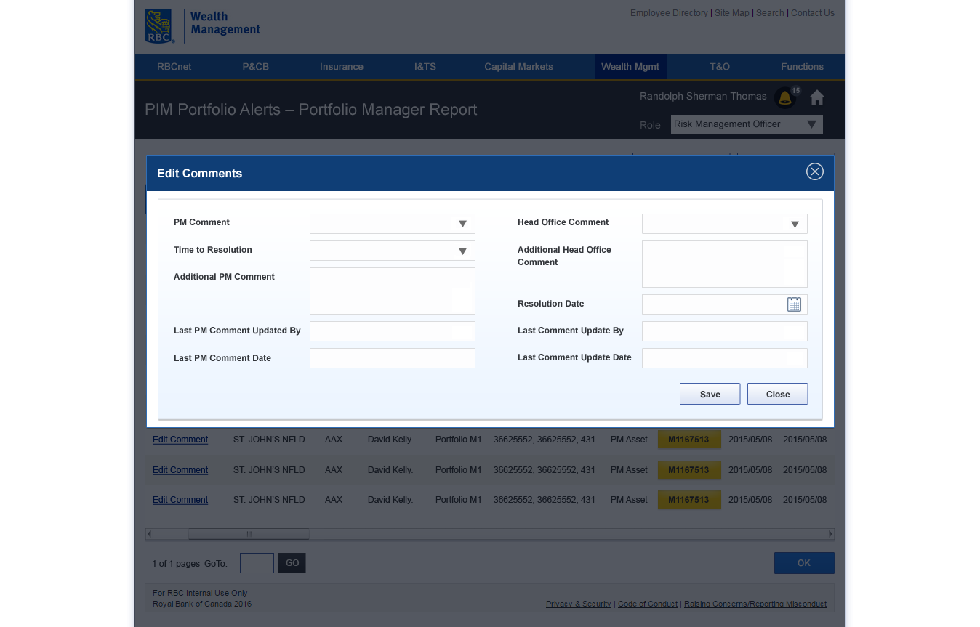
Edit Comments

Slide 8
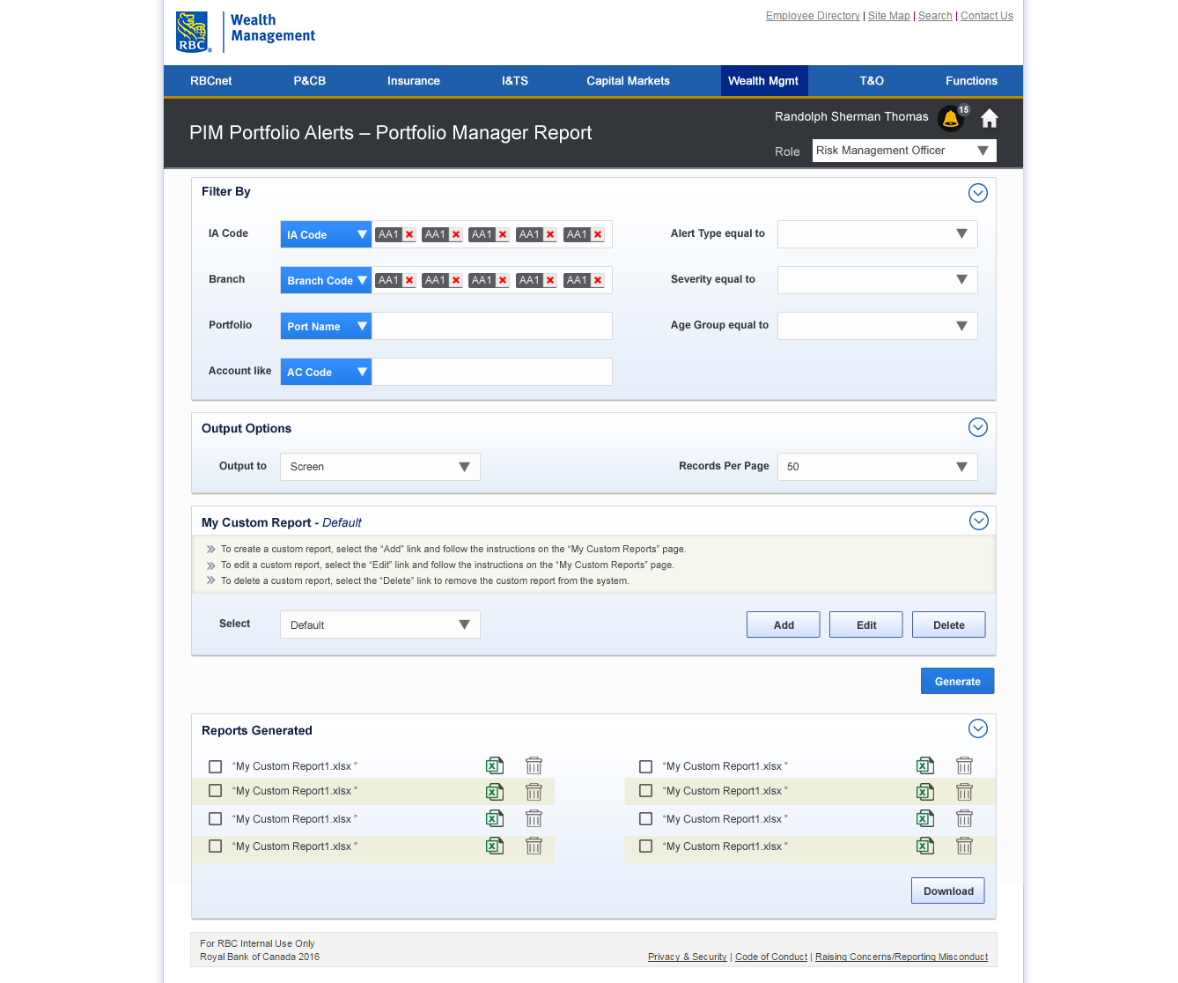
Filters & Reports Generated

Slide 9
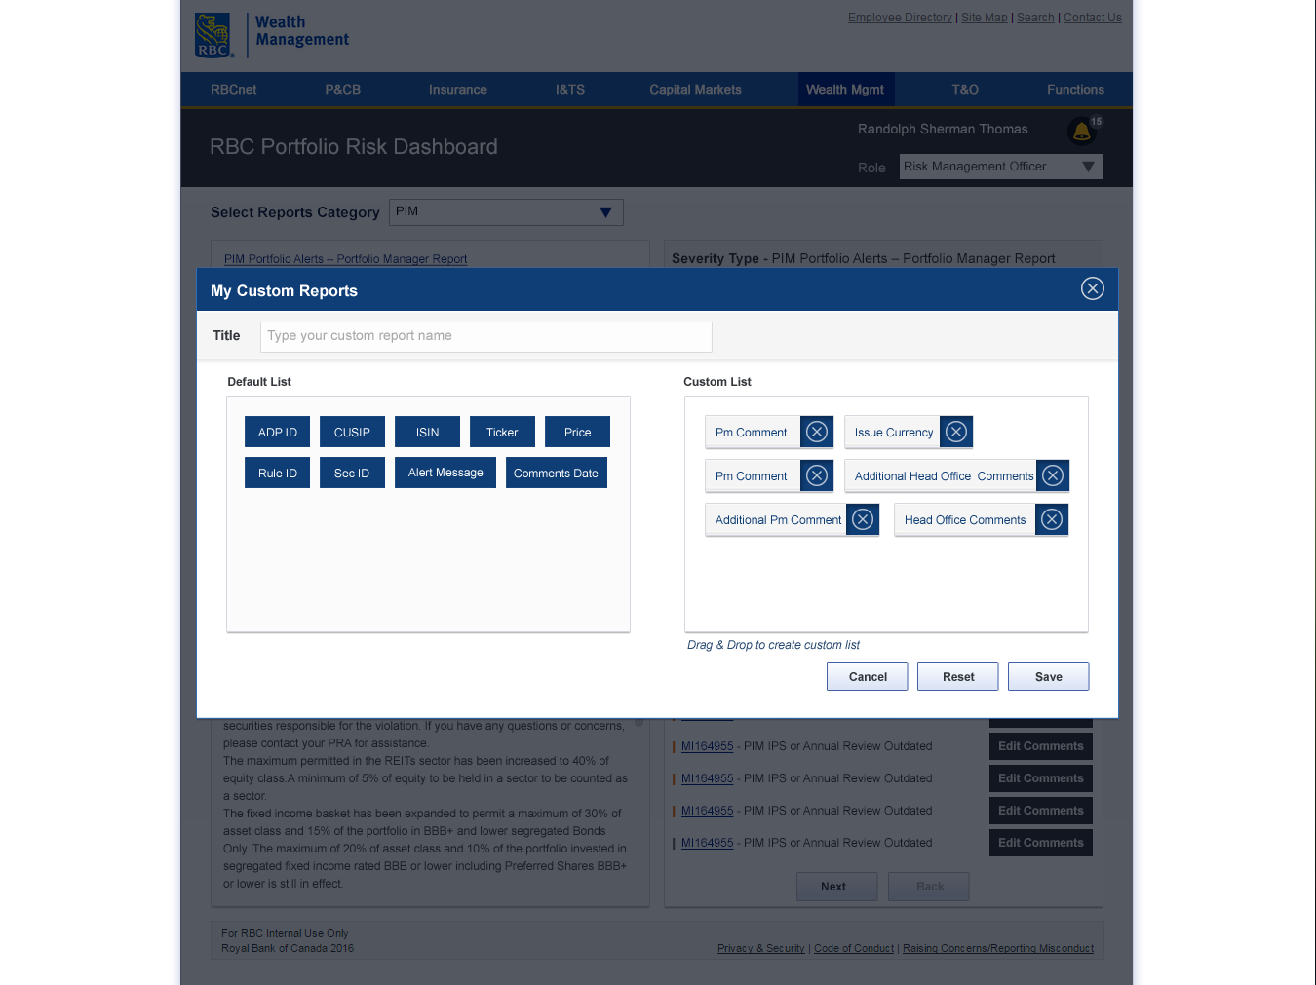
My Custom Reports

Slide 10
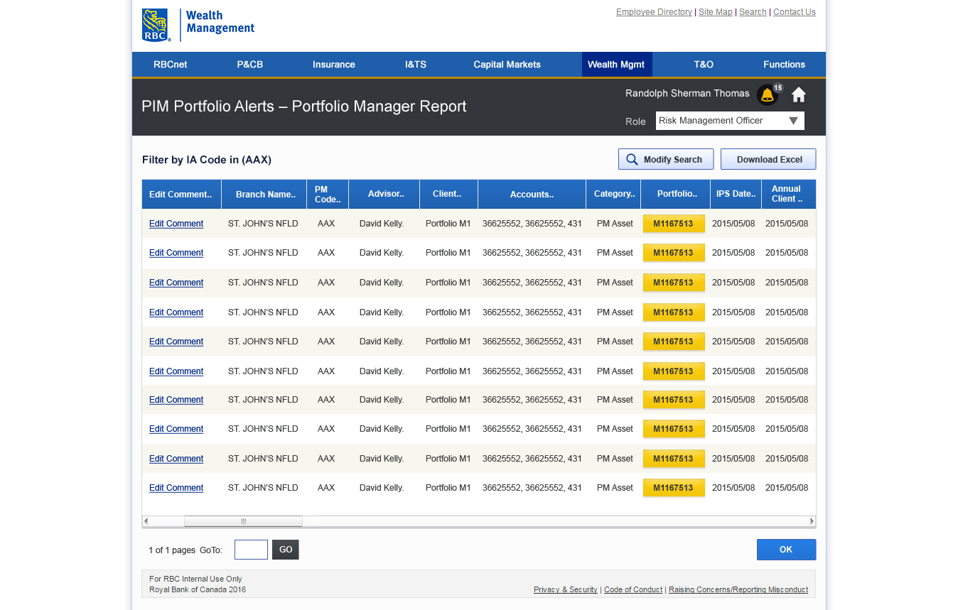
Reports

Slide 11
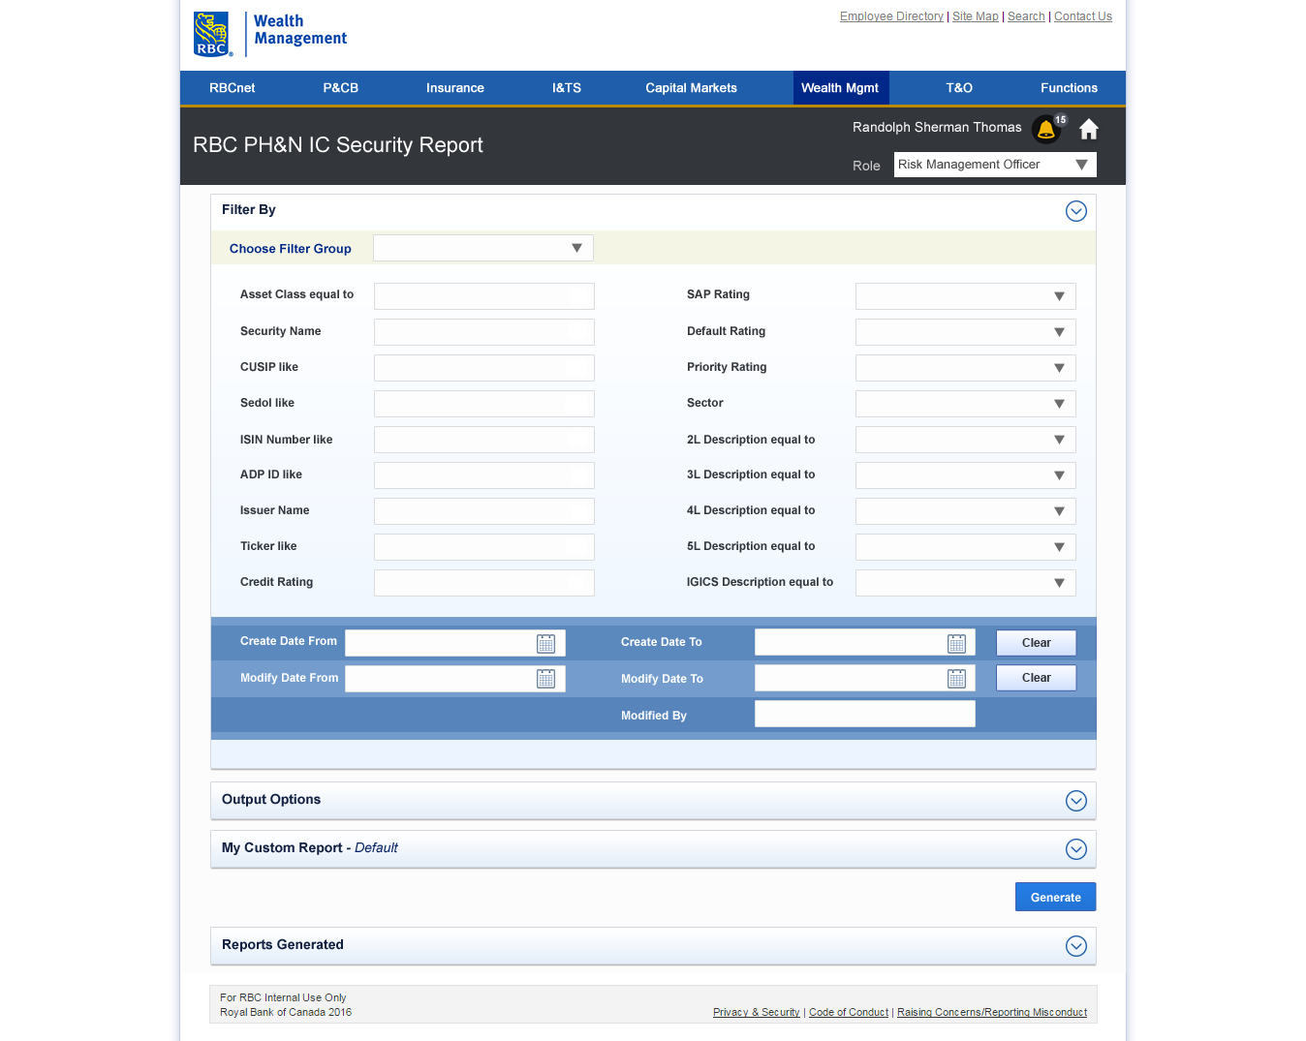
Security Report Filters

Slide 12
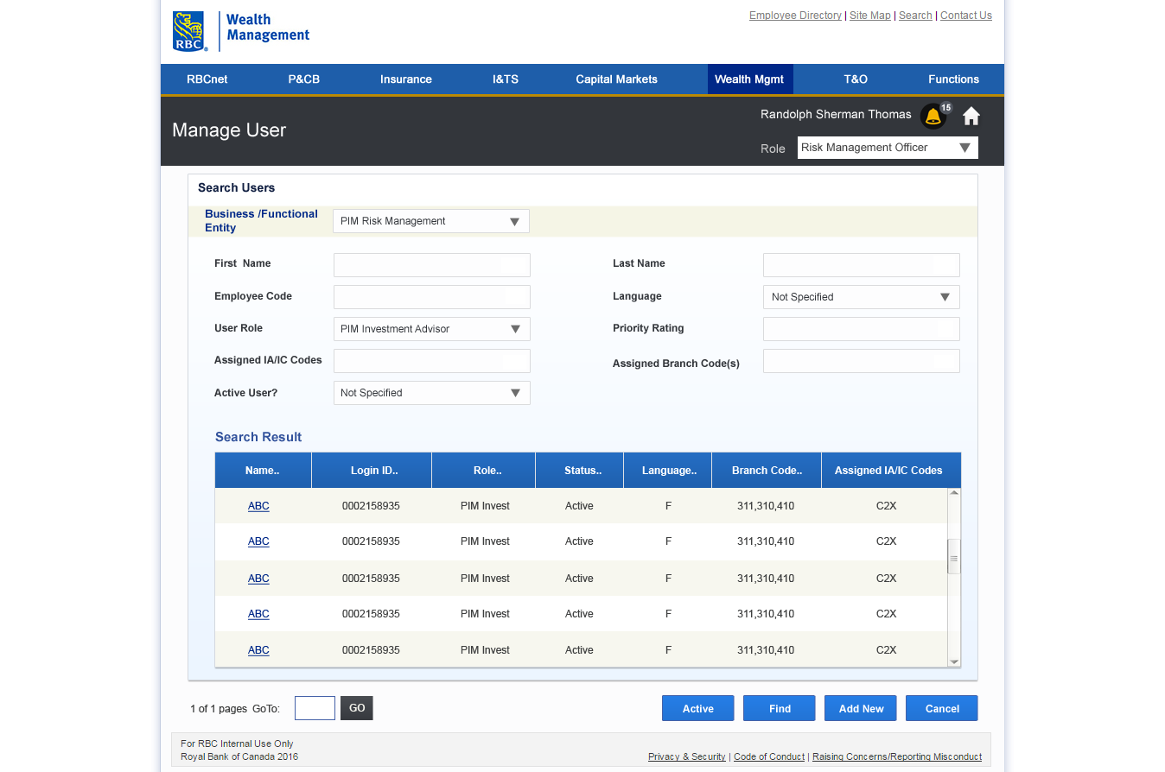
Manage User

Slide 13
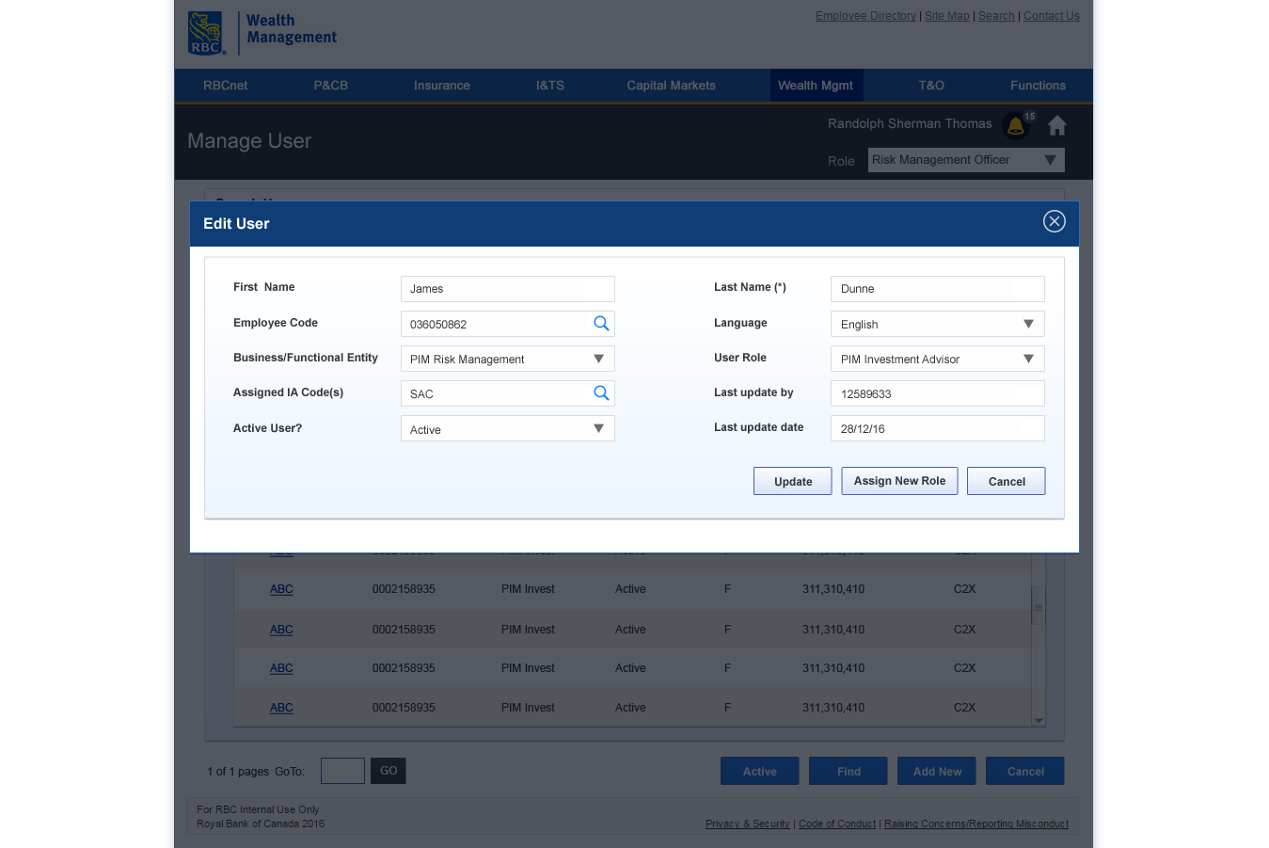
Manage User – Edit User

Slide 14
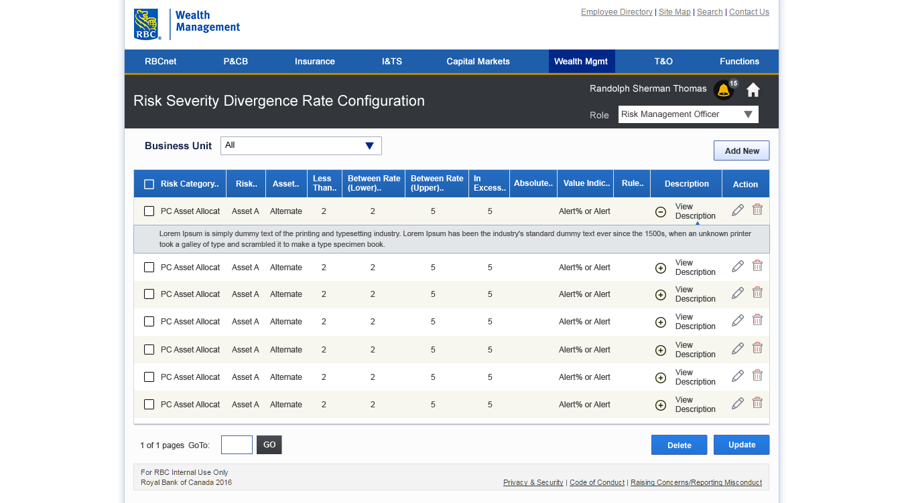
Risk Severity Divergence Rate Configuration

