Slide 1
My History

Slide 2




Generation-1:Grand Father’s -Pots & Business

Slide 3

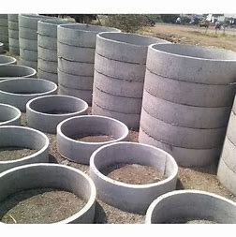

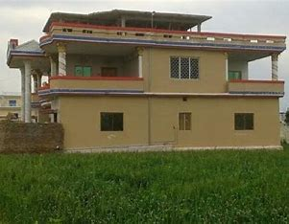

Generation-2: Construction Managers & Construction items Business

Slide 4

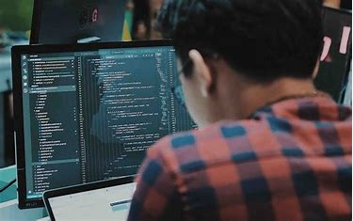


Generation-3: Present: Software, Marketing & Teaching

Slide 5
Training Program-Roles
Data Scientist
Data Engineer
Data Analyst
Cloud Engineer
DevOps Engineer

Slide 6


Data Science

Slide 7



Data Engineering

Slide 8



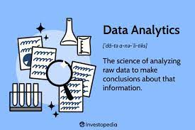
Data Analysis

Slide 9


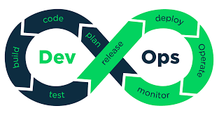


DevOps

Slide 10

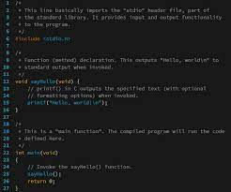



Training →Free → No Payment
Python → Programming Language → 20 Days
CICD → Continue integration and continuous Deployment →5 Days
Git→ File storage repository →5 Days
OS → Operating system(Windows/Linux/Ubuntu) →5 Days
Cloud → (AWS/Azure/GCP) → 5 Days
Others → 5 Days
Overall 45 Days( 20+5+5+5+5+5)

Slide 11
Training Method
1 Hour Video Watch
1 Hour practise
1 Hour Assignment work
Maximum 3 hours per day
Per 45 days 135 hours
Minimum 1 hour per day
Per 45 days 45 hours

Slide 12
Weekly two days connect with trainer (Wends day & Fri day)
Doubts clarification –same day or next day
Assignment results – same day or next day
Note: Tracking is on and available as chart & reports.

Slide 13
Qualification
Minimum +12(intermediate) completed
Any Degree/ Any Engineering/Any graduation and above
No previous experience required
Dependence on previous experience advantages added
Dependence on Higher Education advantages added

Slide 14




Pre-Project Assignment/Apprentice/Shadow Project
Its payable –5000/- per month
Partial understanding of project
Partial work assignment
Work timings 8 hours (includes breaks & Lunch)
Shift1→ 2pm-10 pm
Shift2 → 9am -5pm
Note: Time Limit 1 month only

Slide 15
Project Assignment
Its payable –10000/- per month
Full understanding of project
First week project & tasks explanation
Second week project tasks solution discussion
Third week project task assignment
Fourth week individual contribution
Training on project related work, Tools & Domain
Work timings 8 hours (includes breaks & Lunch)
Shift1→ 2pm-10 pm
Shift2 → 9am -5pm
Note: No limit for the project duration. Till one year from join date same pay applicable.

Slide 16
Benefits
Development of skills
Free training on software industry
Realtime Project experience
Personally and professionally growth

Slide 17
Risks
Project Duration is short
Project unavailability
Project ram down
Project budget cross cutting
Market issues

Slide 18
Taken Care
One month half payment payable.
Training availability
Project information and practise
Deploying in project ASAP.

Slide 19



Objective
Development of people
Development of area
Development of culture

Slide 20
My Team → 1 Year of Journey
1. Bhavani K
2. Arifa A
3. Anwar A

Slide 21
My Team
4. AleemPasha A
5. Salam A
6. Sireesha V

Slide 22
My Team
7. Liyakhath M

Slide 23
Deployed & Running status
Deployed 7 member in project
4 member are in Running status
3 members are in hold status → Due to their personals

Slide 24
Team Experience

Slide 25
comments
Its business
Its for revenge
Its for name and fame
Its publicity
Its development
Wasting money
Wasting time
Some other activity

Slide 26
Thank you

