Slide 1
Customer Churn Analysis for Telecom Industry
Prepared By: Devaguptapu Jaya Sri
Tools: SQL, Python, Scikit-Learn, SHAP, Jupyter Notebook
Objective: Predict customer churn and identify retention factors.

Slide 2
Project Overview
Customer churn refers to customers who stop using a company's services.
Goals:
• Predict churn
• Identify churn factors
• Create customer segments
• Recommend retention strategies

Slide 3
Dataset Description
Dataset: Telco Customer Churn Dataset
Target Variable: Churn (Yes/No)
Total Records: ~7032 customers
Features: Gender, Tenure, Charges, Contract Type, Internet Service, Payment Method, etc.

Slide 4
Tools & Technologies
Python,Pandas
NumPy, Matplotlib
Seaborn, Scikit-Learn
SHAP
SQL
Jupyter Notebook

Slide 5
Project Workflow
1. Data Collection
2. Data Cleaning
3. EDA
4. Feature Engineering
5. Model Building
6. Evaluation
7. Customer Segmentation
8. Recommendations

Slide 6
Data Analysis Findings
• Month-to-month contracts have higher churn
• High monthly charges increase churn
• Short-tenure customers churn more
• Long-term customers are more loyal

Slide 7
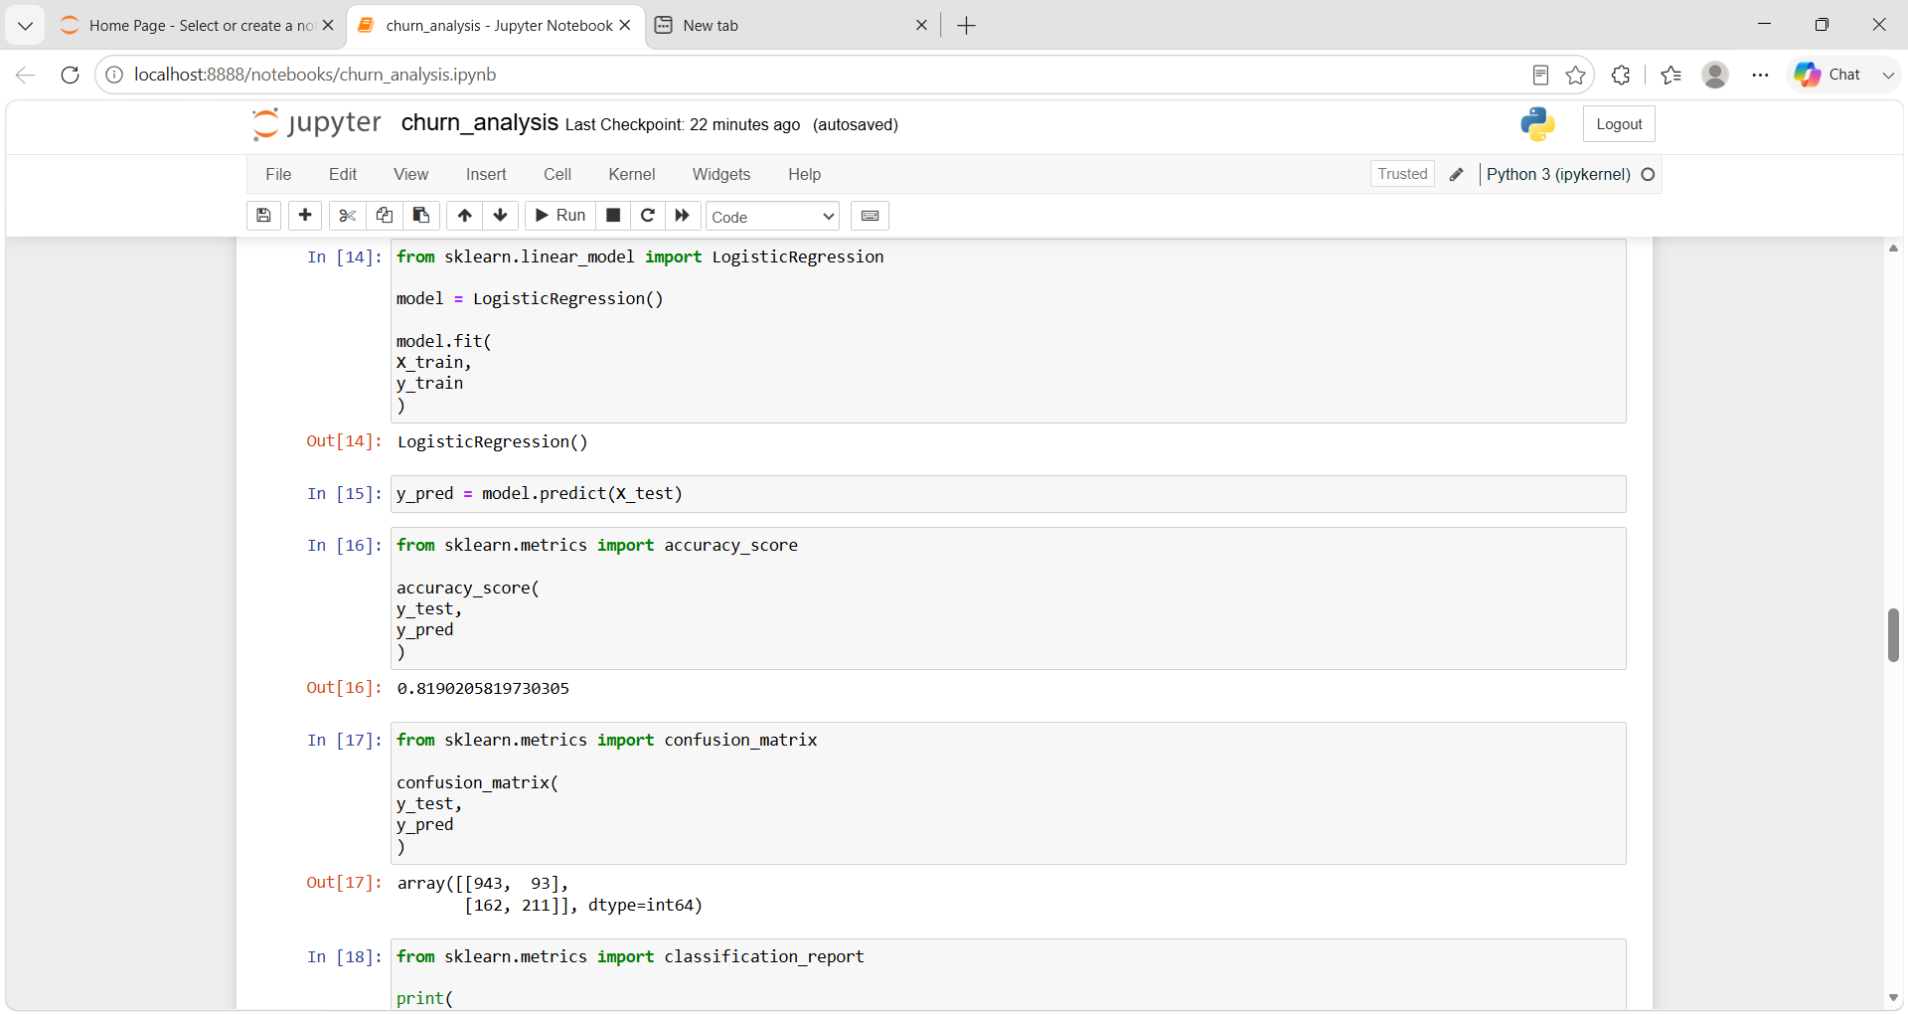
Machine Learning Model
Model: Logistic Regression
Evaluate using Accuracy, Precision, Recall, F1 Score

Slide 8
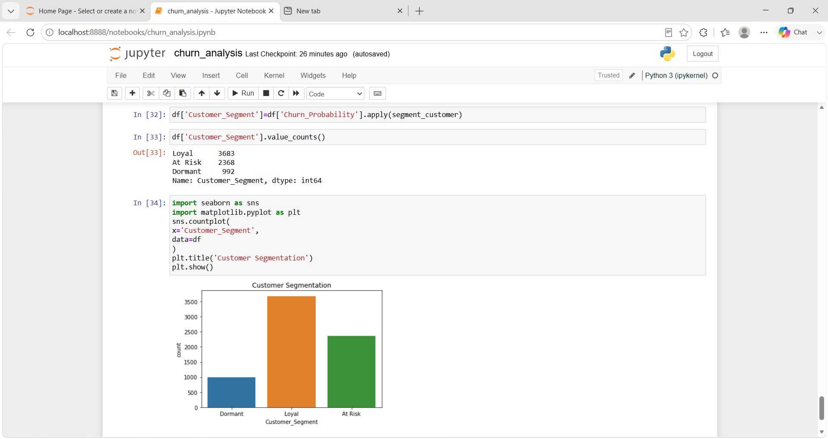
Customer Segmentation
Loyal: <20% churn probability
At Risk: 20%-60%
Dormant: >60%

Slide 9
Final Recommendations
Promote Long-Term Contracts
Offer discounts and benefits for 1-year and 2-year contracts.
Reduce dependency on month-to-month subscriptions, which show higher churn rates.
Retain High-Risk Customers
Identify customers with high churn probability.
Provide personalized offers, discounts, and retention campaigns.
Improve Customer Support
Resolve customer complaints quickly.
Increase customer satisfaction through better service quality.
Implement Loyalty Programs
Reward long-term customers with exclusive benefits.
Encourage continued usage through loyalty points and special offers.
Focus on New Customers
Provide onboarding support during the first few months.
Engage customers early to improve retention.
Optimize Pricing Strategies
Review plans with high monthly charges.
Introduce flexible and affordable pricing options.

Slide 10
Conclusion
Successfully analyzed churn, built a prediction model, segmented customers, and generated recommendations.
Future Scope: Random Forest, XGBoost, Power BI Dashboard.

