Slide 1

Customer Shopping Behavior Analysis
Unlocking customer insights to reveal patterns, opportunities, and growth.

Slide 2
Dataset at a Glance
3,900
$59.76
Total Transactions
Avg. Purchase Value
Across 18 features including demographics, purchase details, and behavior signals
Avg. review rating of 3.75 / 5.0 across all transactions
4
50
Product Categories
Locations
Clothing, Accessories, Footwear, and Outerwear
37 null review ratings imputed using category-level median

Slide 3
Data Preparation & Feature Engineering
Exploration
Feature Engineering
Cleanup
Database Load
Loaded and explored data with pandas — checked structure, summary stats, and null values
Dropped redundant promo_code_used (identical to discount_applied); standardized column names to snake_case
Loaded cleaned DataFrame into PostgreSQL for SQL-based business analysis
Engineered age_group (binned) and purchase_frequency_days columns for richer segmentation

Slide 4
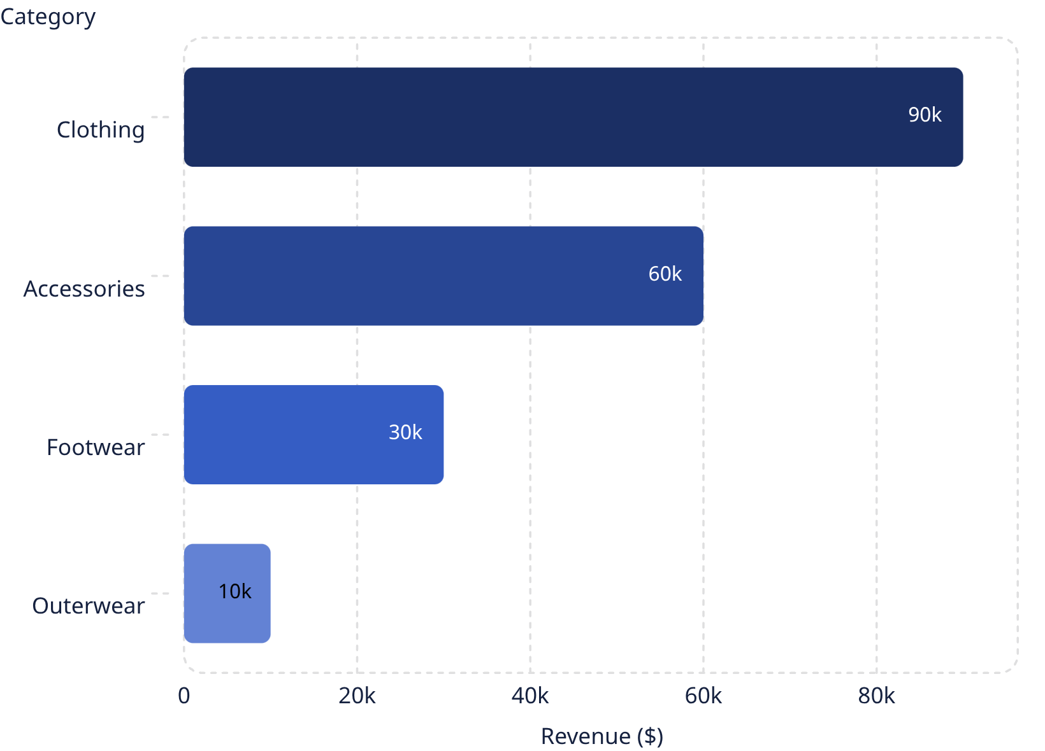

Revenue by Category: Clothing Dominates
Clothing leads with approximately $90K in revenue and ~1,800 sales — far ahead of all other categories.
Accessories (~$60K) holds a strong second position, while Footwear lags behind and Outerwear trails significantly at ~$10K.
Outerwear represents a potential growth opportunity or a candidate for strategic rationalization.

Slide 5
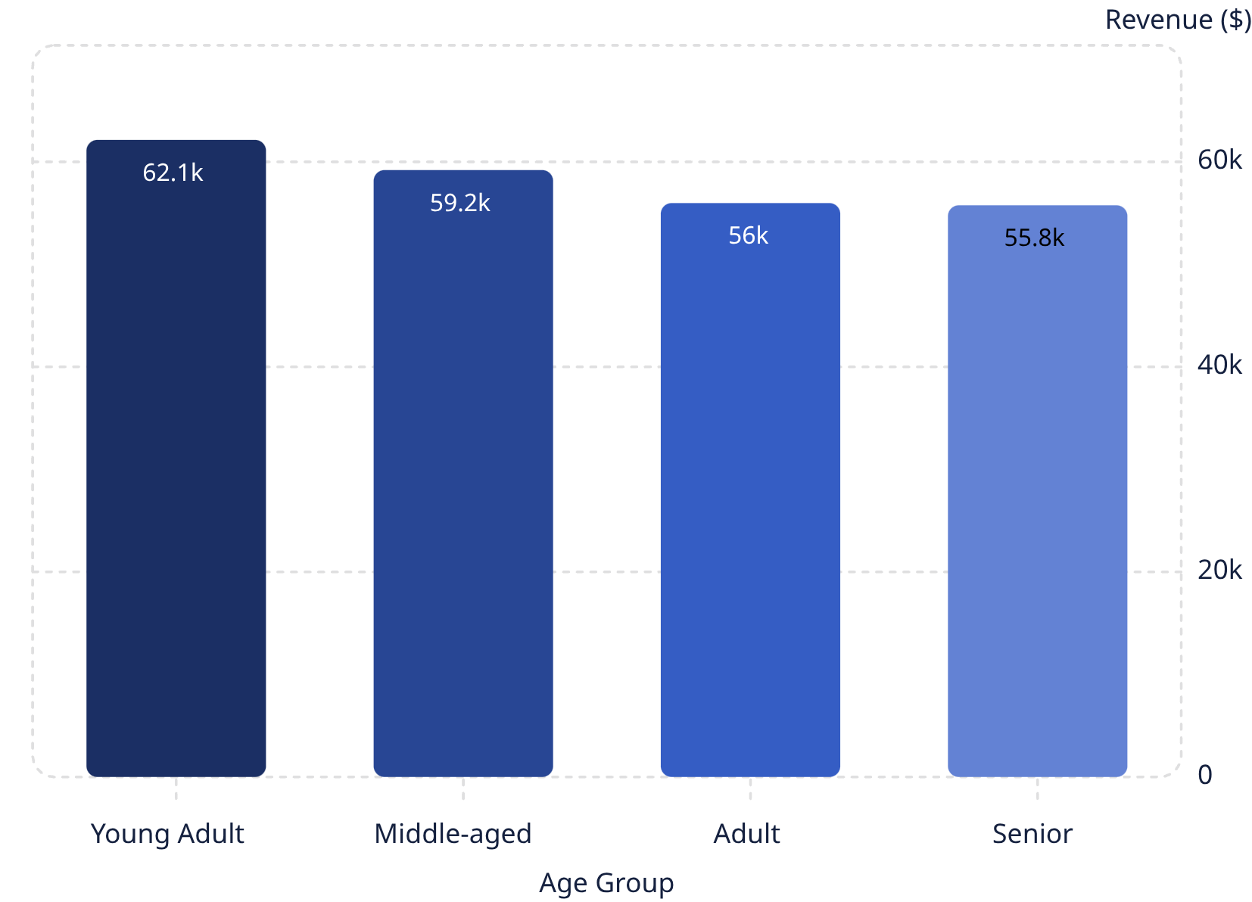
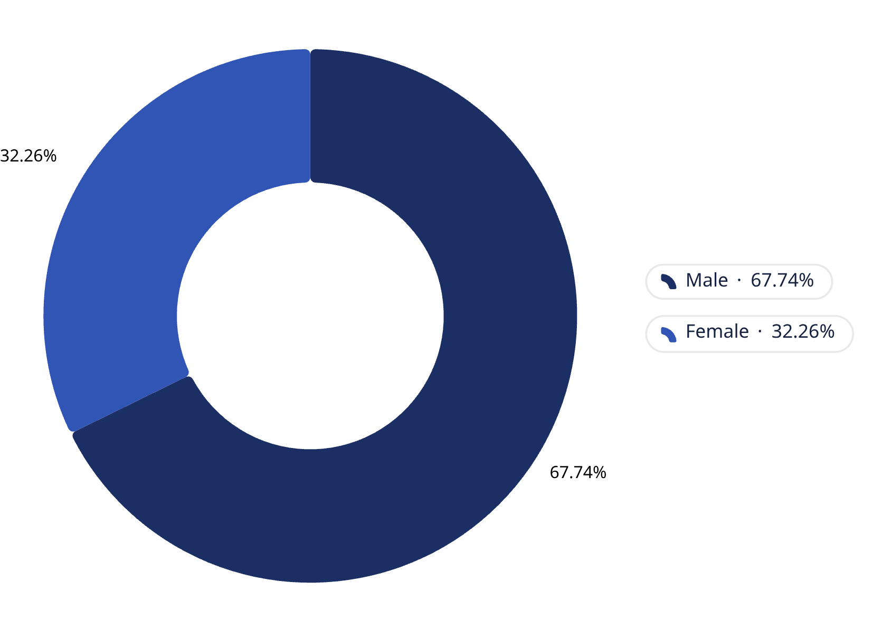
Revenue by Age Group & Gender
Revenue by Age Group
Revenue by Gender
Young Adults lead at $62,143 — but all age groups contribute meaningfully, signaling broad cross-age appeal.
Male customers account for $157,890 vs. $75,191 from female customers. Males represent 68% of the customer base (2,652 of 3,900) — driving the revenue gap.

Slide 6
Subscription Status: 73% Are Non-Subscribers
Non-Subscribers
Subscribers
2,847 customers (73%) hold no subscription
Only 1,053 customers (27%) hold active subscriptions
Avg. Spend — Subscribers
Avg. Spend — Non-Subscribers
$59.49 per transaction
$59.87 per transaction
Average spend is nearly identical across both groups — subscriptions do not drive higher spend, but represent an untapped engagement and retention lever.

Slide 7
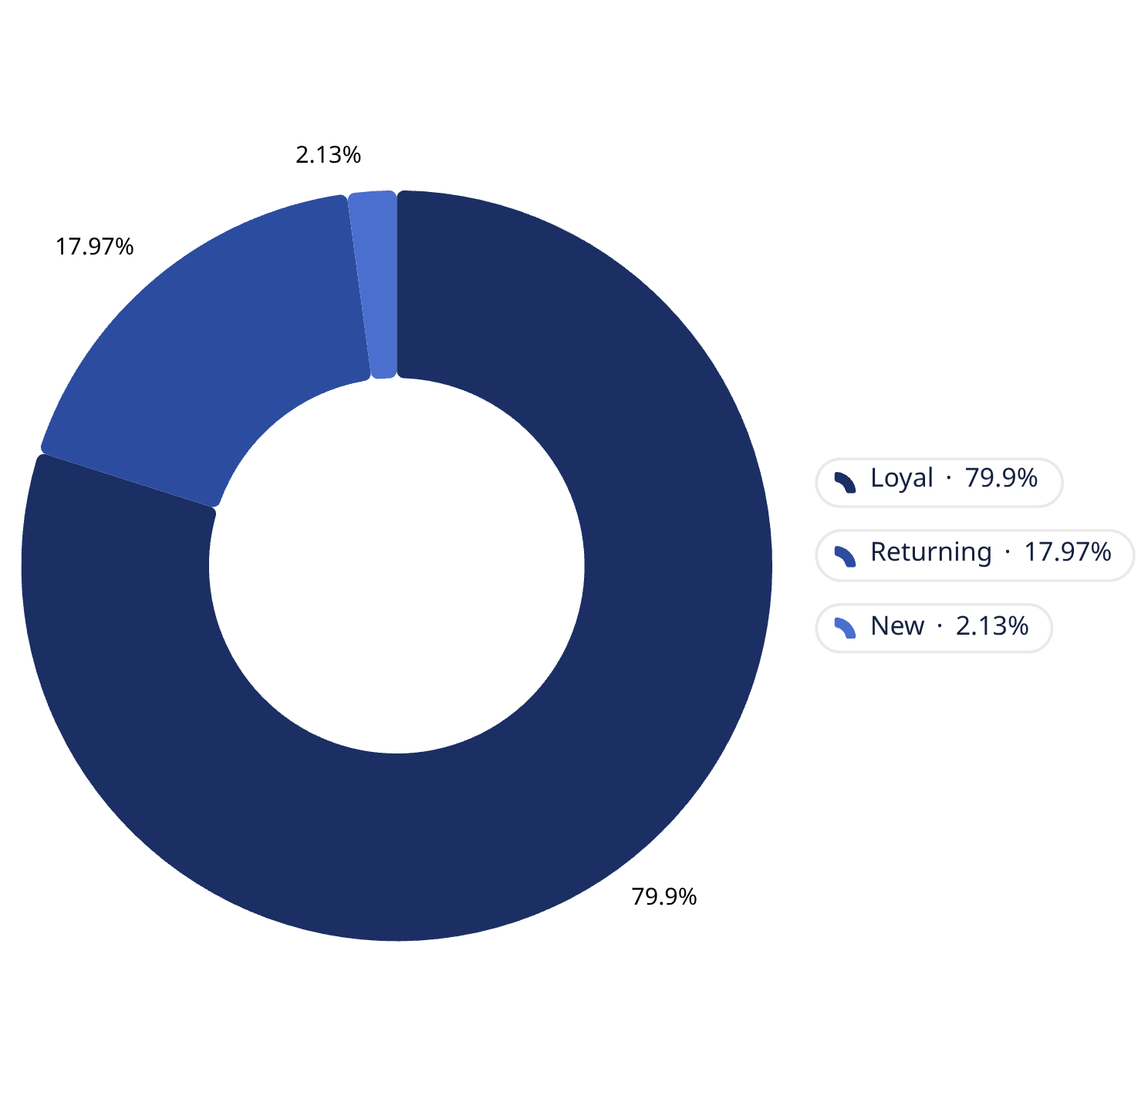

Customer Segmentation by Loyalty
Loyal Customers — 80%
Returning — 18%
701 returning customers represent a warm re-engagement opportunity
3,116 customers form a strong retention base with consistent repeat purchasing behavior
New — Only 2%
Just 83 new customers — a critical pipeline gap requiring attention
2,518 repeat buyers (>5 purchases) remain non-subscribers — a prime conversion opportunity.

Slide 8
Top Products by Rating & Category
Highest-Rated Items
Clothing
Gloves — 3.86 ⭐
Sandals — 3.84 ⭐
Boots — 3.82 ⭐
Hat — 3.80 ⭐
Top seller: Blouse
Runner-up: Pants
Accessories
Footwear & Outerwear
Top seller: Jewelry
Footwear: Sandals
Outerwear: Jacket

Slide 9
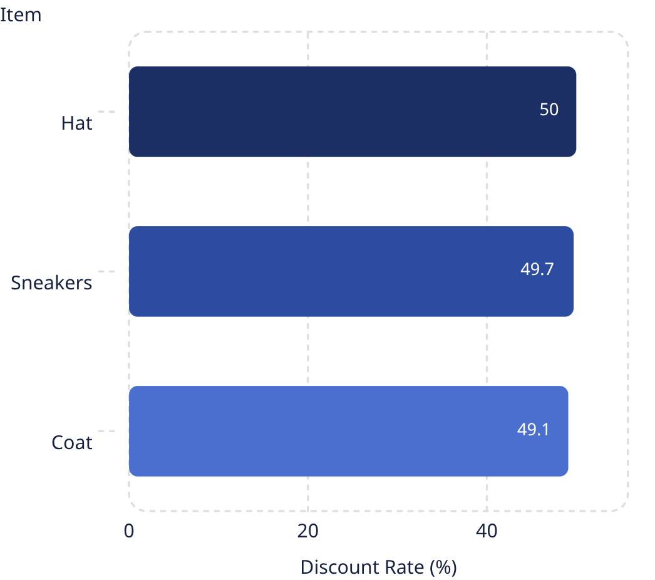
Discount Dependency & Shipping Behavior
Most Discounted Items
Shipping Type & Spend
839 customers used discounts yet still spent above the average — discount-driven but demonstrably high-value.
Express Shipping
Avg. spend: $60.48 — signal of higher-value customers
Standard Shipping
Nearly half of all sales for these items rely on discounts — raising margin erosion concerns.
Avg. spend: $58.46

Slide 10
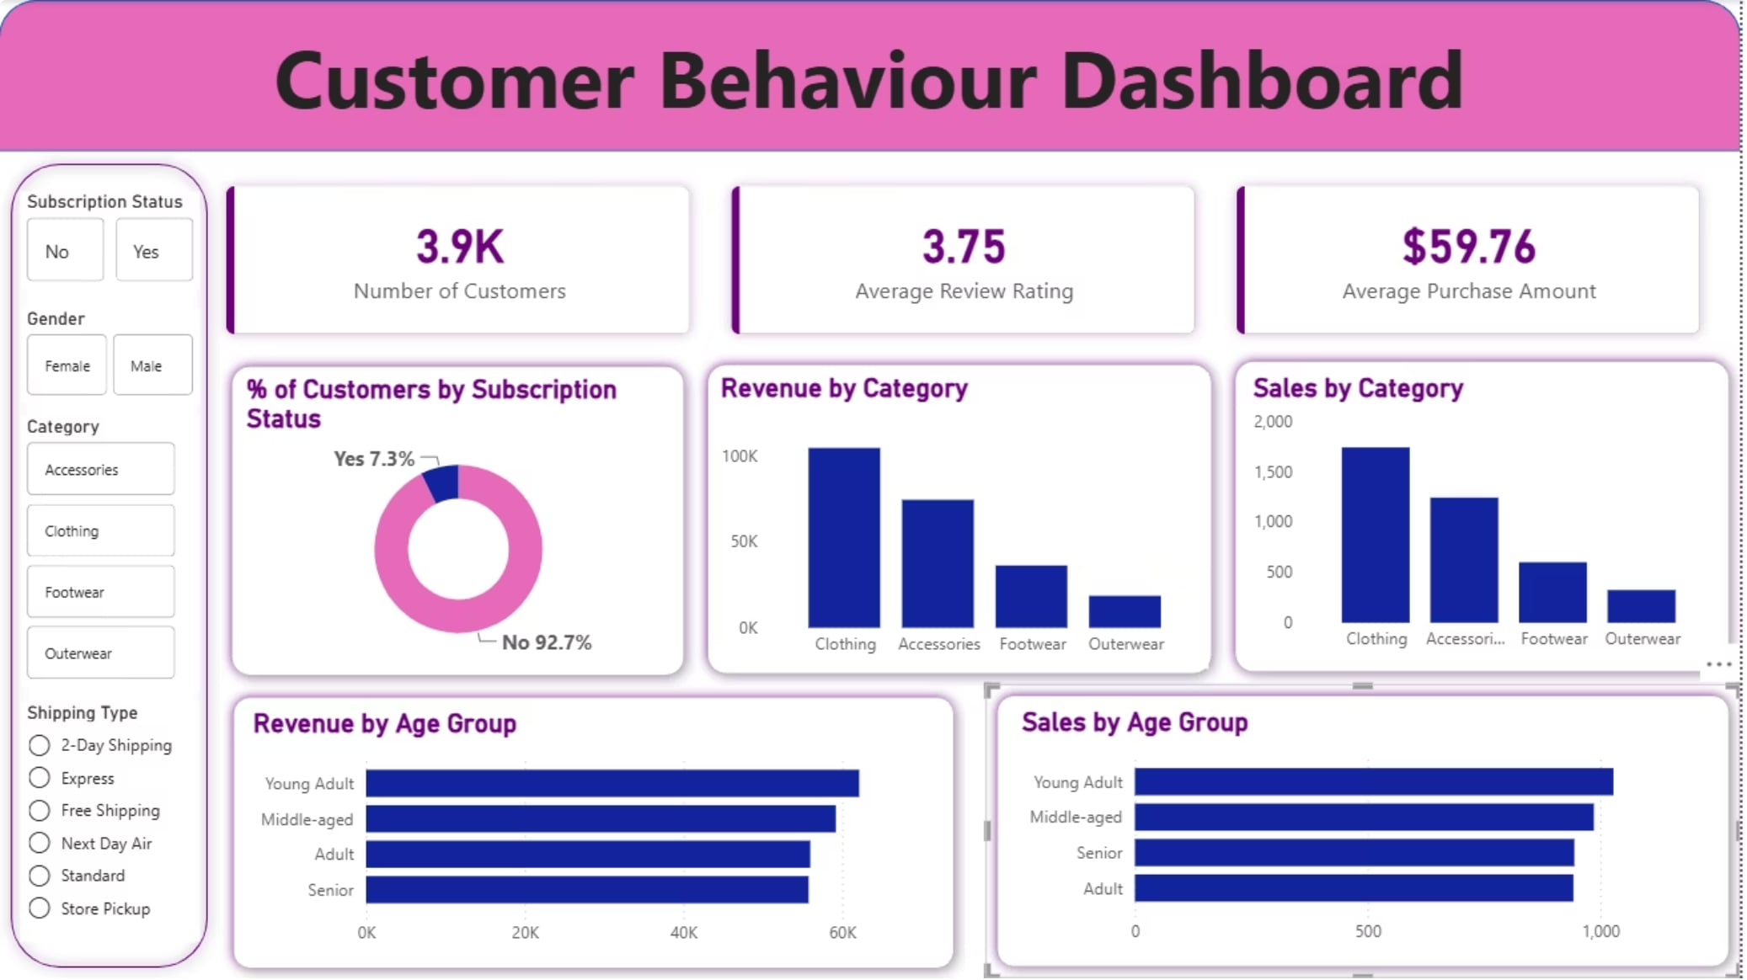
Power BI Dashboard
Interactive Filters
Slice by Subscription Status, Gender, Category, and Shipping Type
KPI Cards
At-a-glance metrics for total revenue, avg. purchase, and customer count
Visual Breakdowns
Donut chart and bar charts for category and age-group revenue distributions

Slide 11
Strategic Recommendations
1
Convert Repeat Buyers
2,518 loyal non-subscribers are prime subscription targets — offer exclusive perks to close the gap
2
Revise Discount Policy
High discount rates on Hats, Sneakers, and Coats (~50%) risk margin erosion — reassess thresholds
3
Target Young Adults & Males
Highest-revenue segments — prioritize in campaigns, product placement, and personalization
4
Boost New Customer Acquisition
Only 83 new customers (2%) signals a critical pipeline gap — invest in top-of-funnel growth initiatives

