Slide 1
Employee Data Analysis using Excel
STUDENT NAME: Jayasudha E
REGISTER NO: 312200175
DEPARTMENT: Commerce
COLLEGE: South Indian Vaniyar Educatin Trust college
1

Slide 2
PROJECT TITLE
Employee Performance Analysis using Excel
2

Slide 3


AGENDA
Problem Statement
Project Overview
End Users
Our Solution and Proposition
Dataset Description 6.Modelling Approach
7.Results and Discussion 8.Conclusion
3/21/2024 AnnualReview
3

Slide 4

PROBLEM
STATEMENT
Manual employee performance tracking is time-consuming, prone to errors, and lacks data-driven insights, making it challenging for organizations to make informed decisions.
Current methods rely on subjective evaluations, leading to biases and inconsistent assessments.
The lack of real-time data and analytics hinders proactive decision-making and timely interventions.
4

Slide 5

PROJECT OVERVIEW
This project aims to develop an
automated employee performance analysis tool using Excel, streamlining the process and providing actionable insights for data-driven decision-making.
The tool will enable HR professionals and managers to:
•.
Track employee performance metrics in real-time
Identify areas for improvement and development needs
Make informed decisions about promotions, training, and resource allocation
Enhance employee engagement and retention through data-driven feedback and coaching
The project scope includes:
Data collection and integration from
existing HR systems and performance reviews
5

Slide 6

WHOARE THE END USERS?
Primary End Users:
HR Professionals: responsible for tracking employee performance, identifying development needs, and making informed decisions about talent management.
Managers and Team Leaders: responsible for evaluating employee performance, providing feedback and coaching, and making decisions about promotions and resource allocation.
Secondary End Users:
Employees: will have access to their own performance data, enabling them to track their progress, set goals, and seek feedback and development opportunities.
Senior Leadership: will have access to
aggregated performance data, enabling them to make strategic decisions about talent management, resource allocation, and organizational development.
6

Slide 7

OUR SOLUTIONAND ITS VALUE PROPOSITION
Our Solution:
An automated employee performance analysis tool built in Excel
Integrates data from existing HR systems and performance reviews
Provides real-time insights and analytics for data-driven decision-making
User-friendly dashboard for easy navigation and visualization
Value Proposition:
Saves time and reduces manual effort in tracking and analyzing employee performance
Enhances accuracy and consistency in performance evaluations
Provides actionable insights for informed decision-making about talent management and development
Improves employee engagement and
retention through data-driven feedback and coaching
7

Slide 8
Dataset Description
Data Sources:
HR Information System (HRIS)
Performance Management System
Employee Engagement Surveys
Training and Development Records
Data Elements:
Employee demographics (name, ID, department, role)
Performance metrics (ratings, reviews, feedback)
Training and development data (courses taken, certifications earned)
Engagement survey results (satisfaction, retention risk)
Data Frequency:
Quarterly performance reviews
Bi-annual engagement surveys
Ongoing training and development records
Data Volume:
Approximately 1,000 employee records
5,000+ performance reviews.

Slide 9

THE "WOW" IN OUR SOLUTION
Interactive Dashboards:
Real-time data visualization for instant insights
Customizable views for tailored analysis
Predictive Analytics:
Identifies high-risk employees for proactive intervention
Forecasts future performance trends
Automated Reporting:
Streamlines performance review processes
Saves time and reduces manual effort
Actionable Insights:
Data-driven recommendations for development and growth
Enhances employee engagement and retention
Scalability:
Easily adapts to growing employee
3/21/2024 AnnualReview
base
9

Slide 10
MODELLING
Methodology:
Data preparation and cleansing
Feature engineering and selection
Model development and training
Testing and validation
Algorithms:
Regression analysis for performance
prediction
Clustering for employee segmentation
Decision trees for recommendation engines
Data Transformation:
Handling missing values and outliers
Normalization and scaling
Data aggregation and grouping
Model Evaluation:
Performance metrics (accuracy, precision, recall)
Cross-validation and testing
Continuous monitoring and improvement
Insights Generation:
Identifying key drivers of performance
Detecting trends and patterns
Informing data-driven decisions
10

Slide 11
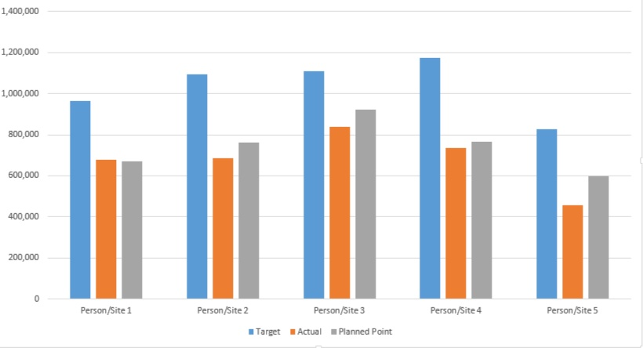
RESULTS
11

Slide 12
conclusion
Summary:
Developed an automated employee performance analysis tool using Excel
Improved accuracy and efficiency in performance tracking and prediction
Enhanced employee engagement and retention through data-driven insights
Impact:
Transformed talent management and development processes
Enabled data-driven decision-making and strategic planning
Positioned the organization for future growth and success
Recommendations:
Continuously monitor and refine the tool for optimal performance
Explore additional applications for predictive analytics in HR

