Slide 1
JIRA – An Introduction
Arpit Jindal
arpit.jindal@utdallas.edu

Slide 2
Topics for today
  Introduction to JIRA and its features
  Demonstration of usage of JIRA
  JIRA for Scrum
  Comparing JIRA with other version control tools
  Q & A

Slide 3
Basic questions
  What is JIRA? In simple terms: “JIRA is an issue tracker”
  Is it web based? Yes
  Is it open source? Yes
  Is it a licensed product? Yes
  Whose product is JIRA? www.atlassian.com

Slide 4
Features (from the creators of JIRA)
  Because you've got issues
    JIRA lets you prioritise, assign, track, report and audit your 'issues,' whatever they may be — from software bugs and help-desk tickets to project tasks and change requests.
  Reporting and statistics
    Customisable reporting allows you to monitor the progress of your issues with detailed graphs and charts.
  Workflow your way
    Map your business process with a custom workflow.
  An extensible platform
    Integrate JIRA into your systems with our open API and 100+ free plugins.

Slide 5
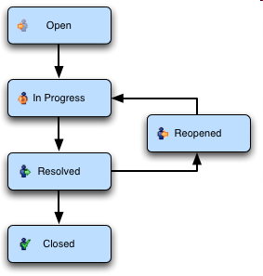
Issues and Workflows
  What is an “Issue”?
    Any task that requires an action from a person
  What is “Workflow”?
  What are fields?
    The attributes of an issue (Standard & Custom)

Slide 6
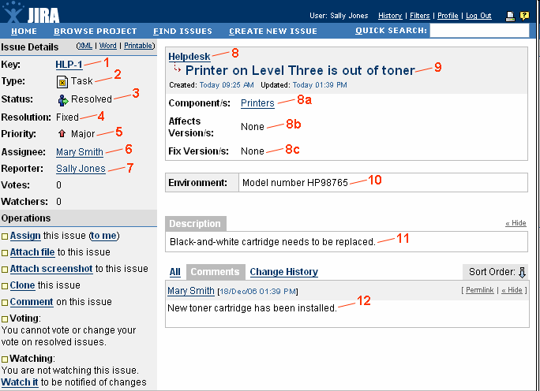
Issue
Sample Issue

Slide 7
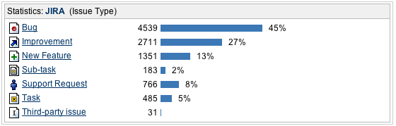
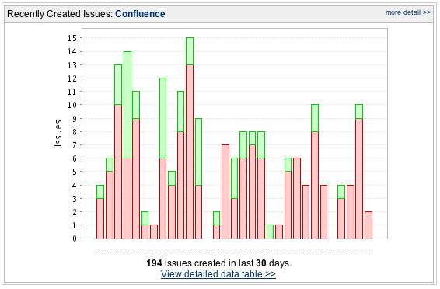
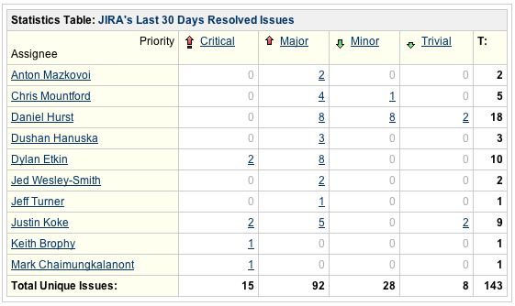
Sample Reports - II

Slide 8
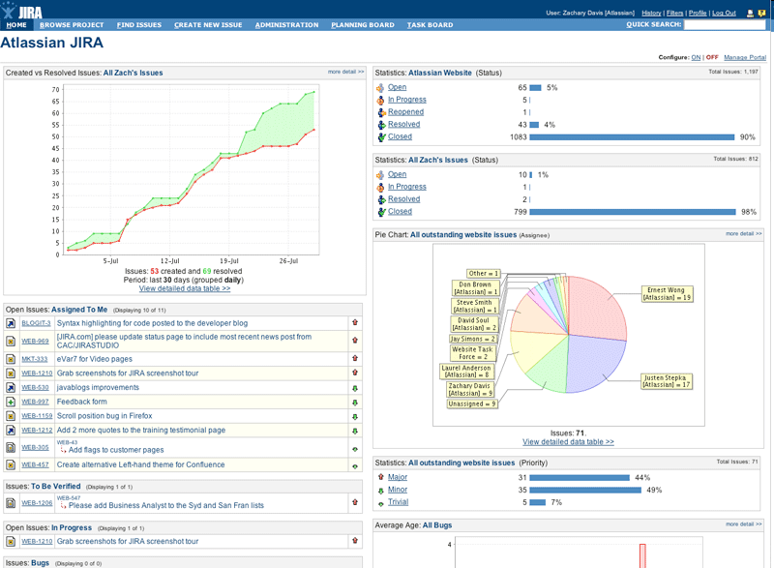
Dashboard
Sample Dashboard

Slide 9
JIRA for Scrum

Slide 10
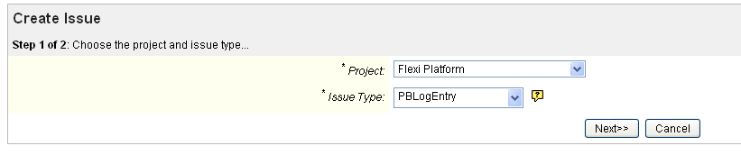
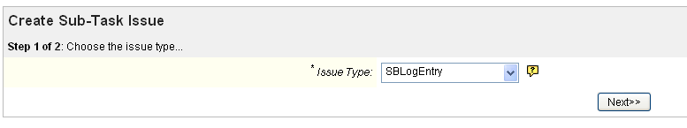

User Stories and Sprint Items
  User stories created as PBLogEntry (Product Backlog Entry)
  Sprint items created as SBLogEntry (Sprint Backlog Entry)
  Sprint Id decided using the custom field “Sprint Id” in the issue

Slide 11
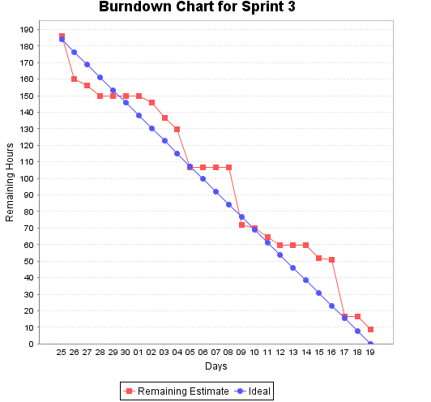
Burn-down Charts
  Original Estimate filled during Spring Planning
  Remaining Estimate updated daily by developers
  Burn down generated using the data in confluence page

Slide 12
Plan Mode - Scrum
Prioritize the Backlog.
Estimate the stories
Create the sprints
Story points are available only for Epics and Stories
Estimations in terms of Hours also possible by configuring the board
Sub tasks can be created
The stories can be grouped under each sprint
The number of issues and the story points / hours are automatically displayed to make plan easier
At one point of time only one sprint is active

Slide 13
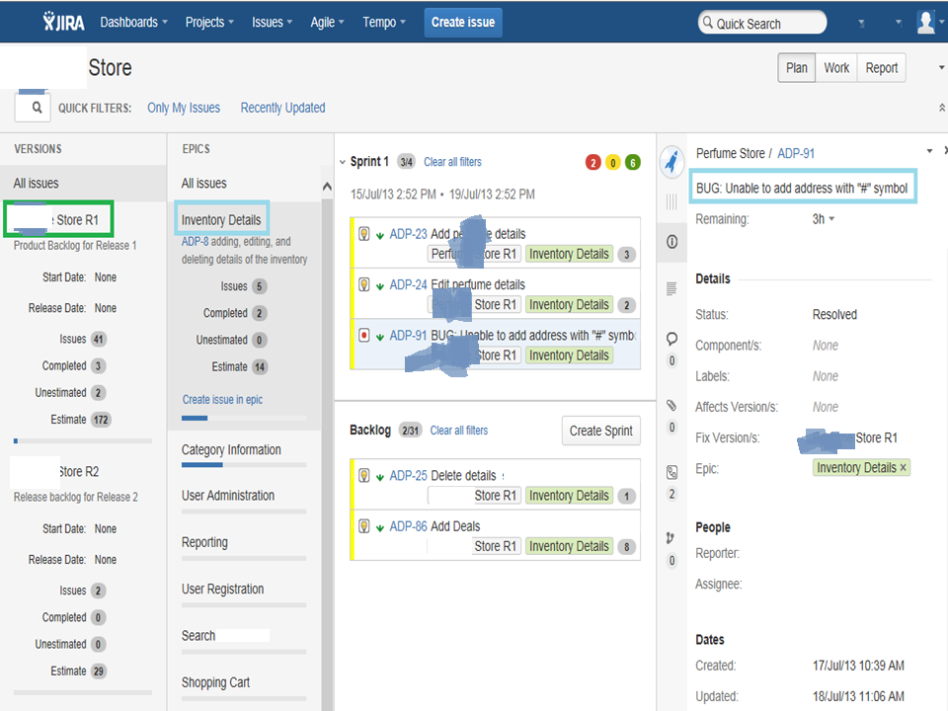

Slide 14
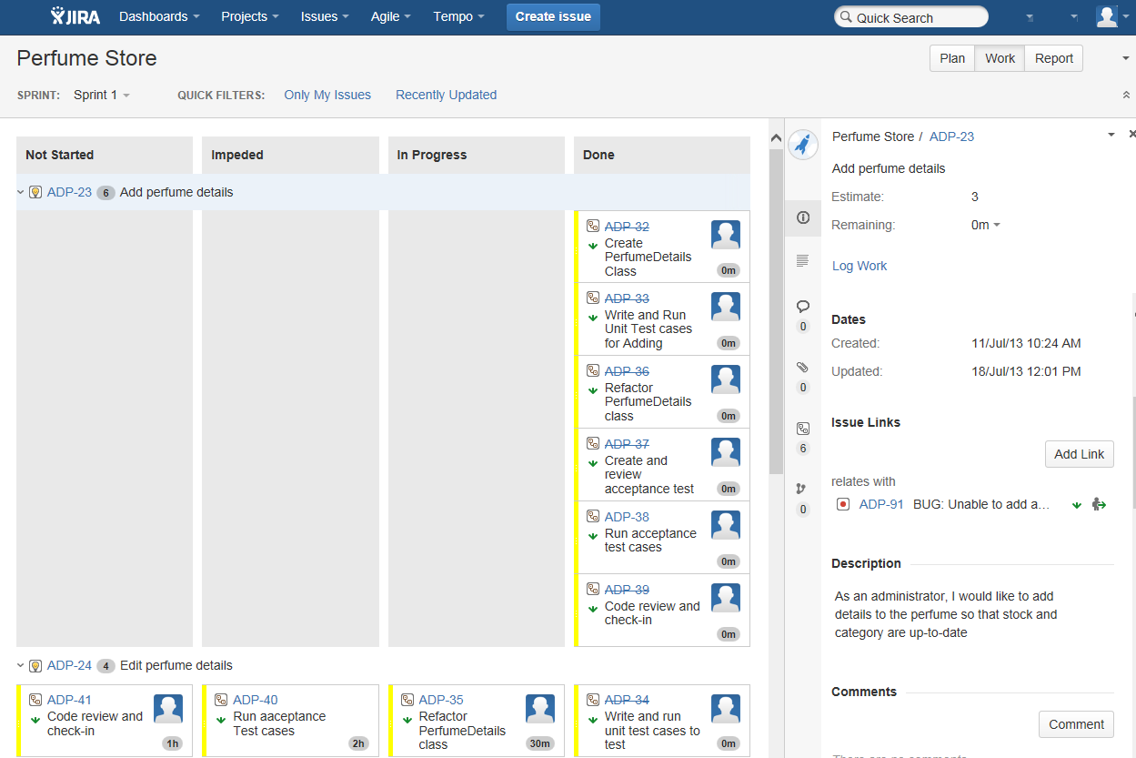
Work Mode - Scrum

Slide 15
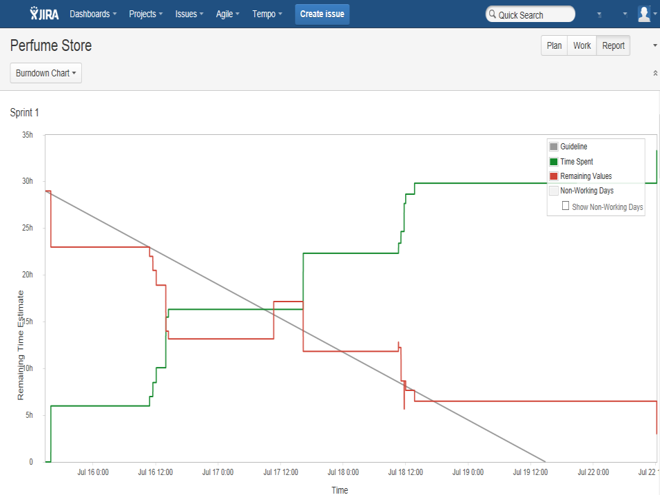
Report Mode - Scrum

Slide 16
JIRA for Software Testing and to file Bugs

Slide 17
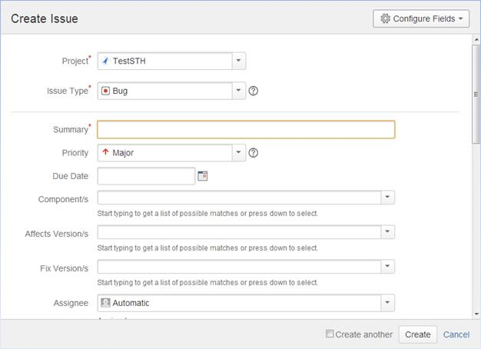
Creating a JIRA issue

Slide 18
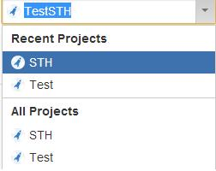
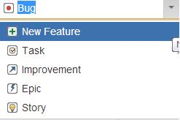
Project Name & Issue Type
Notes:
Project: Every issue belongs to a project. You can choose the same by clicking on the drop down and choosing the project that you want this issue to belong to

Slide 19
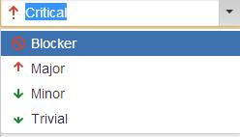

Priority of the Bug & additional attachments

Slide 20
Comparison of JIRA
Top 5 Reasons GitHub Users GO JIRA
Agile at Scale
Scrum and Kanban improve project success and deliver value iteratively. JIRA and JIRA Agile scale Agile across your organization. JIRA also integrates with GitHub to link issues to commits.
Industry Leading Workflow Engine
Don't let your issue tracking software dictate your process. With JIRA's workflow engine you can easily build the process that fits your team.
Powerful Searching and Reporting
Use JIRA's Query Language (JQL) with simple autocomplete to build advanced queries. Create a personalized view of JIRA and share dashboards to track project status, create custom reports, and monitor team progress with wallboards.
Deployment Options
Simple Windows and Linux installers are available for an OnPremise solution, or you can get started hassle-free with JIRA OnDemand. Easily switch between OnPremise or OnDemand as your organization evolves.
Integrate with Everything
Get more from JIRA with flexible REST and Java APIs – plus over 600 plugins and add-ons in the Atlassian Marketplace– to connect with the applications and tools you use every day.

Slide 21
Pricing
Atlassian provides JIRA for free to open source projects meeting certain criteria, and to organizations that are non-profit, non-government, non-academic, non-commercial, non-political, and secular. For academic and commercial customers, the full source code is available under a developer source license

Slide 22
Resources
  Homepage: http://www.atlassian.com/software/jira/
  Documentation: http://www.atlassian.com/software/jira/docs/
  Customers: http://www.atlassian.com/software/jira/customers.jsp

