Slide 1


K.RAMAKRISHNAN COLLEGE OF TECHNOLOGY
(AUTONOMOUS), TRICHY
BLOOD DONATION MANAGEMENT SYSTEM
PRESENTED BY SUPERVISOR
JAYASURYA.L Mrs.K.Valli Priyadharshini M.E., (PhD),
2303811710421066 AP/CSE.

Slide 2
PRESENTATION OVERVIEW
Objective
Project Introduction
Problem Statement
Methodologies (Programming concepts relevant to problem statement)
Architecture of the proposed system
List of Modules
7. Merits
8. Results and Discussion
9. Queries

Slide 3
OBJECTIVE
    The main purpose of the Blood Donation Management System is to streamline the registration, scheduling, and tracking of blood donations for donors while enabling blood banks and healthcare organizations to efficiently manage donor records and blood inventory.
    Donor Management: Easy registration and tracking of donor information and donation history.
    Donation Scheduling: Convenient scheduling of donation appointments.
    Inventory Tracking: Efficient management of blood inventory levels.

Slide 4
PROJECT INTRODUCTION
The Blood Donation Management System streamlines blood donation activities by simplifying donor registration, scheduling, and tracking.
It enables blood banks to efficiently manage donor records, organize appointments, and track inventory levels, ensuring a transparent and organized process for both donors and healthcare organizations.
It reduce the risk of shortages. By automating key processes, the system ensures efficiency and reliability in managing critical blood resources.

Slide 5
PROBLEM STATEMENT
  To Develop a Blood Donation Management System that facilitates the organization and management of blood donation activities.
  This project streamline the process for donors to register, schedule donations, and track their donation history.
  It enable blood banks and healthcare organizations to manage donor records, track inventory, and organize donation drives.

Slide 6
METHODOLOGIES
Object-Oriented Programming (OOP):
Encapsulation: Private fields in the Donor class with public getters and methods ensure controlled access.
Inheritance: Although not directly used, the application structure adheres to OOP principles for scalability.
Interfaces and Abstract Classes: The Donor class implements Comparable<Donor> to facilitate sorting by name using the compareTo method.
Event-Driven Programming: The application uses AWT (Abstract Window Toolkit) to create a GUI and handle user interactions with ActionListener events.
Error Handling: Exception Handling: Input validation and parsing errors, such as invalid date formats, are managed using try-catch blocks.

Slide 7
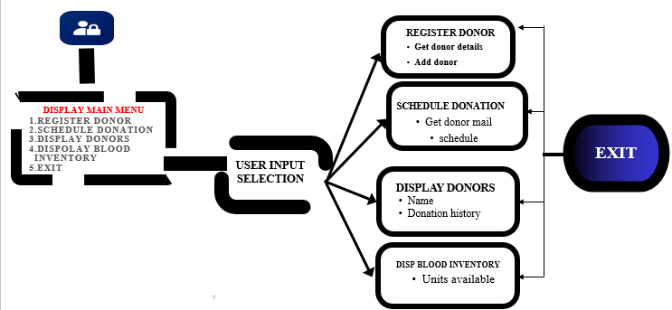
ARCHITECTURE OF THE PROPOSED SYSTEM

Slide 8
LIST OF MODULES
  DONOR MANAGEMENT MODULE:
  Represents a blood donor with personal details and donation history.
  BLOOD BANK MODULE:
    Manages a collection of donors and tracks blood inventory for a specific blood bank.
  BLOOD DONATION SYSTEM MODULE:
    Manages multiple blood banks.
  GUI MODULE:
Add Built using Java AWT components such as Frame, Button, TextField , Label, TextArea , and Checkbox to create an interactive interface. Provides functionalities
  MAIN CLASS:
    Contains the main method to run the application..

Slide 9
MERITS
Efficient Donor Management: Provides an organized system for registering, sorting, and retrieving donor details, ensuring quick and accurate access to information.
Streamlined Operations: Automates key functions like donor registration, donation scheduling, and donor listing, reducing manual effort and improving efficiency.
User-Friendly Interface: Offers an intuitive graphical interface for easy navigation and operation, catering to both administrators and donors.

Slide 10
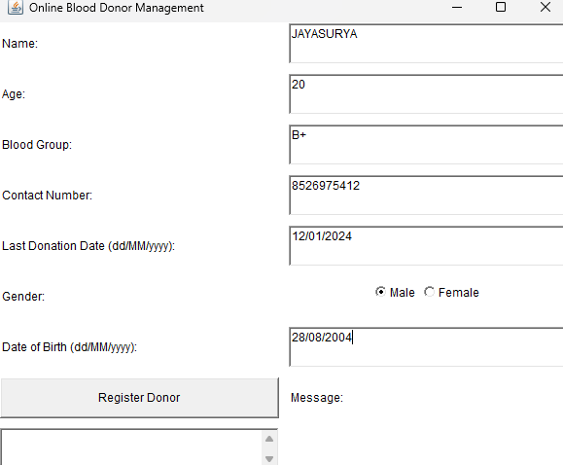
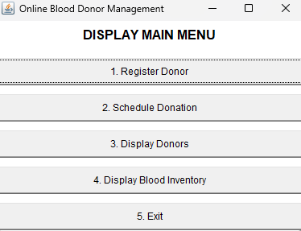
RESULTS AND DISCUSSION

Slide 11
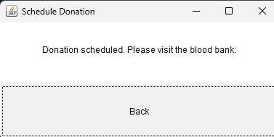
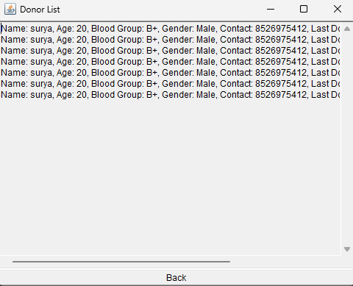
RESULTS AND DISCUSSION

Slide 12

QUERIES

