Slide 1
Digital Portfolio
STUDENT NAME:JAYASURYA V
REGISTER NO : 32724U09027
NMID :763F3B5FBC0D882A97447460D21CF75C
DEPARTMENT: BCA
COLLEGE: S.S.S COLLEGE/ThiruvalluvarUniversity

Slide 2
PROJECT TITLE
Interactive Digital Portfolio on CodePen

Slide 3


AGENDA
Problem Statement
Project Overview
End Users
Tools and Technologies
Portfolio design and Layout
Features and Functionality
Results and Screenshots
Conclusion
Github Link
3/21/2024 Annual Review

Slide 4

PROBLEM STATEMENT
The current challenge is to create a responsive and interactive digital portfolio that showcases projects effectively using CodePen.

Slide 5

PROJECT OVERVIEW
This project involves developing a digital portfolio hosted on CodePen. It allows showcasing coding skills, design creativity, and interactive features.

Slide 6

WHO ARE THE END USERS?
Students
Developers
Recruiters
Employers
Educators

Slide 7

TOOLS AND TECHNIQUES
HTML
CSS
JavaScript
CodePen
PlatformGitHub (for version control)

Slide 8
POTFOLIO DESIGN AND LAYOUT
The portfolio follows a clean and modern layout with sections for projects, about, and contact. Emphasis on responsive design.
8

Slide 9
FEATURES AND FUNCTIONALITY
Interactive project showcase
Responsive layout
Smooth navigation
Integrated links to GitHub/LinkedIn

Slide 10
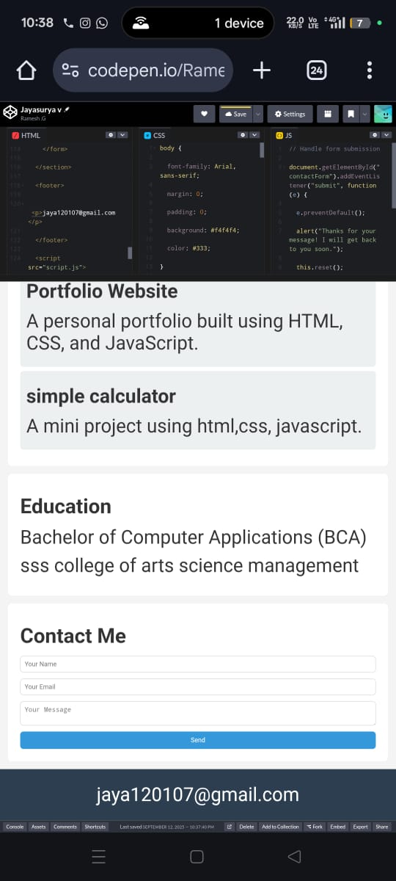
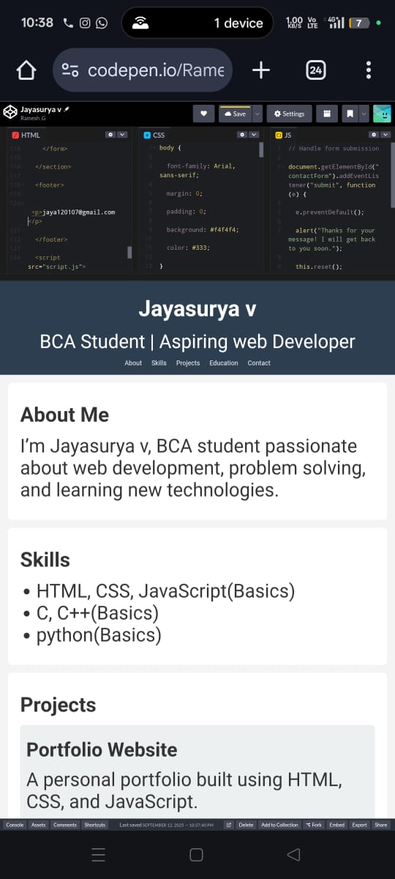

RESULTS AND SCREENSHOTS
3/21/2024 Annual Review
10

Slide 11
CONCLUSION
An interactive portfolio on CodePen effectively demonstrates coding abilities, project experience, and creativity.
11

