Slide 1

Capstone Project: Telecom Churn
Date: 4th April 2023
Submitted by
Jayasurya B Jinaralkar
Data Science trainee
Batch:116 ID:4694
TuringMinds.ai
Bangalore. 560102

Slide 2

Contents
Problem statement
About Dataset
Flowchart of tasks
Exploratory data analysis
Data Visualization
Model Building
Model evaluation & Tuning
Deployment
References

Slide 3


Problem Statement
Problem Description:
A telecom company is facing a high customer churn rate and wants to reduce it. Customer churn refers to the process where a customer stops doing business with a company. In the telecom industry, customer churn is a major problem as acquiring new customers is more expensive than retaining existing customers. The company wants to use machine learning to predict which customers are likely to churn so that they can take proactive measures to retain them.
Objective: To predict the likelihood of customer churn.

Slide 4

About Dataset
Dataset includes:
Customers who left within the last month – The column is called Churn.
Services that each customer has signed up for – phone, multiple lines, internet, online security, online backup, device protection, tech support, and streaming TV and movies.
Customer account information – how long they’ve been a customer, contract, payment method, paperless billing, monthly charges, and total charges.
Demographic info about customers – gender, age range, and if they have partners and dependents

Slide 5

Flow chart of Tasks
Business understanding
Data Cleaning
Data Visualization
Model Building
Model Evaluation
Model Tuning
Prediction
Model
Deployment

Slide 6
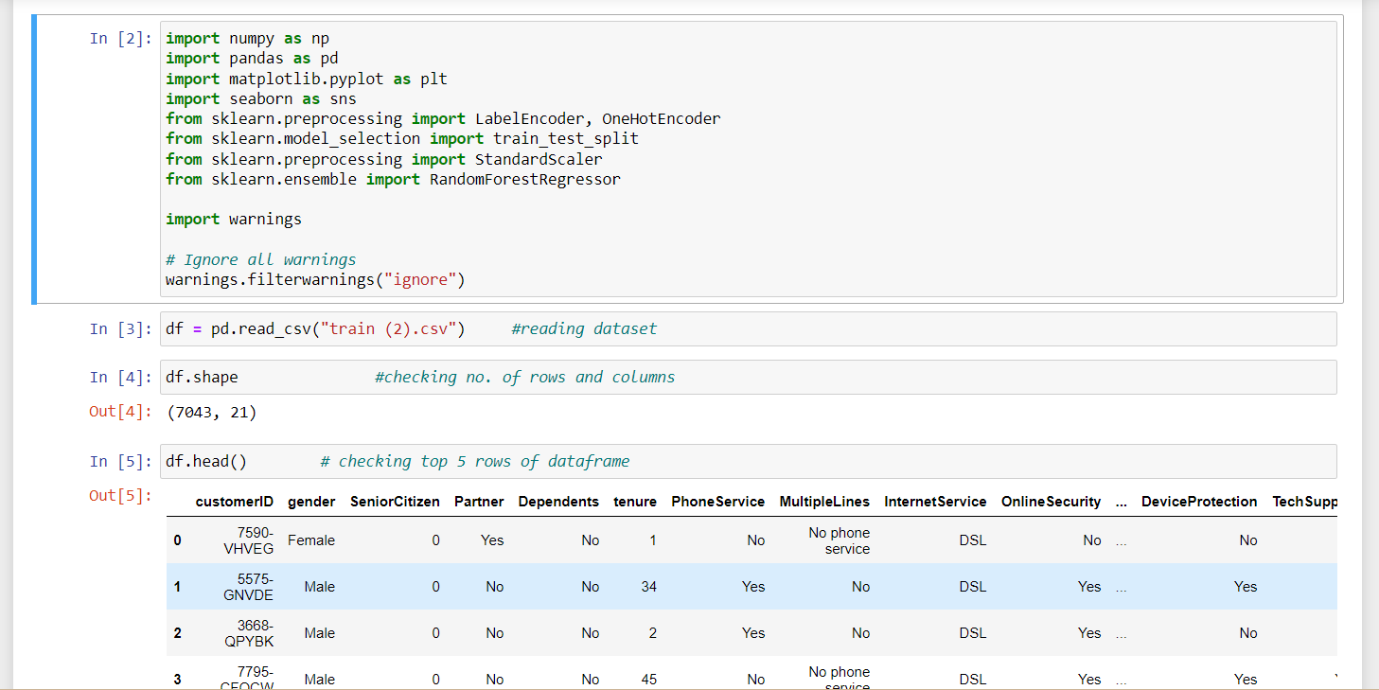
Reading Dataset

Slide 7

Exploratory Data Analysis
Missing Value treatment
Removing duplicate values
Outliers treatment
Converting categorical to numerical
Converting numerical to categorical
Feature selection
Feature transformation
Feature scaling

Slide 8
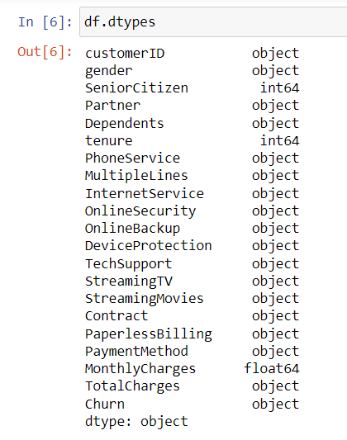
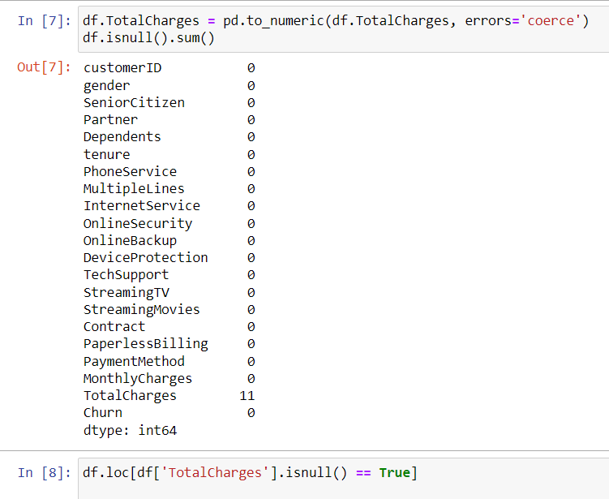
Exploratory Data Analysis

Slide 9
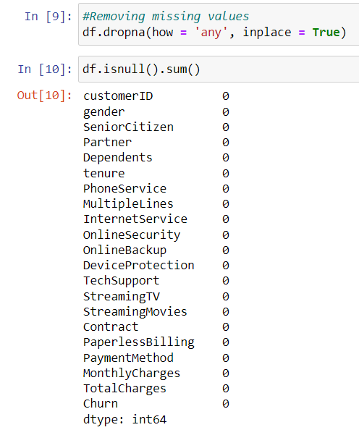
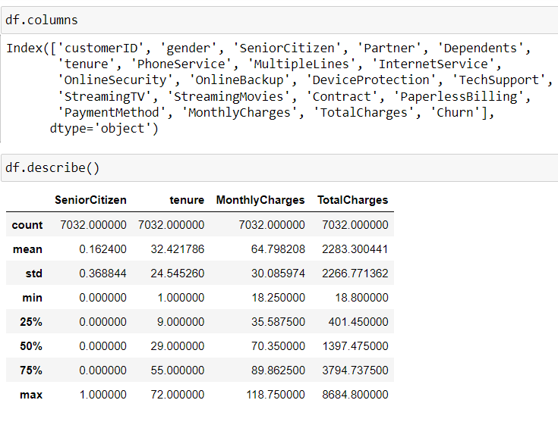
Exploratory Data Analysis

Slide 10
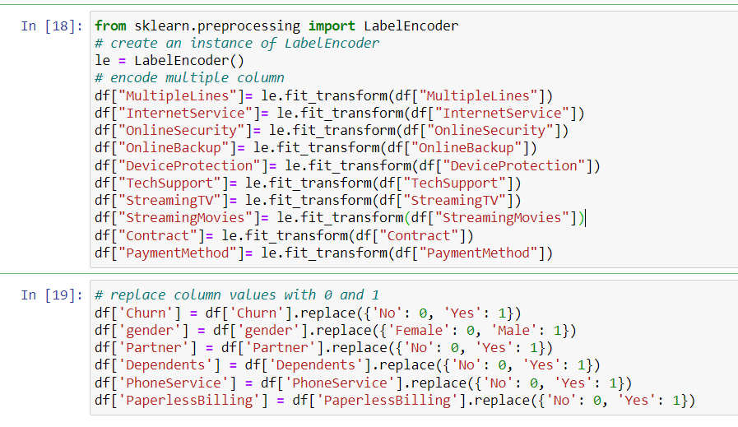
Exploratory Data Analysis
Label Encoding

Slide 11
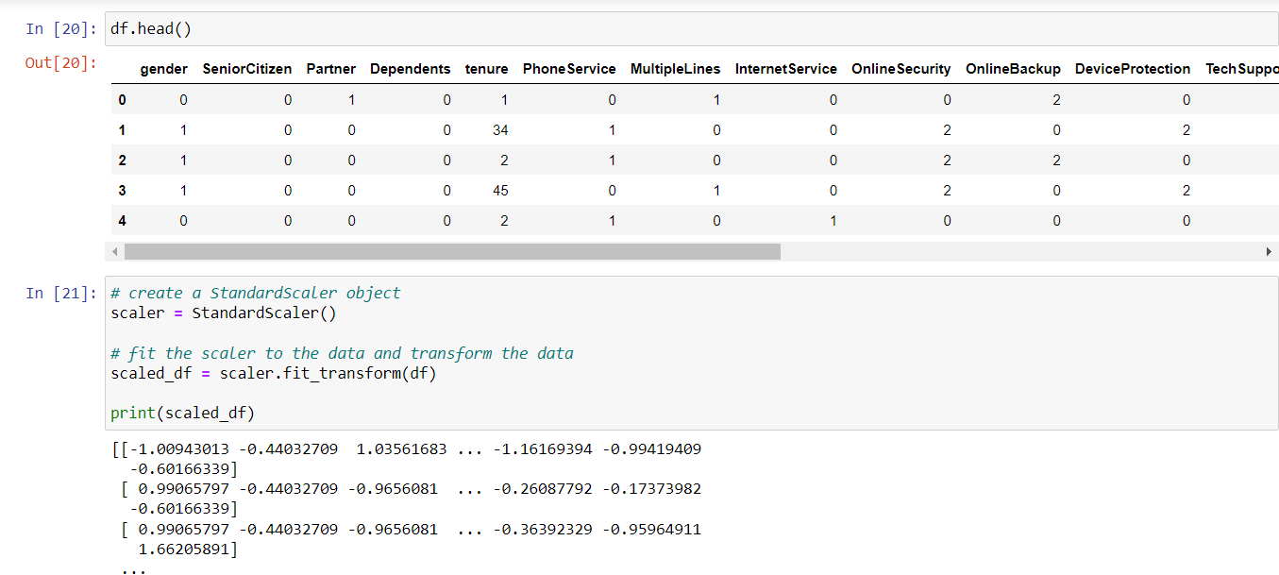
Exploratory Data Analysis
Label Encoding

Slide 12
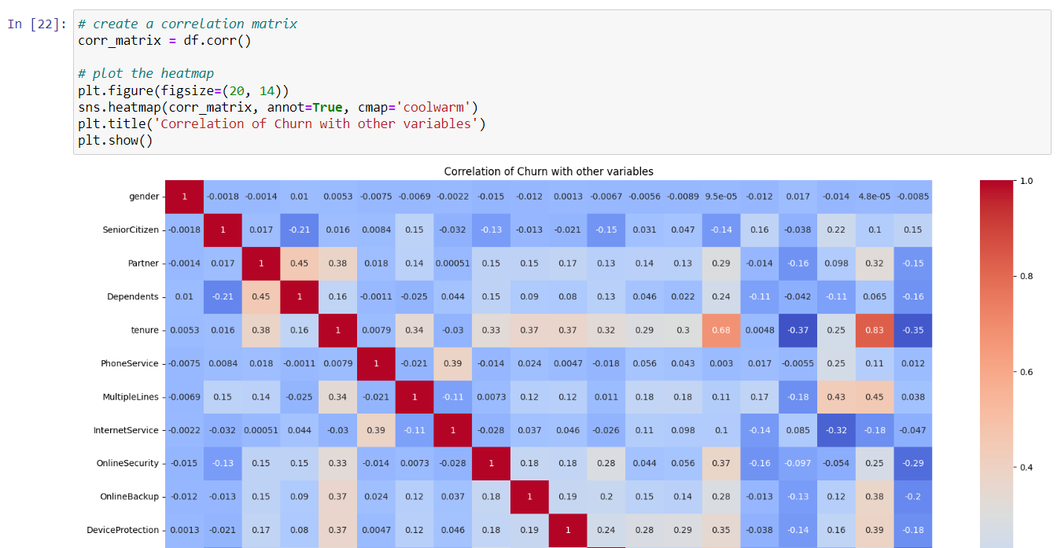
Data Visualization

Slide 13
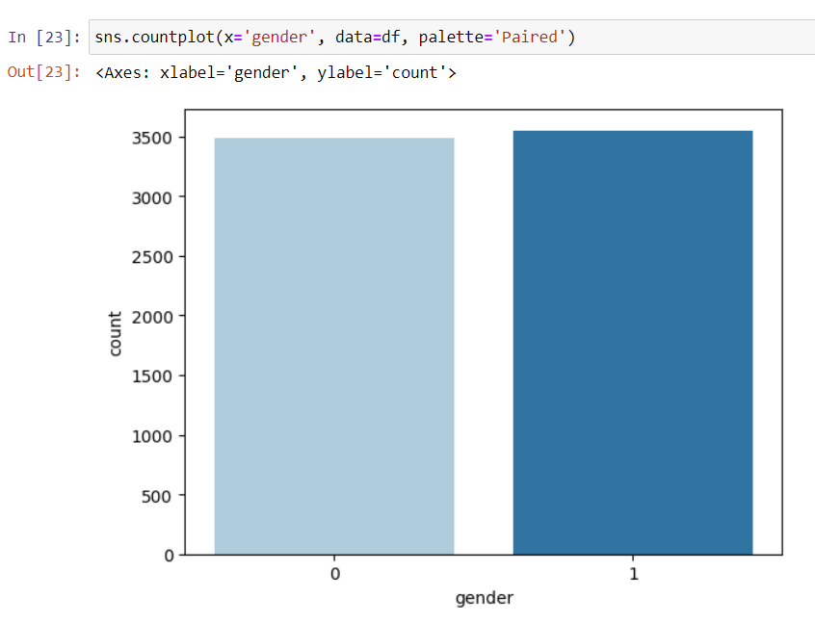
Data Visualization

Slide 14
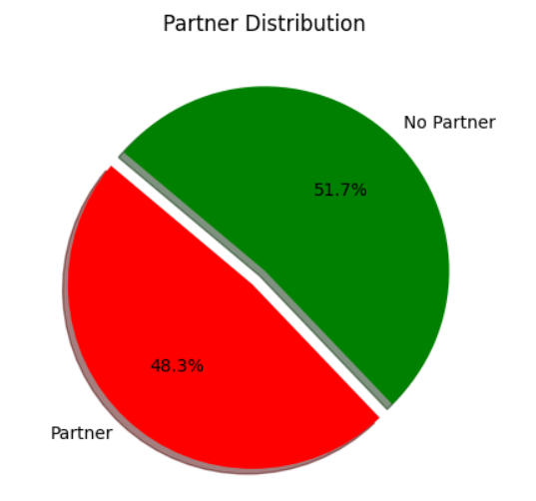
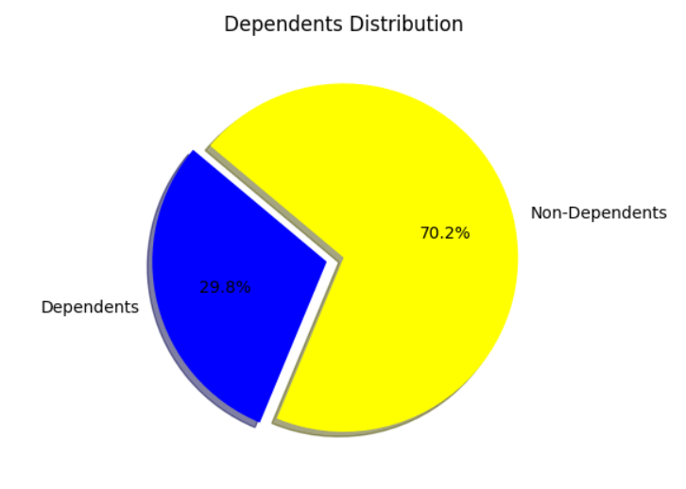
Data Visualization

Slide 15
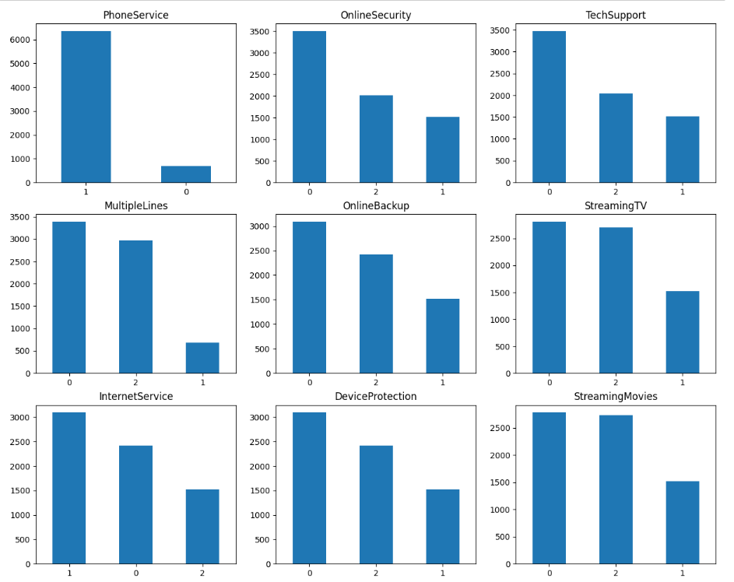
Data Visualization

Slide 16
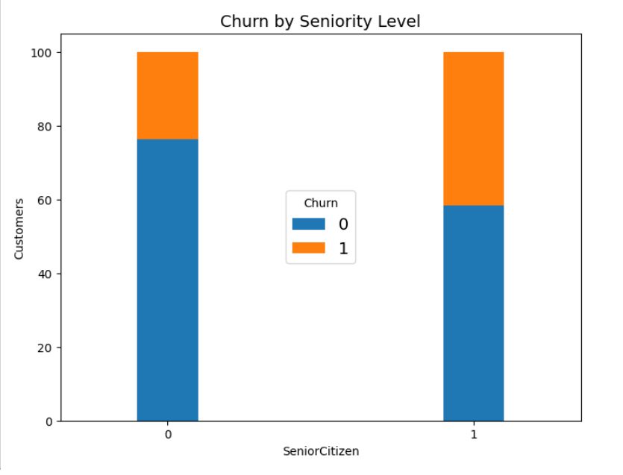
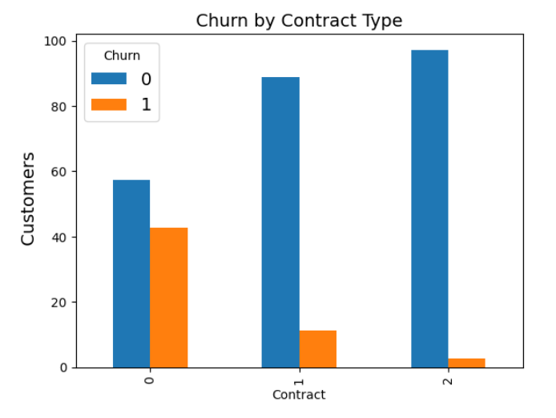
Data Visualization

Slide 17
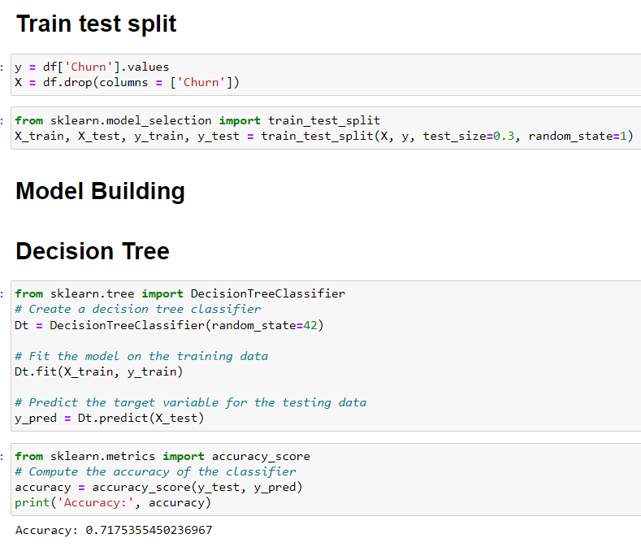
Model 1:Decision Tree

Slide 18
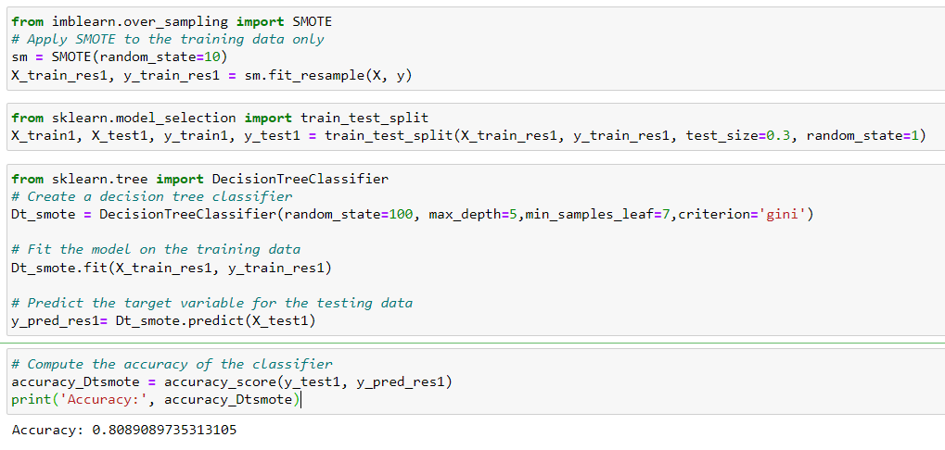
Model 1:Decision Tree

Slide 19
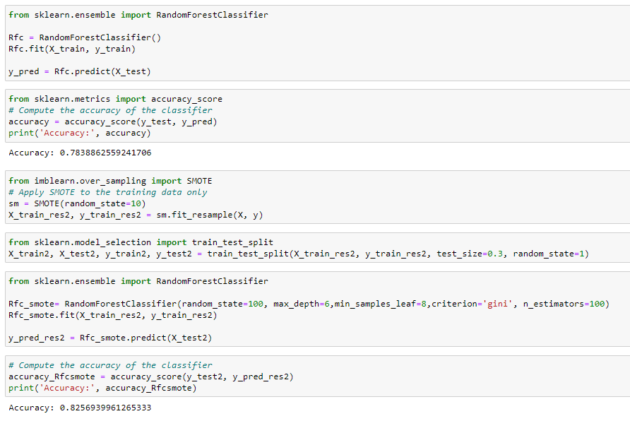
Model 2:Random Forest

Slide 20
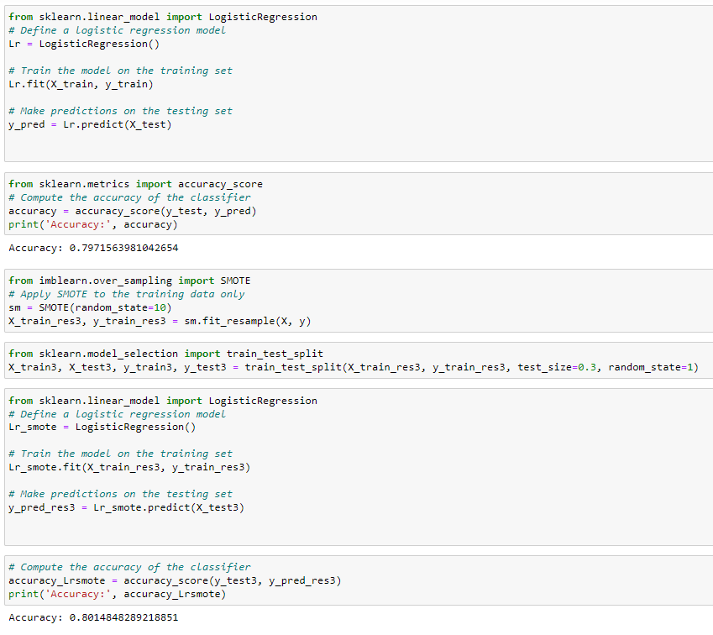
Model 3: Logistic Regression

Slide 21
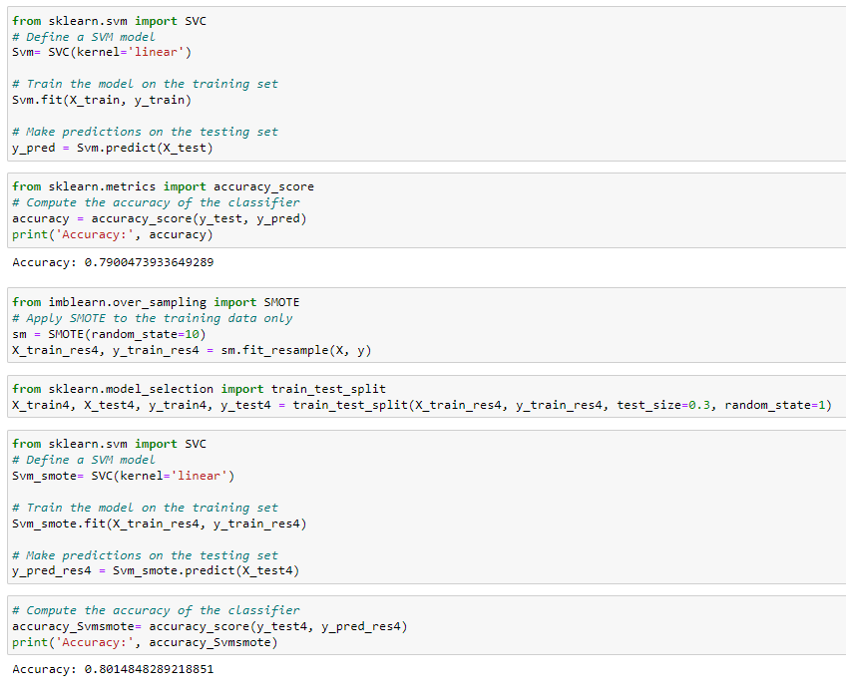
Model 4: Support vector machine

Slide 22
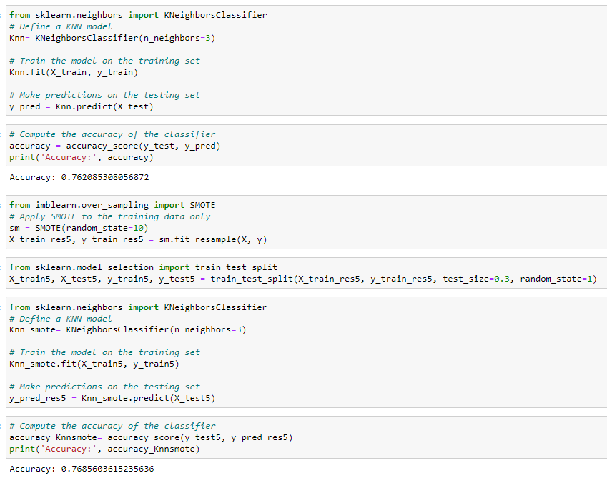
Model 5: KNN

Slide 23
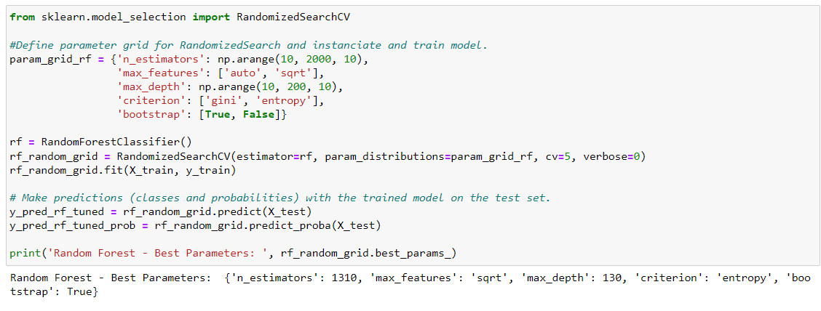
Hyperparameter Tuning

Slide 24
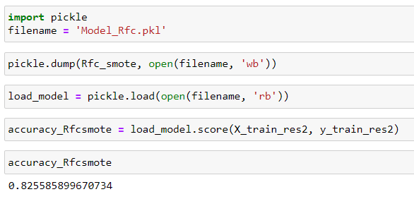
Pickling the model
Conclusion
Out of all the models Random forest model is giving the best score, hence Model_Rfc.pkl is ready and dumped in , which we will use and prepare API's so that we can access our model from UI.

Slide 25
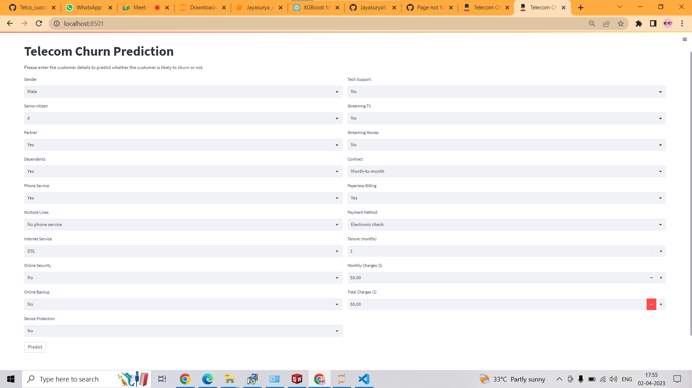
Model Deployment

Slide 26
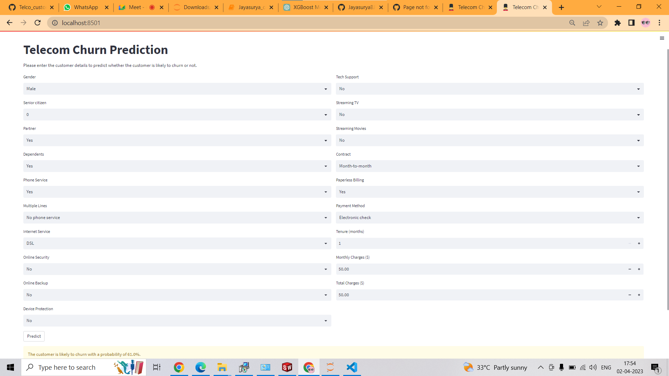
Model Deployment

Slide 27
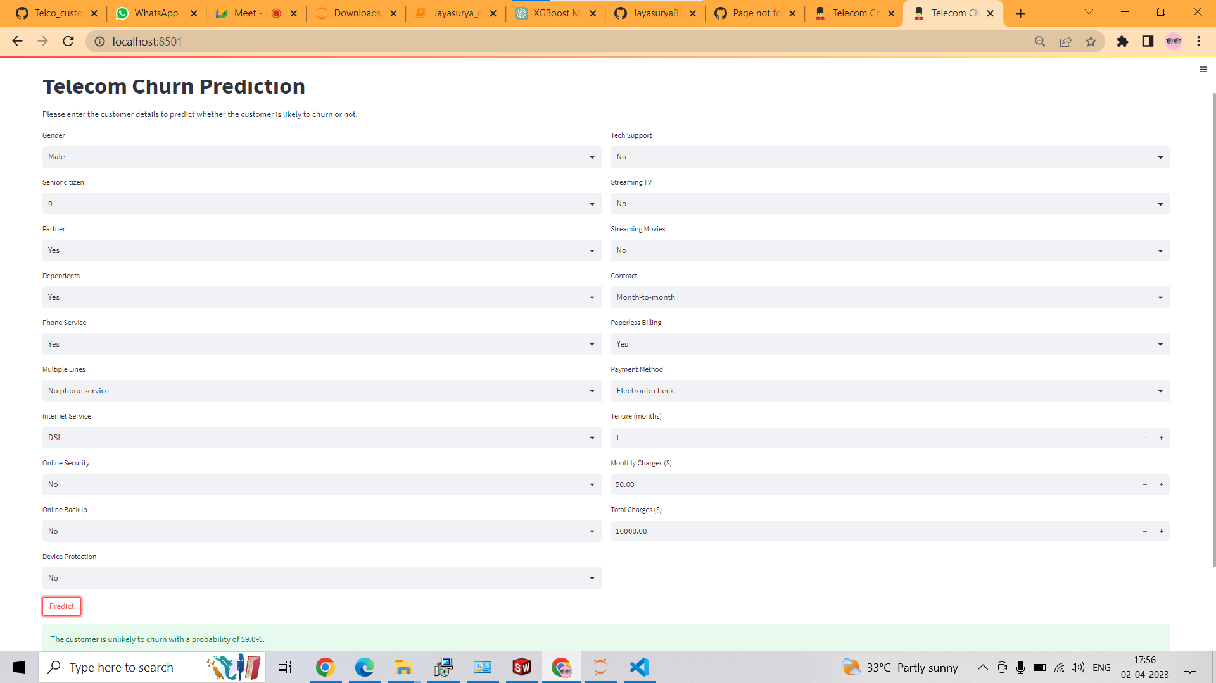
Model Deployment

Slide 28
References
https://www.youtube.com/watch?v=1IQOtJ4NI_0&list=RDLV1IQOtJ4NI_0&index=1
https://www.youtube.com/watch?v=5aIFgrrTqOw
https://www.youtube.com/watch?v=FuTRucXB9rA
https://www.turing.com/kb/random-forest-algorithm
https://www.simplilearn.com/tutorials/machine-learning-tutorial/random-forest-algorithm

