Slide 1
Kids Clothes Sales Performance Dashboard
By JS

Slide 2
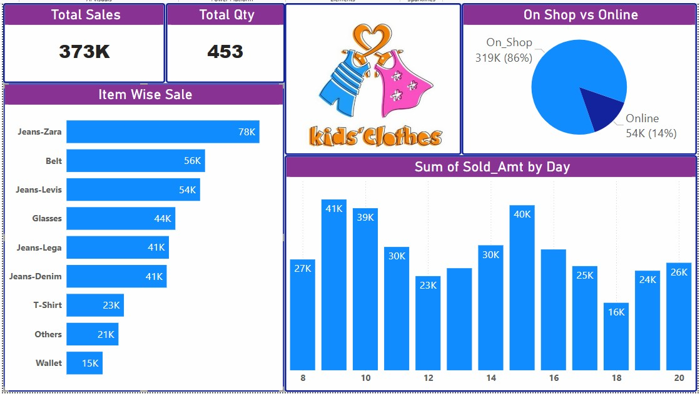
PROJECT OVERVIEW
Tools Used:
Power BI
Excel (Data Source)
DAX
Data Modeling
Domain:
Retail / E-commerce

Slide 3
Dataset Information
Data Contains:
Order Date
Product Name
Category
Sales Amount
Quantity
Sales Channel (On-Shop / Online)

Slide 4
Data Cleaning & Preparation
Removed null values
Standardized item names
Converted date column to proper date format
Created calculated columns if needed
Built relationships (if multiple tables)

Slide 5
Visuals
KPI Cards
Item Wise Sale (Bar Chart)
On Shop vs Online (Pie Chart)
Sales by Day (Column Chart)

Slide 6

Business Problem Statement
Track total sales performance
Compare On-Shop vs Online sales
Identify top-selling products
Analyze daily sales trend
Improve low-performing categories

Slide 7

Key Business Insights
Jeans are top revenue contributors
Physical store dominates revenue
Online channel underperforming
Some days show peak demand
Certain items need promotion strategy

Slide 8
Business Recommendations
Increase online marketing
Offer combo deals on low-selling products
Analyze peak days for future inventory planning
Create loyalty programs
Expand top-performing brands

Slide 9
Conclusion
Monitor sales performance
Compare sales channels
Identify top and bottom products
Make data-driven decisions

Slide 10
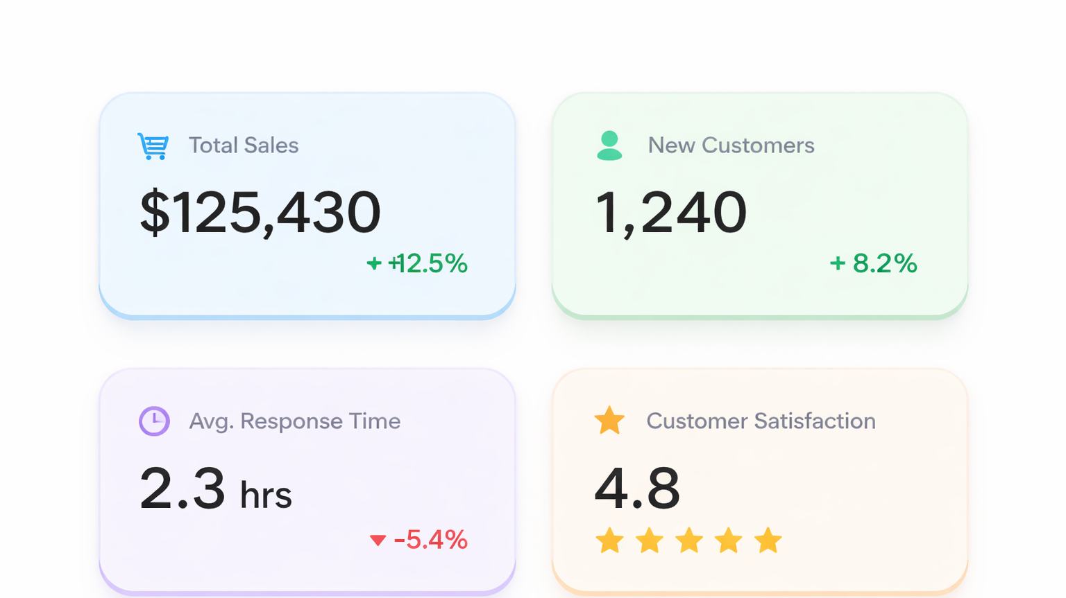

Slide 11
