Slide 1
Statistics

Slide 2
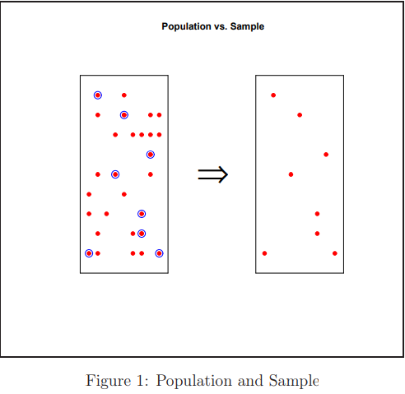
Population and sample
A population is the entire group that you want to draw conclusions about.
A sample is the specific group that you will collect data from.
The size of the sample is always less than the total size of the population

Slide 3
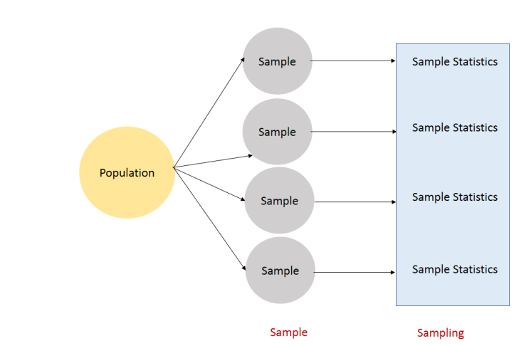
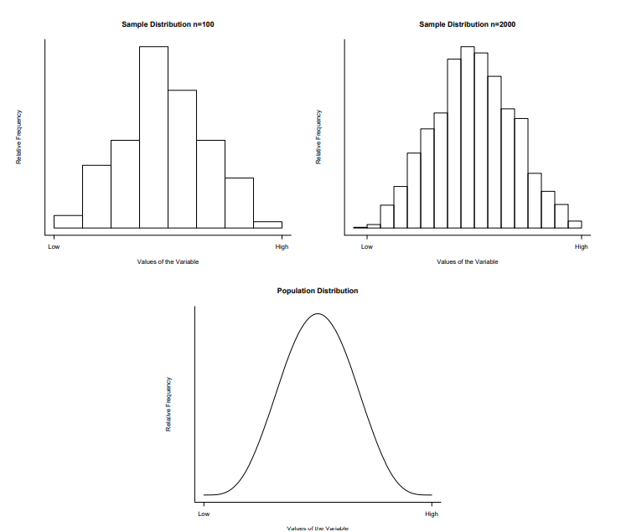
Sample and Population Distributions
The sample distribution is a blurry photograph of the population distribution.
As the sample size increases, the sample relative frequency in any class interval gets closer to the true population relative frequency
larger samples provide more precise estimates of population characteristics.

Slide 4
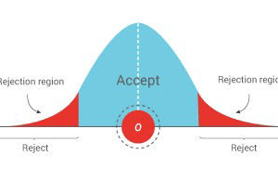
Hypothesis testing
Hypothesis or significance testing is a mathematical model for testing a claim or an idea about a parameter of interest in a given population set, using data measured in a sample set.
Example Hypothesis: Students in the school score an average of 7 out of 10 in exams.
Null Hypothesis(Ho) : A claim/idea assumed to be true. status quo
In the above example, the average 7 is assumed to be true
Alternate Hypothesis: The claim/idea is false.
The average is not equal to 7

Slide 5
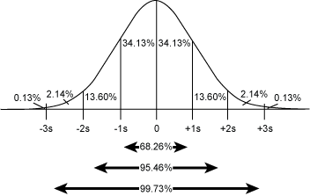
A neurologist is testing the effect of a drug on response time by injecting a 100 rats with unit dose of a drug, subjecting it to neurological stimulus and recording its response time. The neurologist knows that the mean response time for the rats not injected with the drug is 1.2 seconds. The mean of the 100 injected rats’ response time is 1.05 seconds with sample standard deviation of 0.5 seconds. Does the drug has an effect on response time.
H0: Drug has no effect. Mean=1.2
H1: Drug has an effect. Mean != 1.2. (two tailed test)
Assuming the H0 to be true, what is the probability of getting the above results.
α : significance level:0.05
σ = 0.5
n = 100
Standard deviation = σ/sqrt(n)=0.05
Z score = (1.05-1.2)/0.5 = 3
Actual Z score is 3 standard deviation away from the mean. This means the probability of achieving the above result given null hypothesis is TRUE is less than 5%. Hence Null hypothesis can be rejected.

Slide 6
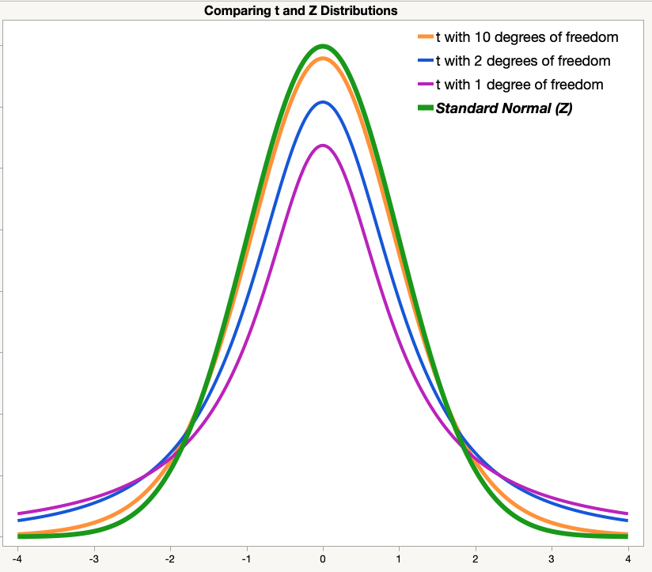
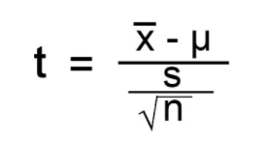
T-tests – one sample t test
Developed by William Gosset under pseudonym student
The one sample t test compares the mean of your sample data to a known value.
For example, you might want to know how your sample mean compares to the population mean.
You should run a one sample t test when you don’t know the population standard deviation or you have a small sample size
Assumption: The data flows the Normal distribution

Slide 7
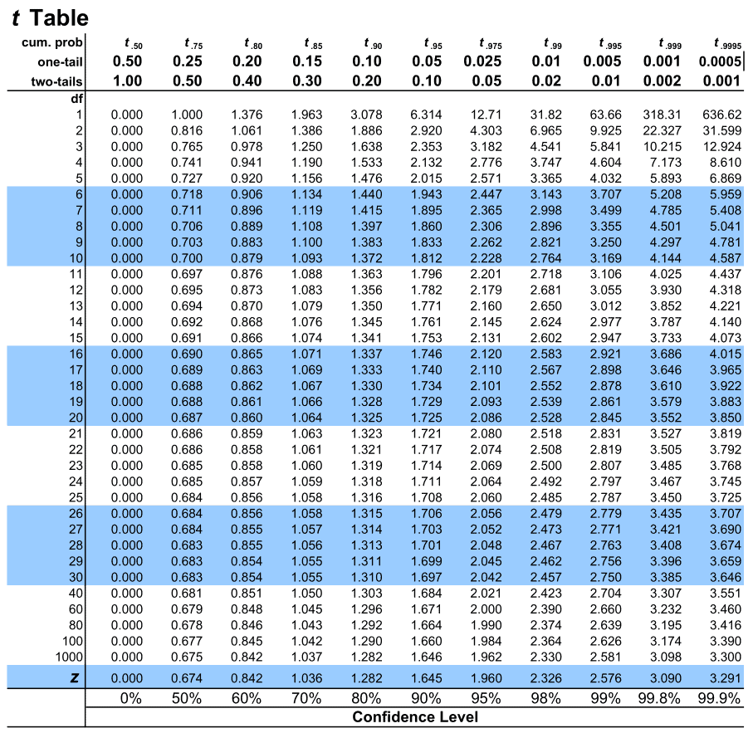
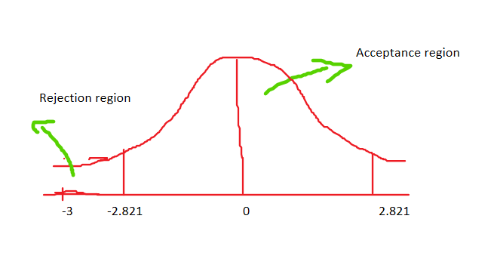
The mean emissions of all engines of a new design needs to be below 20ppm if the design is to meet new emission requirement. Ten engines are manufactured for testing purposes and emission of each is determined. The emission data is as given: 15.6,16.2,22.5,20.5,16.4,19.4,16.6,17.9,12.7,13.9. Does the data provide sufficient evidence that the engine meets the new standard. Assume alpha threshold=0.01
H0: mu=20ppm
Ha: mu<20ppm (one tailed test/less)
Alpha = 0.01
Mean = 17.17
Std dev = 2.98
Dof = 9
T-stat = (17.17-20)/(2.98/sqrt(10))
= -3
Tcrit value = 2.821 (negative) for this problem

Slide 8
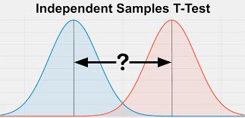
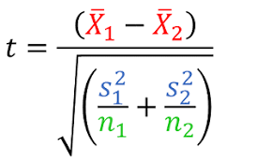
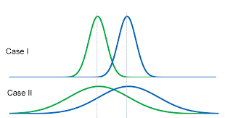
Independent T-test
Compare the means of 2 groups which are independent of each other.
The means of the two populations being compared should follow normal distributions.
the two populations being compared should have the same variance

Slide 9
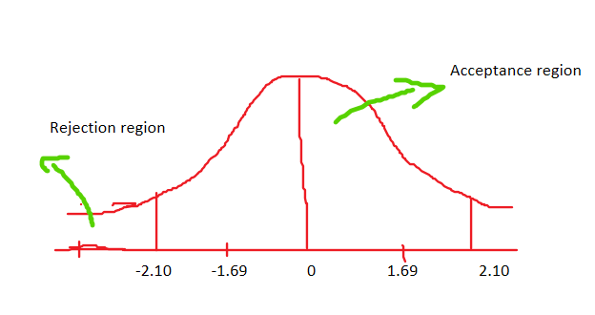
Given weight of 2 independent samples of a filling machine
A = [1,2,2,3,3,4,4,5,5,6]
B = [1,2,4,5,5,5,6,6,7,9]
Determine if the mean are statistically different
H0: mean of A = mean of B
Ha: mean of A != mean of B (two tailed)
Alpha = 0.05
Dof = 10+10-2 = 18
meanA = 3.5, std = 1.5
meanB = 5, std = 2.19
Numerator = 1.5
Denominator = 0.88
T value = 1.69
Tcrit = 2.10

Slide 10
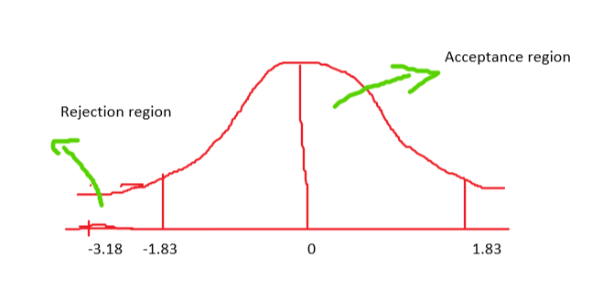
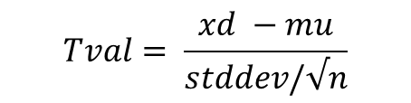
Paired T-test
$$Tval= \frac{xd −mu}{stddev/√n}$$
The paired sample t-test, sometimes called the dependent sample t-test, is a statistical procedure used to determine whether the mean difference between two sets of observations is zero. In a paired sample t-test, each subject or entity is measured twice, resulting in pairs of observations. Common applications of the paired sample t-test include case-control studies or repeated-measures designs
Eg: Determine the effectiveness of a weight loss program:
before = [185,192,206,177,225,168,256,239,199,218]
after = [169,187,193,176,194,171,228,217,204,195]
H0 = difference of means is zero
Ha = difference of means is less than zero
Therefore it is a one sided(less) T-test
Alpha=0.05
Dof = 10 – 1 = 9
Sample_diff_mean = -13.1
Sample_diff_std = 13.025
T val = (-13.1-0)/13.025/sqrt(10)) = -3.18
Tcrit = 1.833(negative since it is one sided)
T val < Tcrit
Null Hypothesis rejected

Slide 11
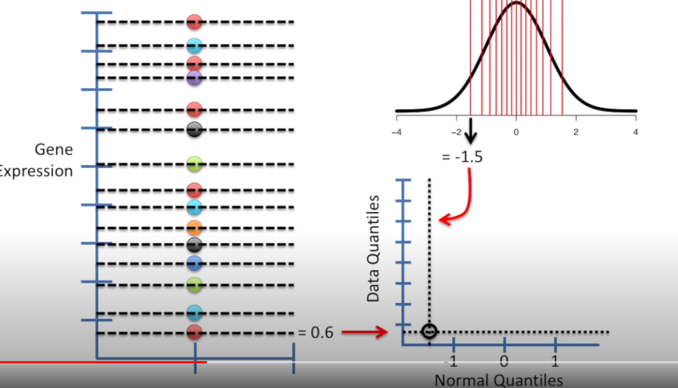
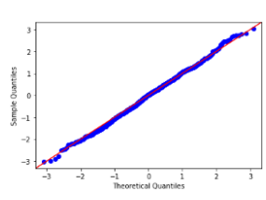
Normality test – QQ plot
The Q-Q plot, or quantile-quantile plot, is a graphical tool to help us assess if a set of data plausibly came from some theoretical distribution such as a Normal or exponential
If our variable follows a normal distribution, the quantiles of our variable must be perfectly in line with the “theoretical” normal quantiles: a straight line on the QQ Plot tells us we have a normal distribution.
Calculate quantiles for given data. Get equal number of quantiles from Normal distribution. Plot the theoretical quantiles on x-axis and data quantiles on y-axis. If the given data is normally distributed, then the scatter plot falls on the diagonal line.

Slide 12
Statistical tests for Normality
Null Hypothesis H0 : The given dataset is Normal
Alternate Hypotheis: The given dataset is not Normal
Shapiro-wilks test
D’Agostino’s K^2 Test
Anderson-Darling Test
Kolmogorov-smirnov test

Slide 13
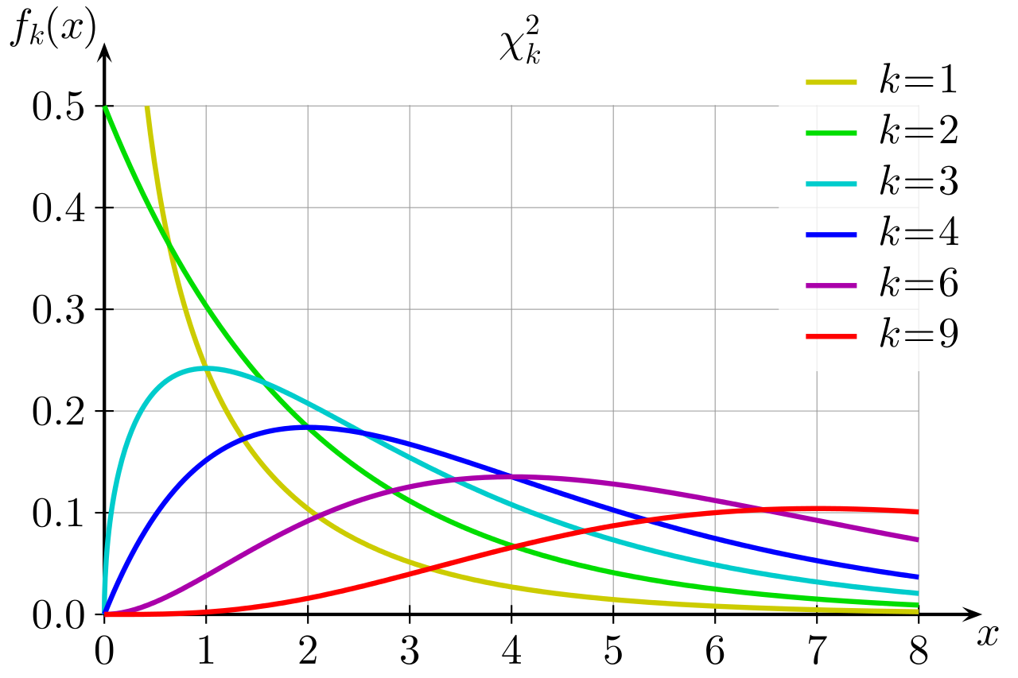


Chi square distribution
The chi-square distribution (also chi-squared or χ2-distribution) with k degrees of freedom is the distribution of a sum of the squares of k independent standard normal random variables.
If Z1, ..., Zk are independent, standard normal random variables, then the sum of their squares,
is distributed according to the chi-square distribution with k degrees of freedom. This is usually denoted as

Slide 14

Pearson’s chi square test
Pearson's chi-squared test is a statistical test applied to sets of categorical data to evaluate how likely it is that any observed difference between the sets arose by chance.
It tests a null hypothesis stating that the frequency distribution of certain events observed
in a sample is consistent with a particular theoretical distribution.
A simple example is the hypothesis that an ordinary six-sided die is "fair" (i. e., all six outcomes are equally likely to occur.)
Example:
Determine if the given 2 medicine to people has any effect on the people based on given contingency table. Let alpha threshold be 0.1
 | Medicine 1 | Medicine 2 | placebo
Sick | 20 | 30 | 30
healthy | 100 | 110 | 90
Ho: There is no difference in effect of medicines
Ha: there is difference in effect of medicines
Dof = (row-1)*(col-1) = 1*2 =2

Slide 15
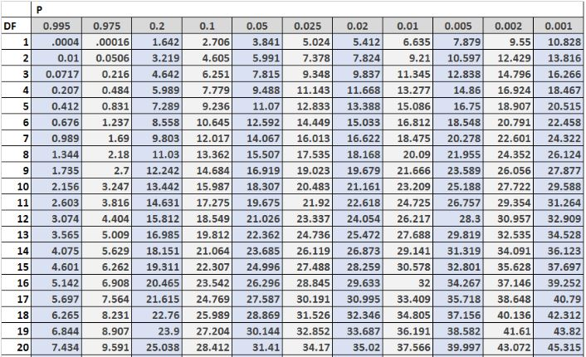
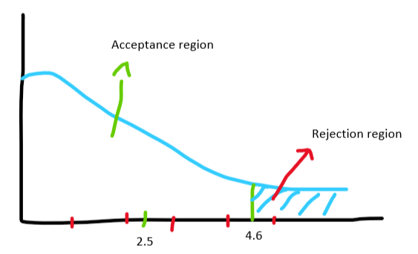
Calculate expected values table
 | Medicine 1 | Medicine 2 | placebo | Row_sums | Row_sum_percentage
Sick | 20 | 30 | 30 | 80 | 80/380=0.21
healthy | 100 | 110 | 90 | 300 | 300/380=0.79
Col sums | 120 | 140 | 120 | 380
Expected values table
 | Medicine 1 | Medicine 2 | placebo
Sick | 0.21*120=25.2 | 0.21*140=29.4 | 0.21*120=25.2
healthy | 0.79*120=94.7 | 0.79*140=110.5 | 0.79*120=94.7
Chi square value = (O – E)^2/E = 2.5
Critical chi square value = 4.65
Chi square value is in acceptance region. Hence Null hypothesis is not rejected

