Slide 1
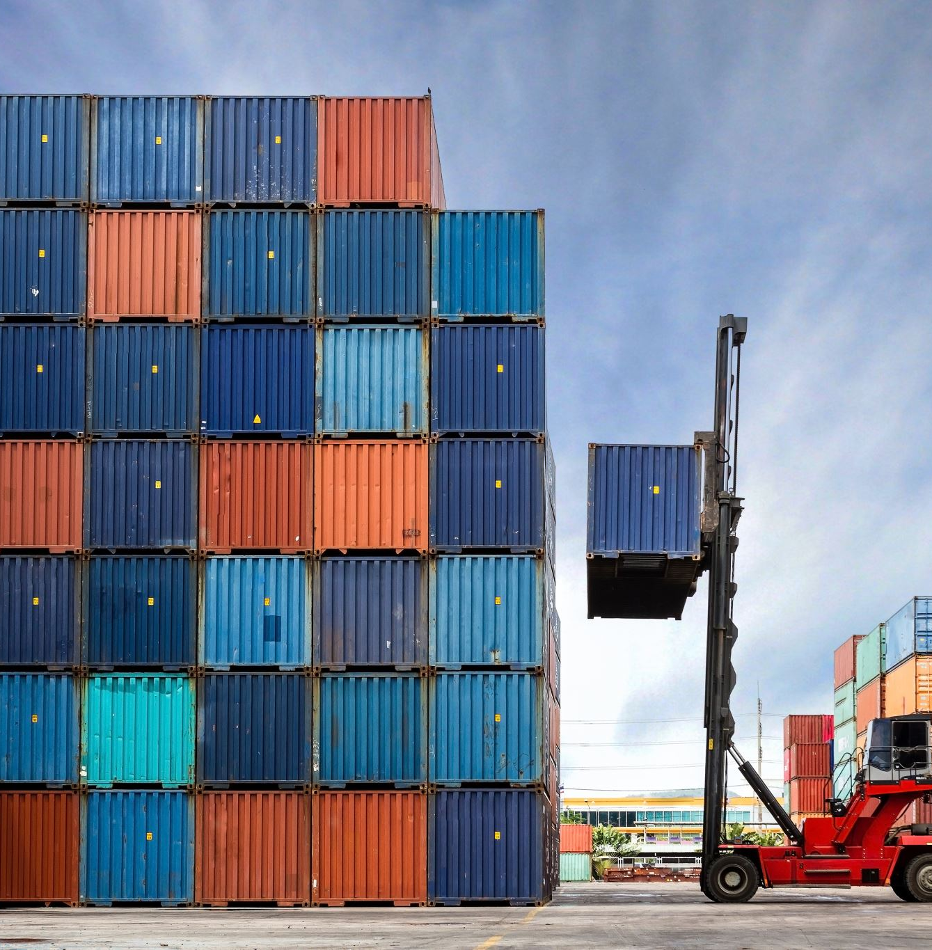
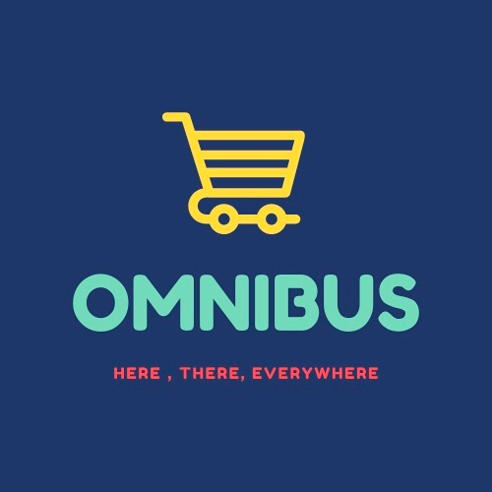
A Supply Chain Management System

Slide 2
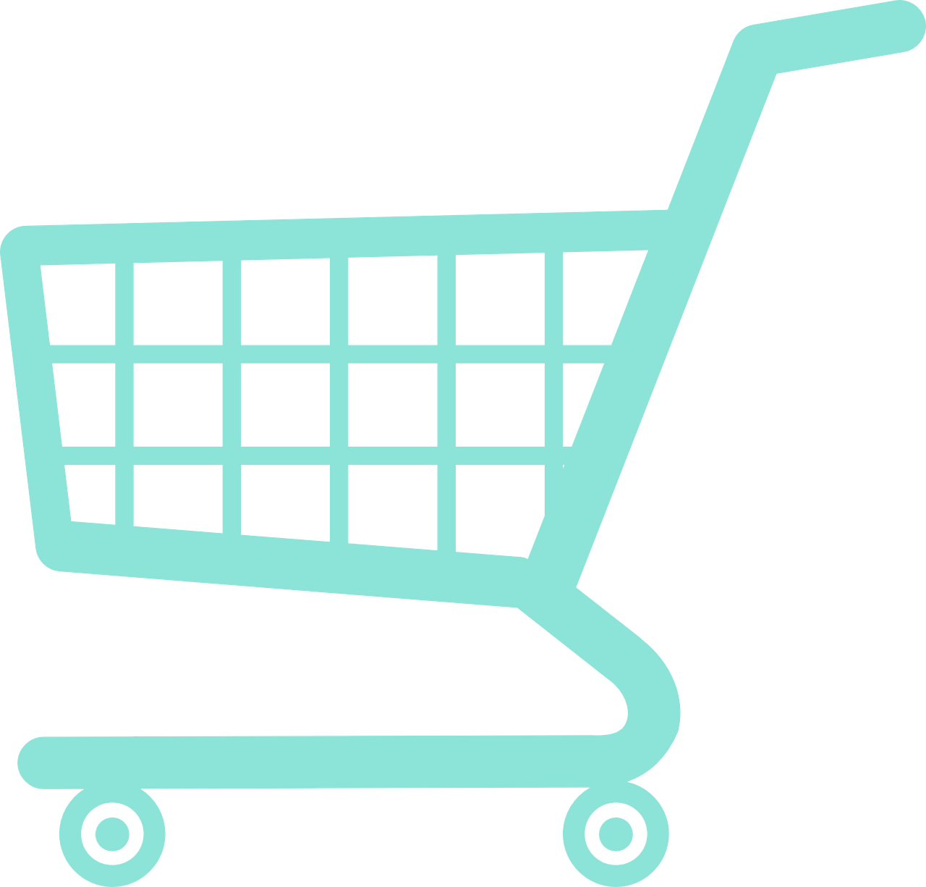
ABOUT ECOSYSTEM
The motive of Online Shopping System is to provide a unified platform to the customers, service providers and other stakeholders. So basically, customers use the application to order day-to-day goods from the vendors and are delivered via a chain of stakeholders.
The system is designed to store, manage and organize data generated with each and every transaction, to make things easy and quick for the users.

Slide 3
PROBLEM STATEMENT
We have been facing a harsh situation due to the pandemic caused by the COVID-19 since a long time now. One of the most important things we have learnt, is the value of efficient delivery system of the e-commerce businesses. To deliver best of the services to the customers, has the utmost importance to the businesses. The industry not only caters to the needs of the customers but also provide jobs to the citizens during the economic crisis.

Slide 4
BRIEF UNDERSTANDING OF THE SYSTEM
Network:
This is a geography (State and country) where our enterprises are present.
Enterprise:
Delivery - This enterprise takes care of delivery of orders and shipments.
Fulfillment Center - The enterprise takes care of the supply chain. What happens once the shipments are sent from the vendor till they leave for final delivery.
Vendor - The enterprise is responsible for creating products and sending them for shipment.
Hub and Last mile - The enterprise is responsible for receiving the shipments from FC, and delivering them to the last mile delivery.

Slide 5
Organizations:
Vendor - Supply chain organization - This organization consists of Vendor Manager who can create and delete products and assign customer orders to delivery enterprise.
Delivery - Direct Delivery organization - This organization consists of direct delivery managers and direct delivery people who deliver the orders directly to the customer after receiving from vendor enterprise.
Delivery - First Mile Delivery organization - This organization consists of first mile delivery manager and first mile delivery person who delivers shipments from vendors to Fulfilment Center enterprise.

Slide 6
Delivery - Last Mile Delivery organization - This organization consists of last mile delivery manager and last mile delivery person who deliver orders that they receive from Last mile station (Hub and last mile Enterprise) to the customer.
Fulfillment Center - Inbound Organization - This organization consists of Receive and Stow managers. The receive manager receives shipments from First mile delivery organization (Delivery Enterprise). These shipments are broken into products and sent to the Stow manager for inventory storage. Once all the quantity is stored in the FC, the stow people send the products to the Outbound Organization of the Fulfillment center enterprise.

Slide 7
Fulfillment Center - Outbound Organization - This organization consists of Picker and Packers and Dock manager. The pickers and packers pick products from the inventory and recreate orders according to the order placed by the customer. Once the orders have been recreated, they are sent to the Dock manager. In the Dock, geography comes into picture. The orders are converted into shipments based on the proximity from the respective customers who have ordered the items. For example, order 1 and order 2 will be combined to make a shipment if order 1 and order 2 have been ordered by 2 customers who belong to the same city. From the dock, the shipments are then sent to the Hub and Last mile Enterprise (Hub organization) based on the city.

Slide 8
Hub and Last mile - Hub Organization - In Hubs, the arrived shipments are again broken into their respective orders based on the customer requests. Subsequently, these orders are then assigned to the Lastmile Station Organization to the Last mile manager. These are assigned based on the area the orders belong to. For example, if 2 orders belong to same city, the orders will be sent to the same Last mile stations if they belong to nearby areas within the city.

Slide 9
Hub and Last mile - Last Mile Organization - In last mile stations, the arrived shipments are again broken into their respective orders based on the customer requests. Subsequently, these orders are then assigned to the Lastmile Station Organization to the Last mile manager. These are assigned based on the area the orders belong to. For example, if 2 orders belong to the same city, the orders will be sent to the same Last mile stations if they belong to nearby areas within the city. The last mile manager sends the orders to the Last mile delivery organization.

Slide 10
Roles:
Customer
Vendor enterprise - Supply chain organization - Vendor manager
Delivery enterprise - Direct Delivery organization - Direct delivery person, Direct delivery manager
Delivery enterprise - First mile Delivery organization - First mile delivery person, First mile delivery manager
Delivery enterprise - Last mile Delivery organization - Last mile delivery person, Last mile delivery manager

