Slide 1
MITRON BANK
Well –Established and respected financial institution with a long –standing presence and reputation in the financial market
OBJECTIVE
Analysing Data to Tailor Credit Cards for Market Trend
To Conduct a comprehensive analysis of the provided sample dataset to derive actionable insights for the tailoring of credits cards to meet customer needs and market trends. This analysis will help Mitron bank to implement a new line of credit cards, thereby extending their reach in financial market
To Achieve this objective, we performed the below tasks:
Demographic analysis
Determine key metric for the analysis
Track customer spending patterns
Segment customers based on their profiles
Result: Credit card feature recommendations and additional thought based on other surveys.

Slide 2
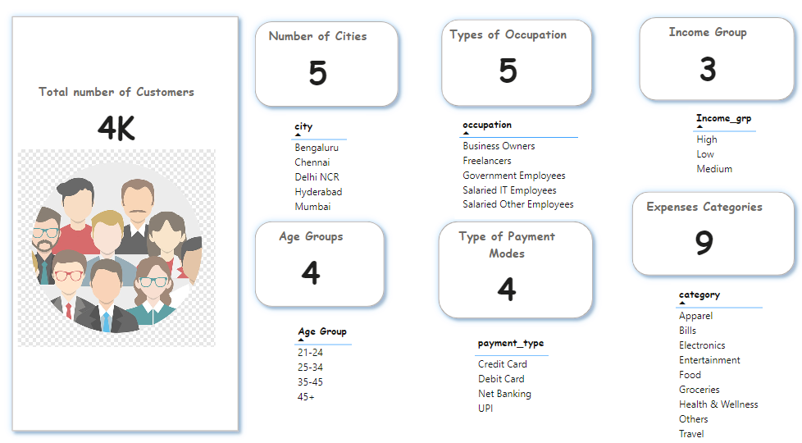
Dataset Overview

Slide 3
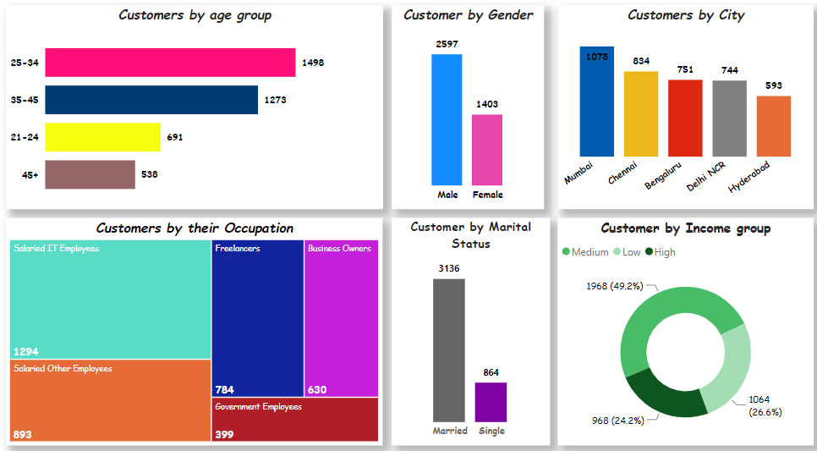
Demographic Analysis And Insights
The majority of our customers fall within the 25-34 age group..
ut of a total of 4,000 customers, 2,597 are male, and 70% of them are married..
The highest concentration of customers is observed in Mumbai, followed by Chennai. Bengaluru and Delhi NCR have a similar customer count, while Hyderabad has the fewest customers.“
Among various occupations, the largest customer segment consists of salaried IT employees, while government employees make up the smallest proportion.
Income groups are categorized into three segments: High (average income > 65,000), Medium (average income between 39,000 and 65,000), and Low (average income < 39,000). The majority of our customers belong to the Medium Income Group.

Slide 4
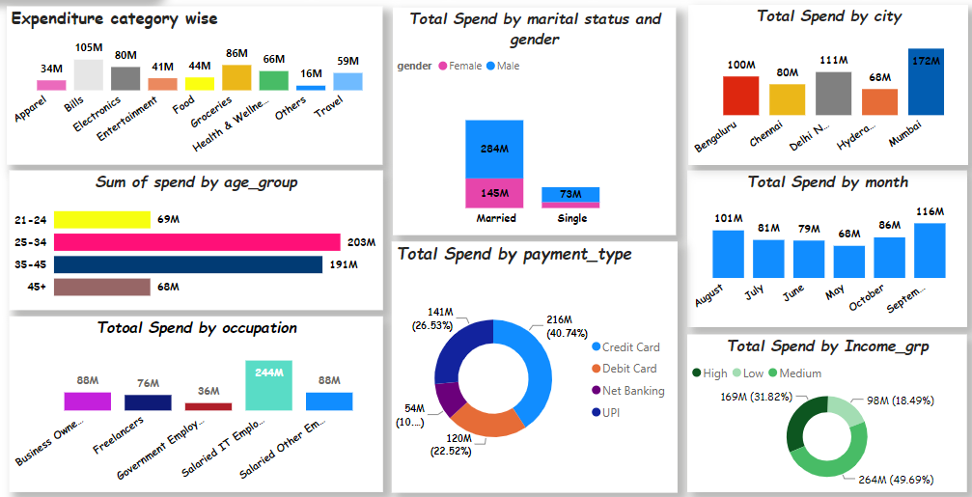
Spending Patterns Based on Average Income and insights
The highest avg. customer spending caters to the bill's payment followed by groceries and electronics. The payment are mostly done using is Credit card followed by the UPI.
Customers between 25-34 years and 34-45 years of age working as Salaried IT employees spend the most.
As the festival season commences, month of September records the highest spending across all segment. The spending on groceries and electronics are closer to the bill payment.
Government employees remain potential target customers as the penetration of the usage of the credit card is very less and subsidising them will bring them in CC ambit.
If we add UPI, Debit and Net Banking spending, it is more than CC and therefore, productizing these customers will result in more customer using Credit Card.

Slide 5
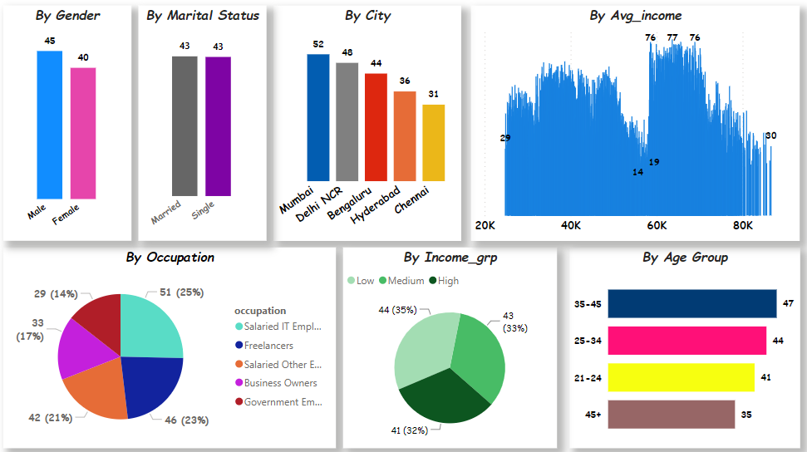
Average Income Utilization% analysis and insights
On average, the highest Income Utilization% is observed in the age group of 35-45, followed by the age group of 25-34.
Salaried customers represent the predominant occupation group, exhibiting, on average, higher income utilization compared to other occupations.
Customers from both low and medium-income groups tend to have a higher Income Utilization% compared to the high-income group.
Mumbai customers exhibit the highest Average Income Utilization%, followed by Delhi NCR and Bengaluru. This aligns with the cost of living, with Mumbai being the costliest city in India.
Male customers, on average, tend to spend more. Interestingly, there is an equal distribution of average Income Utilization% between married and single status customers."

Slide 6
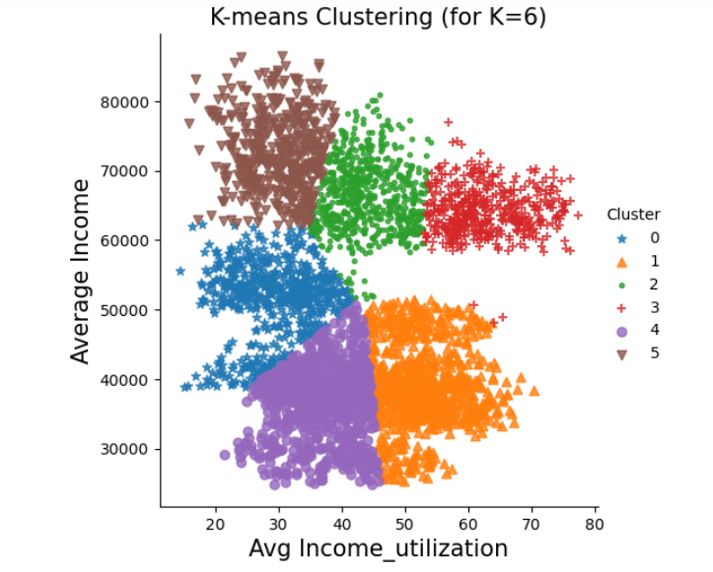
Customer segments using Kmeans clustering
Segmentation based on Average Income and the Average Income Utilization%
Our target customers should belong to this specific group, as they exhibit the highest Average Income Utilization%. Notably, it's evident that these customers do not fall into the high-income category, confirming our findings from previous analyses. There are 472 customers in this group, making it convenient for us to reach out and elaborate on the advantages of our new credit card features. For further details on these customers, please refer to the attached Excel file link.
 | Profile1 | Profile2 | Profile3 | Profile4 | Profile5 | Profile6
Avg_income_Utilization% | 29.35 | 52.78 | 44.02 | 62.82/77.37 | 36.77 | 29.84
Age Group | 25-34 | 35-45 | 25-34 | 35-45 | 25-34 | 45+
Marrital status | Married | Married | Married | Married | Married | Married
Occupation | Government Employees | Freelancers | Salaried IT Employees | Salaried IT Employees | Salaried Other Employees | Business Owner
Income_group | Medium | Medium | High | Medium/High | Low | Low
Gender | Male | Male | Male | Male | Male | Male
City | Chennai | Mumbai | Chennai | Mumbai | Chennai | Chennai

Slide 7
Recommendations
Cashback for Utility Bills:
Introduce a new feature offering up to 3% cashback for the first 12 months on utility bill payments using the credit card, recognizing the significant portion of income utilized for bill payments.
Online Grocer Tie-Up:
Establish partnerships with online grocery platforms to reward new users spending $2500 or more in the high-Income Utilization% months of September, August, and October.
Targeting Salaried IT Employees:
Focus on salaried IT employees, who exhibit the highest average Income Utilization%. Introduce a points system for their online shopping activities, including apparel and groceries, to encourage increased credit card usage.
Travel Incentives for IT Employees:
Cater to the travel habits of IT employees by collaborating with airlines to provide exclusive discounts and benefits, thereby boosting credit card usage among this demographic.
International Travel Features:
Introduce new features for international travel, allowing customers to seamlessly utilize their credits for expenses abroad, enhancing the card's appeal for global travelers.
Mumbai-Specific Benefits:
Acknowledge Mumbai as the city with the highest income utilization%. Tailor features to offer additional discounts and bonus points, recognizing the higher cost of living in the city.
Customized Features for Government Employees:
Design new features specifically catering to government employees, encouraging credit card usage among this demographic that may not typically utilize credit cards extensively.
Family-Oriented Benefits:
Attract new customers with families by offering a complementary card to the spouse, providing a 2% gain on each for the first 6 months with the booking of the first 5 new tickets.
City-Specific Incentives for Chennai:
Provide special benefits for new customers from Chennai, such as a 5% cashback for the first year on online shopping, spanning food, apparel, and entertainment categories.

Slide 8
THANKYOU
Peter Pandey
ATLIQ HARDWARE

