Slide 1
Trauma Registration Simulation Model

Slide 2
Start
ABC Medical Emergency/Trauma Center
Trauma/Emergency Patients Registration Front Desk
Trauma Patients Airlifted/Ambulance
Queued in Trauma Level(3,2,1)
Level 3
Registering Trauma Patients
(Wait Time:6 mins)
Level 3 (Cardiac arrest/cardiac attack/brain stroke, severe head injury accident patients
3rd priority
1st priority
2nd priority
Level 2(severely Burned patients, Kidney failure,injured severely)
ICU Treatment Area

Slide 3
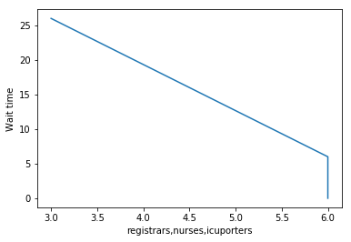
Trauma Patient Registration Simulation Model Results
Below are the plot results of the Model I created using simpy with different input values
Input # of registrars working: 6
Input # of traumanurses working: 6
Input # of icuporters working: 3
Running simulation... The average wait time is 0 hours, 6 minutes and 26 seconds.

Slide 4
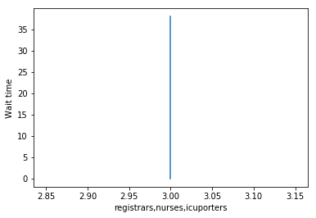
Trauma Patient Registration Simulation Model Results
Input # of registrars working: 3 Input # of traumanurses working: 3
Input # of icuporters working: 3 Running simulation... The average wait time is 0 hours, 7 minutes and 38 seconds.

