Slide 1
Trauma Registration Simulation Model

Slide 2
Start
ABC Medical Emergency/Trauma Center
Trauma/Emergency Patients Registration Front Desk
Trauma Patients Airlifted/Ambulance
Queued in Trauma Level(3,2,1)
Level 3
Registering Trauma Patients
(Wait Time:6 mins)
Level 3 (Cardiac arrest/cardiac attack/brain stroke, severe head injury accident patients
3rd priority
1st priority
2nd priority
Level 2(severely Burned patients, Kidney failure,injured severely)
ICU Treatment Area

Slide 3
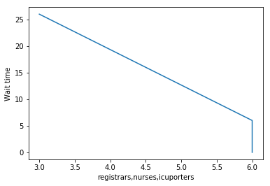
Trauma Patient Registration Simulation Model Results
Below are the plot results of the Model I created using simpy with different input values
Input # of registrars working: 6
Input # of traumanurses working: 6
Input # of icuporters working: 3
Running simulation... The average wait time is 0 hours, 6 minutes and 26 seconds.

Slide 4
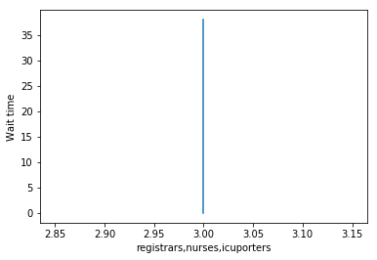
Trauma Patient Registration Simulation Model Results
Input # of registrars working: 3 Input # of traumanurses working: 3
Input # of icuporters working: 3 Running simulation... The average wait time is 0 hours, 7 minutes and 38 seconds.

Slide 5
Validation Of The Model
I validated the Model and plotted the results by giving different input values for num_registrars, num_traumanurses, num_icuporters Everytime I noticed that greater the number of resources(num_registrars, num_traumanurses, num_icuporters) less is the wait time. So to reduce the wait time in Trauma centers more numer of shared resources(the staff we need). I again validated model by increasing and decreasing the random time take n by icu porters and trauma level validation nurses, More time taken by them results in more wait time.
Example1: Below the average wait time at trauma nurse is 1 to 7 minutes and icuporter is 1 to 6 minutes def get_registered(self, patient): yield self.env.timeout(random.randint(1, 3))
def check_traumanurse(self, patient): yield self.env.timeout(random.randint(1, 7)) def get_icuporter(self, patient): yield self.env.timeout(random.randint(1, 6))
Input # of registrars working: 10 Input # of traumanurses working: 10 Input # of icuporters working: 10 Running simulation... The average wait time is 0 hours, 9 minutes and 15 seconds.
Example 2 : Below the average wait time at trauma nurse is 1 to 4 minutes and icuporter is 1 to 3 minutes def get_registered(self, patient): yield self.env.timeout(random.randint(1, 3))
def check_traumanurse(self, patient): yield self.env.timeout(random.randint(1, 4)) def get_icuporter(self, patient): yield self.env.timeout(random.randint(1, 3))
Input # of registrars working: 10 Input # of traumanurses working: 10 Input # of icuporters working: 10 Running simulation... The average wait time is 0 hours, 6 minutes and 22 seconds.

Slide 6
Conclusion
I am concluding from this simulation especially at Trauma centers we need more people to Register, look at the patient Trauma intensity level and then people to transfer them to ICU activity. As I mentioned in Flow Chart 1st priority is given to Level 3 Trauma patients(Cardiac,brainstroke,severe brain injury patients), 2nd priority to Level2(Burned patients, Kidney Failure, Accident Patients) and third priority to Level3(other Trauma Patients) all are queued in.
So more number of shared resources less wait times for Trauma Emergency patients.

