Slide 1
Ru-Tag Internship
Improving K-Means Algorithm
Jaya Vardhan

Slide 2
Overview
The original k-means algorithm is computationally expensive and the resulting set of clusters strongly depends on the selection of initial centroids.
To tackle this problem, I came up with a solution by modifying the original K-means algorithm. This modification proposes an accurate to calculate the initial centroids using “median”. By fixing the initial centroids in a smart way, the time complexity of the algorithm can be reduced

Slide 3
What is Clustering?
Clustering is a fundamental technique in machine learning and data analysis used to group similar data points together based on their similarities or distance from each other. The goal of clustering is to divide a dataset into distinct groups or clusters in such a way that data points within the same cluster are more similar to each other than to those in other clusters. Clustering is an unsupervised learning technique, meaning it does not require labeled data for training.

Slide 4
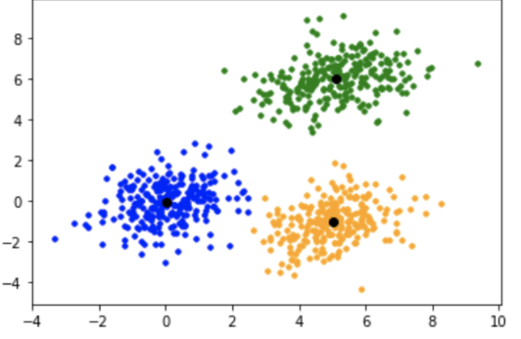
Kmeans Algorithm
K-means is a popular clustering algorithm used for partitioning data into 'k' clusters. It is an iterative algorithm that aims to group similar data points together and minimize the sum of squared distances between data points and their corresponding cluster centers (centroids).

Slide 5
Input:
- Data points: X = {x1, x2, ..., xn} (where xi represents the i-th data point)
- Number of clusters: k
Output:
- Cluster centroids: C = {c1, c2, ..., ck} (where ci represents the centroid of the i-th cluster)
- Cluster assignments: A = {a1, a2, ..., an} (where ai represents the cluster assignment of the i-th data point)

Slide 6
Pseudo Code for Kmeans
1. Randomly initialize k cluster centroids:
For i = 1 to k:
Randomly initialize ci as a data point from X
2. Repeat until convergence:
a. For each data point xi in X:
- Calculate the distance between xi and each centroid ci in C
- Assign xi to the cluster with the nearest centroid
ai = argmin(dist(xi, ci)) for ci in C
b. For each cluster centroid ci in C:
- Update the centroid ci as the mean of all data points assigned to the cluster
ci = (1 / size of cluster i) * sum of all xi assigned to cluster i
3. Return the final cluster centroids C and cluster assignments A

Slide 7
Drawbacks of the Kmeans Algorithm
Generally, Kmeans is implemented using a popular library in Python known as “Scikit-learn”. Although it is widely used, it has a few drawbacks regarding its time complexity -:
The Kmeans in the sci-kit learn library runs for 300 iterations by default which ensures maximum accuracy.
Same algorithm is repeated 10 times by initiating different initial centroids. The final result is given by taking the average of the results obtained in 10 tests.
Time Complexity Analysis -:
Let m be the number of features of a dataset.
The time complexity of the K-means algorithm is dominated by the assignment step, which is typically the most computationally expensive part. Therefore, the overall time complexity of the K-means algorithm is approximately O(300 * n * k * m)
Overall time complexity is 10 * O(300 * n * k * m).

Slide 8
From the drawbacks discussed in the previous slide, while K-means is relatively efficient and widely used for clustering tasks, its time complexity can become a limitation when dealing with large datasets, high-dimensional data, or a large number of clusters.
In such cases, alternative clustering algorithms or techniques that can handle these challenges may be more suitable.

Slide 9
Modified Kmeans Algorithm using “Median”
Pseudo Code to find initial centroids-:
1. Calculate the sum score of each data point.
i.) di = [x1,x2,...xm] where 1 <= i <= n
ii.) sum score = x1 + x2 + ... + xm
2. Sort the data based on the sum scores.
3. Divide the data set into k subsets.
4. Calculate the median value of each subset as follows -:
i.) Create a list to store the initial centroid.
ii.) Calculate the median for all features(column-wise) in the subset and append it to the list.
5. Repeat step 4 for all k subsets and take the list obtained as an initial centroid.

Slide 10
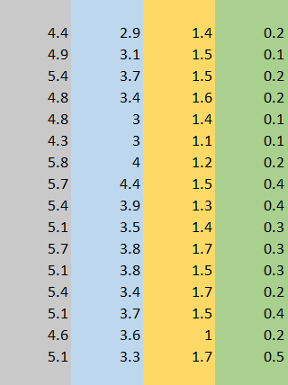
Visualization of Algorithm
Consider this table as an ith division of the data set. (1 <= i <= k)

Slide 11
This method for finding the initial centroids of the clusters is more efficient than the original k-means where centroids are selected randomly. The algorithm converges faster than the original k-means.
Time Complexity Analysis -:
Let n be the size of the dataset and m be the number of features, then the time complexity of the median algorithm is -:
O((3*n + nlogn + 100*n)*m)
Where the number of iterations is 100.

