Slide 1

Government
Schemes
Finder
https://github.com/jayavardhan-g/govt-schemes
TEAM MATES
SANDEEP (25M2139)
ADITYA (25M0748)
JAYAVARDHAN (25M0807)

Slide 2
Problem Statement
Bridging the Information Gap in Public Welfare Distribution
Despite the existence of hundreds of government welfare schemes intended to uplift various sections of society, a significant portion of the funds remain unutilized.
The primary reasons are low awareness and information asymmetry.
Citizens, especially in rural or lower-income brackets, struggle to find schemes relevant to them because the data is scattered across dozens of different ministry websites.
Adding to the problem - most of the government websites are cluttered and are difficult to navigate

Slide 3
Scope – Intelligent Government Scheme Matching
User profiling and management:
  A secure registration and login system for citizens to create persistent profiles.
  Collection of key demographic data points: Age, Income, Gender, Occupation, Caste, State, Disability status, and Household size.

Slide 4
Rule-Based Matching Engine:
  Development of a deterministic matching algorithm that evaluates user attributes against scheme criteria with higher logical accuracy.
  Support for complex logical operators (GreaterThan, LessThan, Equals, InList) to handle criteria like "Age between 18-35 AND Income < 5 Lakhs".
  Classification of results into "Eligible," "Not Eligible," and "Maybe Eligible" (for cases with missing data).

Slide 5
Admin & Content Management:
  A dashboard for administrators to manually add, edit, or delete schemes.
  A verification workflow where scraped data is marked as "Unverified" until reviewed by a human admin.
Automated Data Pipeline (Prototype):
  A web scraping module capable of fetching scheme details (Title, Description) from external URLs.
  A heuristic-based Rule Extraction Engine (NLP/Pattern Matching) that attempts to convert unstructured text (e.g., "must be earning less than 20k") into structured machine-readable JSON rules.

Slide 6
Limitations
Rule Extraction Accuracy:
  The rule extractor relies on keyword matching and heuristics (Regular Expressions). Complex rules currently require manual verification by an admin.
Language Support:
  The system currently processes and displays content in English only.
Attribute Limitation:
  The matching is limited to the 8 specific attributes defined in our model (Age, Income, etc.). Specialized schemes requiring niche criteria

Slide 7
Future Scope
LLM Integration: Replacing the Regex-based rule extractor with a Large Language Model (like GPT-4 or Llama) to parse complex legal text into JSON rules with near-human accuracy.
Multilingual Support: Integrating Google Translate API to allow users to view schemes in their local language.
WhatsApp/SMS Integration: Sending alerts to users when a new scheme matching their profile is added to the database.

Slide 8
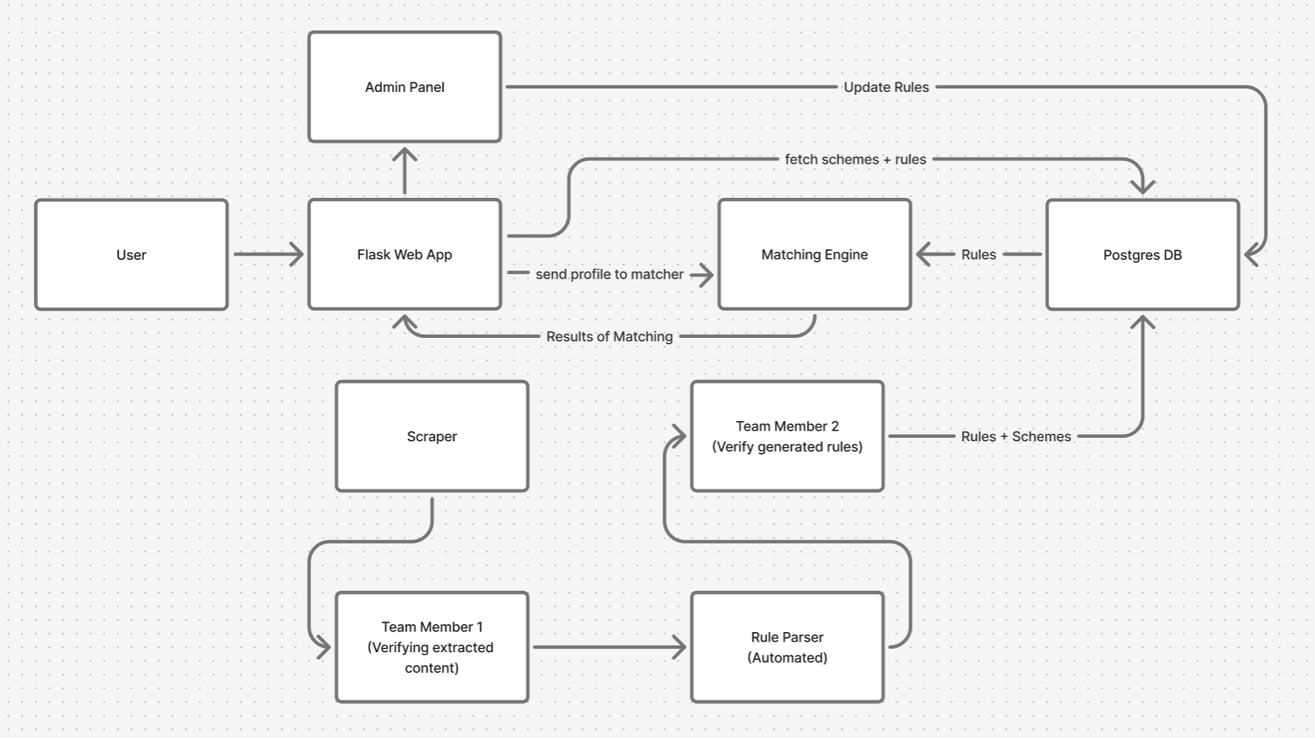
Architecture
&
Data
Flow

Slide 9
Technology Stack
Frontend
  HTML5: Structure of the web pages (forms, tables, dashboards).
  CSS3: Custom styling for the "clean" UI, including the progress bars and badge indicators.
  JavaScript (Vanilla ES6): Client-side logic for the results table (sorting, filtering, color-coding matches) and dynamic form fallbacks.
  Jinja2: The Python templating engine used to inject data (like user profiles and match scores) into the HTML before it is sent to the browser.

Slide 10
Backend (Server & API)
  Python 3.13: The core programming language.
  Flask: A lightweight WSGI web application framework. It handles the HTTP routes (/, /match, /admin), sessions, and request context.
  Werkzeug: The library for Flask that handles password hashing (generate_password_hash) and secure authentication.
Core Logic (Matching Engine)
  Python used for matching
  JSON: Used as data structure for storing complex notations
  Regular Expressions (re): Used in the extraction pipeline to identify patterns like "Age 18-30" or "Income < 1 Lakh" from raw text.

Slide 11
Web Scraping
  Requests: For sending HTTP GET requests to fetch government websites.
  BeautifulSoup4 (bs4): For parsing the HTML content of scraped websites to extract titles and text descriptions.
Database & Persistence
  SQLAlchemy (ORM): An Object Relational Mapper that allows us to interact with the database using Python classes (Scheme, UserProfile) instead of writing raw SQL.
  PostgreSQL: The robust relational database management system (RDBMS) intended for the production environment.

Slide 12
Contributions - Sandeep
Built automated scrapers using Requests to extract government scheme data from multiple official portals.
Implemented HTML archiving, ensuring each scraped page was saved with timestamps for provenance.
Designed and developed the data extraction pipeline, including:
  Title extraction
  Description extraction
  Eligibility text extraction
Performed data cleaning and normalization
Did manual verification also because of the complexity of websites and errors produced

Slide 13
Contributions - Aditya
Designed the eligibility rule schema (JSON-based AST) to represent conditions like age, income, category, occupation, etc
Developed the Rule Parser using NLP to convert eligibility text into structured machine-readable rules.
Implemented detection algorithms for:
  Numerical ranges (age, income)
  Boolean conditions (disability, gender-based rules)
  Category-based conditions (SC/ST/OBC)
  Location/state-based restrictions
Did manual verification also because the regex-based rule system is not reliable

Slide 14
Contributions - Jayavardhan
Designed and built the full Flask web application
Implemented the user-facing profile submission system allowing users to enter age, income, state, occupation, caste, etc.
Created the Admin Panel (critical contribution):
  Rule verification page
  Editable JSON rule viewer
  Admin authentication
  Ability to save corrected rules back into DB
Implemented User Management so that the user doesn’t have to enter his/her details every time they visit

Slide 15
Timeline
Week 1(Oct 15-21): Scraping and data Extraction
  Found various government schemes
  Scraped the titles, descriptions and eligibility texts
  Cleaned the text and archived it
Week 2(Oct 22-28): Rule schema and parser
  Designed JSON-based eligibility rule schema(AST)
  Built a regex/NLP-based rule parser to convert raw eligibility text into structured rules
  Implemented detection for various eligibility metrics

Slide 16
Week 3(Oct 29-Nov 4): Flask app, user system and admin panel
  Built complete Flask web app structure
  Implemented user profile submission
  Add persistent user accounts as well as authentication
  Created the admin panel
Week 4(Nov 5-Nov 10): Matching engine and integration
  Integrate scraper → parser → admin verification → matching engine.
  Frontend polishing: clean UI, sorting/filtering, badge indicators.
  Test edge cases in parser & web scraping.
Nov 11-13: Demo prep
  Verified schemes and finalized rules
  Prepare sample user profiles for demonstration
  Create PPT, architecture diagrams and flow explanation

Slide 17
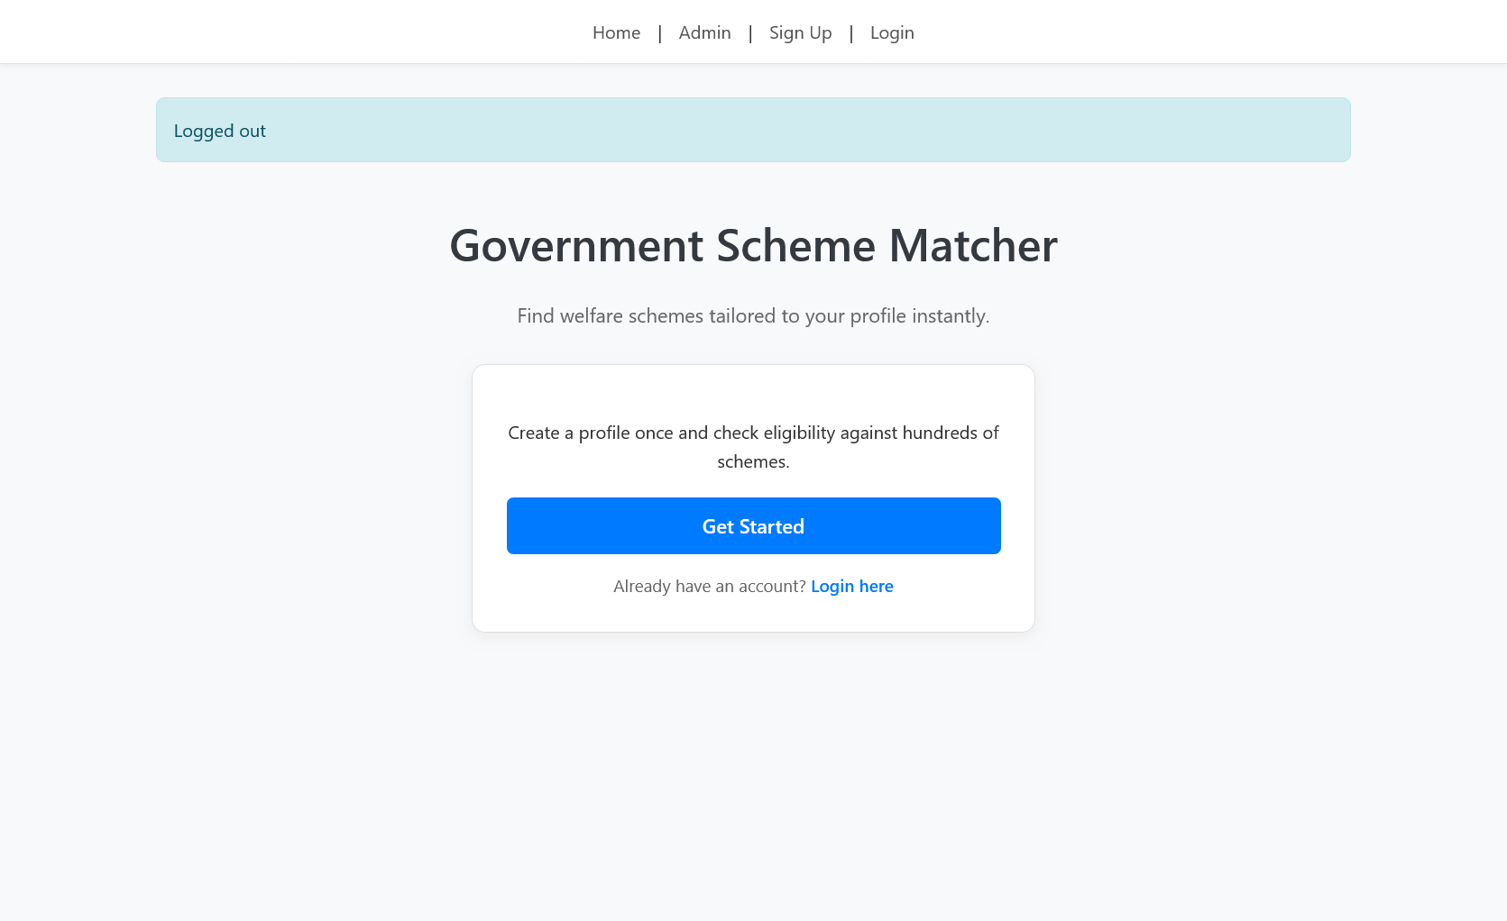
Homepage

Slide 18
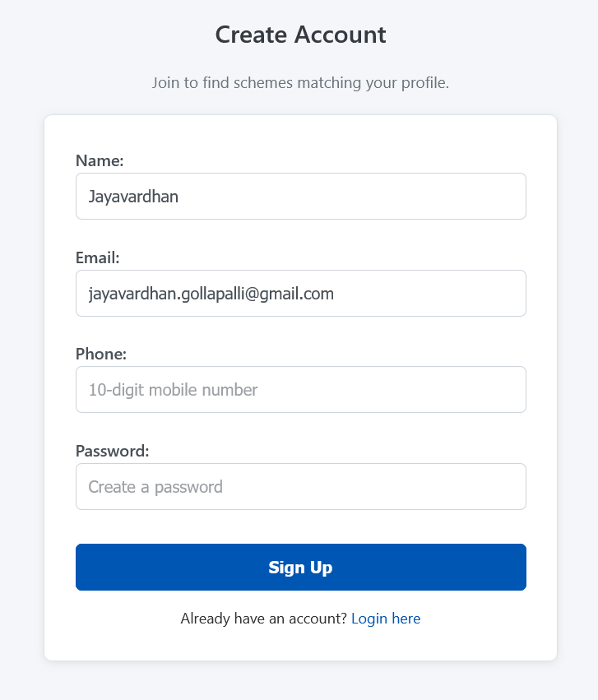
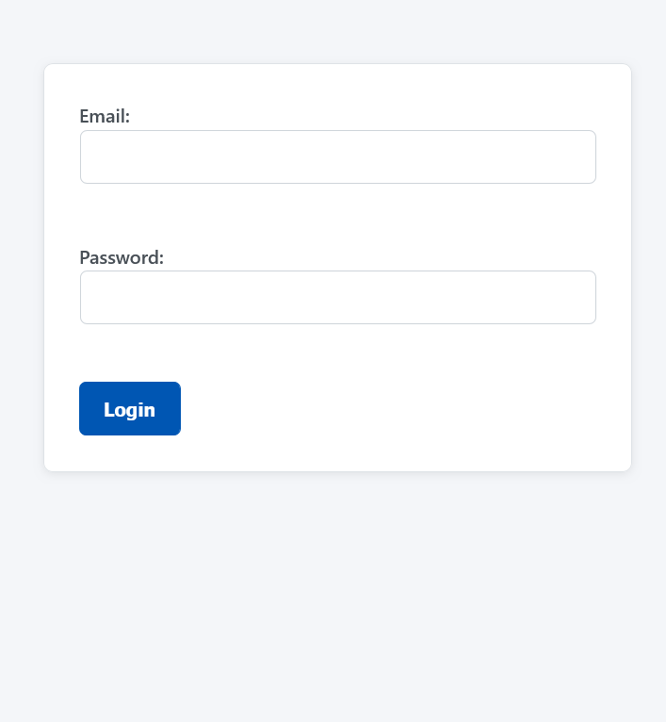
Signup and Login

Slide 19
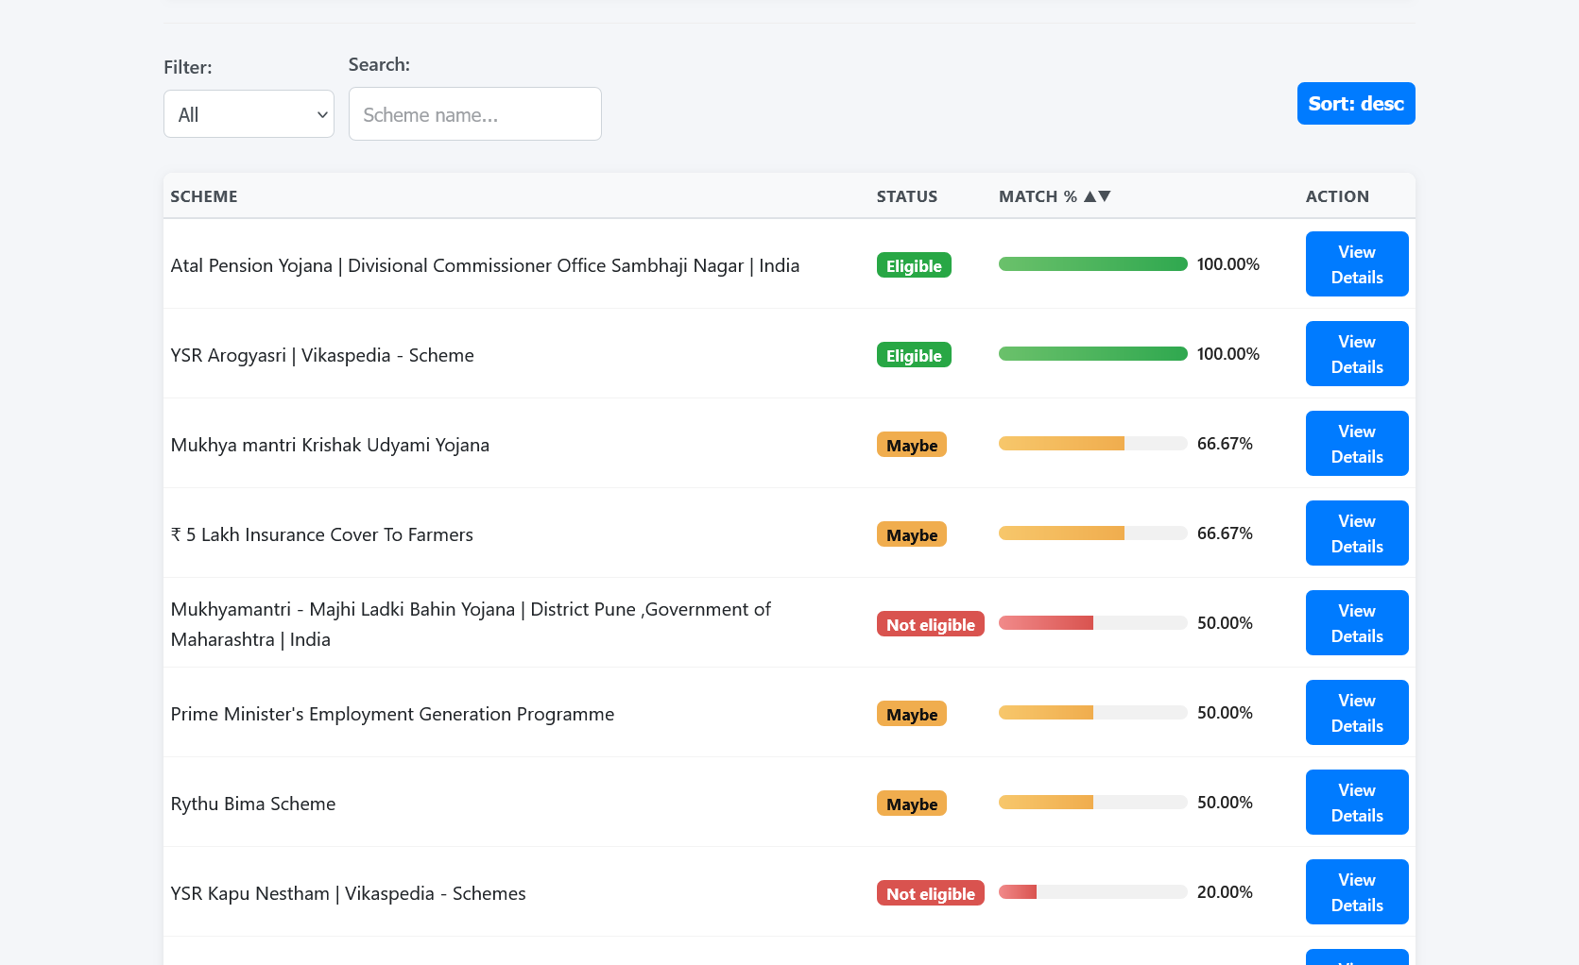
Results Page

Slide 20
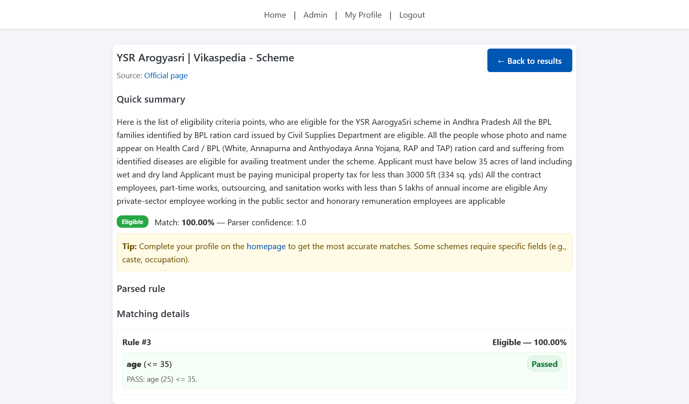

Slide 21
Challenges faced
Web Scraping
  Inconsistent website structures
  websites go down at random time.
  Handling JavaScript-rendered pages
Parser
  Setting up sophisticated regex rules to catch all information
  Utilizing appropriate tests to check various edge cases

