Slide 1
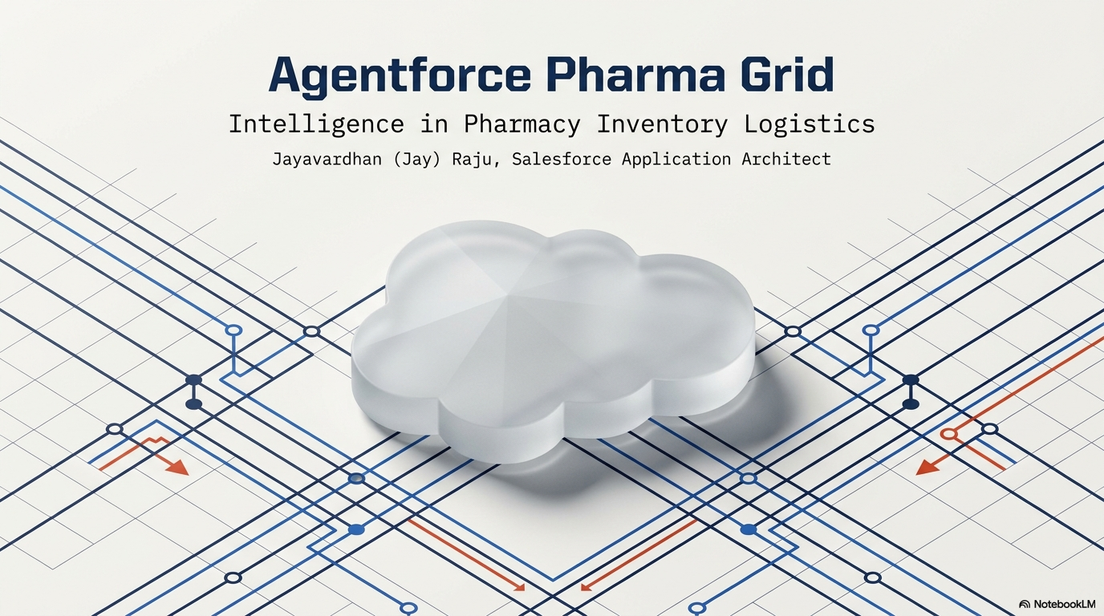

Slide 2
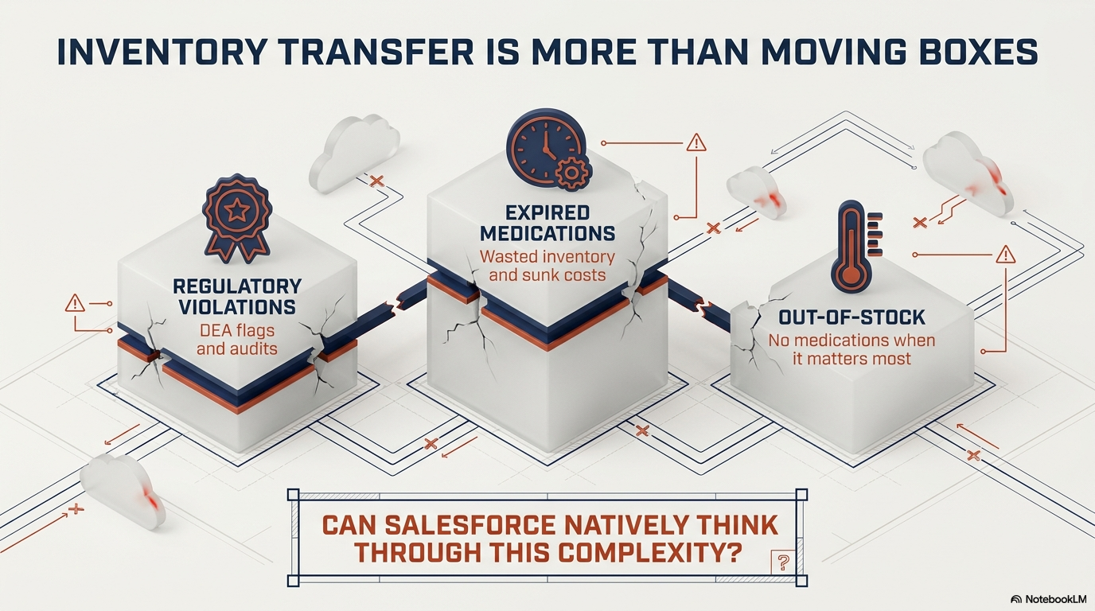

Slide 3
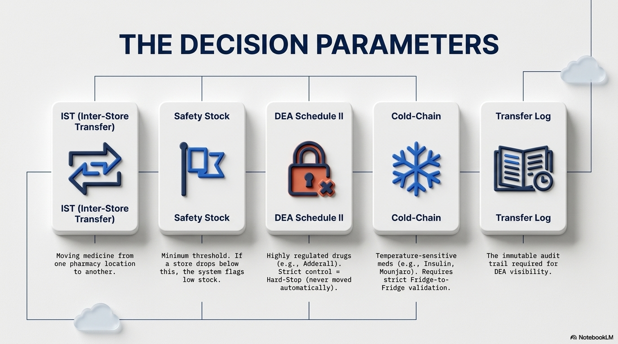

Slide 4
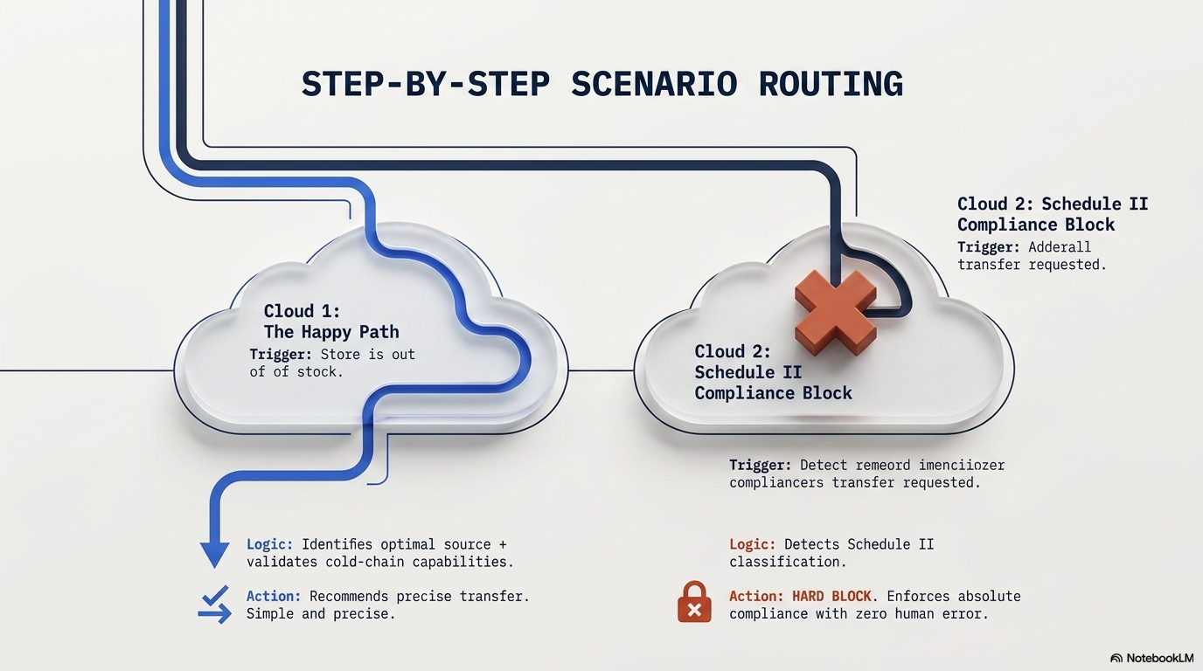

Slide 5
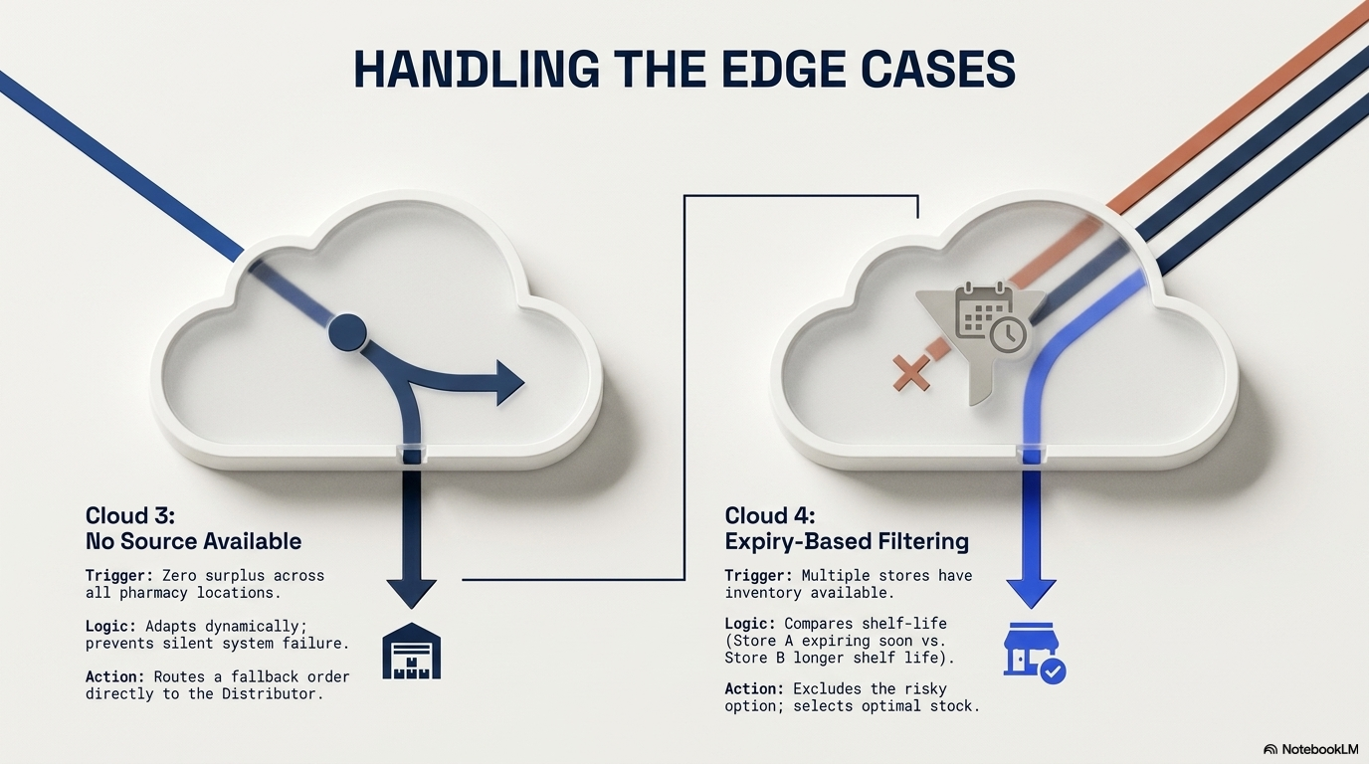

Slide 6
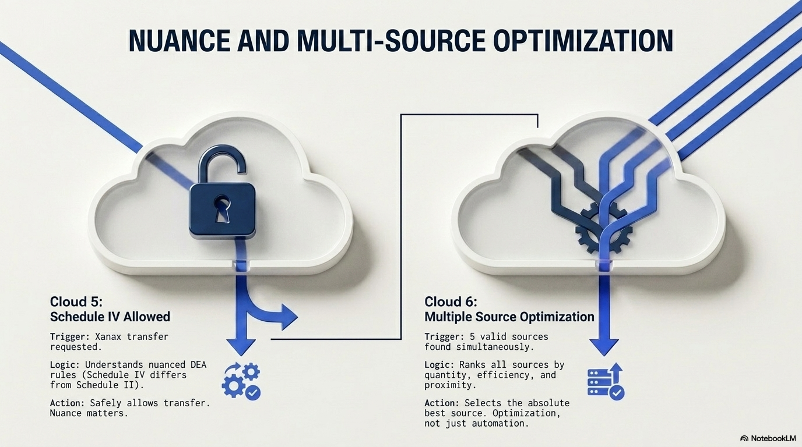

Slide 7

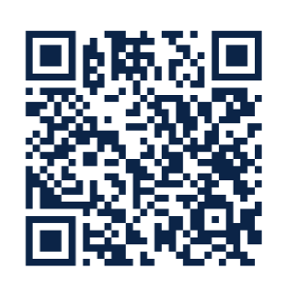

Slide 8
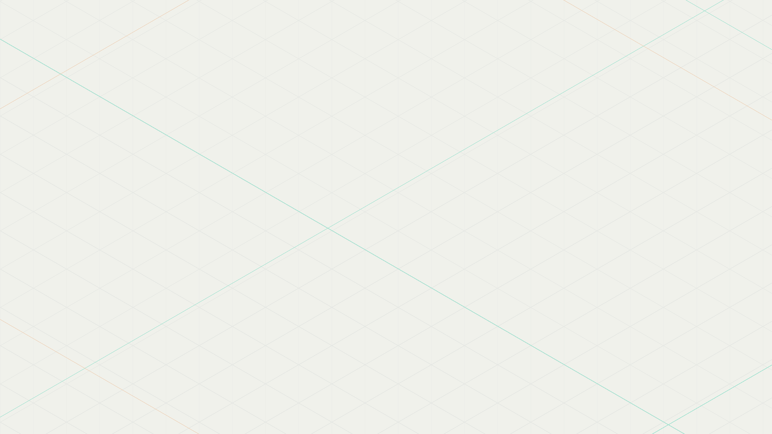
Scenario Summary
# | Medication | Target Store | Outcome | Source Selected
1 | Mounjaro 5mg | CVS Downtown SF | Transfer: 50 units | CVS Westside SF
2 | Adderall XR 30mg | CVS Downtown SF | BLOCKED (Schedule II) | None — gate fires first
3 | Lisinopril 10mg | CVS Downtown SF | Distributor fallback | None — no surplus
4 | Ozempic 1mg | CVS San Jose Central | Transfer: 30 units | CVS Westside SF
5 | Xanax 0.5mg | CVS Eastside Oakland | Transfer: 30 units | CVS San Jose Central
6 | Amoxicillin 500mg | CVS Sunnyvale | Transfer: 50 units | CVS Downtown SF
4 successful transfers | 1 compliance block | 1 distributor fallback

Slide 9

Scenario 1
Mounjaro 5mg — Happy Path Cold-Chain Transfer
Target: CVS Downtown SF | Qty: 0 | Safety Stock: 50 | Need: 50 units | Cold chain required: YES
Store | Stock | Cold Chain | DEA Reg | Expiry | Result
CVS Westside SF | 200 units | capable | DEA-SF-WS-002 | 90 days | SELECTED
CVS Eastside Oakland | 150 units | not capable | DEA-OAK-ES-003 | 60 days | EXCLUDED
CVS San Jose Central | no position | capable | has reg | n/a | no inventory
CVS Sunnyvale | no position | capable | blank | n/a | no inventory
CVS Palo Alto | no position | capable | has reg | n/a | inactive
Why CVS Westside SF wins: Two stores stock Mounjaro. Westside (200 units) is evaluated first (SOQL ORDER BY Quantity DESC) and passes all three checks: cold-chain capable, DEA registered, 90-day expiry. Eastside Oakland (150 units) has stock but Cold_Chain_Capable = false — disqualified because Mounjaro requires cold chain. Transfer qty: MIN(150 x 50%, 50) = 50 units.

Slide 10

Scenario 2
Adderall XR 30mg — Schedule II Compliance Hard Stop
Target: CVS Downtown SF | Qty: 5 | Safety Stock: 30 | Need: 25 units | DEA Schedule: II | Cold chain: NO
Store | Stock | Evaluation | Result
CVS San Jose Central | 100 units | Never evaluated — Schedule II gate fires before source search | NEVER REACHED
CVS Westside SF | no position | No Adderall inventory at this store | never reached
CVS Eastside Oakland | no position | No Adderall inventory at this store | never reached
CVS Sunnyvale | no position | No Adderall inventory at this store | never reached
CVS Palo Alto | no position | Inactive store | never reached
Why it is blocked: Adderall is DEA Schedule II. The compliance gate (DEA_Schedule__c == 'II') fires as the very first check — before findSurplusSources() runs. Even though CVS San Jose Central has 100 surplus units, the code never looks. A Transfer_Log__c is created: Status = Blocked, Qty = 0. The agent directs the user to use DEA Form 222. confirm = true does NOT bypass — the gate fires and blocks again.

Slide 11

Scenario 3
Lisinopril 10mg — No Suitable Source (Distributor Fallback)
Target: CVS Downtown SF | Qty: 0 | Safety Stock: 60 | Need: 60 units | Cold chain: NO | DEA: None
Store | Stock | SOQL Filter | Cold Chain | DEA Reg | Result
CVS Westside SF | 30 units | 30 < 61 needed | not checked | not checked | insufficient
CVS Eastside Oakland | none | no Lisinopril at this store | — | — | no inventory
CVS San Jose Central | none | no Lisinopril at this store | — | — | no inventory
CVS Sunnyvale | none | no Lisinopril at this store | — | — | no inventory
CVS Palo Alto | none | inactive — excluded by SOQL | — | — | inactive
Why no source is found: SOQL requires Quantity > Safety_Stock + 1 = 61. CVS Westside SF has just 30 units — below threshold. SOQL returns zero rows. selectBestSource() gets an empty list. Code falls through to distributor fallback recommendation. No Transfer_Log__c created — nothing was attempted or denied.

Slide 12

Scenario 4
Ozempic 1mg — Near-Expiry Source Excluded
Target: CVS San Jose Central | Qty: 5 | Safety Stock: 40 | Need: 35 units | Cold chain required: YES
Store | Stock | Cold Chain | DEA Reg | Expiry | Result
CVS Downtown SF | 100 units | capable | DEA-SF-DT-001 | 15 days < 30 | EXCLUDED
CVS Westside SF | 80 units | capable | DEA-SF-WS-002 | 120 days | SELECTED
CVS Eastside Oakland | no position | not capable | has reg | n/a | no inventory
CVS Sunnyvale | no position | capable | blank | n/a | no inventory
CVS Palo Alto | no position | capable | has reg | n/a | inactive
Why CVS Westside SF wins: CVS Downtown SF had more stock (100 vs 80) and was evaluated first, but its 15-day expiry failed the 30-day minimum threshold. CVS Westside SF passed all three checks — cold chain, DEA registration, and 120-day expiry — so it was selected despite having less stock. Transfer qty: MIN(60 x 50%, 35) = 30 units.

Slide 13

Scenario 5
Xanax 0.5mg — Schedule IV Allowed Transfer
Target: CVS Eastside Oakland | Qty: 10 | Safety Stock: 40 | Need: 30 units | DEA Schedule: IV | Cold chain: NO
Store | Stock | Cold Chain | DEA Reg | Expiry | Result
CVS San Jose Central | 150 units | not needed | DEA-SJ-CT-004 | 180 days | SELECTED
CVS Downtown SF | no position | no Xanax inventory at this store | — | — | no inventory
CVS Westside SF | no position | no Xanax inventory at this store | — | — | no inventory
CVS Sunnyvale | no position | — | blank | — | no inventory
CVS Palo Alto | no position | inactive store | — | — | inactive
Why Schedule IV is allowed: The compliance gate checks DEA_Schedule__c == 'II' only. Xanax is Schedule IV ('IV' != 'II'), so the gate does not fire. The code proceeds to normal source selection. Only Schedule II triggers the hard block. Transfer qty: MIN(120 x 50%, 30) = 30 units.

Slide 14

Scenario 6
Amoxicillin 500mg — Multiple Sources (Highest Qty Wins)
Target: CVS Sunnyvale | Qty: 0 | Safety Stock: 50 | Need: 50 units | Cold chain: NO | DEA: None
Store | Stock | Cold Chain | DEA Reg | Expiry | Result
CVS Downtown SF | 300 units | not needed | DEA-SF-DT-001 | 150 days | SELECTED
CVS San Jose Central | 120 units | not needed | DEA-SJ-CT-004 | 100 days | never evaluated
CVS Westside SF | no position | no Amoxicillin at this store | — | — | no inventory
CVS Eastside Oakland | no position | no Amoxicillin at this store | — | — | no inventory
CVS Palo Alto | no position | inactive — excluded by SOQL | — | — | inactive
Why CVS Downtown SF wins: Both stores are eligible but SOQL sorts by Quantity DESC. CVS Downtown SF (300 units) is evaluated first, passes all checks, and is selected immediately. CVS San Jose Central (120 units) is never evaluated — the loop exits on the first eligible match. Transfer qty: MIN(260 x 50%, 50) = 50 units.

Slide 15
Thank You!!!

