Slide 1
Dunnhumby – Complete Journey
Analyzing the Effects of Coupons and Promotion in the Grocery Retail Sector

Slide 2
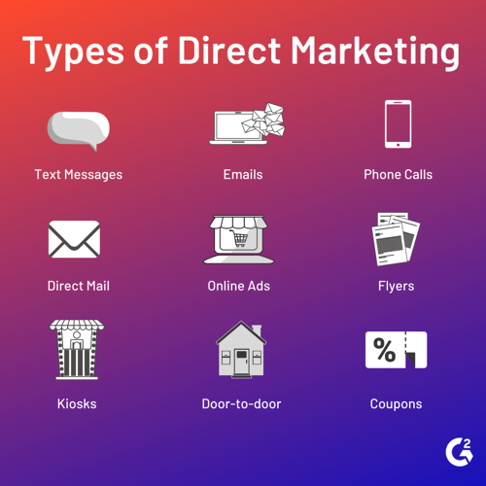
Introduction:
Direct marketing is done to attract new customers.
Direct mail coupon advertising is the powerful, cost-effective way to grow your customer base, increase sales and drive brand awareness.

Slide 3
Modelling Approach
1.Data Collection & Pre processing Data:
Downloaded Data from secure source.
2. Understanding Data:
Find Insights derived from the data.
3.Solve the problem from a each perceptive:
Campaign point of view.
Create a Data Description.
Made necessary changes for the data to look clean and tidy.
Find association among the features by doing univariate and multi variate analysis.
Develop a list of questions to obtain further information from the data.
Product Point of view.
Consumer point of view
Store point of view
Overall sales and revenue of the whole retailer.
4.Feature Extraction & Feature Engineering:
Find independent features.
Identify the most important features that gives out the maximum information.
Enhance the features by Hypothesis testing.
Variables reduction.
5.Model training and testing:
Split the train and test data.
Perform cross validation.
Find the performance metrics for this model.
Test the model.
Loaded the data into relational Postgresql Database.

Slide 4
1.Data collection and Preprocessing the Data:
Downloaded the data from https://www.dunnhumby.com/careers/engineering/sourcefiles
Unzipped the files and transferred the files from the local machine to the Zettamine central server using FileZilla software.
Created the tables in the PostgreSQL Database and then uploaded the csv files into relational database.
Made necessary changes to have a conventional name to each features.

Slide 5
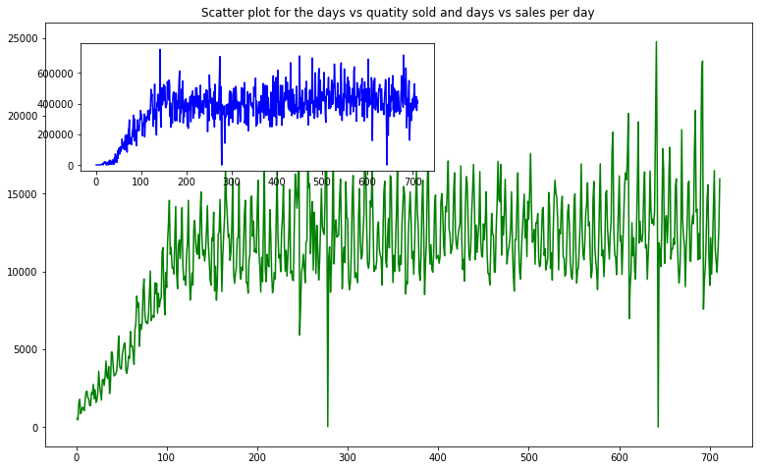
For the campaign to reach the public and for the campaign to get the required flow of sales it takes around 120 days.

Slide 6
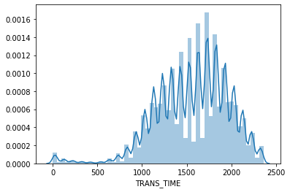
The peak hours are between 10:00 to 20:00 The discounts provided by the retailer, manufacturer and retailer to loyal customers are independent of each other. transaction['RETAIL_DISC'].corr(transaction['COUPON_DISC']): 0.045 transaction['RETAIL_DISC'].corr(transaction['COUPON_MATCH_DISC']): 0.013 transaction['COUPON_MATCH_DISC'].corr(transaction['COUPON_DISC']): 0.21

Slide 7
Each campaign type is associated with different campaigns, and each household received a different campaign.
Campaign Description | Households reached through campaign | Campaign | Days
Type A | 3979 | 8,13,18,26,30 | 47 days(approx)
Type B | 2655 | 1,2,4,5,7,9,10,11,12,16,17,19,21,22,23,24,25 | 32days(approx)
Type C | 574 | 3,6,14,15,20,27 | 64days(approx)

Slide 8
These are the highest selling department from the past two years data
Department | Products sold
GROCERY | 39,021
DRUG GM | 31,529
PRODUCE | 3118
COSMETICS | 3011
NUTRITION | 2914
MEAT | 2544
MEAT-PCKGD | 2427
DELI | 2354
PASTRY | 2149

Slide 9
Top selling products in a department and in their lower levels of sub department.
Department | Commodity_desc | Sub_commodity_desc | Count of products
DRUG GM | GREETING CARDS/WRAP/PARTY SPLY | CARDS EVERYDAY | 1005
GROCERY | BEERS/ALES | BEERALEMALT LIQUORS | 770

Slide 10
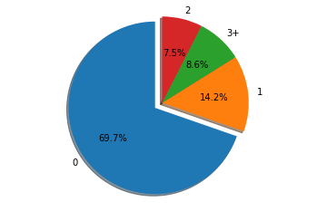
Most of the consumers don't have kids. We can see from the pie chart below.

Slide 11
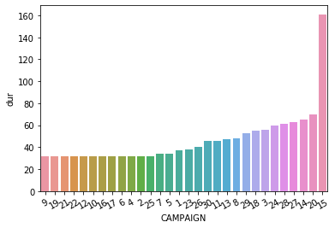
Campaign no 15 was run for 160 days, whereas the other campaigns ranges close to each other.

Slide 12
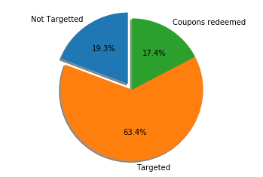
Among 2500 households only 1584 households were targeted. By the end of this 2 year marketing campaign only 434 households redeemed the coupons.

Slide 13
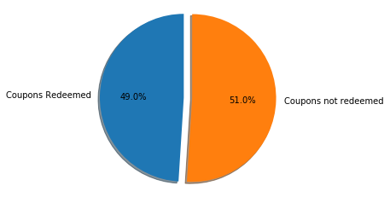
Only 556 coupons were redeemed among 1135 coupons

Slide 14
Campaign number 18, 13 and 8 being the most frequent ones reaching 1000 and more households each (no campaigns applied to same customer more than once therefore Frequency axis gives unique number of households).
GROCERY DEPT: Mostly food items
CAMPAIGN-1 AND TYPE B
CAMPAIGN 2,4,5,12,23,25,26,28,29,30
CAMPAIGN 6, with only one product(Yogurt).
CAMPAIGN 15 with only CAT Food.
CAMPAIGN 17 with mostly frozen food.
CAMPAIGN 24 Pet Supplies.

Slide 15
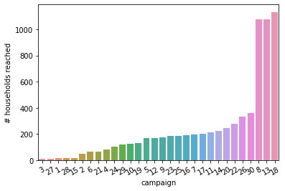
Campaigns 18,13,8 reached more than 1000 consumers. And these campaigns 18,13,8 belong to the TypeA campaign.

Slide 16
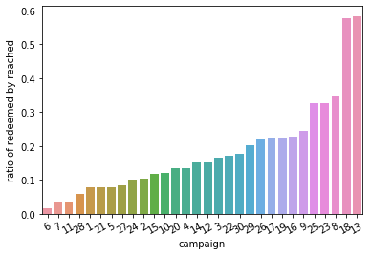
The campaigns with the most redemption rate are also 18,13. With the redemption rate of more than 0.5 for 18,13. With a redemption rate of around 0.3 for 25,23,8.

Slide 17
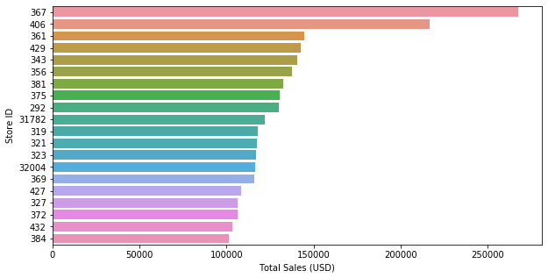
There are 582 stores transaction data available with us. Among these stores the top stores based on total sales are: 367,406 with more than 200,000 dollars sales in this 2 year marketing campaign.

